Slide 1
DEPARTMENT OF NUTRITION AND DIETETICS
CLASS : Second year
SUBJECT : Basic Food Processing and Preservation
SUBJECT CODE : 16SCCND4
SUBJECT INCHARGE : Ms.G.K.GOMATHI

Slide 2
Unit-5 fpo specification

Slide 3


Slide 4
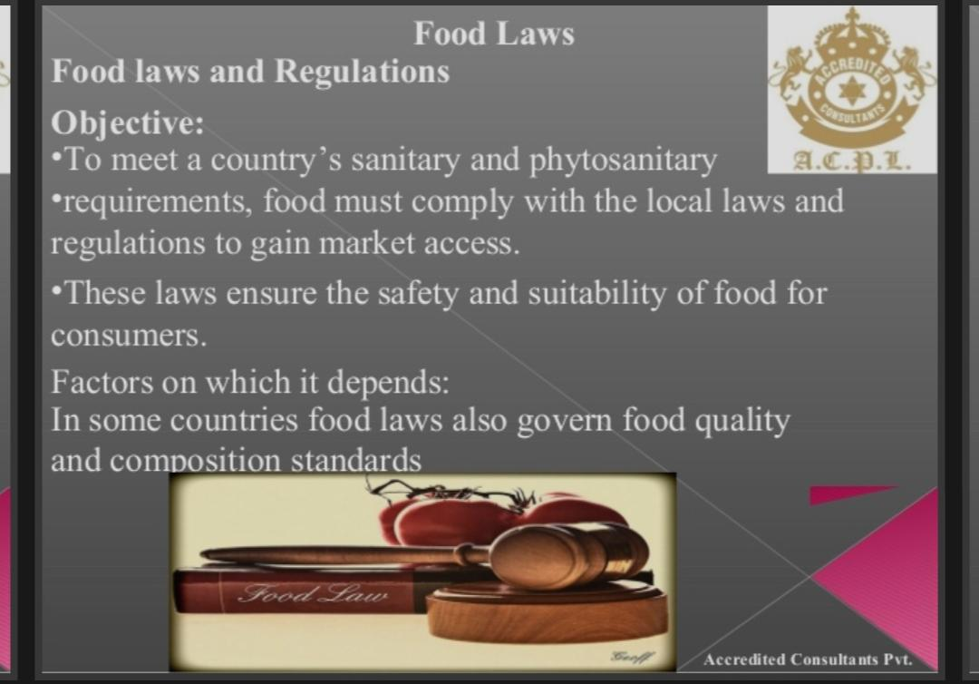

Slide 5
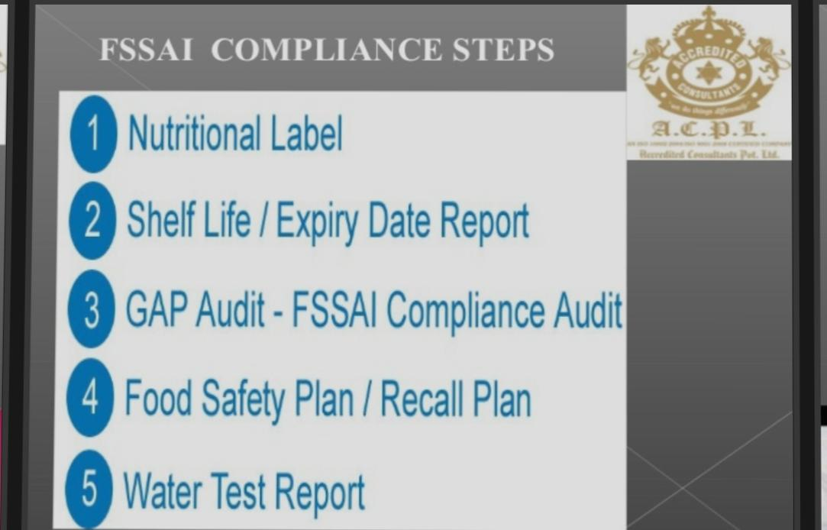

Slide 6
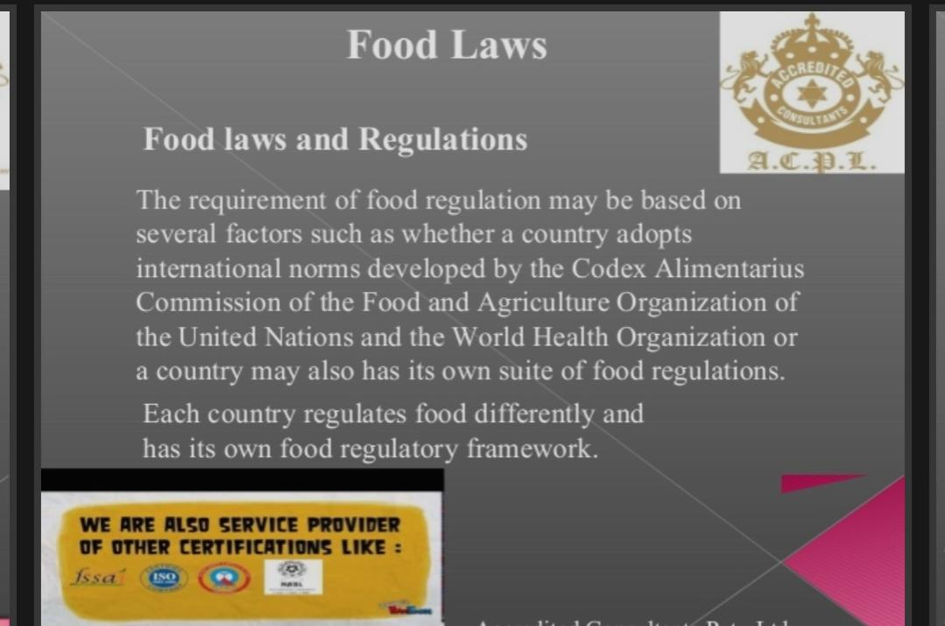

Slide 7
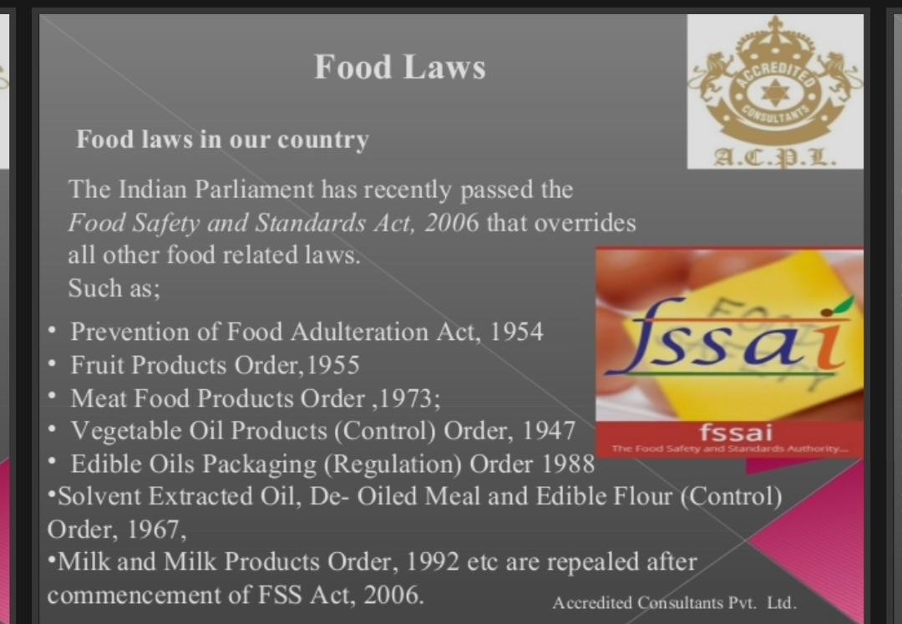

Slide 8
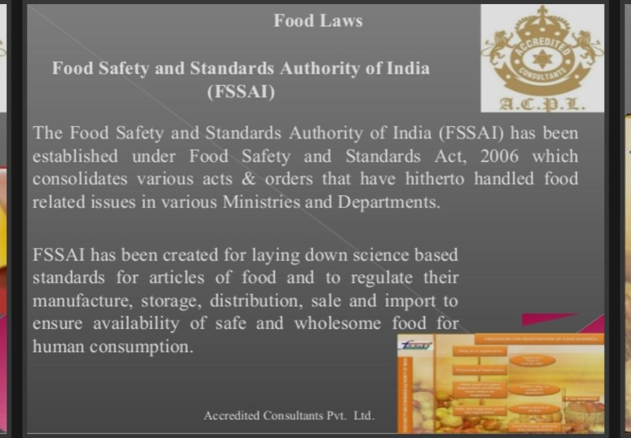

Slide 9
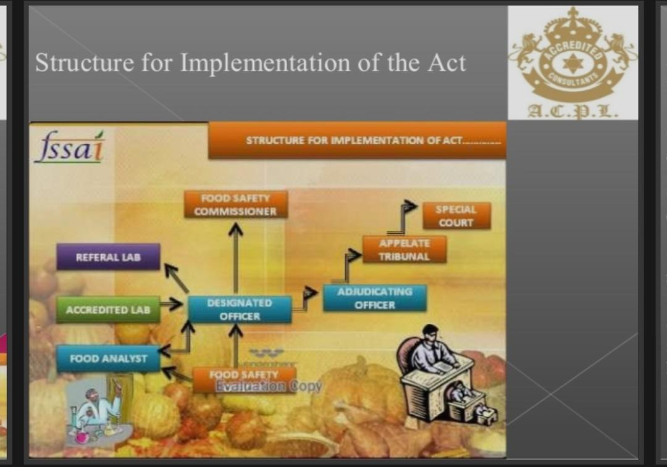

Slide 10
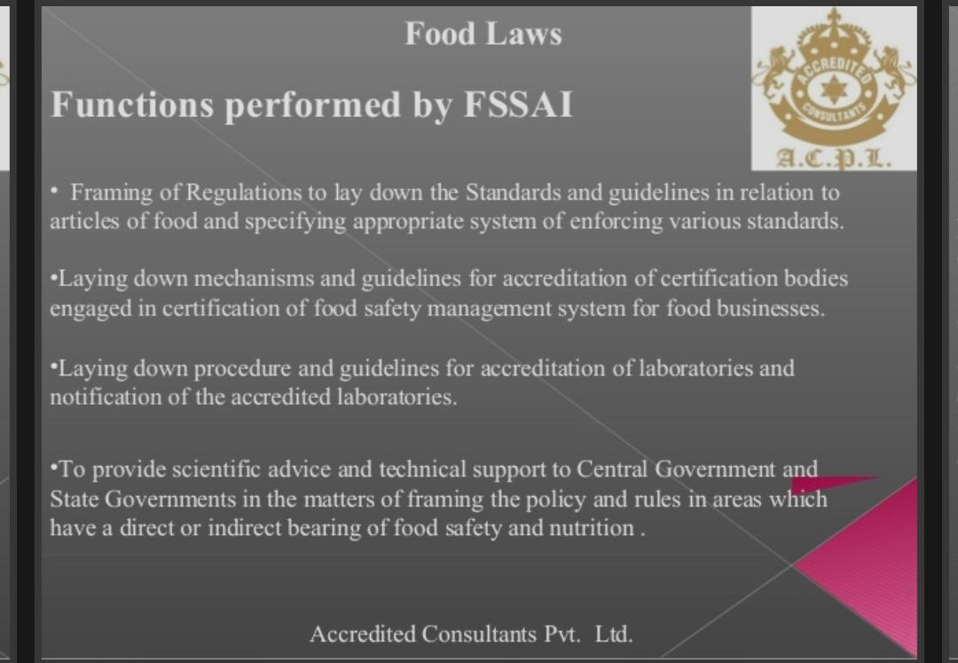

Slide 11
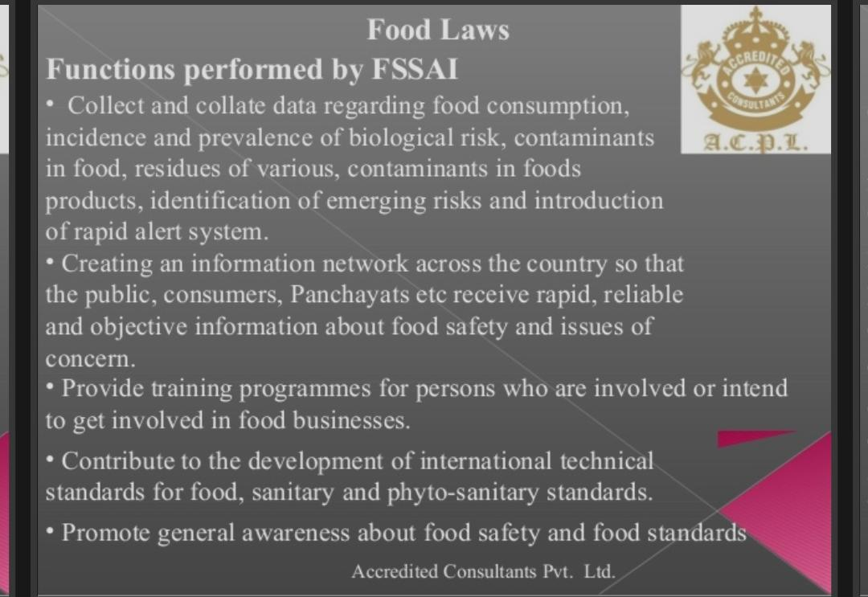

Slide 12
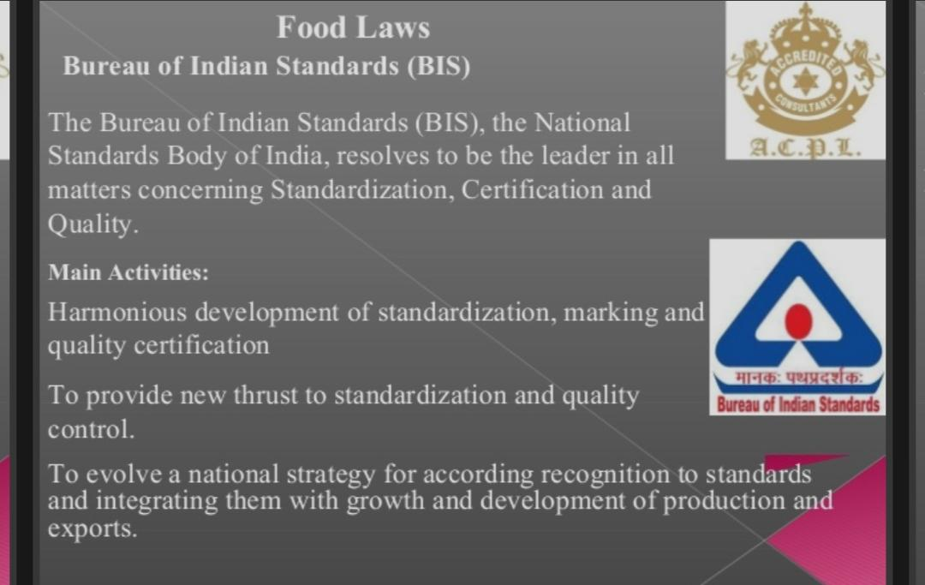

Slide 13
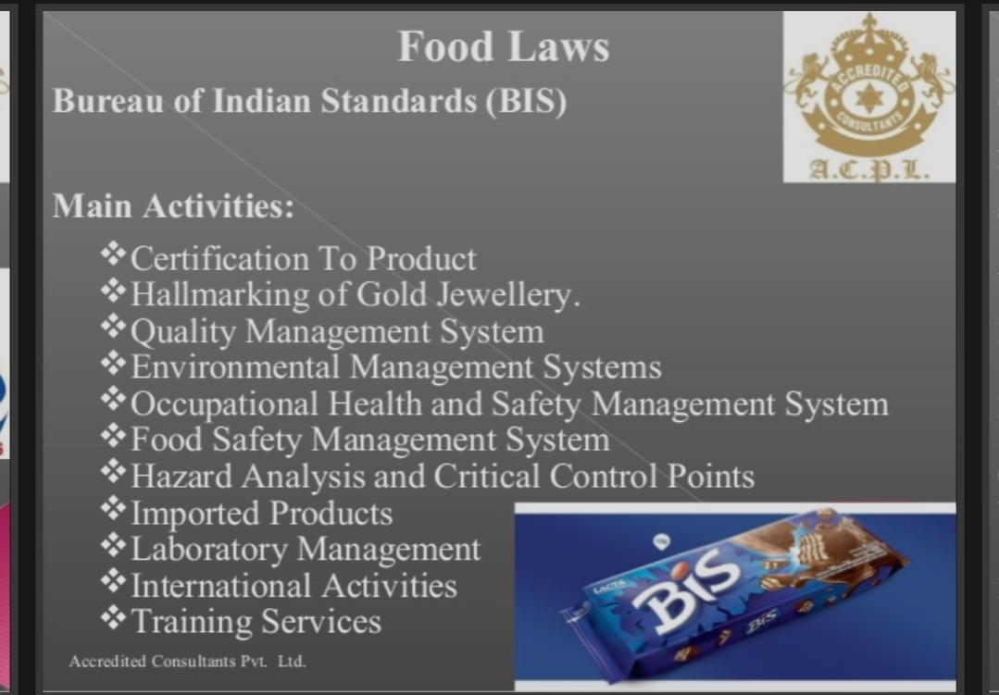

Slide 14
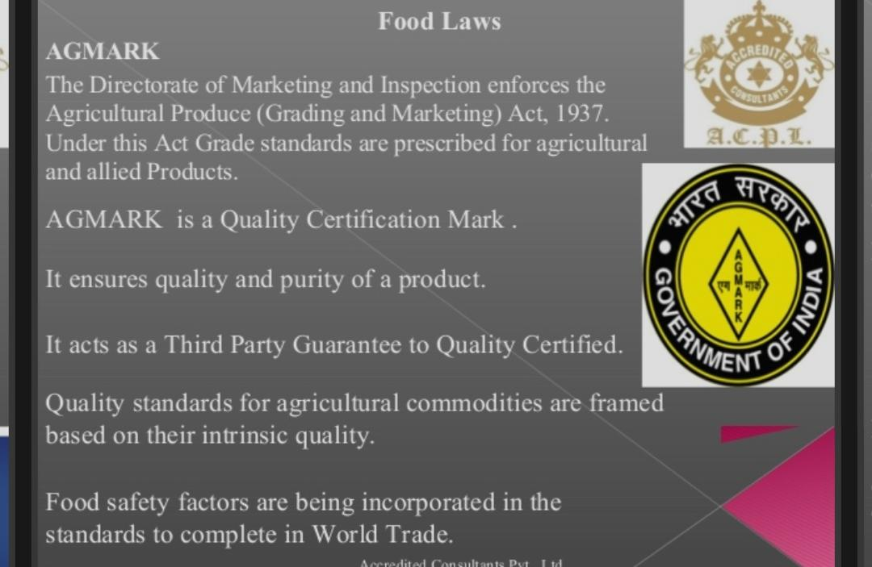

Slide 15


Slide 16
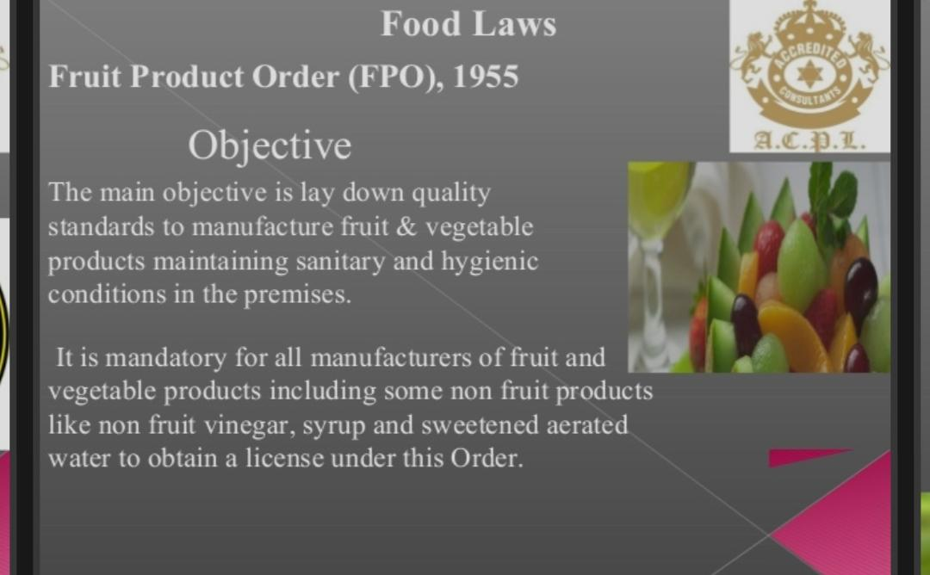

Slide 17
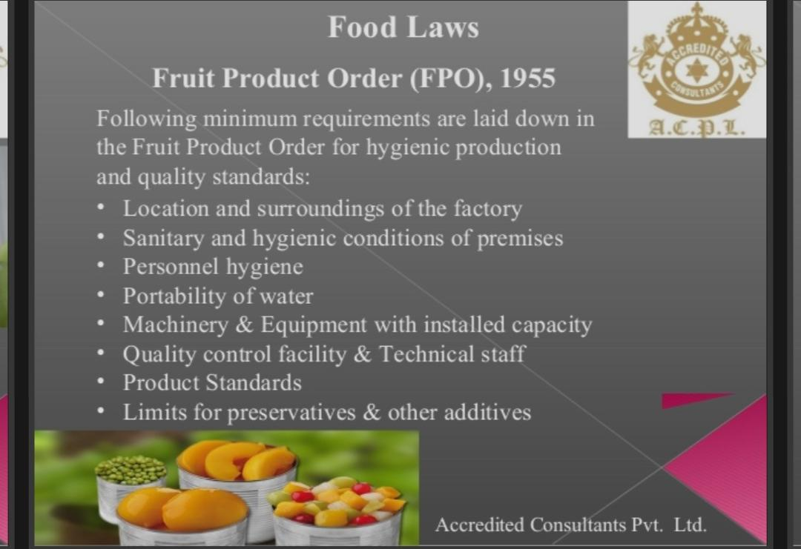

Slide 18
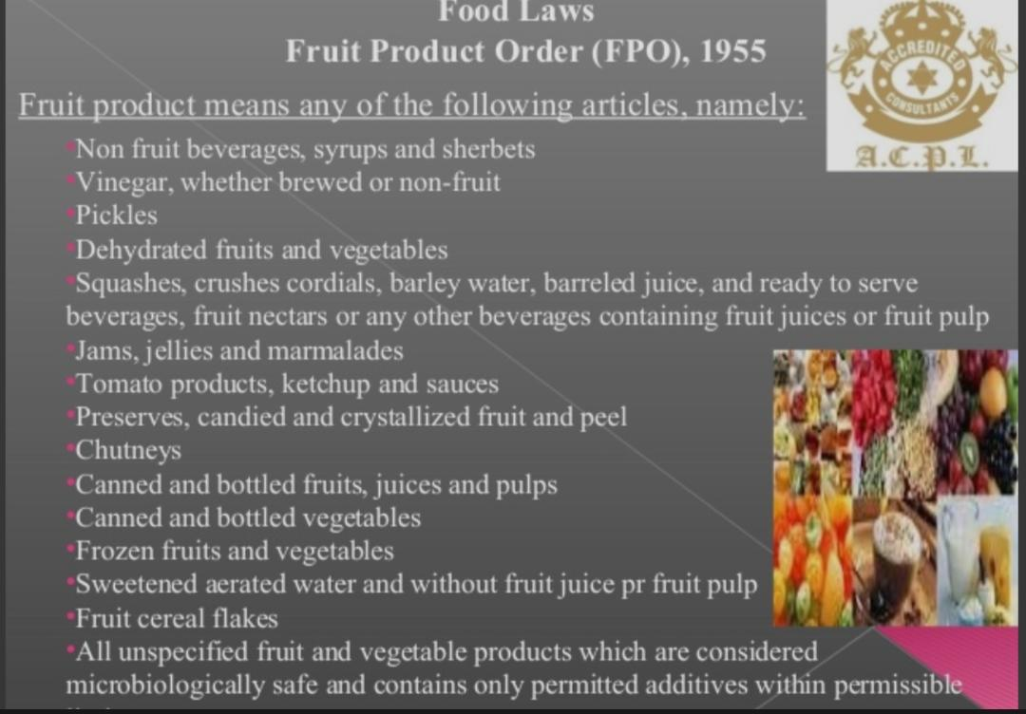

Slide 19


