Slide 1

SENGAMALA THHAYAAR EDUCATIONAL TRUST WOMEN’S COLLEGE,
(Affiliated to Bharathidasan University,Tiruchirapalli)
(Accredited with A grade by NAAC)
(An ISO 9001:2015 Certified Institution)
SUNDARAKKOTTAI, MANNARGUDI - 614016.
THIRUVARUR Dt, TAMIL NADU, INDIA
CLASS: II B.SC BIOCHEMISTRY
SUBJECT: CC IV-ENZYMES
CODE: 16SCCBC4
SEMESTER: IV
Prepared by,
Dr.G.Prasanna,
Assistant Professor,
PG & Research Department of Biochemistry

Slide 2

PYRUVATE DEHYDROGENASE COMPLEX (PDH)

Slide 3
Pyruvate Dehydrogenase Complex (PDH)
Pyruvate dehydrogenase complex (PDC) is a complex of three enzymes that converts pyruvate into acetyle CoA by a process called pyruvate decarboxylation
Acetyl-CoA may then be used in the citric acid cycle to carry out cellular respiration, and this complex links the glycolysis metabolic pathway to the citric acid cycle
Pyruvate decarboxylation is also known as the "pyruvate dehydrogenase reaction" because it also involves the oxidation of pyruvate

Slide 4
This multi-enzyme complex is related structurally and functionally to the oxoglutarate dehydrogenase and branched chain oxoacid dehydrogenase multi-enzyme complexes
Pyruvate Dehydrogenase complex (PDH) connects the citric acid cycle and subsquent oxidative phosphorylation to the glycolysis, gluconeogenesis and lipid and amino acid metabolism pathways

Slide 5
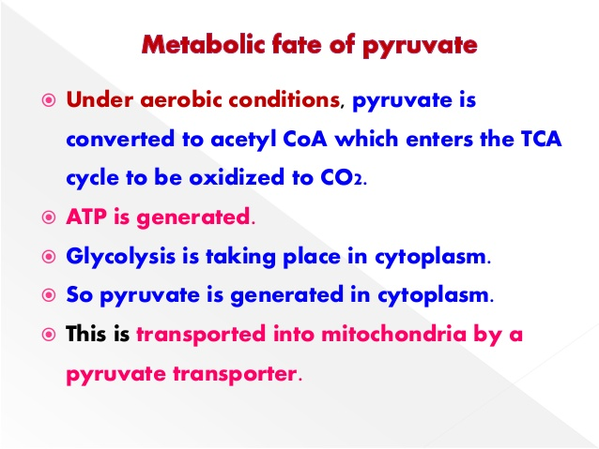

Slide 6
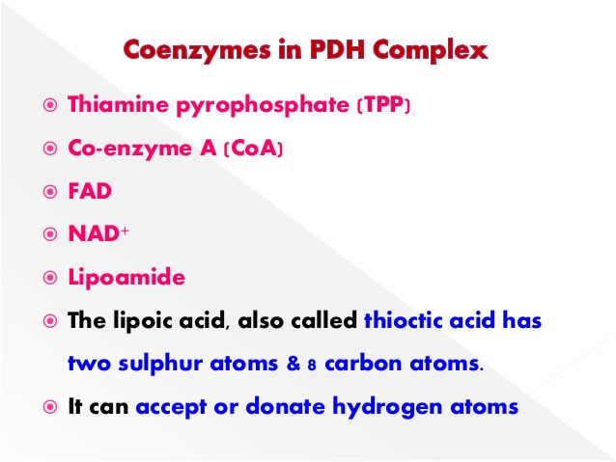

Slide 7
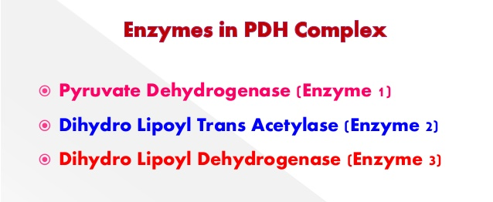
An additional structural subunit, the E2/E3 binding protein, is necessary to support the interactions between the E2 and E3 subunits.

Slide 8
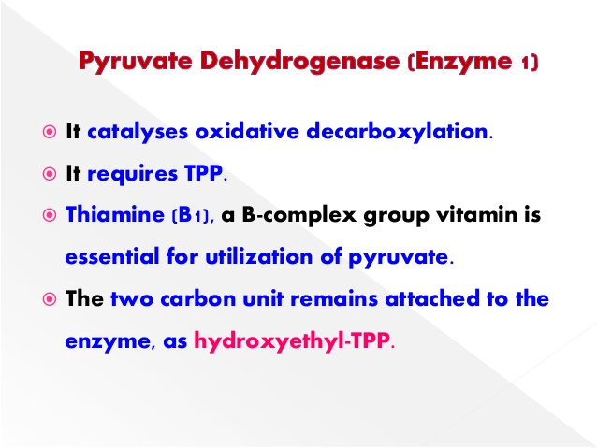

Slide 9
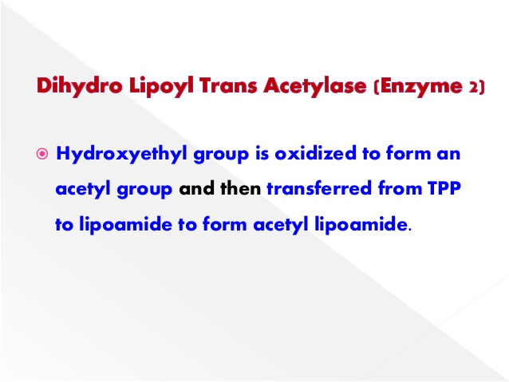

Slide 10
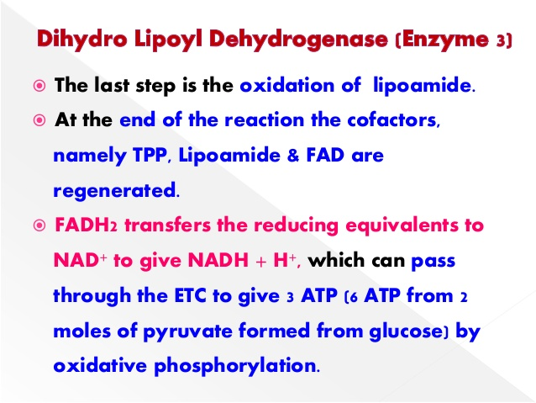

Slide 11
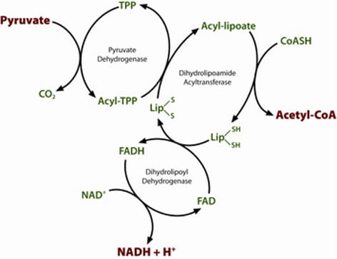

Slide 12
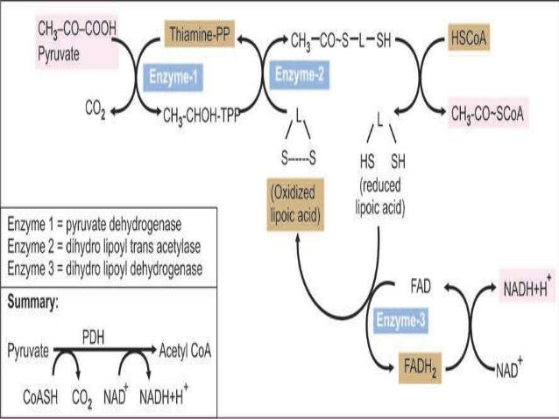

Slide 13
PDH catalyzes the oxidative decarboxylation of pyruvate to produce acetyl coenzyme A (acetyl-CoA), NADH and CO₂.
PDH facilitates the use of carbohydrate to meet energy demands: when carbohydrate stores are depleted in mammals, PDH activity is downregulated to limit the use of glucose by oxidative phosphorylation.
Fatty acids or ketone bodies are then used as an energy source in tissues such as heart and skeletal muscle.​​​

Slide 14
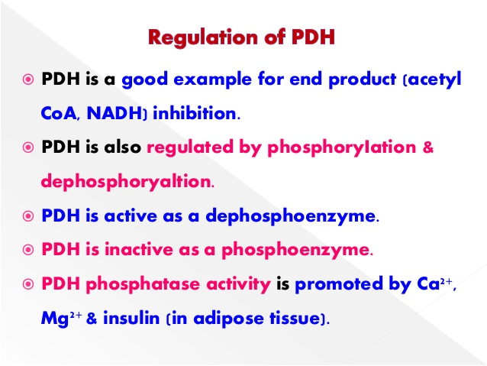

Slide 15
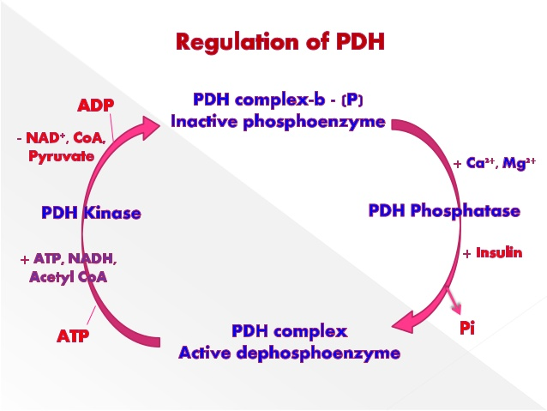

Slide 16
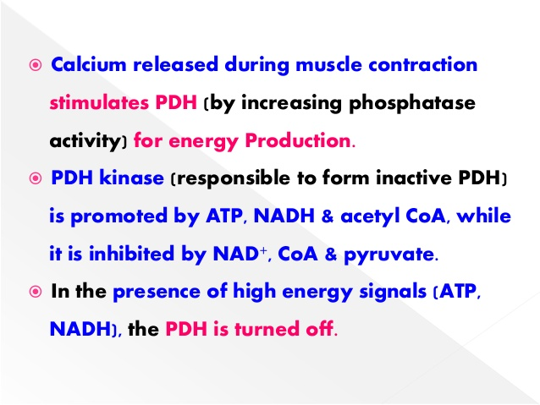

Slide 17
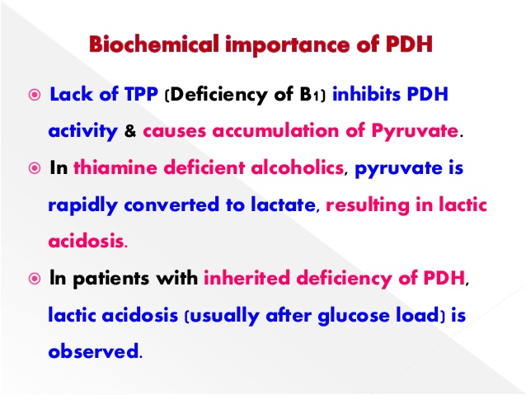

Slide 18
