Slide 1
DEPARTMENT OF NUTRITION AND DIETETICS
CLASS : Second year
SUBJECT : Nutrition Through Life Cycle
SUBJECT CODE : 16SCCND4
SUBJECT INCHARGE : MS.R. Kaviyarasi

Slide 2
UNIT-I
FACTORS AFFECTING RDA

Slide 3
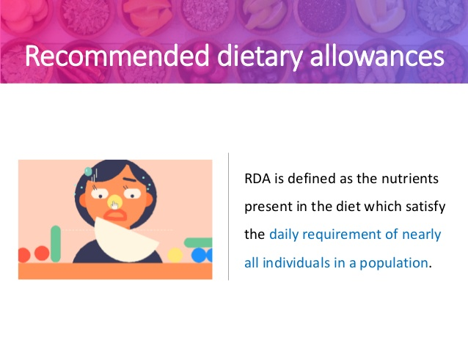

Slide 4
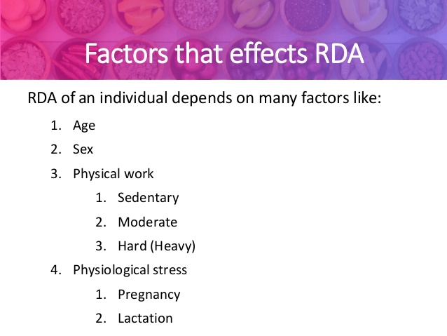

Slide 5
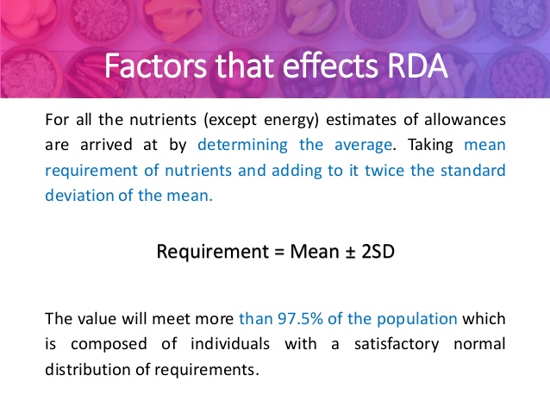

Slide 6
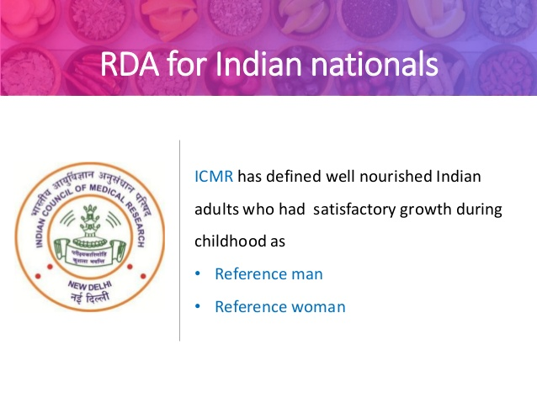

Slide 7
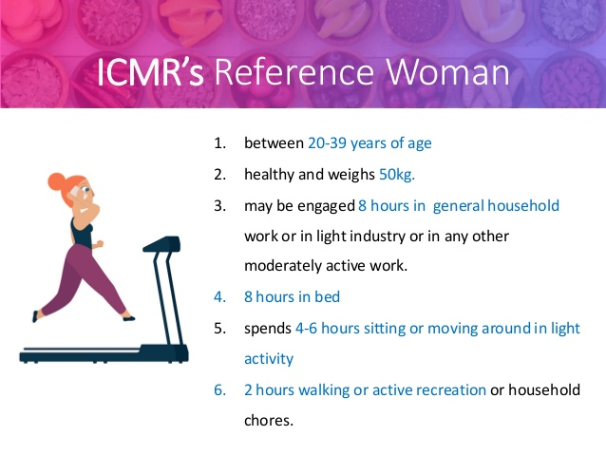

Slide 8
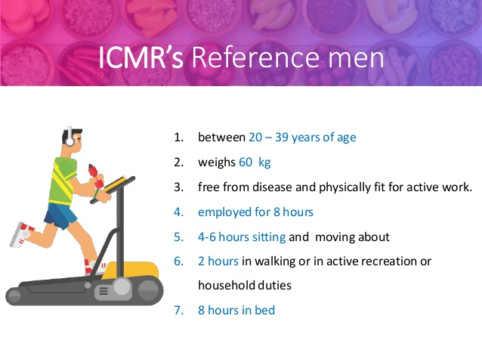

Slide 9
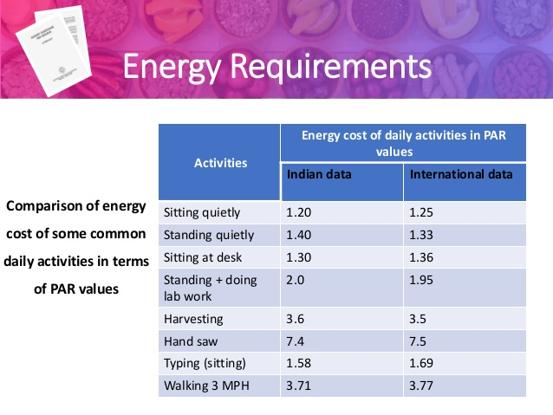

Slide 10
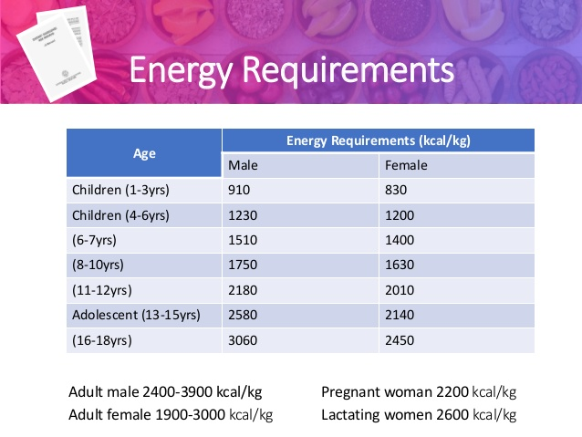

Slide 11
THANK
…
YOU

