Slide 1
DEPARTMENT OF NUTRITION AND DIETETICS
DIETETICS-II
III B.Sc NUTRITION AND DIETETICS
SUBJECT INCHARGE: R.VIJAYALAKSHMI

Slide 2


Slide 3
EXCHANGE LIST
To introduce variety and flexibility in diet prescription

Slide 4
FUNDAMENTAL SKILLS OF COUNSELLING
Listening
Responding
Questioning
Communication tools

Slide 5
COUNSELLING INVOLVES
Discussing
Advising
Teaching
Instructing

Slide 6
WHAT IS THE DIETITIAN’S ROLE?
To educate and advise people on diet
To provide support through treatment
To work as part of Nutrition support team

Slide 7
DIET COUNSELLING
Dietitians use their knowledge of nutritional, medical and social science to devise appropriate eating patterns and their communication skills to inform and educate others
British Dietetic Association - 1994

Slide 8
DIETITIANS SHOULD….
Wherever they work, they should
Promote nutritional well being
Treat disease and prevent nutrition related problems
Enable people to make informed choices about food and life style

Slide 9
DIETITIAN NEEDS TO HAVE
Effective communication skills
Confidence in talking
Knowledge on up-to-date and accurate information
Caring and competent attitude
Trustworthiness
A desire to help

Slide 10
AIMS OF DIET THERAPY
Maintain normal biochemistry level
Minimize symptoms
Prevent malnutrition and un intentional weight loss

Slide 11
DIET COUNSELLING
What are the basic principles?
Evaluation of the patient’s diet
Suggestions to modify the main meals
Give reliable and practical options for alternate foods

Slide 12
DIET COUNSELLING
When giving appointment- Explain
Where and when to come
How long it will take
How much is the fee

Slide 13
DIET COUSELLING
Attending – Giving someone our attention as fully as we can
Attending non verbal communication
  The voice
  Eye contact
  Appearance
  Posture
  Gestures

Slide 14
DIET COUNSELLING
Should be individually varied
Nutritionally balanced approach
Educating the patient regarding nature of disease
Benefits and importance of following the diet

Slide 15
DIET HISTORY
Meal time
Amount
Portion size
Preparation of dishes
Amount of sugar , milk and oil used

Slide 16
DIET DIARY
Food and Activity Log
Minimum three day diet record to be maintained
One of the three days should be a week end.

Slide 17
DIET COUNSELLING
Establishing time boundary
Confidentiality of the information and records
End by
- Allowing time to review
Invite questions
Giving contact numbers

Slide 18
CHALLENGES OF DIETITIANS IN PEDIATRIC SET UP
To adapt dietary advice appropriate to kids
To take into account their careres
Need flexible communication skills
Awareness of child’s needs
Familiarity with the ways the kids express themselves

Slide 19
BEHAVIOR MODIFICATION
Self monitoring
  Daily food record and activity log
. Stimulus control
  Internal and external cues and triggers with over eating
  Changing eating behavior
  Reinforcement
Healthy eating strategies are encouraged with rewards
- Cognitive behavioral techniques
Developing alternative behavior for overeating

Slide 20
DIET COUNSELLING
It is a science since it involves a scientific base
It is an art since one needs the skill base to perform it successfully!

Slide 21
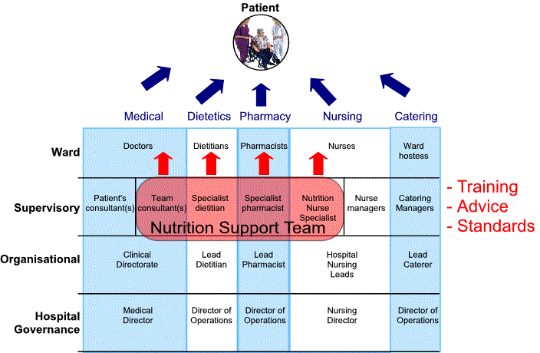
AREAS OF RESPONSIBILITIES FOR THE NUTRITION SUPPORT TEAM

Slide 22
How Significant Is Really The Role Of A Dietician As A Multidisciplinary Team Member In A Hospital
A random questionnaire being forwarded to 87 nursing personnel, 15 physical medicine personnel & almost an equal number of social workers in Baton Rouge General Acute Care Division, Baton Rouge, LA, USA on 21st May 2003, the questions pertaining to some common set of issues like the knowledge of availability of the Dietician, how to contact the Dietician, whether or not their patients were adequately followed up by the Dietician & suggestions on how the Dietician would be more effective in in better quality care

Slide 23
So, The Final Impact Of This Survey:
Versatile colourful role of the Dietician.
Integral and irreplaceable involvement of a Dietician in a multidisciplinary approach.

Slide 24
And Now The Results
97% agreed unanimously Dietician’s role added completion & unique dimensions to multidisciplinary approach to a patient. By
Monitoring food intake.
Promoting wound healing.
Providing education.
And by effectively solving problems like
Diminishing appetite
Inadequate food intake
Food preference
Nutritional support
Food drug interaction
Providing other team members with important nutrition information
Cross-training in other disciplines (accu-checks etc)

Slide 25
What should a dietician do while he/she is a part of the multidisciplinary approach to the patient?
Assessment:
  Nutritional assessment
On admission of patient
During the stay
Long term care patients
  What might be the obstacles?
Condition of the patient
Physical barrier
Language barrier
Learning disabilities

Slide 26
ii. Planning and counseling
After sharing & exchanging information with other team members, the consultant,
Develops plans to provide effective evidence based dietary advice.
Provide support to patient with the main aim to prevent and treat nutrition related symptoms
Extend help to all patients, their carers & all the staff involved in patient care
Counselling the patients, their family & attendents on the diet recommended & how to maintain to achieve the desired outcomes

Slide 27
B. Patient & Family Education:
Types of recommended diet
Food drug interaction
Dietary counselling
  In an approach which is warm
  In a language which is lucid & simple for understanding
  In a way which is accessible
  In a manner which is sensitive to the individual needs
of the patients from all ethnic, cultural backgrounds
  In a path to maintain the highest possible clinical & professional standards in accordance with internationally acclaimed best practices
What are the possible means to convey your education
  Verbal Counselling With Teaching & Explaination
  Providing reading materials

Slide 28
DIET COUNSELLING
Finally –
Stress how FEW things are restricted and
How MANY things are allowed.

