Slide 1
DEPARTMENT OF NUTRITION AND DIETETICS
FOOD SERVICE MANAGEMENT-II
III B.Sc NUTRITION AND DIETETICS
SUBJECT INCHARGE: Dr.S.VISHNUPRIYA

Slide 2

Methods of purchasing
DEPARTMENT OF NUTRITION AND DIETETICS
DEPARTMENT OF NUTRITION AND DIETETICS

Slide 3


Slide 4
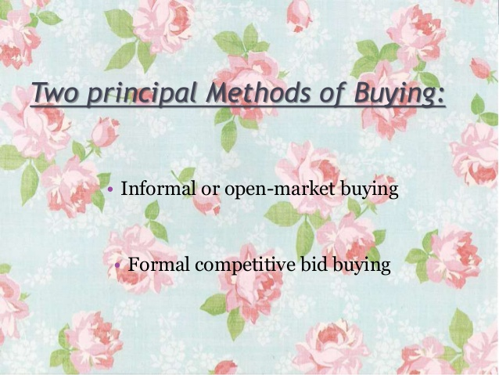

Slide 5
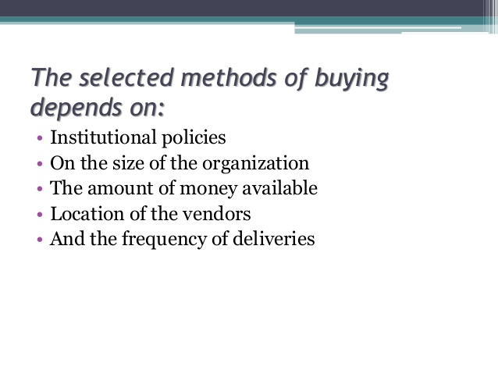

Slide 6


Slide 7
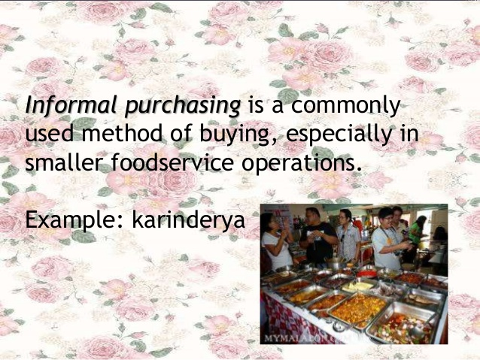

Slide 8
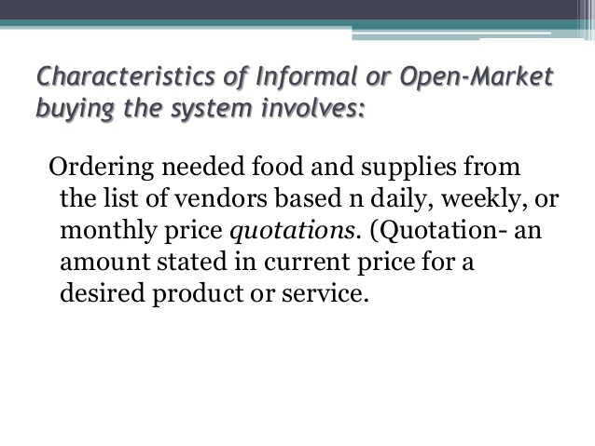

Slide 9
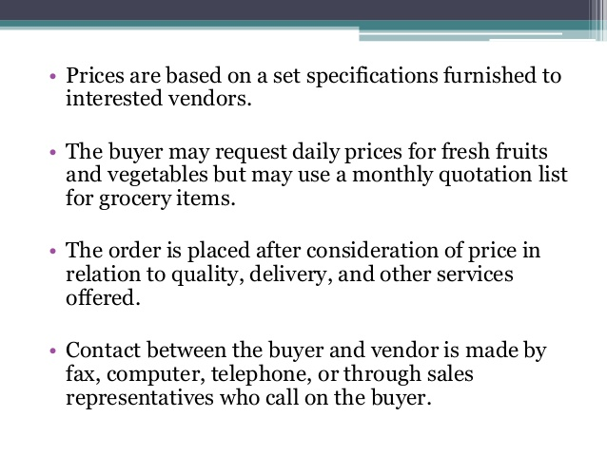

Slide 10
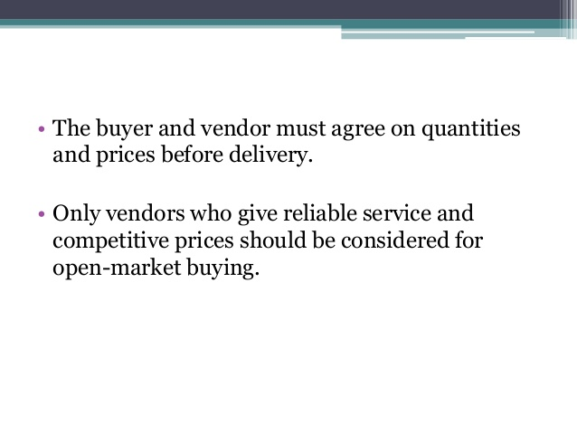

Slide 11
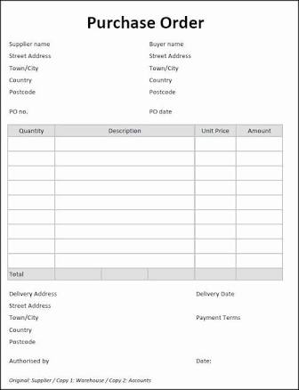

Slide 12
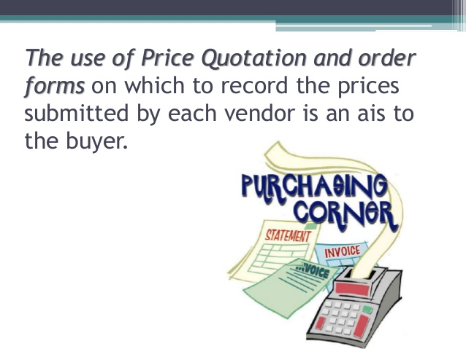

Slide 13


Slide 14
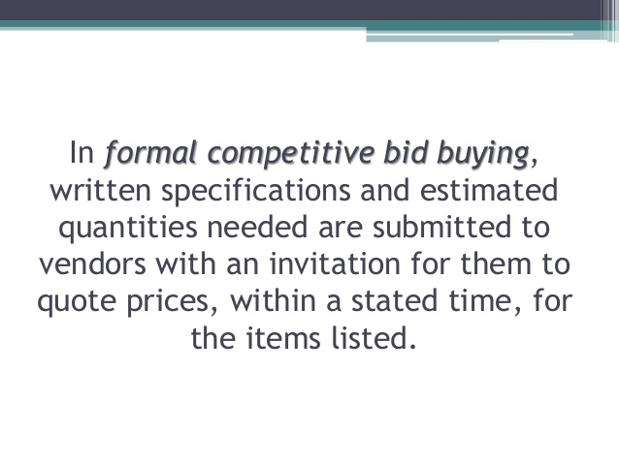

Slide 15


Slide 16
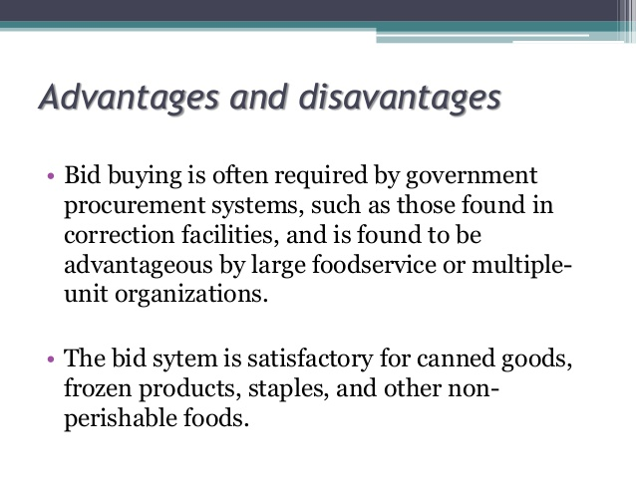

Slide 17
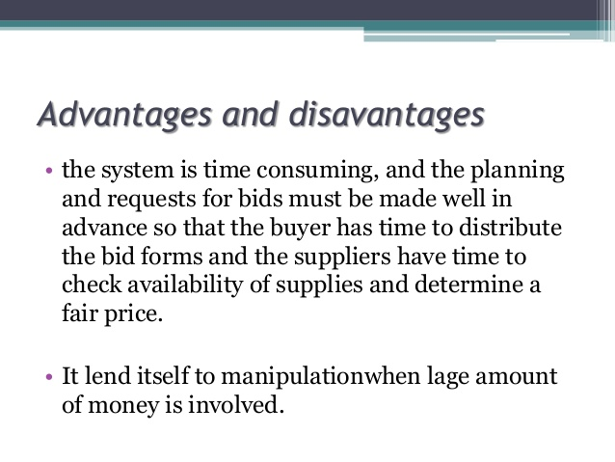

Slide 18
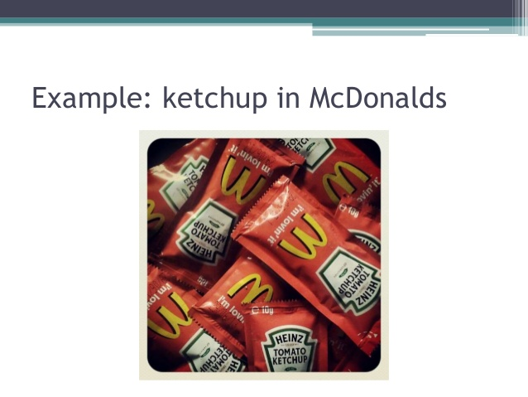
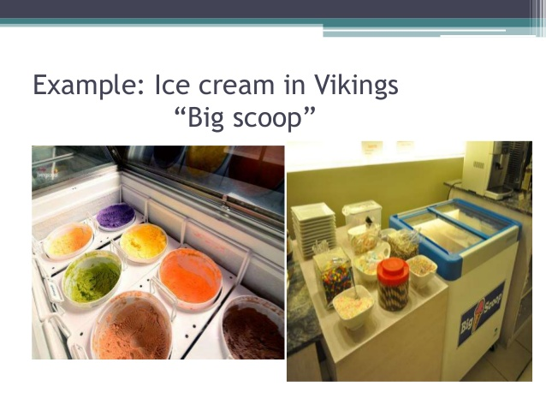

Slide 19


Slide 20
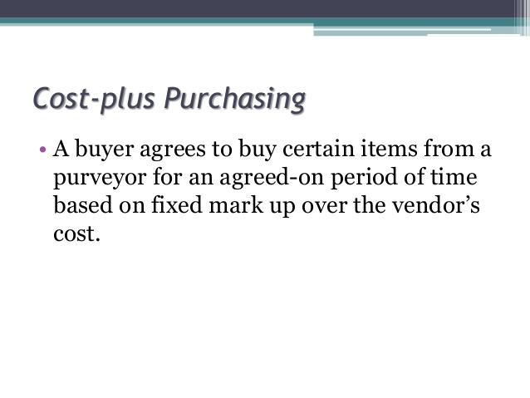

Slide 21
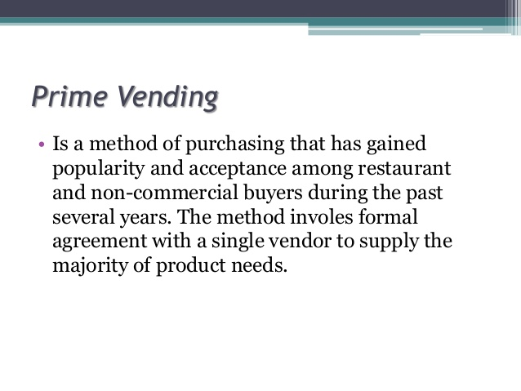

Slide 22
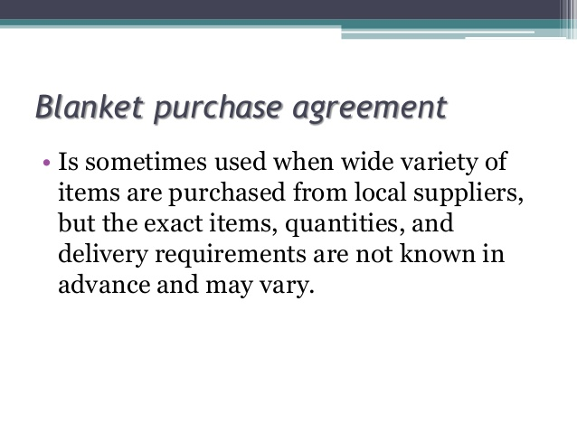

Slide 23
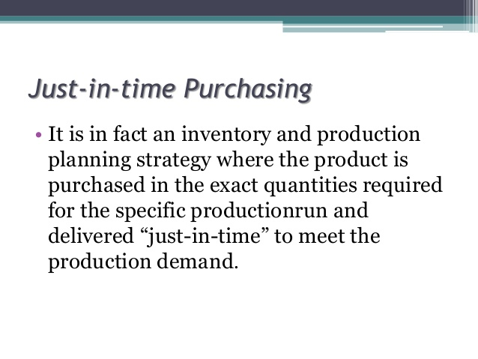

Slide 24


