Slide 1
DEPARTMENT OF NUTRITION AND DIETETICS
FOOD SERVICE MANAGEMENT-II III B.Sc NUTRITION AND DIETETICS SUBJECT INCHARGE: Dr.S.VISHNUPRIYA

Slide 2
FOOD SERVICE MANAGEMENT-II
PRESENTATION ON MENU & MENU PLANNING

Slide 7
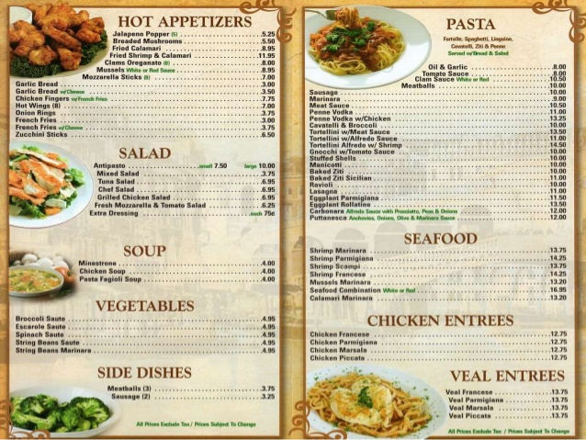

Slide 13
