Slide 1

 | Sengamala Thayaar Educational Trust Women’s College (Affiliated to Bharathidasan University) (Accredited with ‘A’ Grade {3.45/4.00} By NAAC) (An ISO 9001: 2015 Certified Institution) Sundarakkottai, Mannargudi-614 016. Thiruvarur (Dt.), Tamil Nadu, India.
MEC III-BASIC BIOTECHNOLOGY-16SMBEBC3
Dr. R. ANURADHA
ASSISTANT PROFESSOR & HEAD
PG & RESEARCH DEPARTMENT OF BIOCHEMISTRY

Slide 2
ETHANOL PRODUCTION FROM BIOMASS

Slide 3
Synopsis:
                INTRODUCTION
                BIOCHEMISTRY OF ETHANOL FERMENTATION
                INDUSTRIAL PRODUCTION OF ETHANOL
                *FORMULATION OF MEDIUM
                *DESIGNING OF FERMENTATION SYSTEM
                *CULTURE OF MICROBES IN FERMENTER
                *RECOVERY OF ETHANOL
                APPLICATION OF ETHANOL

Slide 4
Introduction:
Ethanol, also called alcohol, ethyl alcohol and grain alcohol, is a clear, colourless liquid and the principle ingredient in alcoholic beverages like beer, wine or brandy. Because it can readily dissolve in water and other organic compounds, ethanol also is an ingredient in a range of products, from personal care and beauty products to paints and varnishes to fuel.
Ethanol is a natural byproduct of plant fermentation and also can be produced through the hydration of ethylene.

Slide 5
Ethanol is prepared from the following wastes and plant products:
Sugarcane molasses
Cane juices
Sugar beets
Cassava
Maize
Corn
Crop wastes

Slide 6
Carbohydrates are fond locked in wastes. The complex polysaccharides are converted into simple sugars.
It is carried out by Closteridium thermocellum, C. thermohydosulphuricum and C. thermosaccharolyticum.
The simple sugars are converted to ethanol by Zymomonas mobilis, Thermoanerobacter ethanolicus, etc.,
Some microbes are produce ethanol directly from carbohydrate wastes. Eg, Monilia, fusarium.

Slide 7
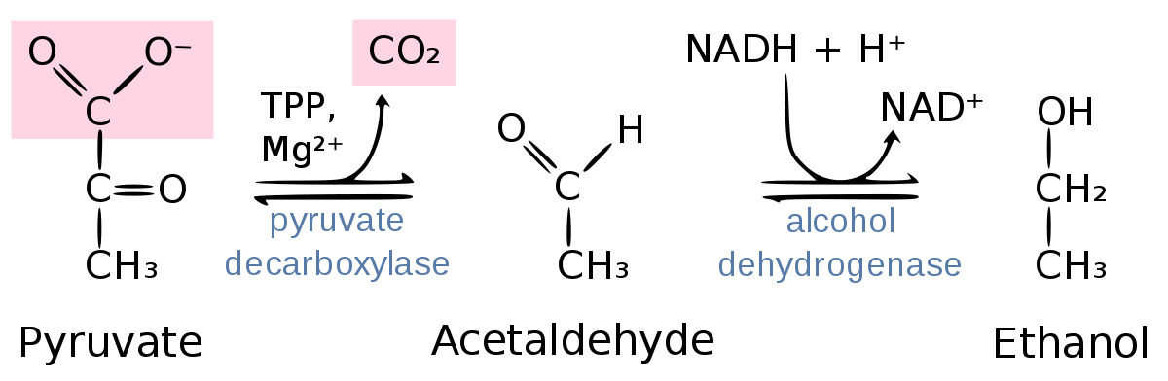
Biochemistry of ethanol fermentation:

Slide 8
Industrial production of ethanol:
Formulation of medium
Designing of fermentation system
cultures of microbes in fermenters
Recovery of ethanol

Slide 9
Formulation of medium:
The sugar concentration of cane molasses and of other carbohydrates in the waste is diluted to 10 – 18 %. This sugar concentration favors the growth of the micro organisms.
Ammonium sulphate or ammonium phosphate is added to the diluted medium.
The pH of the medium is adjusted to 4 - 5 to using dilute sulphuric acid.

Slide 10
The starchy media like corn, rye, and barley are hydrolyzed with dilute acids before they are pumped into the fermenter.
The hydrolysis of starchy yields simple sugars which are directly converted to ethanol.
Sometimes starchy feed stock is treated with amylase enzyme, extracted from Aspergillus and Rhizopus.
Amylase convert the starch into 80% maltose and 20% dextrin that can easily be converted into glucose.

Slide 11
Designing fermentation system:
The fermentation system consists of,
Three molasses tank
Three seed tanks
A fermenter
Wash camber
Molasses storage tank

Slide 12
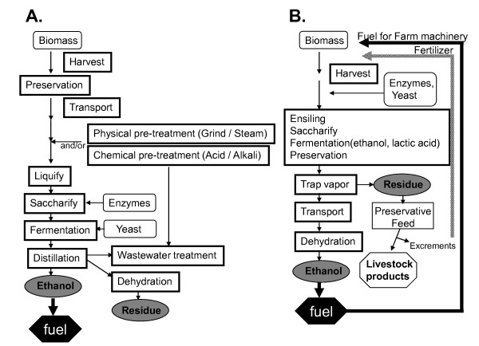

Slide 13
The stored molasses enter another tanks where the molasses are diluted properly with water.
The diluted molasses then enter the sterilization tank for sterilization.
The sterilized medium is used to carry out fermentation.
The fermenter is connected with wash chamber by a pipeline.
Harvested broth is transferred to the wash chamber for distillation.

Slide 14
Culture of microbes in fermenter:
Sterilized medium in the sterilization tank is pumped into the fermenter then microbial inoculum is pumped into the fermenter to carry out ethanol fermentation.
330k temperature is found to be suitable for fermentation.
Ethanol fermentation is complete in about 3 days.

Slide 15
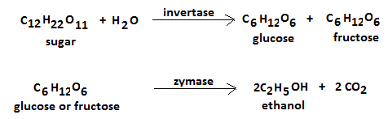
The enzyme invertase of Zymomonas (yeast) converts sucrose in the molasses into glucose.
This glucose is converted to ethanol by the enzyme zymase.

Slide 16
Recovery of ethanol:
The fermented broth in the fermenter is known as wash.
It is distilled in the washed chamber to recover ethanol.
The distillation setup is called coffey still.
It consists of 2 column,
Analyser
rectifier

Slide 17
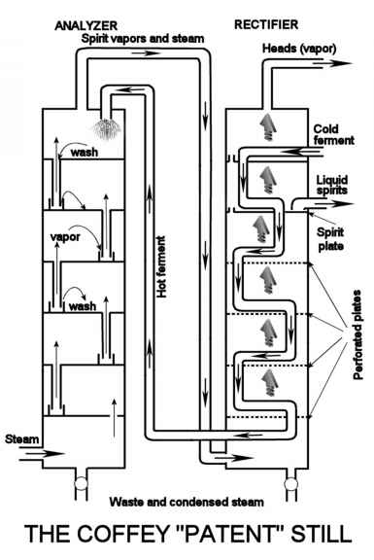

Slide 18
Wash flowing through a folded pipe is heated in the rectifier. This pipe releases the contents at the top of the analyser.
Steam is passed through the base of the analyser to carry the alcohol vapour to the base of the rectifier.
The spent liquor is collected from the outlet of the analyser.
Alcohol vapour in the rectifier is collected through a pipe jacketed with cool water to get 95% ethanol.

Slide 19
Application of ethanol:
Owing to its antibacterial and antifungal properties, ethanol (also known as ethyl alcohol) is used in many hand sanitizers and medical wipes.
Ethanol is also used as an antiseptic and as a disinfectant.
In cases of ethylene glycol poisoning or methyl alcohol poisoning, ethanol is often administered as an antidote.
Several medications that are insoluble in water are often dissolved in ethanol. For example, ethanol (in concentrations ranging from 1% to 25%) is used as a solvent for some analgesics and mouthwashes.

Slide 20
Ethanol is the primary ingredient in many alcoholic drinks that are orally consumed for recreational purposes. It acts as a psychoactive drug by reducing anxiety and creating a feeling of euphoria in Humans. However, it also impairs cognitive and motor functions and acts as a central nervous system (CNS) depressant.
Ethanol is used industrially in the production of ethyl esters, acetic acid, diethyl ether, and ethyl amines.
This compound is widely used as a solvent due to its ability to dissolve both polar and nonpolar compounds.
Since it has a melting point of -114.1oC, ethanol is used as an ingredient in cooling baths in several laboratories. It also serves as the active fluid in many spirit thermometers.

Slide 21
Thank you!!!

