Slide 1
 | Sengamala Thayaar Educational Trust Women’s College (Affiliated to Bharathidasan University) (Accredited with ‘A’ Grade {3.45/4.00} By NAAC) (An ISO 9001: 2015 Certified Institution) Sundarakkottai, Mannargudi-614 016. Thiruvarur (Dt.), Tamil Nadu, India.
MEC III-BASIC BIOTECHNOLOGY-16SMBEBC3
Dr. R. ANURADHA
ASSISTANT PROFESSOR & HEAD
PG & RESEARCH DEPARTMENT OF BIOCHEMISTRY

Slide 2
MICROBIAL GROWTH

Slide 4
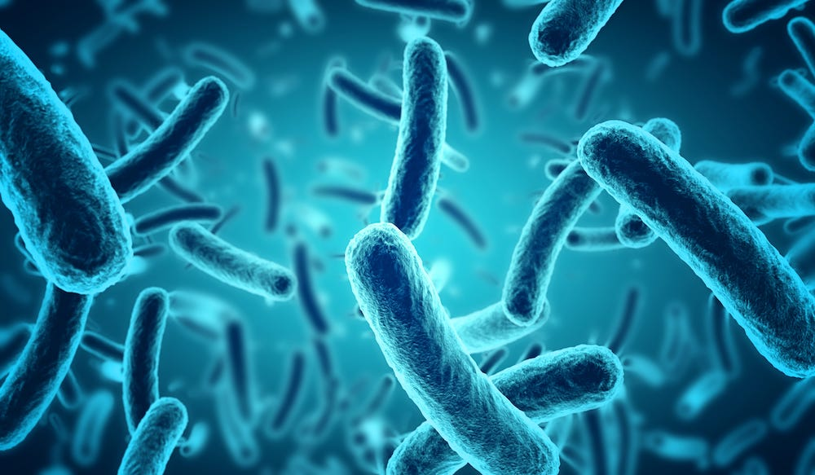
INTRODUCTION
MICROBIAL GROWTH
It is defined as the proliferation of bacterium into two daughter cells, in a process called binary fission.
The growth of microorganism is a highly complex and coordinated process, ultimately expressed by increase in cell number.
The process of growth depends on the availability of requisite nutrients and their transport into the cells, and the environmental factors such as aeration, oxygen supply, temperature and pH.

Slide 5
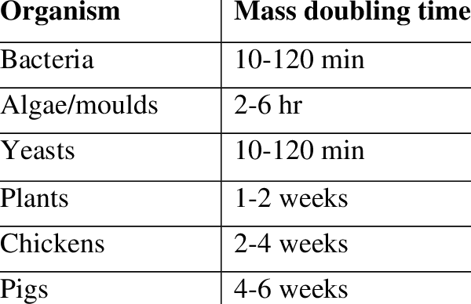
DOUBLING TIME
It refers to the time period required for doubling the weight of the biomass while generation time represents the period for doubling the cell numbers.
It increases with increasing cell size and complexicity.

Slide 6
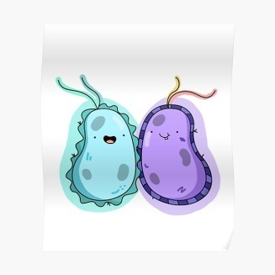
BATCH FERMENTATION
It is regarded as a closed system, the sterile nutrient culture medium in the bioreactor is inoculated with microorganisms.
The incubation is carried out under optimal physiological condition.
It may be necessary to add acid or alkali to maintain pH, and anti-foam agents to minimize foam.

Slide 7
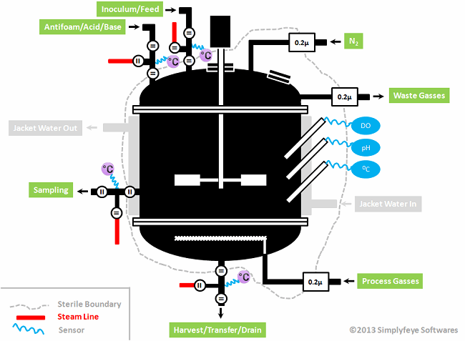
DIAGRAM

Slide 8
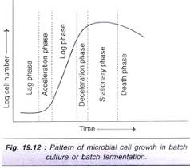
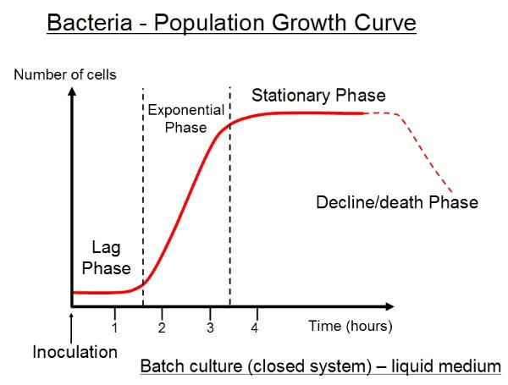
DIAGRAM

Slide 9
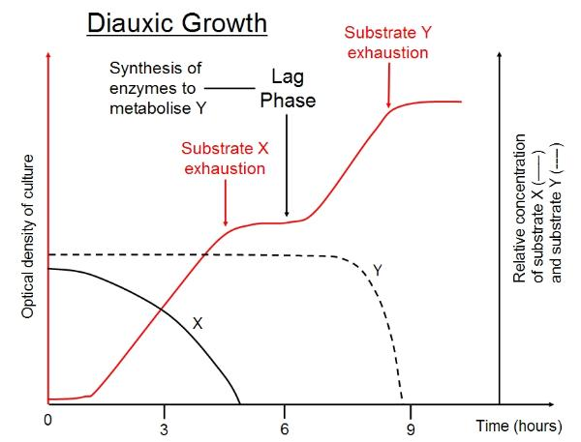
LAG PHASE
The initial brief period of culturing after inoculation is referred to as lag phase.
During this, the microorganisms adapt to the new environment – available nutrients, pH.
There is no increase in the cell number although the cellular weight may slightly increase.

Slide 10
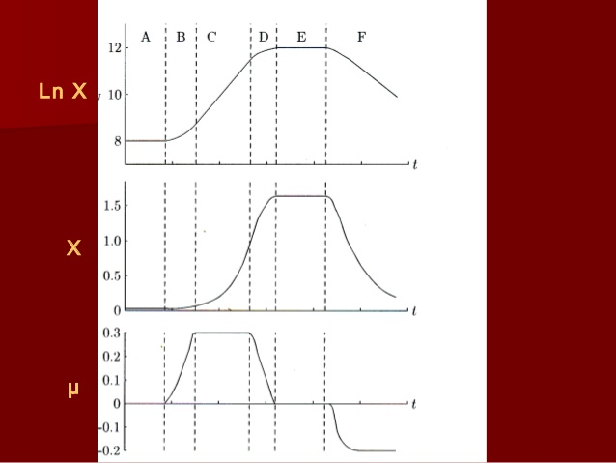
ACCELERATION PHASE
It is a brief transient period during which cells start growing slowly in fact, acceleration phase connects the lag phase and log phase.

Slide 11
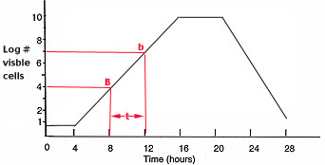
LOG PHASE
The most active growth of microorganisms and multiplication occur during log phase, The cells undergo several doublings and the cell mass increases.
When the number of cells or biomass is plotted against time on a semi logarithmic graph, a straight line is obtained, hence the term log phase.

Slide 12
DECELERATION
As the growth rate of microorganisms during log phase decreases, they enter the deceleration phase, This phase is very short – lived and may not be observable.

Slide 13
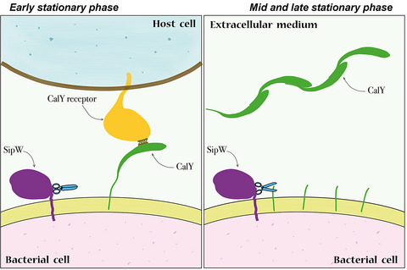
STATIONARY
As the substrate in the growth medium gets depleted, and the metabolic end products that are formed inhibit the growth, the cells enter the stationary phase.
The microbial growth may either slow down or completely stop.
The biomass may remain almost constant during stationary phase.

Slide 14
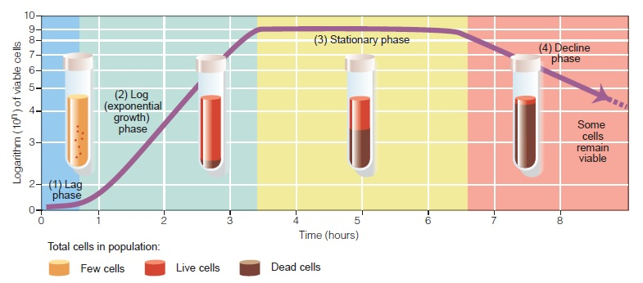
DEATH PHASE
This phase is associated with ceasation of metabolic activity and depletion of energy reserves.
The cells die at an exponential rate.

