Slide 1

 | Sengamala Thayaar Educational Trust Women’s College (Affiliated to Bharathidasan University) (Accredited with ‘A’ Grade {3.45/4.00} By NAAC) (An ISO 9001: 2015 Certified Institution) Sundarakkottai, Mannargudi-614 016. Thiruvarur (Dt.), Tamil Nadu, India.
MEC III-BASIC BIOTECHNOLOGY-16SMBEBC3
Dr. R. ANURADHA
ASSISTANT PROFESSOR & HEAD
PG & RESEARCH DEPARTMENT OF BIOCHEMISTRY

Slide 2
PARTICLE BOMBARDMENT AND MICROINJECTION

Slide 3
RECOMBINANT TECHNOLOGY-INTRODUCTION
The transfer of rDNA into a bacterial cell or plant cell is called introduction of rDNA into host cells. The cell receiving the rDNA is called Host cell. The host cell containing rDNA is known as Transformed or Recombinant cell.

Slide 4
TRANSFER INTO ANIMAL CELLS
Transfection,
Liposome mediated gene transfer,
Particle bombardment method,
Virus vector method,
Microinjection,
Electroporation.

Slide 5
PARTICLE BOMBARDMENT
Shooting the plant or animal cells by DNA coated gold or tungsten particles for introducing DNAs into the cells, is called PARTICLE BOMBARDMENT or BIOLISTICS. In this method rDNA can be introduced into plant cells, fungal cells, animal cells and cell Organelles such as chloroplast and mitochondria.

Slide 6
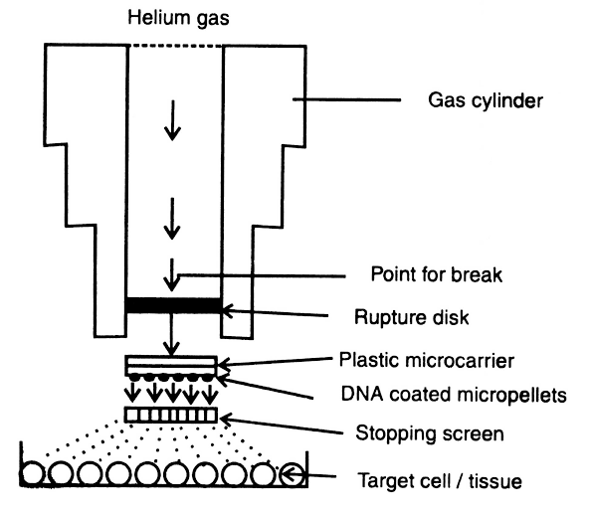
MICROPROJECTILE
Vectors are used to introduce the rDNA into the cells.
The instrument used to shoot the DNA into cells are GENE GUN or MICROPROJECTILE GUN.
The gene gun is doing the work of a vector.

Slide 7
Microprojectile gun consist of,
Blank charge
Firing pin
Nylon macroprojectile
Microprojectiles
Stopping screen
Target cells.
All these components are enclosed in vaccum chamber.

Slide 8
The rDNA is mixed with tungsten or gold particles of microscopic size and it is treated with CaCl₂ or spermidine or PEG.
CaCl₂ precipitates the rDNA onto the metal particles.
The rDNA coated with tungsten or gold particles are said to be Microprojectiles.

Slide 9
The Microprojectiles are positioned on a holder about 5 cm above the cells, within the chamber of the gun.
The chamber is sealed and Helium gas is pumped into a small compartment situated above the gold particles.

Slide 10
Once a predetermined pressure is reached, the gas is released and the gold particles are shot in the cells
The gold particles act as Bullets, penetrating the cell wall and delivering the rDNA into the cells, interior.

Slide 11
The Microprojectiles are fired into plant cells or animal cells with the speed of 300-600 m/s using gene gun.
Gun powder, pressurized helium gas or electric power is used to provide propelling force for the gun to drive the Microprojectiles into the cells. The rDNA gets integrated with the cell and hence recombinant cells are formed.

Slide 12
USES:
Biolistics is an effective method for rDNAs into Mammalian cells.
Useful method to transfer Immature embryos, Embryonic calling, Epidermal cells and Dicot plants.

Slide 13
MICROINJECTION
Microinjection refers to the injection of cell Organelles directly into cells using a injection needle.
By this method, as DNAs, proteins or cell Organelles are injected into animal cells, eggs, zygotes and protoplasts.

Slide 14
For microinjection the following instruments are required.
A Sterioscopic Dissecting microscope,
A micropipette,
A glass injection needle.

Slide 15
The fertilized egg is transferred onto a microscopic slide under the microscope.
The cell is held in position using a sucking pippete.

Slide 16
One end of the sucking pippete is positioned on the surface of the cell and a gentle suction pressure is applied on its other end.
The rDNA is sucked into the Glass injection needle.

Slide 17
It is gently inserted into the zygote by viewing through the microscope.
The rDNA is delivered into the zygote and the needle is drawn back carefully.

Slide 18
The rDNA gets integrated into the genome of the zygote.
The microinjected embryos are cultured in vitro upto the morula or blastocyst stage and then implanted into a female to produce Transgenic organism.

Slide 19
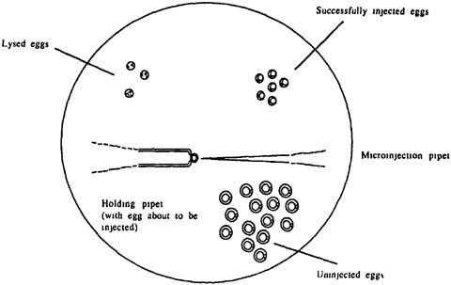
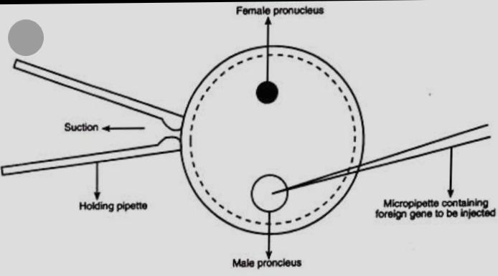
The surviving embryos are transferred into the uterus of a suurrogate mother
These embryos developed into Transgenic mice.

Slide 20
LIMITATIONS
rDNAs can be microinjected only into a few cells at a time.
Microinjection needs technical experienced workers.
It needs a micromanipulator.

Slide 21
THANK YOU.

