Slide 1

 | Sengamala Thayaar Educational Trust Women’s College (Affiliated to Bharathidasan University) (Accredited with ‘A’ Grade {3.45/4.00} By NAAC) (An ISO 9001: 2015 Certified Institution) Sundarakkottai, Mannargudi-614 016. Thiruvarur (Dt.), Tamil Nadu, India.
MEC III-BASIC BIOTECHNOLOGY-16SMBEBC3
Dr. R. ANURADHA
ASSISTANT PROFESSOR & HEAD
PG & RESEARCH DEPARTMENT OF BIOCHEMISTRY

Slide 2
VITAMIN B12

Slide 3
INTRODUCTION OF VITAMIN B12
Vitamins are organic compounds which are essential for normal metabolism ,growth and development of body .
They are important for normal functioning and maintaining proper health of the body.

Slide 4
VITAMIN B12
Cyanocobalamine is VITAMIN B12 the important vitamin required in the human was first isolated from liver cells animal 1942 by Riches and Smith .
It is an industrial product . It is product by bacteria . It is obtained by fermentation.

Slide 5
MICROBIAL PRODUCTION OF VIT B12
Formulation of medium
Sterilization of medium
Making starter cultures
Anaerobic fermentation
Aerobic fermentation
Recovery of vitamin b12

Slide 6
FORMULATION OF MEDIUM
Corn steep liquor , Beet molasses , Soya bean , glucose is used as the carbon source.
Ammonium phosphate or ammonium hydroxide is nitrogen source .
PH 7 is the most likely for Cyanocobalamin
production.

Slide 7
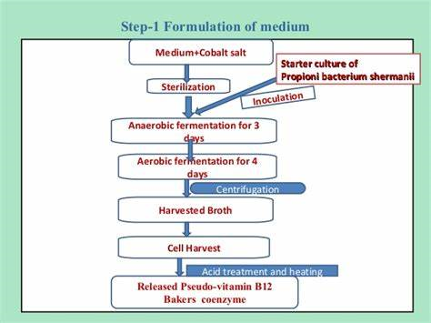
FLOW CHART

Slide 8
STERILIZATION OF MEDIUM
Medium is sterilized by autoclaving .
The sterilized medium is then used for fermentation

Slide 9
MAKING STARTER CULTURE
The process organism is selected and grown in large flasks for being used as an inoculum.
bacillus megaterium
Streptomyces olivaceous
Propionibacterium shermanii
Propionibacterium freudenreichii
Pseudomonas denitrificans
Rhodopseudomonas species.

Slide 10
A starter culture of Propionibacterium shermanii is made to use as an inoculum
Such improved strains produce 50,000 times more vitamin b12 than the wild strains.
This is a great boon for biotechnologists to increase the production of vitamin b12.

Slide 11
ANAEROBIC FERMENTATION
The fermentation is a batch fermentation.
The sterilized medium is filled in a stirred tank fermenter
Anaerobic condition is maintained to encourage the production of 5,6-dimethyl benzimidazole cobalamin (DBC) by Shermanii.

Slide 12
AEROBIC FERMENTATION
Anaerobic fermentation is over , sterile air is pumped in to the fermenter .
The culture is stirred well for proper aeration .
Aerobic fermentation is performed for 4 days.
Some amount of DBC and pseudovitaminb12 ( (adeninyl cobalamin ) are produced . DBC and pseudovitamin b12 are immediate precursors of cyanocobalamin.

Slide 13
RECOVERY OF CYANOCOBALAMINE
Inside the microbial cells cyanocobalamin exists in the form of natural substances such as DBC and pseudovitaminb12 .
The cultured broth contains 10-23 mg per liter.
It is harvested and centrifuged at a high speed to get a concentrated mass of cells.
The cell is treated with a dilute acid and heat shock at 10-39 C.

Slide 14
During this treatment ,precursors of vitamin b12 are released free.
Then it is treated with a cyanide solution to split the pseudovitaminb12 and DBC. As a result cyanocobalamin (vitamin b12) is released free in the solution .

Slide 15
Cyanocobalamin in the liquid is separated by using an adsorption column chromatography with IRC-50 resin . The adsorbed cyanocobalamin is then eluted out of the column using a phenolic solvent.

Slide 16
APPLICATION
It is a food preservative.
It is a cofactor.
It is a protective medicine.

Slide 17
CONCLUSION
The solvent fraction is evaporated by exposing it to atmospheric air .
As a result ,crystals of cyanocobalamin is let in the vessel.
It is stored for future use.

Slide 18
THANK YOU

