Slide 1
DEPARTMENT OF NUTRITION AND DIETETICS
COMMUNITY NUTRITION
III B.Sc NUTRITION AND DIETETICS
SUBJECT INCHARGE: A.VIDHYA

Slide 2
INFANT MORTALITY RATE AND ITS PREVENTION AND CONTROL MEASURES IN INDIA

Slide 3
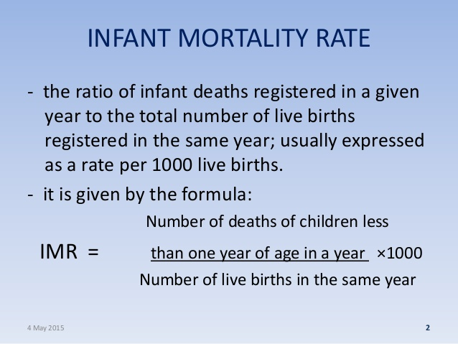

Slide 4
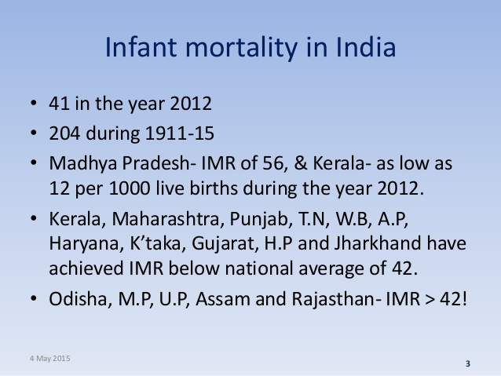

Slide 5
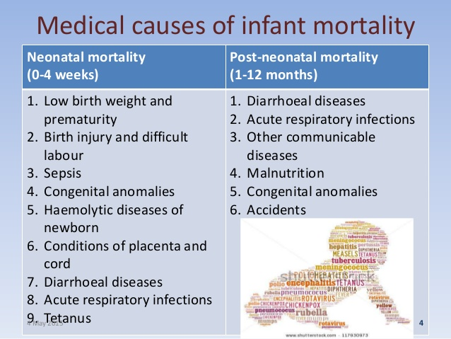

Slide 6
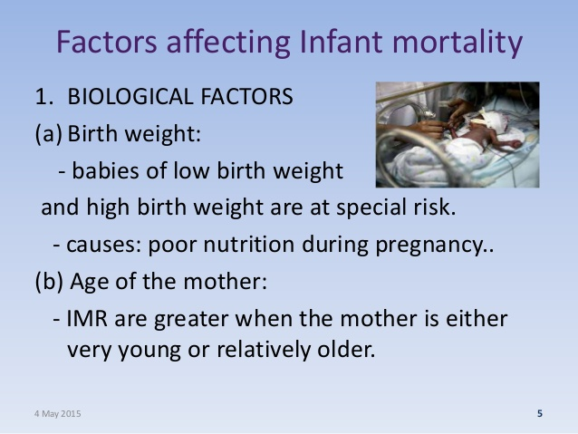

Slide 8
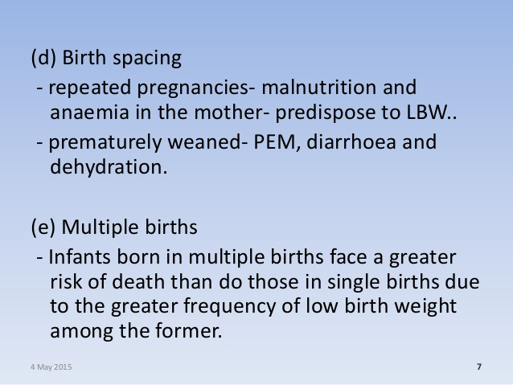

Slide 9
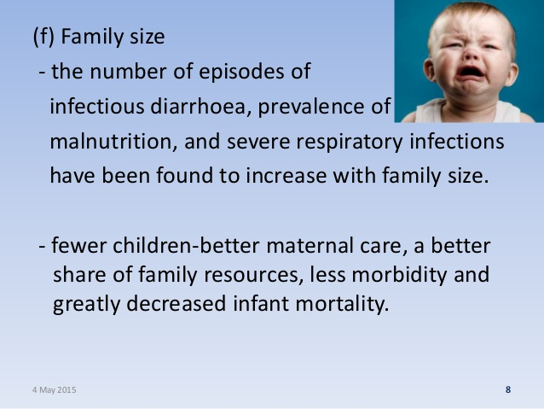

Slide 10
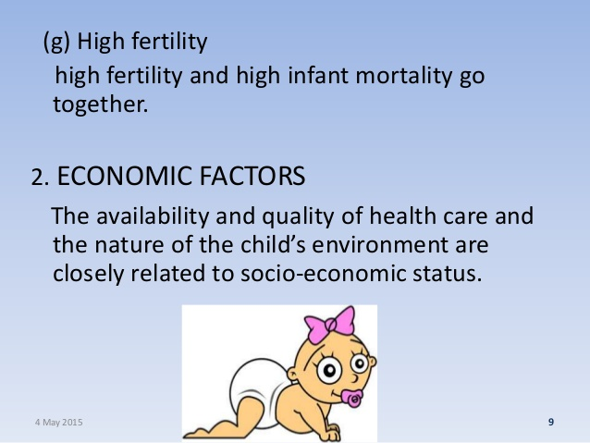

Slide 11
3. CULTURAL AND SOCIAL FACTORS (a)Breast feeding: Early weaning and bottle- fed infants living under poor hygienic conditions are more prone to die than the breast-fed infants living under similar conditions.

Slide 12
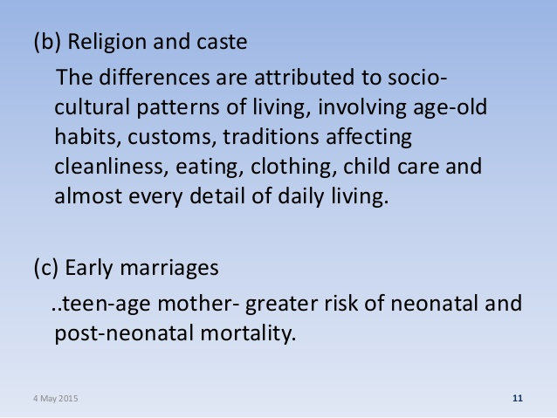

Slide 13
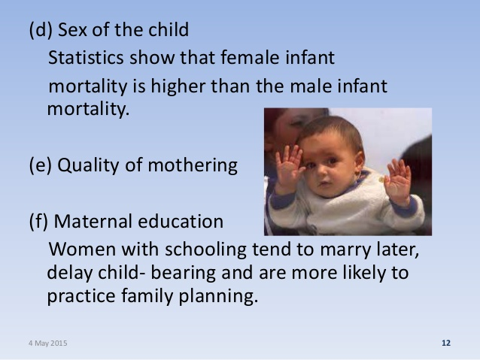

Slide 14
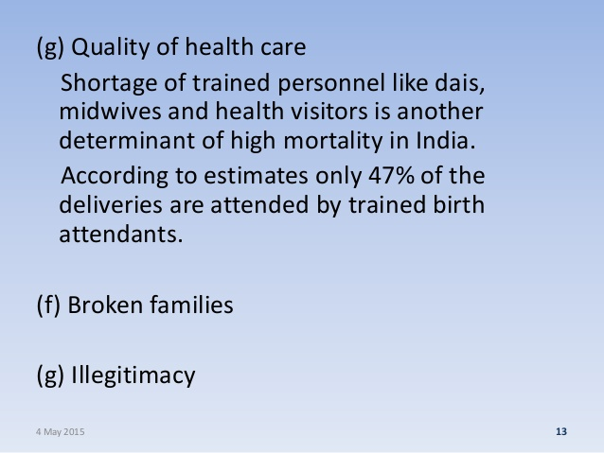

Slide 15
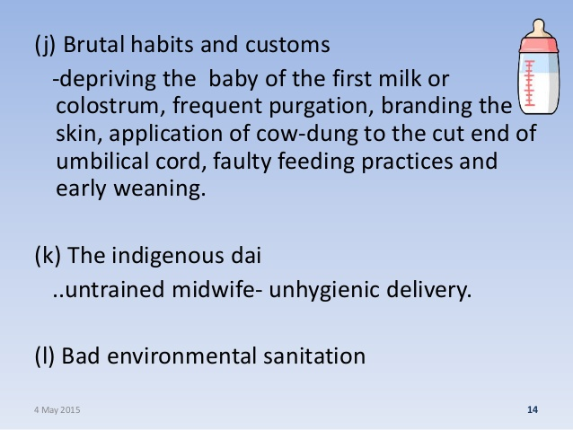

Slide 16
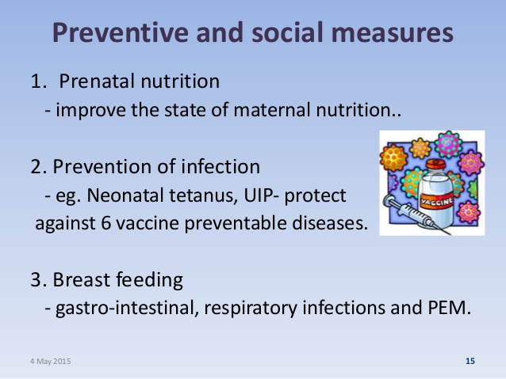

Slide 17
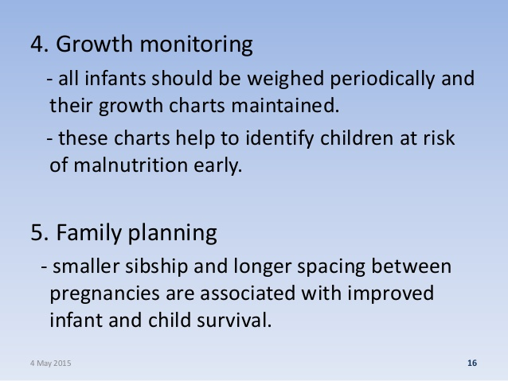

Slide 18
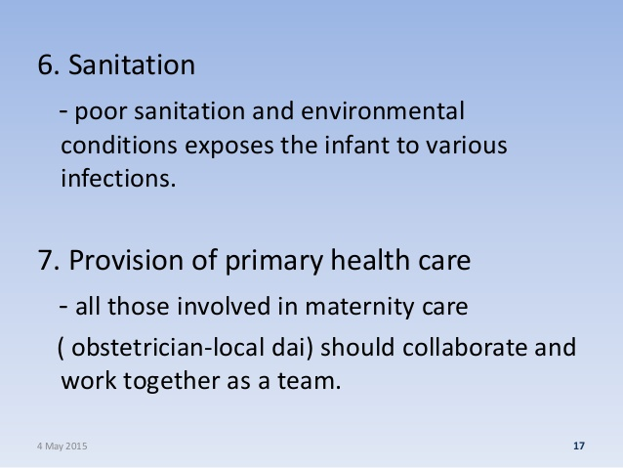

Slide 19
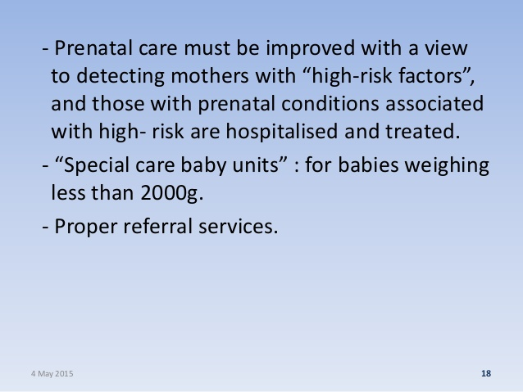

Slide 20
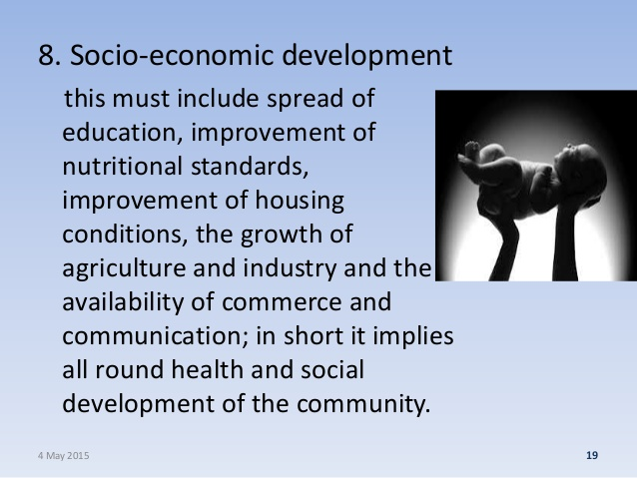

Slide 21


