Slide 1
DEPARTMENT OF NUTRITION AND DIETETICS
FOOD MICROBIOLOGY AND SANITATION
I M.Sc FOOD SERVICE MANAGEMENT AND DIETETICS
SUBJECT INCHARGE: Dr.S.VISHNUPRIYA

Slide 2


Slide 3
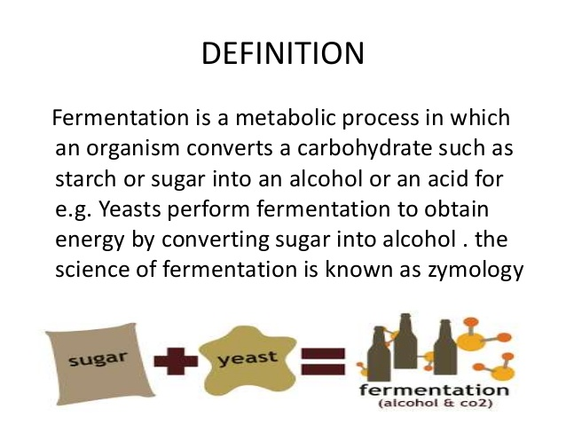

Slide 4
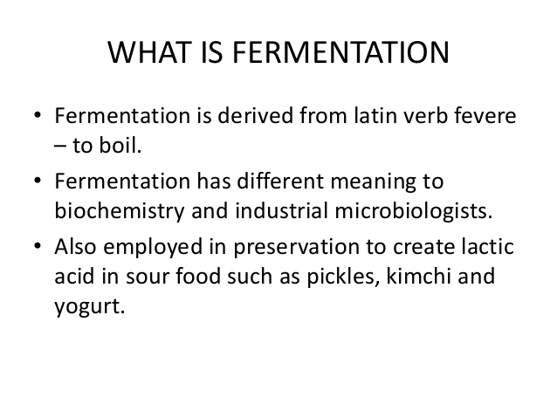

Slide 5
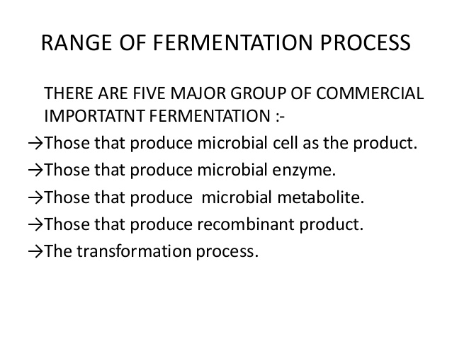

Slide 6
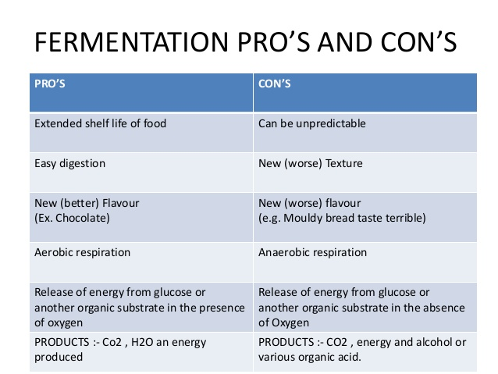

Slide 7
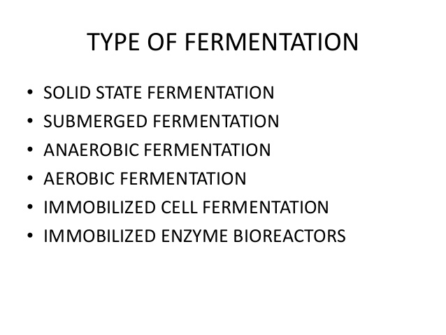

Slide 8
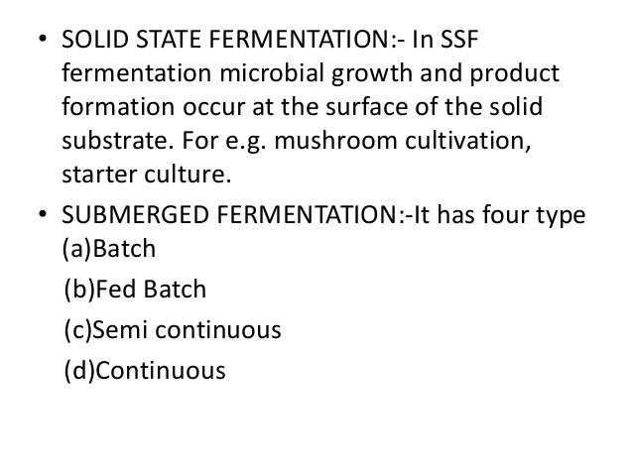

Slide 9
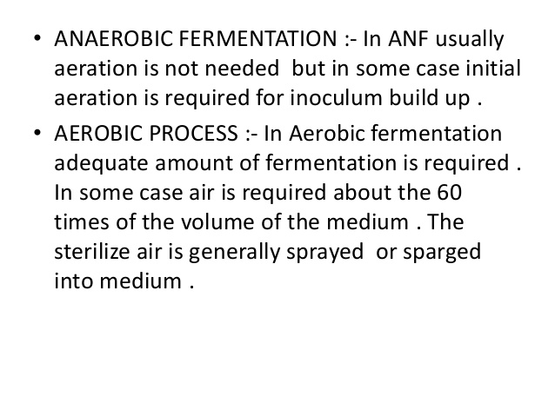

Slide 10
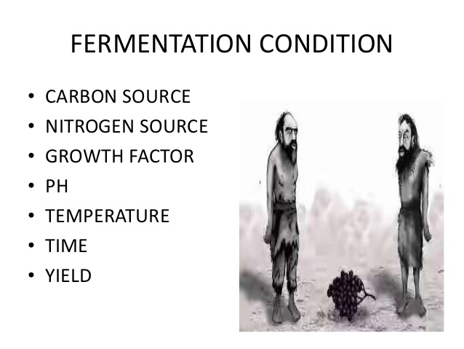

Slide 11
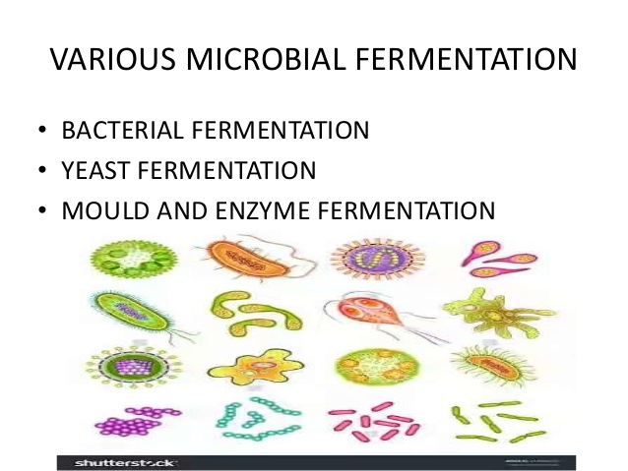

Slide 12
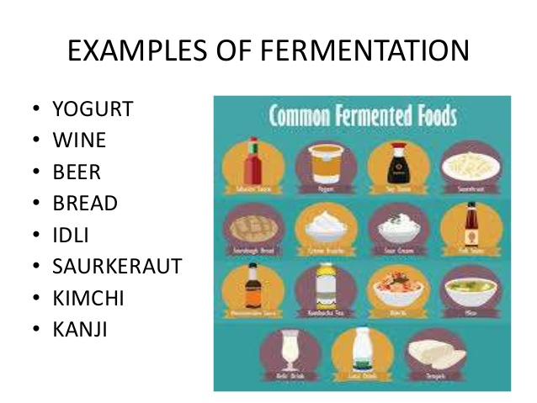

Slide 13
