Slide 1
DEPARTMENT OF NUTRITION AND DIETETICS
FUNCTIONAL FOODS AND NUTRACEUTICALS
I M.Sc FOOD SERVICE MANAGEMENT AND DIETETICS
SUBJECT INCHARGE: V.ANITHA

Slide 2
FUNCTIONAL FOOD AND NEUTRACEUTICALS ROLE OF FUNCTIONAL FOOD

Slide 5
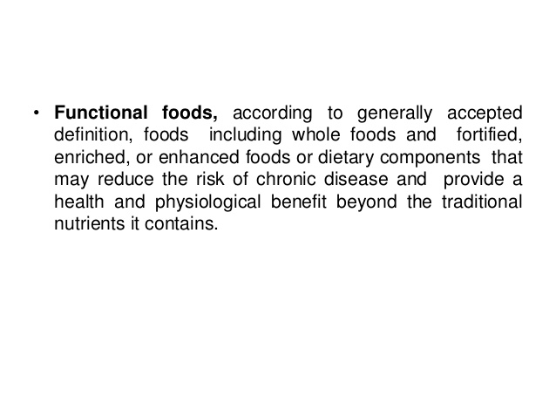

Slide 8
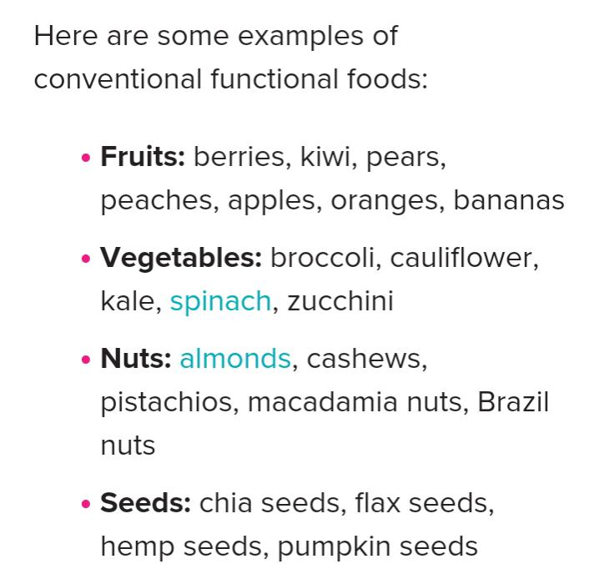

Slide 9
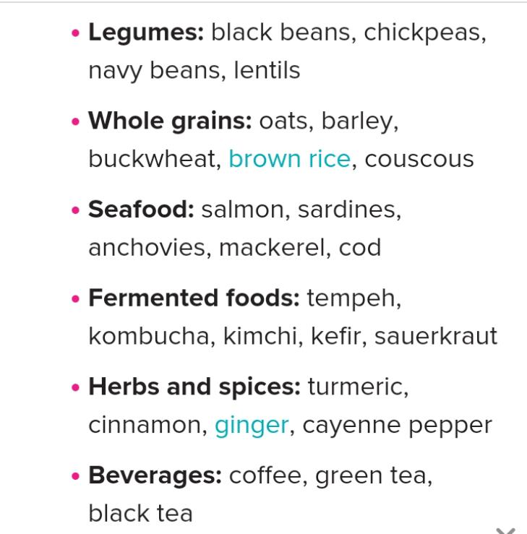

Slide 10
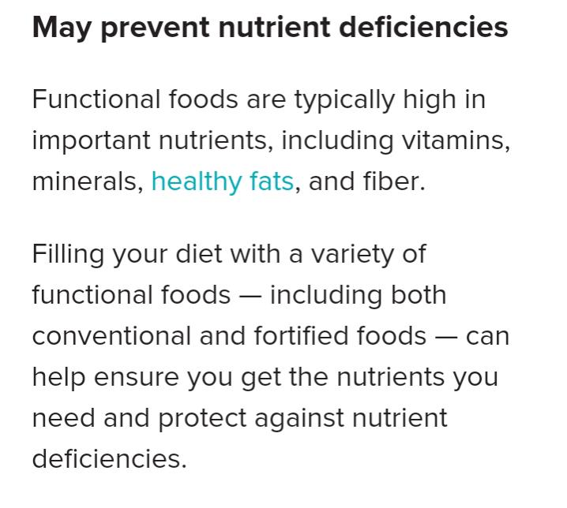

Slide 11
