Slide 1
DEPARTMENT OF NUTRITION AND DIETETICS
FRONT OFFICE MANAGEMENT
I M.Sc FOOD SERVICE MANAGEMENT AND DIETETICS
SUBJECT INCHARGE: R.VIJAYALAKSHMI

Slide 2
FRONT OFFICE MANAGEMENT AND HOUSEKEEPING FUNCTIONTS OF FRONT OFFICE MANAGEMENT

Slide 4
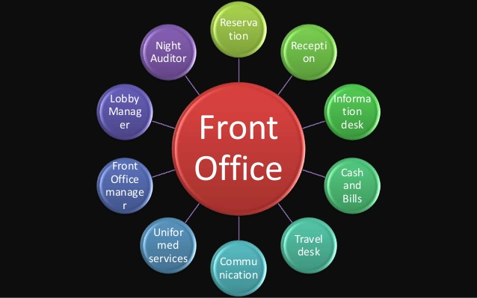

Slide 11
