Slide 1
DEPARTMENT OF NUTRITION AND DIETETICS
COUNSELING SKILLS
II M.Sc FOOD SERVICE MANAGEMENT AND DIETETICS
SUBJECT INCHARGE: R.KAVIYARASI

Slide 2
COUNSELING SKILLS objectives
Definition of counseling
Types of Counselling
Need of counseling
Expectations of counseling
Goals of counseling
Scope of counseling
Limitations in counseling
conclusion

Slide 4
Definition of counseling
Counseling is an art and science. It’s a short term, interpersonal, theory based, helping profession. Its aim is to resolve developmental and situational difficulties. Counseling helps to bring change in life: Change in thought; Change in emotion; and Change in behavior.

Slide 5
Counseling is a profession. Practitioners should complete a prescribed course of study usually leading to a master’s degree or a doctorate degree.
Counselors are members of organizations that set professional and ethical standards and promote state licensing and certification by national associations (Wittmer & Loesch, 1986).

Slide 6
Counselling is a process that focuses on enhancing the psychological well-being of the client, such that the client is then able to reach their full potential. This is achieved by the counsellor facilitating your personal growth, development, and self-understanding, which in turn empowers you to adopt more constructive life practices.
Counselling may be helpful in a number of ways.

Slide 7
It can enable you to develop a clearer understanding of your concerns and help you acquire new skills to better manage personal and educational issues.
The counsellor can offer a different perspective and help you think of creative solutions to problems.
Sharing your thoughts and feelings with someone not personally involved in your life can be most helpful

Slide 8
Types of Counselling
Counselling can be split into two distinctive forms:
Directive counselling
Non-Directive counselling
Directive Counselling:-
involves a formal process where the counsellor assesses the situation, decides an appropriate course of action and directs the employee to follow this course of action.
Non-directive Counselling:-
involves the counsellor facilitating a process where the employee deals with their issues.

Slide 10
Need of counseling
Counseling is needed to solve psychosocial problems of the counselee.
For creating self sufficiency to the client.
For better social functioning.
For the client to make functional decisions.
For the attitudinal and behavioural change of the counselee.
For managing anger, stress, anxiety, depression, frustration etc.

Slide 11
Expectations of counseling can include:
Insight and understanding of oneself, with greater self-awareness.
Changing of one's beliefs and mental models.
Increased acceptance and appreciation of oneself.
Increased emotional intelligence.
Increased ability to control oneself and one's urges.
Development of skills and abilities that require self-management.

Slide 12
Cont….
Improved motivation towards actions that are good for one's self.
Understanding of others and why they act as they do.
Increased appreciation and care for others.
Improvement in relationships with others.
Changing of relationship with family, friends and others.
Making amends for past negative actions.

Slide 13
Goals of counseling
The five major goals are :
• Facilitating behavior change.
• Improving the client’s ability to establish and maintain relationships.
• Enhancing the client’s effectiveness and ability to cope.
• Promoting the decision-making process .
• Facilitating client potential and development.

Slide 14
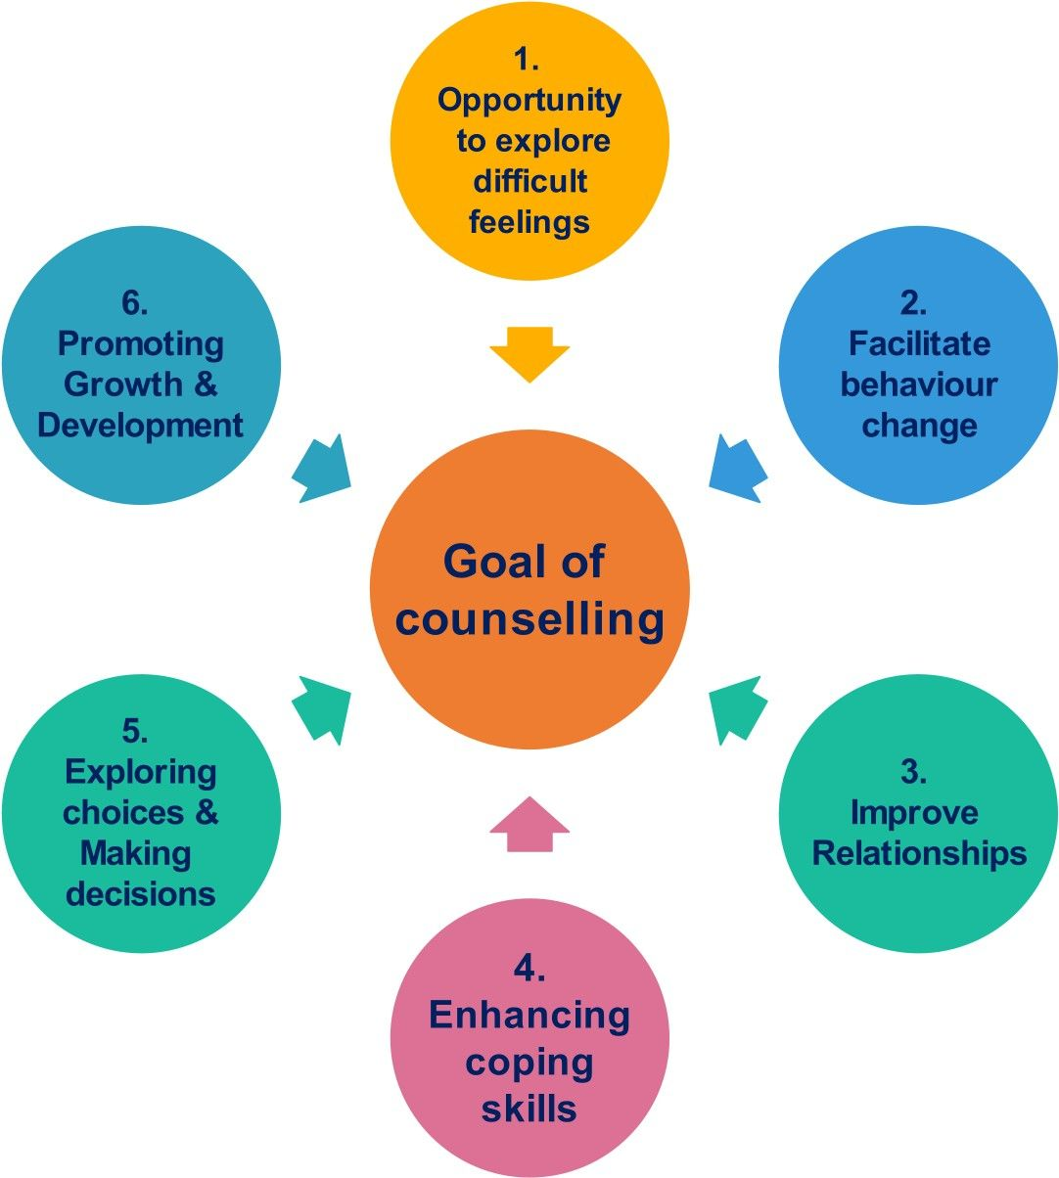

Slide 15
Scope of counseling
Clients are encouraged to meet with a counselor even if they are not sure that they need counseling. Any clients facing the following common problems are encouraged to see a counselor:
Academic Performance
Trouble with Concentrating, Studying, or Attending Classes
Anxieties about Aspects of Study including Exams and Presentations
Achievement Conflicts
Family Issues
Anxiety/Persistent Worry/Panic Attacks
Bereavements and Parental Separations
Cultural Concerns

Slide 16
Stress
Life Transitions
Loneliness/Isolation/ Homesickness
Difficulty Adjusting to Life
Relationships/Intimacy Issues
Friend or Roommate Conflicts
Difficulty Making or Keeping Friends
Lack of Self Confidence or Low Self esteem
Self-Injury
Suicidal Thoughts
Worries about Appearance
Anger Management

Slide 17
Grief/Loss
Identity Confusion
Sexual Orientation/Gender Identity
Eating or Sleeping Disorders/ Body Image Concerns
Weight Loss or Gain
Depression/Apathy
Sexuality
Abusive Relationships
Alcohol or Drug/Substance Use/ Abuse
Sexual Assault/Rape/Abuse
Pregnancy
Difficulty in making Decisions
Uncertainty about the Future.

Slide 18
Limitations in counseling
Person being counselled may not have trust in his counselor (normally, his superior) or the organization
Suspicion over the level of confidentiality
Organization's constraints on using it's resources, time and efforts
Lack of skills of the counselor

Slide 19
conclusion
Counselling can be explained as a discussion of a emotional problem with an client with the general objective of decreasing it.
It helps to grow self confidence, understanding self control and ability to work effectively in an organization

