Slide 1
UNIT V
CHAPTER 18
Content-Based retrieval in Digital Libraries

Slide 2
H ow Should W e Retrieve Images?
Text- based search will do the best job, provided the multi- media database is fully indexed with proper keywords.
Most multimedia retrieval schemes, however, have moved to- ward an approach favoring multimedia content itself (content-based)
Many existing systems retrieve images with the following
image features and/or their variants:
  Color histogram: 3-dimensional array that counts pixels with specific Red, Green, and Blue values in an image.
  Color layout: a simple sketch of where in a checkerboard grid cov- ering the image to look for blue skies or orange sunsets, say.
  Texture : various texture descriptors, typically based on edges in the
image.
2

Slide 3
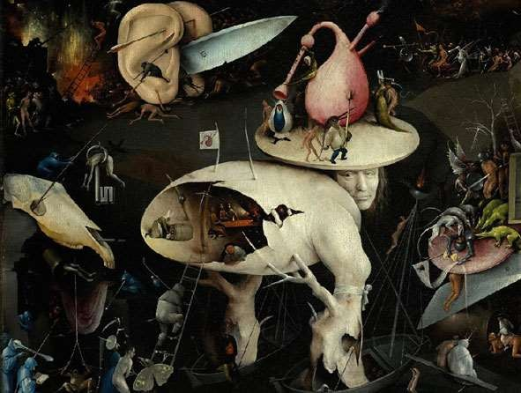
Fig.18.1 How can we best characterize the information content of an image?
3

Slide 4
C - B I R D — A Case Study
C- BIRD (Content-Base Image Retrieval from Digital libraries): an image database search engine devised by one of the authors of this text.
C- BIRD GUI:
The C-BIRD image database contains
approximately 5,000 images, many of them key frames from videos. The database can be searched using a selection of tools:
Text annotations
Color histogram
Color layout
Texture layout
Illumination Invariance
Object Model
4

Slide 5
Color H istogram
A color histogram counts pixels with a given pixel value in Red, Green, and Blue ( R G B ( .
An example of histogram that has 256³ bins, for images with 8- bit values in each of R, G, B:
int hist[256][256][256]; // reset to 0
//image is an appropriate struct with byte fields red, green, blue
for i=0..(MAX_Y-1) for j=0..(MAX_X-1)
{
R = image[i][j].red;
G = image[i][j].green;
B = image[i][j].blue;
hist[R][G][B]++;
}
5

Slide 6
Color Histogram (Cont’d)
Image search is done by matching feature- vector (here color histogram) for the sample image with feature-vector for im- ages in the database.
In C- BI RD, a color histogram is calculated for
image as a preprocessing step, and then
each target
referenced in the
database for each user query image.
For example, Fig. particular image — background.
18.2 shows that
one of a red
the
flower on a green foliage
user has selected a
The result obtained, from a database of some 5,000 images, is a
set of 60 matching images.
8

Slide 7
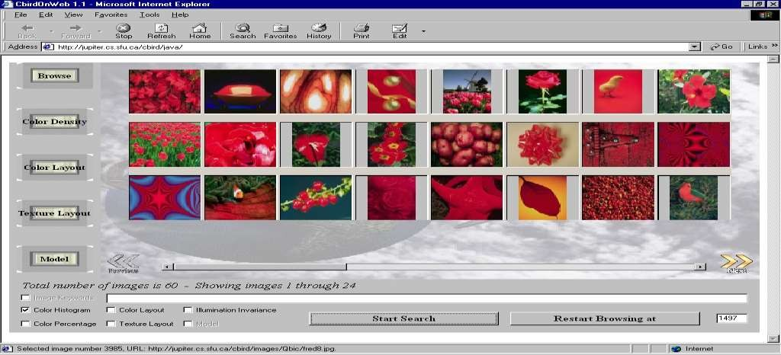
Fig. 18.2:
Search by color histogram results.

Slide 8

Histogram Intersection
Histogram intersection: The standard measure of similarity used for color histograms:
  A color histogram Hi is generated for each image i in the database – feature vector.
  The histogram is normalized so that its sum (now a double) equals
unity – effectively removes the size of the image.
  The histogram is then stored in the database.
  Now suppose we select a model image – the new image to match against all possible targets in the database.
  Its histogram Hm is intersected with all database image histograms
Hi according to the equation
j – histogram bin, n – total number of bins for each histogram
– The closer the intersection value is to 1, the better the images match.

Slide 9
Color D ensity and Color L ayout
Color D ensity
To specify the desired colors by their density, the user selects the percentage of the image having any particular color or set of colors is selected by the user, using a color picker and sliders.
User can choose from either conjunction ( ANDing) or dis-
junction ( ORing) a simple color percentage specification.
This is a very coarse search
method.

Slide 10
Color L ayout
The user can set up a scheme of how colors should appear in the image, in terms of coarse blocks of color.
The user has a choice of four grid sizes: 1 × 1, 2 × 2, 4 × 4 and 8 × 8.
Search is specified on one of the grid sizes, and the grid can be filled with any R G B color value or no color value at all to indicate the cell should not be considered.
Every database image is partitioned into windows four times, once for every window size.
  A clustered color histogram is used inside each window and the five most frequent colors are stored in the database
  Position and size for each query cell correspond to the
position and size of a window in the image
Fig. 18.3 shows how this layout scheme is used.

Slide 11
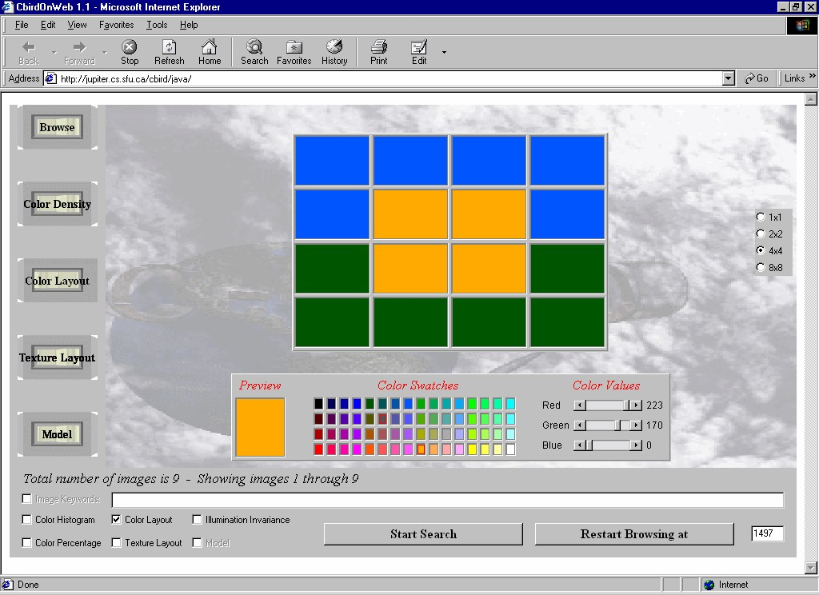
Fig. 18.3:
Color layout grid.

Slide 12



T exture A nalysis Details
Edge-based texture histogram
  A 2-dimensional texture histogram is used based on edge directionality φ, and separation ξ (closely related to repetitiveness )
  To extract an edge-map for the image, the image is first converted to luminance Y via Y = 0.299R + 0.587tt + 0.114B.
  A Sobel edge operator is applied to the Y -image by sliding the fol- lowing 3
× 3 weighting matrices (convolution masks) over the image.
  The edge magnitude D and the edge gradient φ are given by
 | -1 | 0 | 1 |  | 1 | 2 | 1
dx : | -2 | 0 | 2 | dy : | 0 | 0 | 0
 | -1 | 0 | 1 |  | -1 | -2 | -1
.
2 2
D = d _{x} + d _{y},
φ = arctan ^{dy}
dx

Slide 13
Texture Analysis Details (Cont’d)
Preparation for creation of texture histogram
  The edges are thinned by suppressing values.
all but maximum
If a pixel i with edge gradient φ_{i} and
edge magnitude
D _{i} has a neighbor pixel j along the direction of φ_{i} with gradient φ_{j}
≈ φ_{i} and edge magnitude D _{j} >
0.
D _{i} then pixel i is suppressed to
To make a binary edge image, set all pixels with D greater than a threshold value to 1 and all others to 0.
For edge separation ξ, for each edge pixel i we measure the distance along its gradient φ_{i} to the nearest pixel j having φ_{j} ≈ φ_{i} within 15◦.
If such a pixel j doesn’t exist, then the separation is con- sidered infinite.

Slide 14
Texture Analysis Details (Cont’d)
Having created edge directionality and edge separation maps, a 2D texture histogram of ξ versus φ is constructed.
  The initial histogram size is 193 × 180, where separation value ξ
= 193 is reserved for a separation of infinity (as well as any ξ >
192).
  The histogram is “smoothed” by replacing each pixel with a weighted sum of its neighbors, and then reduced to size 7 × 8, separation value 7 reserved for infinity.
  Finally, the texture histogram is normalized by dividing by the number of pixels in the image segment. It will then be used for matching.

Slide 15
Search by Illumination Invariance
To deal with illumination change from the query image to dif- ferent database images, each color channel band of each im- age is first normalized, and then compressed to a 36-vector.
A 2-dimensional color histogram is then created by using the
chromaticity, which is the set of band ratios
{R, G }/ (R + G + B)
To further reduce the
DCT coefficients for the
number of
vector components, the
and
smaller histogram are calculated
placed in zigzag order, and then all but 36 components dropped.
Matching is performed in the compressed domain by taking the Euclidean distance between two DCT-compressed 36- component feature vectors.
Fig. 18.4 shows the results of such a search.

Slide 16
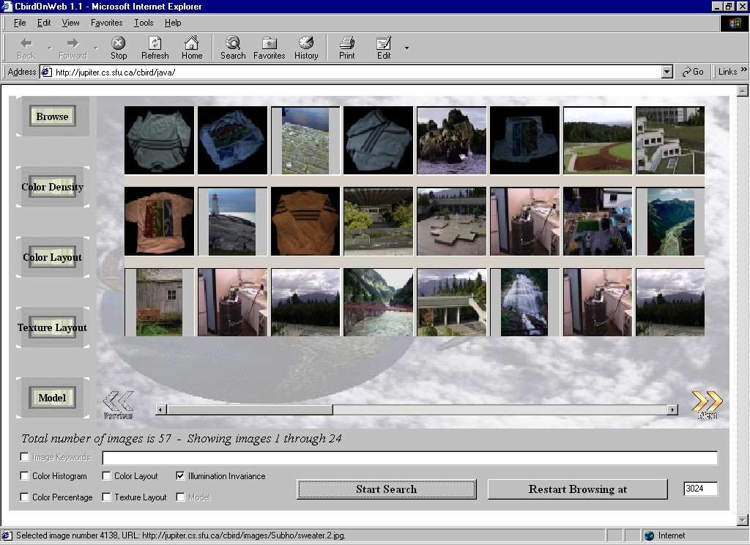
Fig. 18.4:
Search with illumination invariance.

Slide 17
Search by O b j e c t M o del
This search type proceeds by the user selecting a thumbnail and
clicking the Model tab to enter object selection mode.
– An image region can be selected by using primitive shapes
such
as a rectangle or an ellipse, a magic wand tool that is basically a seed-based flooding algorithm, an active con- tour (a “snake”), or a brush tool where the painted region is selected.
An object is then interactively selected as a portion of the image.
Multiple regions can be dragged to the selection pane, but only the active object in the selection pane will be searched on.
A sample object selection is shown in Fig. 18.5.

Slide 18
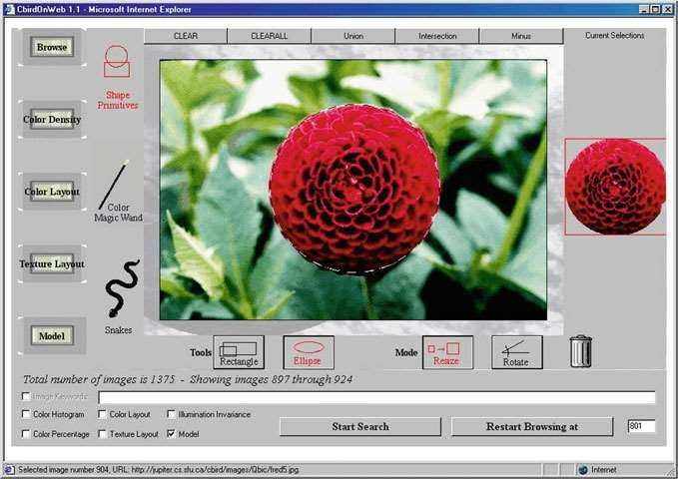
Fig. 18.5 C- B I R D interface showing object selection using primitive.
an ellipse

Slide 19
Details of Search by O b j e c t M o del
1. The user-selected model image is processed and its features localized (i.e., generate color locales [see below]).
2. Color histogram intersection, based on the reduced maticity histogram, is then applied as a first screen.
chro-
Estimate the pose (scale, translation, rotation) of the object inside a target image from the database.
Verification by intersection of texture histograms, and then a final check using an efficient version of a Generalized Hough Transform for shape verification.

Slide 20
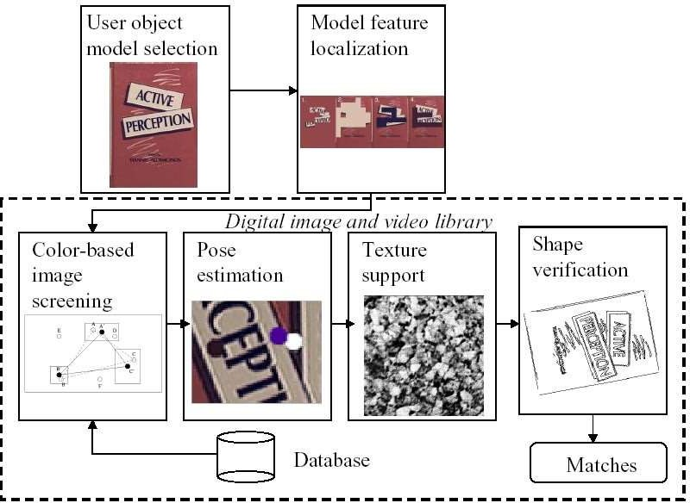
Fig. 18.6:
Block diagram of object matching steps.

Slide 21
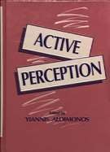
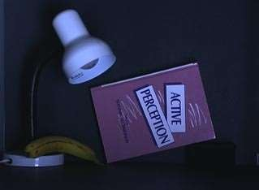
M o del Image and T arget Images
A possible model image and one of the target images in the database might be as in Fig. 18.7.
Fig. 18.7 : Model and target images. ( a): Sample model image. ( b): Sample database image containing the model book.

Slide 22
Synopsis of C B I R Systems
The following provides examples of some CBIR systems. It is by no means a complete synopsis. Most of these engines are experimental, but all those included here are interesting in some way.
QBIC (Query By Image Content)
Chabot
Blobworld
WebSEEk
Photobook and FourEyes
Informedia
UC Santa Barbara Search Engines
M ARS
Virage
22

Slide 23
Relevance Feedback
Relevance Feedback :
images retrieved are used
onto correct returns.
involve the user in a loop, whereby in further rounds of convergence
Relevance Feedback Approaches
  The usual situation: the user identifies images as good, bad, or don’t care, and weighting systems are updated according to this user guidance.
  Another approach is to move the query towards positively marked content.
  An even more interesting idea is to move every data point in a disciplined way, by warping the space of feature points.
23

Slide 24
Quantifying Search Results
Precision is the percentage of relevant documents retrieved compared to the number of all the documents retrieved.
Relevant images returned All retrieved images
P recision =
Recall is the percentage of relevant documents retrieved out of all
relevant documents.
Relevant images returned All relevant images
Recall =
These measures are affected by the database size and the amount of similar information in the database, and as well they do not consider fuzzy matching or search result ordering.

Slide 25

Quantifying Search Results (Cont’d)
Alternatively, they may also be written as:
where TP (True Positives) is the number of relevant images returned, FP (False Positives) is the number of irrelevant images returned, and FN (False Negatives) is the number of relevant images not returned.

Slide 26
Querying on V ideos
Video indexing can make use of motion as the salient fea-
of temporally changing images for various types of query.
ture
Inverse Hollywood: can we recover thevideo director’s “flowchart”?
  Dividing the video into shots, where each shot consists roughly of the video frames between the on and off clicks of the record button.
  Detection of shot boundaries is usually not simple as fade-in, fade- out, dissolve, wipe, etc. may often be involved.

Slide 27
In dealing with digital video, it is desirable to avoid uncom- pressing M P E G files.
  A simple approach to this idea is to uncompress only enough to re- cover just the DC term, thus generating a thumbnail that is 64 times as small as the original.
  Once DC frames are obtained from the whole video, many different approaches have been used for finding shot boundaries – based on features such as color, texture, and motion vectors.

Slide 28
A n Example of Querying on V ideo
Fig) 18.8: ( a shows a selection of frames from a video of activity.
beach
Here the keyframes in( Fig. 18.8 ( b. are selected based mainly on color information (but being careful with respect to the changes incurred by changing illumination conditions when videos are shot (
.
A more difficult problem arises when changes between shots are gradual, and when colors are rather similar overall, as in Fig) 18.9(.a
The keyframes in Fig) 18.9 (b. are sufficient to show the
development of the whole video sequence.

Slide 29
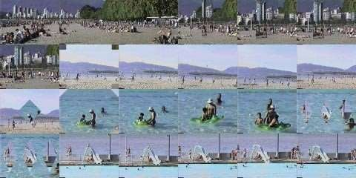

( a )
( b)
Fig. 18.8: Digital video and associated keyframes, beach video. ( a):
Frames from a digital video. ( b): Keyframes selected.

Slide 30
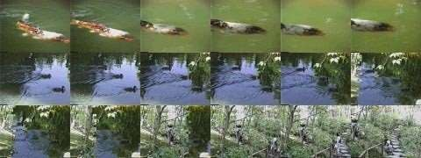

( a )
( b)
Fig. 18.9: Garden video. ( b): Keyframes selected.
(a ) :
F rames from a digital
video.

Slide 31
Querying on Videos Based on Human Activity
Thousands of hours of video are being captured every day by CCTV cameras, web cameras, broadcast cameras, etc. However, most of the activities of interest (e.g., a soccer player scores a goal) only occur in a relatively small region along the spatial and temporal extent of the video. In this scenario, effective retrieval of a small spatial/temporal segment of the video containing a particular activity from a large collection of videos is very important.
  Lan et al.’s work on activity retrieval is directly inspired by the application
of searching for activities of interest from broadcast sports videos. For example, consider the scene shown in Fig. 18.10.
we can explain the scene at multiple levels of detail such as low-level actions (e.g., standing and jogging) and mid-level social roles (e.g., attacker and first defenders).
The social roles are denoted by different colors. In this example, we use magenta, blue and white to represent attacker, man-marking and players in the same team as the attacker respectively.

Slide 32
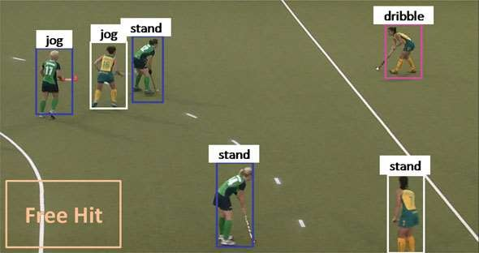
Fig.18.10 An example of human activity in realistic scenes . Beyond the general scene-level activity description (e.g. Free Hit).

