Slide 1
E- content material
S.T.E.T WOMEN’S COLLEGE MANNARGUDI
PG AND RESEARCH DEPARTMENT OF COMMERCE
SUBJECT: QUANTITATIVE TECHNIQUES FOR BUSINESS DECISIONS
SUBJECT CODE: P16MC22
CLASS: I M.COM
STAFF NAME: DR.D.SUPULAKSHMI

Slide 2
Unit 4 & unit 5
UNIT-4
TRANSPORTATION PROBLEM
The transportation problem in operational research is concerned with finding the minimum cost of transporting a single commodity from a given number of sources (e.g. factories) to a given number of destinations (e.g. warehouses). These types of problems can be solved by general network methods, but here we use a specific transportation algorithm.

Slide 3
Types of Transportation Problem in Operational Research
Balanced Transportation Problem
Unbalanced Transportation Problem
Solution of the transportation problem
Stage I: Finding an initial basic feasible solution.
Stage II: Checking for optimality

Slide 4
Finding an Initial Basic Feasible Solutions
There are three methods as given below
Northwest corner method
Least cost method
Vogel’s approximation method (or Penalty method)

Slide 5
Northwest corner method
Steps for North-West Corner Method
Allocate the maximum amount allowable by the supply and demand constraints to the variable
If a column (or row) is satisfied, cross it out. The remaining decision variables in that column (or row) are non-basic and are set equal to zero. If a row and column are satisfied simultaneously, cross only one out (it does not matter which).
Adjust supply and demand for the non-crossed out rows and columns.
Allocate the maximum feasible amount to the first available non-crossed out element in the next column (or row).
When exactly one row or column is left, all the remaining variables are basic and are assigned the only feasible allocation.

Slide 6
North west corner method example

Slide 8
Least Cost Method
Steps for Least Cost Method
Assign as much as possible to the cell with the smallest unit cost in the entire tableau. If there is a tie then choose arbitrarily.
Cross out the row or column which has satisfied supply or demand. If a row and column are both satisfied then cross out only one of them.
Adjust the supply and demand for those rows and columns which are not crossed out.
When exactly one row or column is left, all the remaining variables are basic and are assigned the only feasible allocation.

Slide 9
Least cost method example

Slide 11
Vogel’s Approximation Method
Steps for Vogel’s Approximation Method
Determine a penalty cost for each row (column) by subtracting the lowest unit cell cost in the row (column) from the next lowest unit cell cost in the same row (column).
Identify the row or column with the greatest penalty cost. Break the ties arbitrarily (if there are any). Allocate as much as possible to the variable with the lowest unit cost in the selected row or column. Adjust the supply and demand and cross out the row or column that is already satisfied. If a row and column are satisfied simultaneously, only cross out one of the two and allocate a supply or demand of zero to the one that remains.
If there is exactly one row or column left with a supply or demand of zero, stop.
If there is one row (column) left with a positive supply (demand), determine the basic variables in the row (column) using the Minimum Cell Cost Method. Stop.
If all of the rows and columns that were not crossed out have zero supply and demand (remaining), determine the basic zero variables using the Minimum Cell Cost Method. Stop.
In any other case, continue with Step 1.

Slide 12
Vogel’s approximation method example

Slide 14
ASSIGNMENT PROBLEM
Meaning
An assignment problem is a particular case of transportation problem where the objective is to assign a number of resources to an equal number of activities so as to minimize total cost or maximize total profit of allocation.
The problem of assignment arises because available resources such as men, machines etc. have varying degrees of efficiency for performing different activities, therefore, cost, profit or loss of performing the different activities is different.
Hungarian Method for Solving Assignment Problem:
The Hungarian method of assignment provides us with an efficient method of finding the optimal solution without having to make a-direct comparison of every solution. It works on the principle of reducing the given cost matrix to a matrix of opportunity costs.

Slide 15
The Hungarian method can be summarized in the following steps:
Step 1: Develop the Cost Table from the given Problem:
If the no of rows are not equal to the no of columns and vice versa, a dummy row or dummy column must be added. The assignment cost for dummy cells are always zero.
Step 2: Find the Opportunity Cost Table:
(a) Locate the smallest element in each row of the given cost table and then subtract that from each element of that row, and
(b) In the reduced matrix obtained from 2 (a) locate the smallest element in each column and then subtract that from each element. Each row and column now have at least one zero value.

Slide 16
Step 3: Make Assignment in the Opportunity Cost Matrix:
The procedure of making assignment is as follows:
(a) Examine rows successively until a row with exactly one unmarked zero is obtained. Make an assignment single zero by making a square around it.
(b) For each zero value that becomes assigned, eliminate (Strike off) all other zeros in the same row and/ or column
(c) Repeat step 3 (a) and 3 (b) for each column also with exactly single zero value all that has not been assigned.

Slide 17
(d) If a row and/or column has two or more unmarked zeros and one cannot be chosen by inspection, then choose the assigned zero cell arbitrarily.
(e) Continue this process until all zeros in row column are either enclosed (Assigned) or struck off (x)
Step 4: Optimality Criterion:
If the member of assigned cells is equal to the numbers of rows column then it is optimal solution. The total cost associated with this solution is obtained by adding original cost figures in the occupied cells.
If a zero cell was chosen arbitrarily in step (3), there exists an alternative optimal solution. But if no optimal solution is found, then go to step (5).

Slide 18
Step 5: Revise the Opportunity Cost Table:
Draw a set of horizontal and vertical lines to cover all the zeros in the revised cost table obtained from step (3), by using the following procedure:
(a) For each row in which no assignment was made, mark a tick (√)

Slide 19
(b) Examine the marked rows. If any zero occurs in those columns, tick the respective rows that contain those assigned zeros.
(c) Repeat this process until no more rows or columns can be marked.
(d) Draw a straight line through each marked column and each unmarked row.
If a no of lines drawn is equal to the no of (or columns) the current solution is the optimal solution, otherwise go to step 6.

Slide 20
Step 6: Develop the New Revised Opportunity Cost Table:
(a) From among the cells not covered by any line, choose the smallest element, call this value K
(b) Subtract K from every element in the cell not covered by line.
(c) Add K to very element in the cell covered by the two lines, i.e., intersection of two lines.
(d) Elements in cells covered by one line remain unchanged.
Step 7: Repeat Step 3 to 6 Unlit an Optimal Solution is Obtained

Slide 21
Hungarian or minimisation method example

Slide 24
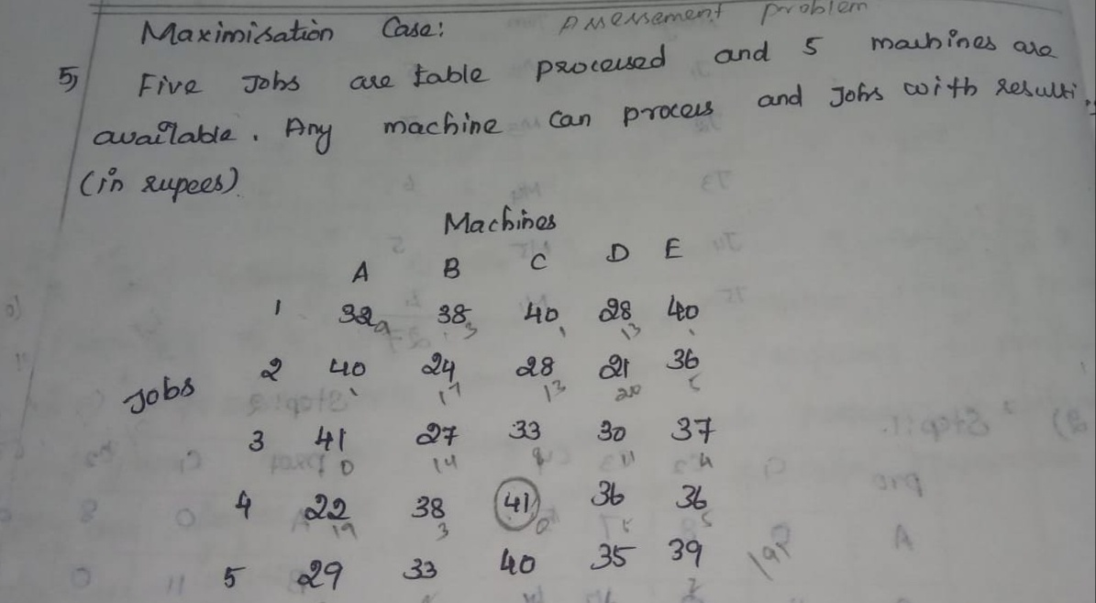
Maximisation method

Slide 26
UNIT-5
LINEAR PROGRAMMING PROBLEM
1.Simplex method,
Standard technique in linear programming for solving an optimization problem, typically one involving a function and several constraints expressed as inequalities. The inequalities define a polygonal region and the solution is typically at one of the vertices. The simplex method is a systematic procedure for testing the vertices as possible solutions.

Slide 27
Simplex method example

Slide 29
2.Graphical Method
Introduction
Graphical method of linear programming is used to solve problems by finding the highest or lowest point of intersection between the objective function line and the feasible region on a graph.

Slide 30
Graphic method example

Slide 32
EXTRAPOLATION AND INTERPOLATION
INTERPOLATION
Interpolation is an estimation of a value within two known values in a sequence of values

Slide 33
Binomial expansion method example

Slide 36
Parabolic curve method example

Slide 38
EXTRAPOLATION
Extrapolation is an estimation of a value based on extending a known sequence of values or facts beyond the area that is certainly known. In a general sense, to extrapolate is to infer something that is not explicitly stated from existing information.

