Slide 1

Sengamala Thayaar Educational Trust Women’s College
(Affiliated to Bharathidasan University)
Accredited with ‘A’ grade {3.45/4.00} By NAAC)
(An ISO 9001:2015 Certified Institution)
Sundarakkottai, Mannargudi - 614016.
Thiruvarur(Dt),Tamilnadu,India.
I M.SC., PHYSICS
SEMESTER II
ELECTROMAGNETIC THEORY
Mrs.B.REVATHI,
Assistant Professor,
PG Department of Physics

Slide 2
PLANE ELECTROMAGNETIC WAVES
AND THEIR PROPAGATION
Electromagnetic Waves in free space
We know that Maxwell's equations are

Slide 3
Electromagnetic Waves in free space
So Maxwell's equations reduce to
The above equation are standard wave equation representing unattenuated wave traveling at a speed u.

Slide 4
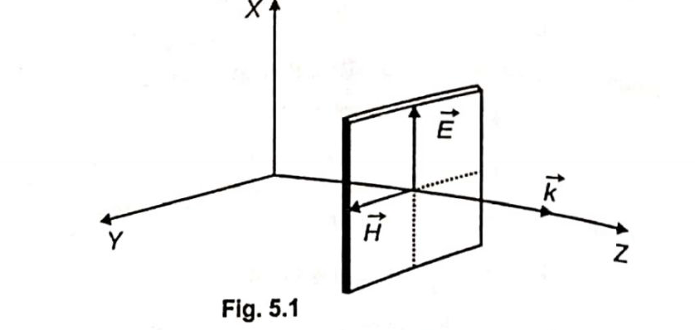
Electromagnetic Waves in free space
i.e. the velocity of light.

Slide 5
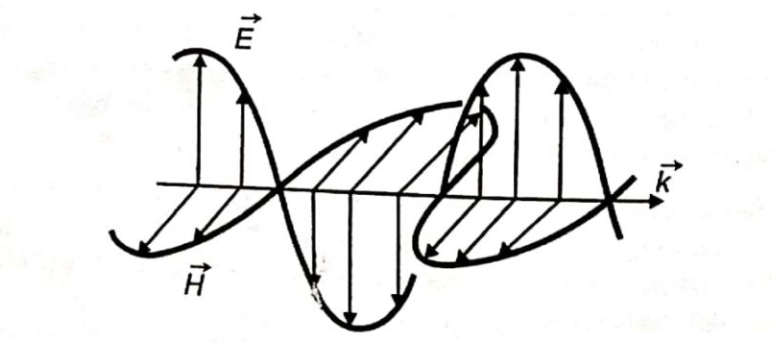
Electromagnetic Waves in free space
In case of propagation E. M. W. in free space.
The wave propagates with a speed equal to that of light in free space.
The electromagnetic waves are transverse in nature.
The wave vectors E and Hare mutually perpendicular.
The vector E and H are in phase.
The electromagnetic energy is transmitted in the direction of wave propagation
The electrostatic energy density is equal to the magnetostatic energy density

Slide 6
PROPAGATION OF E.M.W IN ISOTROPIC DIELECTRICS
We know that Maxwell's field equations are
So Maxwell’s equation reduce to
and in isotropic dielectrics

Slide 7
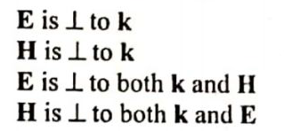
PROPAGATION OF E.M.W IN ISOTROPIC DIELECTRICS
The speed of electromagnetic wave in isotropic dielectric is less than the speed of electromagnetic waves in free space.
The vector E and H are orthogonal i.e.the electromagnetic wave is transverse in nature and in the dielectric electric and magnetic vectors are also mutually orthogonal

Slide 8

PROPAGATION OF E.M.W IN ISOTROPIC DIELECTRICS
The vector E and H are in phase and their magnitudes are related to each other by the relation
Z is called the impendence of the medium
The direction of flow of energy is the direction in which the wave propagation and the poynting vector is₍ n ⁄ μ₎ times of the poynting vector if the same wave propagates, through free space

Slide 9
PROPAGATION OF E.M.W IN ISOTROPIC DIELECTRICS
The electromagnetic energy density is equal to the magnetostatic energy density and the total energy density ε_{r} times of the energy density if the same wave propagates through free space.

Slide 10
Reflection and refraction of E.M.W
When an electromagnetic wave hits a boundary between different materials, some of the wave’s energy is reflected back while the rest continues on through the second material, although the direction of the continuing wave may be somewhat different from the original wave’s; this bending of the wave’s direction is called the refraction.

Slide 11
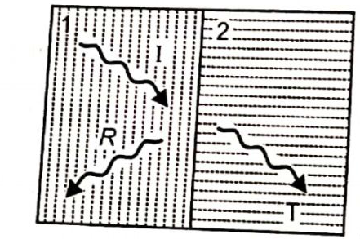
Reflection and refraction of E.M.W
The kinematic relations between the directions of the incident, the refracted, and the reflected waves.
• The dynamical relations between the intensities, the phases, and the polarizations of all the waves

Slide 12
Reflection and refraction of E.M.W
Kinematic Properties:
Law of Frequency:
      The frequency of the wave remains unchanged by reflection or refraction
      The reflected and refracted waves are in the. same plane as the incident wave and the normal to the boundary surface.
Law of reflection:
    In case of reflection the angle of reflection is equal to the angle of incidence.

Slide 13
Reflection and refraction of E.M.W
Snell‘s Law :
  In case of refraction the ratio of the sin of the angle of refraction to the sin of angle of incidence is equal to the ratio of the refractive indices of the two media.
Dynamic properties:
  Intensities of reflected and refracted waves
  Phase changes and polarization of waves

Slide 14
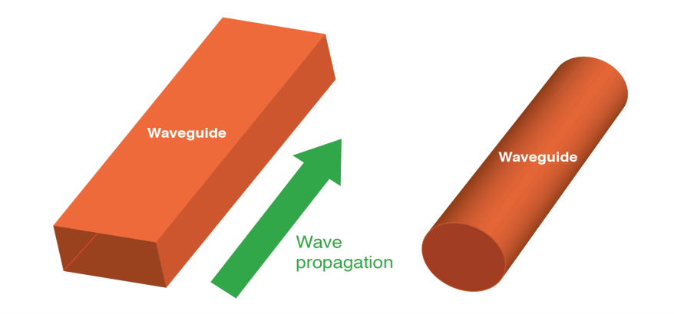
WAVE GUIDE
A hollow metallic tube of uniform cross section for transmitting electro magnetic waves by successive reflections from inner walls of the tube is called Waveguide.

Slide 15
WAVE GUIDE
Waveguide may be used to carry energy between pieces of equipments.
Waveguides are made from Copper, Aluminium.
TYPES OF WAVE GUIDE
  1.RECTANGULAR WAVEGUIDE
  2.CIRCULAR WAVEGUIDE

Slide 16
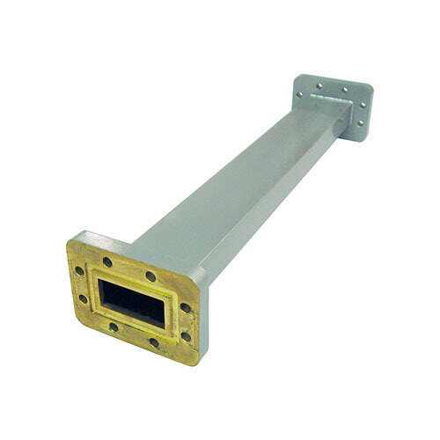
RECTANGULAR WAVEGUIDE
Dominant mode is TE10
Supports TE and TM waves but not TEM waves
There is only one conductor
Bands between 1GHz

Slide 17
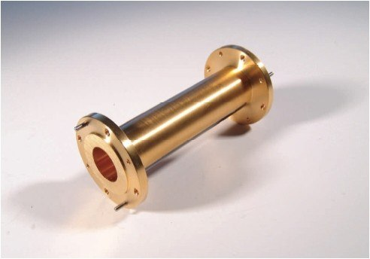
CIRCULAR WAVEGUIDE
It support both transverse TE and TM modes.
The dominant mode is TE11
It is easily manufacture than rectangular waveguides.
It is usually used to connect a horn antenna with a reflector in tracking radars and for long distance wave guide transmission as 10 GHz.

Slide 18
TE &TM MODES
TE mode:
  This waveguide mode is dependent upon the transverse electric waves, also sometimes called H waves, characterised by the fact that the electric vector (E) being always Perpendicular to the direction of propagation.
TM mode:
  Transverse magnetic waves, also called E waves are characterised by the fact that the magnetic vector (H vector) is always perpendicular to the direction of propagation.

Slide 19
TE &TM MODES
TEM mode:
The TEM wave is characterised by the fact that both the electric vector (E vector)and the magnetic vector (H vector) are perpendicular to the direction of propagation.

Slide 20
APPLICATIONS
To reduce Attenuation loss.
Can operate only above certain frequencies
Short and medium distance broad band communication

Slide 21
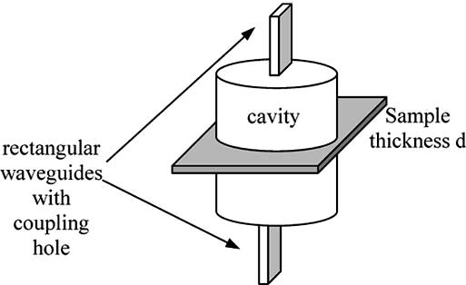
CAVITY RESONATOR
An electronic device consisting of a space usually enclosed by metallic walls within which resonant electromagnetic fields may be excited and extracted for use in microwave systems.

Slide 22
TYPES OF CAVITY RESONATOR
Regulated Cavity Resonator.
Un Regulated Cavity Resonator.
Co-axial Cavity Resonator.
Capacitive Cavity Resonator.
Inductive Cavity Resonator.
Waveguide Cavity Resonator.
Reentrant Cavity Resonator.

Slide 23
APPLICATIONS
Cavity resonators are widely used as the frequency determining element in microwave oscillators.
Waveguides are used at the highest frequencies to transmit power and signals. Similarly, cavity resonators are employed as tuned circuits at such frequencies.

Slide 24
THANK YOU

