Slide 1
Dr. S. ANURADHA Assistant Professor in History
D.G.G.ARTS COLLEGE (W),
MAYILADUTHURAI

Slide 2
CONSTITUTIONAL HISTORY OF INDIA

Slide 3
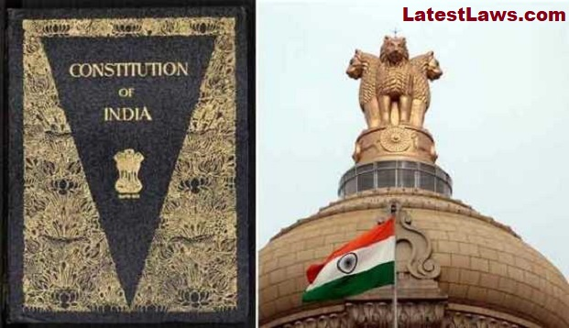

Slide 21
THANK YOU

