Slide 1
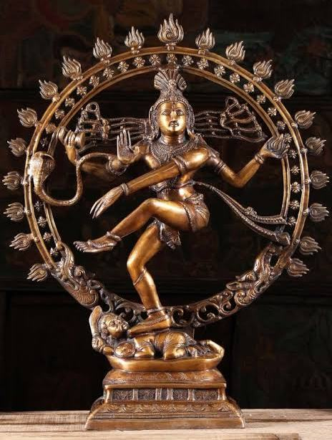
OPERATOR FORMALISM OF
QUANTUM MECHANICS
Dr. N. Shanmugam
ASSISTANT PROFESSOR
DEPARTMENT OF PHYSICS
ANNAMALAI UNIVERSITY
DEPUTED TO D. G. Govt. Arts college (W)
Mayiladuthurai-609001

Slide 2
WHAT IS AN OPERATOR?
Operator is a mathematical quantity when it operates on one function, it charges the function into another one and some times leave the function unaffected.
Examples of operators are addition, subtraction, multiplication, division, differentiation, integration, operations of grad, div, curl etc.

Slide 3
WHY WE NEED AN OPERATOR?
According to Heisenberg’s uncertainty principle, some physical quantities like position, momentum, energy, time, etc cannot be measured beyond a certain degree of accuracy in quantum mechanics. Therefore, the physical variables are given in terms of the average value. To determine the average of physical quantities, some suitable operators are used.

Slide 4
EXPECTATION VALUE
Among the so many measurements made on a single dynamical variable, most of the time we can get a particular value called the expectation value.

Slide 5
The expectation value of an operator A is

Slide 6
Hamiltonian operator
From classical mechanics
Hamiltonian H = T + V
T = kinetic energy, V= potential energy
We know that the value of momentum operator is

Slide 7
Free particle Hamiltonian
For a free particle V=0

Slide 8
(Time Independent Schrodinger Equation)
E= Energy Eigenvalue
(Time dependent Schrodinger Equation)

Slide 9
Prove that
The plane wave solution to the Schrodinger equation is

Slide 10
or

Slide 13
Eigenvalue equation is

Slide 15
Identity (or) Unity operator
Null operator

Slide 16
Inverse operator
⁻¹ =
⁻¹ =
(or)
⁻¹ and
⁻¹ are inverse operators.
Equal operator

Slide 17
Parity operator
The parity operator is a special mathematical operator and
is denoted by .
For a wave function of the variable x, The parity operator
is defined as
This means that when the wavefunction
is operated
by the parity operator, it gets reflected in its co-ordinates.

Slide 18
Eigenvalue of parity operator
,
The Eigenvalue equation of the parity operator is
Operating the above equation again by
This means that is the parity operator is operated twice
Hence,

Slide 19
Therefore, the Eigenvalues are +1 and -1. From the equations 1 and 2
If λ =1, the wave function is even
If λ = -1, the wave function is add
Bosans are described by symmetric wave function.
Fermions are described by symmetric wave function.

Slide 20
Commuting operator
Therefore
AB – BA = 0
[A, B] = 0
Anti commuting operator
ie
AB + BA =0

Slide 21
Linear operator
An operator is said to be linear if it satisfies the relation
where C₁ and C₂ are constants.
The inverse operator A⁻¹ is defined by the relation
An operator commutes with its inverse

Slide 22
Hermitian operator
Consider the Pauli’s spin operator
Conjugate transpose is called dagger.
If
Then
is Hermitian

Slide 23
An operator
is said to be Hermitian if
=A and it should satisfy the following condition.

Slide 24
_{For any operator A}
(a) Hermitian, (b) anti Hermitian, (c) unitary, (d) orthogonal

Slide 25
Eigen values of Hermitian operators are real
Consider the Eigenvalue equation
Pre multiply equation 1 by 𝚿* and than integrate
If A is Hermitian
From equations 2 and 3

Slide 26
Two Eigenfunctions of Hermitian operators, belonging to different Eigenvalues,
are orthogonal
Consider 𝚿, and 𝜙 are the two Eigenfunctions of the Hermitian
operator . There we can write
Pre multiply equation 1 by 𝜙* and then integrate, we can get
If A is Hermitian

Slide 27
3-4 ⇒
From equation 5, it is clear that (a-b) ≠ 0
i.e a ≠ b, but
should be equal to zero. This means that the wavefunctions 𝜙 and 𝚿 are mutually orthogonal.

Slide 28
The product of two Hermitian operators is Hermitian if and only if they commute.
Suppose 𝚿₁ and 𝚿₂ are two functions, using the operators A and B, we can develop an integral
If A is Hermitian
Again, if
is Hermitian we can write
If AB is Hermitian

Slide 29
If the operators A and B commute, we have
Which is the condition for the product operator
to be Hermitian

Slide 30
If A, B, and C are non-zero Hermitian operators, which of the
following relation must false?
a) [A, B] = C, b) AB + BA = C, c) ABA = C, d) A+B =C
Solution
Given
⁺

Slide 31
Prove that the momentum operator is Hermitian
Momentum operator
If P is said to be Hermitian
The expectation value of
can be written as
We have to solve the above integral
Put

Slide 33
Prove that parity operator commutes with the Hamiltonian
π = Parity operator
H = Total Hamiltonian
We have to prove [π, H] = 0
ie πH = H π
πH - H π = 0
we know that

Slide 36
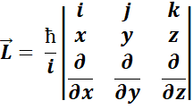
Angular momentum operators
We know that the orbital angular momentum

Slide 41
ll^{iy}
But

Slide 42
Value of
Commutation relation between L² and L_{z}

Slide 43
We know that [AB,C] = [A,C]B + A[B,C]
In the same way we can prove that
-----------1

Slide 44
-------------2
From the equations 1 and 2
We may conclude that the square of the angular momentum operator commutes with one of its components but the components among themselves do not commute.

Slide 45
Raising and Lowering operators (Ladder operators)
are called raising
and lowering operators, repectively.
.
Each time operation of the raising operator may increase the
Eigenvalue of the system by one unit of ћ
On the other hand, each time operation of lowering operator may
decrease the Eigenvalue of the system by one unit of ћ .
Therefore, these operators are called Ladder operators.

Slide 46
Commutation relation between
Similarly

Slide 47
Commutation relation between

Slide 48
In the same way we can prove that

