Slide 1
BUSINESS ENVIRONMENT
E – CONTENT MATERIAL

Slide 2
Bdu - syllabus
UNIT I : BUSINESS – SCOPE – CHARACTERSTICS GOALS – CRITICISMS – BUSINESS ENVIRONMENT – OBJECTIVES AND TYPES
UNIT II : ECONOMIC ENVIROMENT – CONCEPTS – FACTORS – BASIC ECONOMIC SYSTEM – ECONOMIC PLANNING – PRIVATIZATION – NATURE AND OBJECTIVES
UNIT III : POLITICAL ENVIRONMENT – POLITICAL INSTITUTIONS – LEGISLATURE, EXECUTIVES AND JUDICIARY - GOVERNMENT IN BUSINESS – REGULATORY, INTERVENTION AND PARTICIPATORY ROLES
UNIT IV : FINANCIAL ENVIRONMENT – FINANCIAL SYSTEM – RBI – COMMERCIAL BANKS – INTERNATIONAL ECONOMIC INSTITUTION – WORLD BANK – IMF- WTO
UNIT V : SOCIAL AND CULTUREAL ENVIRONMENT – IMPACT OF CULTURE ON BUSINESS – PEOPLES ATTITUDE TO BUSINESS AND WORK – BUSINESS AND SOCIETY – SOCIAL RESPONSIBILITY OF BUSINESS - CSR

Slide 3
NAME : B. MENAKA
DESIGNATION : ASSISTANT PROFESSOR
COLLEGE : AIMAN COLLEGE OF ARTS & SCIENCE FOR WOMEN, TRICHY.
CLASS : I BBA
SEMESTER : II
SUBJECT : BUSINESS ENVIRONMENT
SUBJECT CODE : 16ACBB2

Slide 4
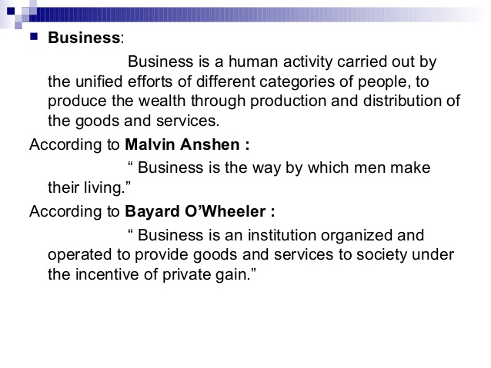
MEANING & DEFINITION OF BUSINESS ENVIRONMENT

Slide 5
CHARACTERSTICS OF BUSINESS ENVIRONMENT
Totality of external forces.
Specific and general forces.
Inter-relatedness:
Dynamic nature
Uncertainty
Complexity
Relativity

Slide 6
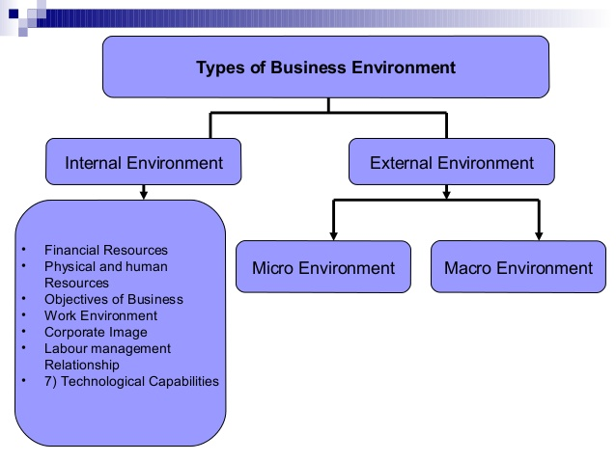
TYPES OF BUSINESS ENVIRONMENT

Slide 7
OBJECTIVE OF BUSINESS ENVIRONMENT
1. ECONOMIC OBJECTIVES
2. SOCIAL OBJECTIVES
3. HUMAN OBJECTIVES
4.NATIONAL OBJECTIVES

Slide 8
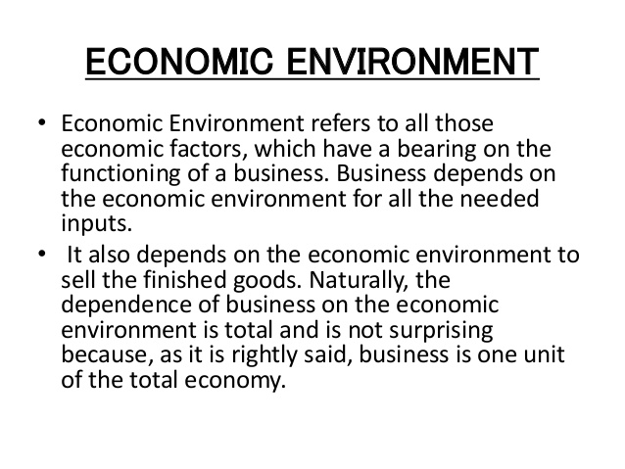
Economic environment

Slide 9
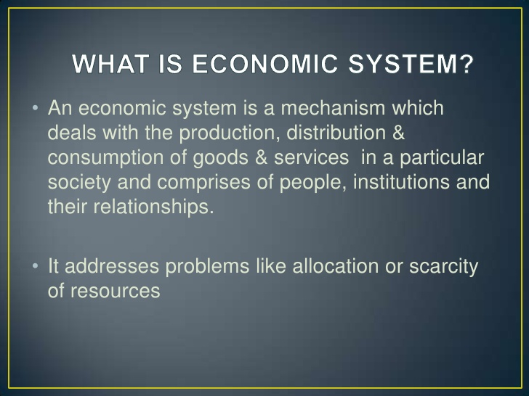
Economic system

Slide 10
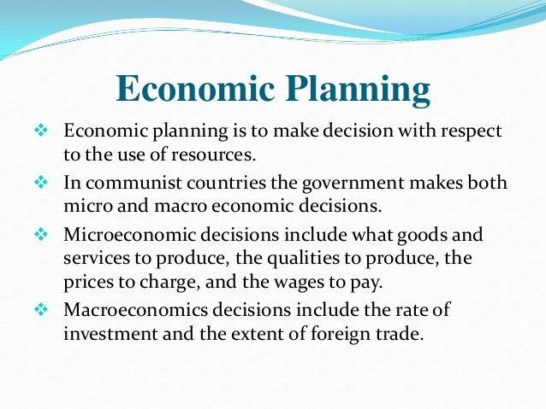
economic planning

Slide 11
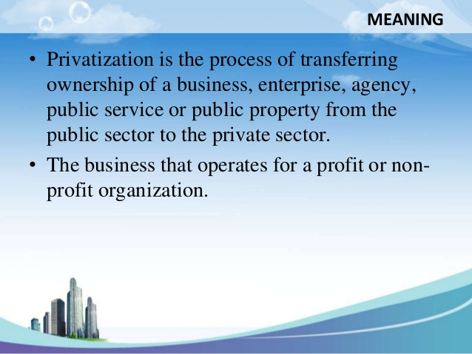
PRIVITAZATION MEANING

Slide 12
Objectives of privatisation
To improve the operational efficiency of Public Enterprises.
To develop competitive efficiency in the industries.
To generate resources for a deficit budget.
For the globalization of domestic Industries.
To invite foreign capital.
To earn foreign currency through export promotion.
To exploit the natural resources of the country with efficiency
To emerge wide public ownership on the economic resources of the company country.
To create an environment for rapid industrialization.
Accord priority to the Welfare activities by the government

Slide 13
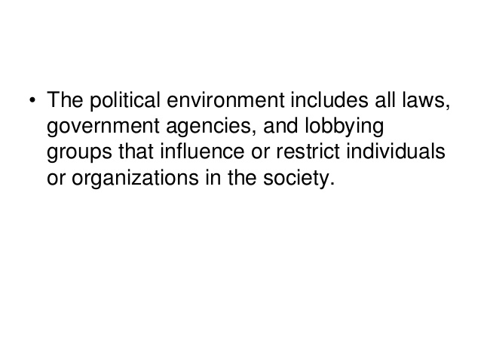
Meaning of political environment

Slide 14
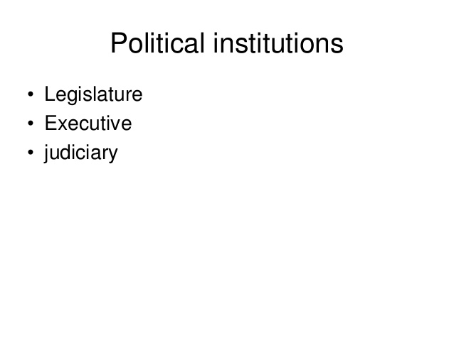

Slide 15
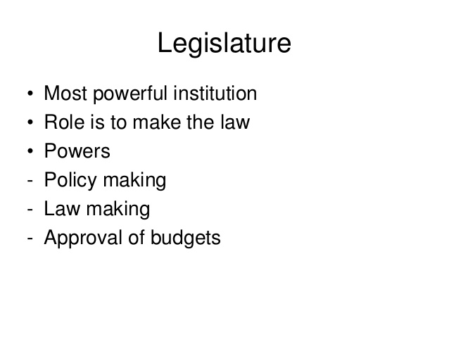
LEGISLATURE

Slide 16
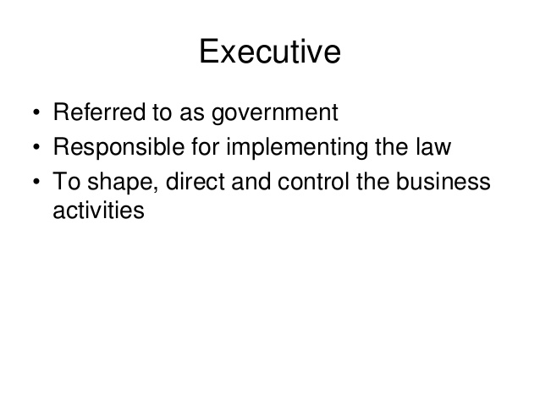

Slide 17
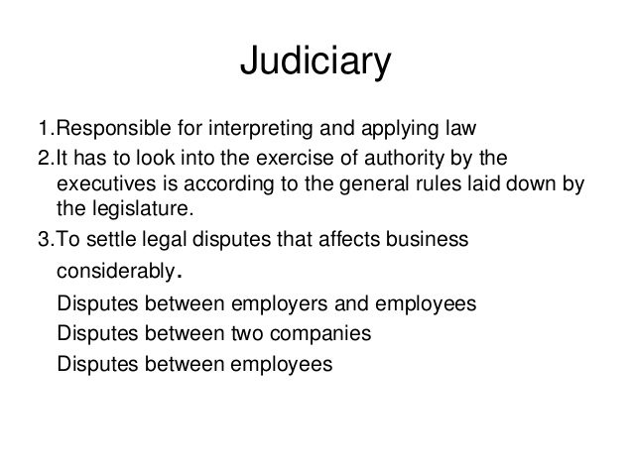

Slide 18
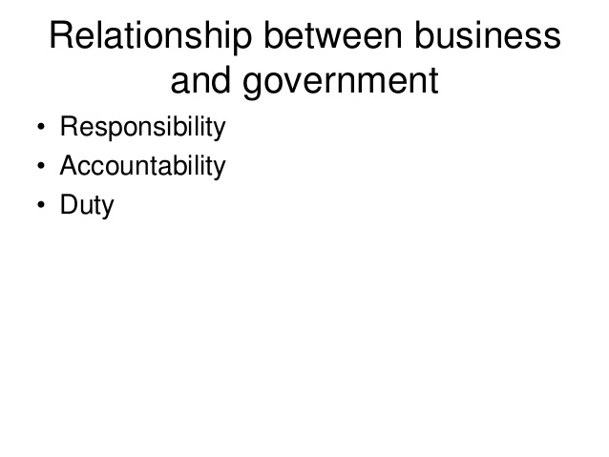
GOVERNMENT IN BUSINESS

Slide 19
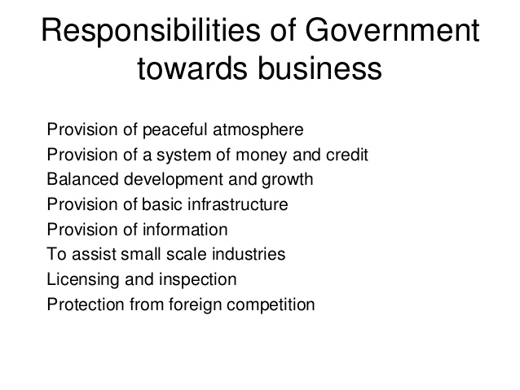

Slide 20
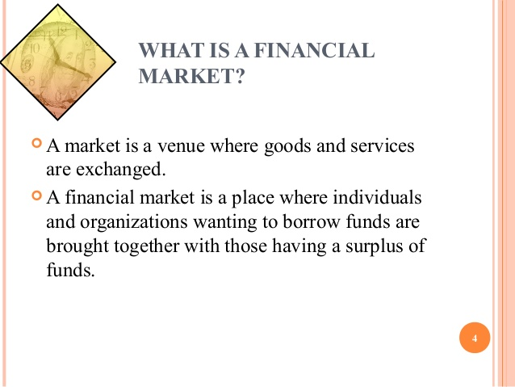
Financial enviroment

Slide 21
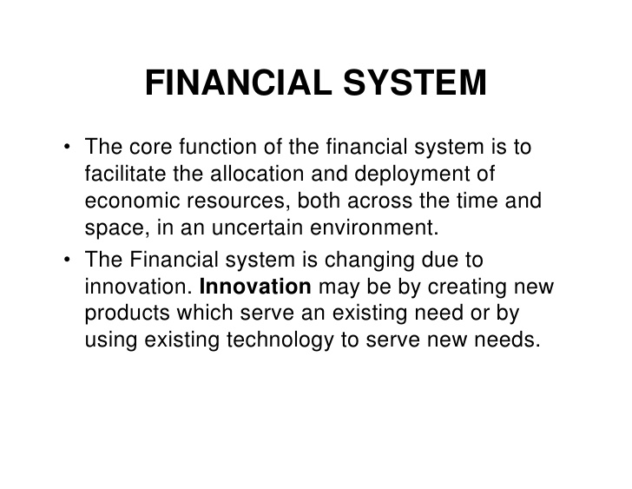

Slide 22
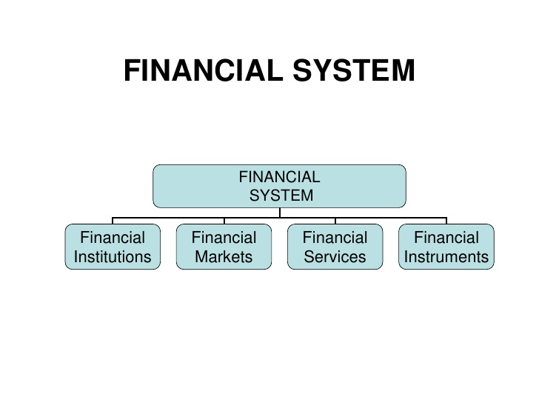

Slide 23
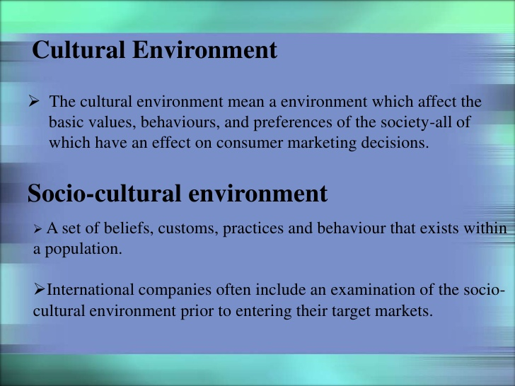
SOCIAL CULTURAL ENVIRONMENT

Slide 24
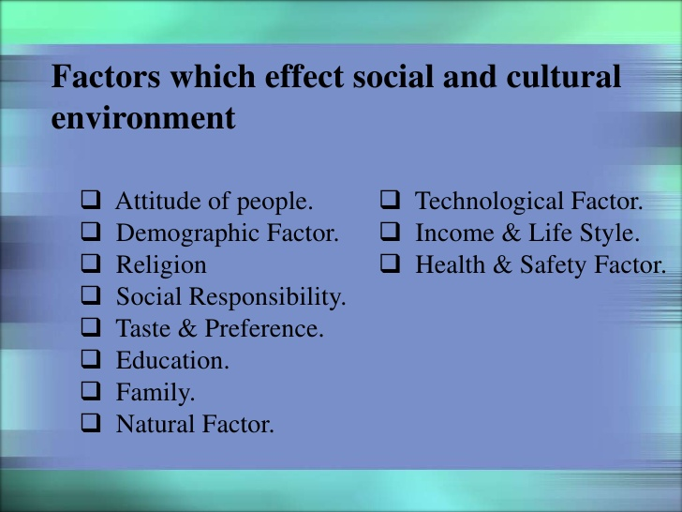

Slide 25
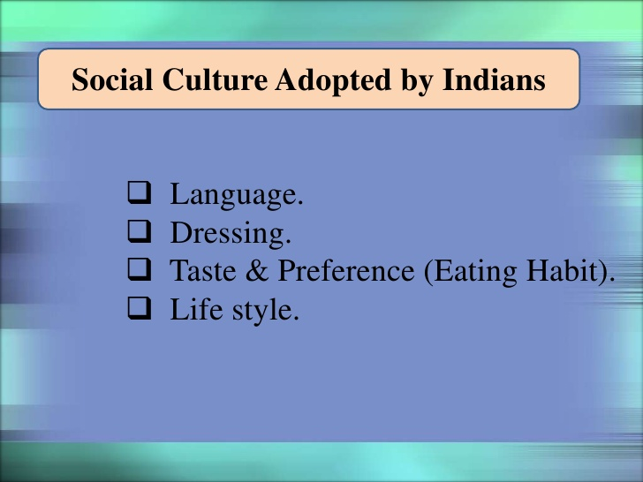

Slide 26
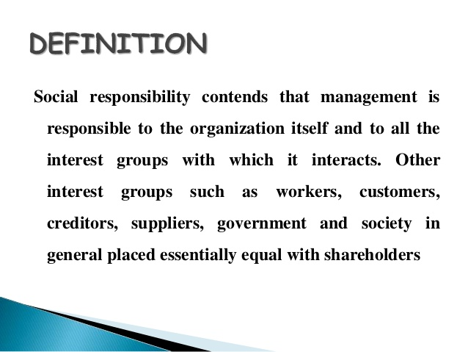
SOCIAL RESPONSIBILITY OF BUSINESS

Slide 27
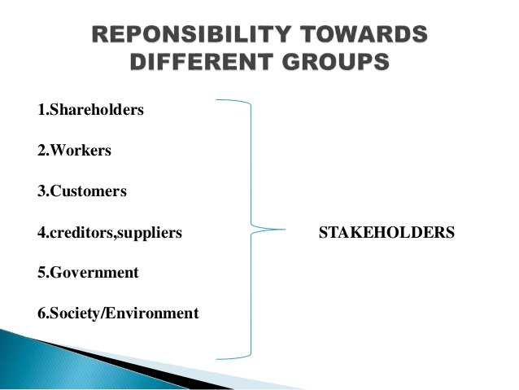

Slide 28
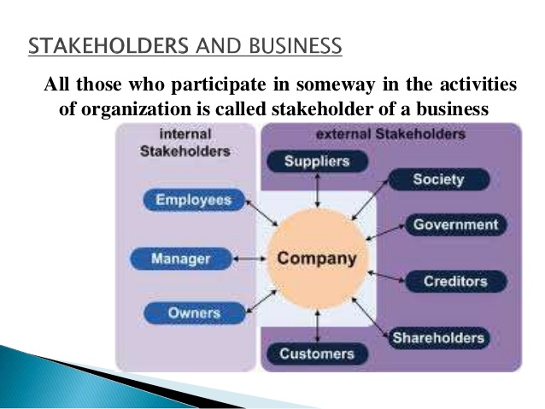

Slide 29
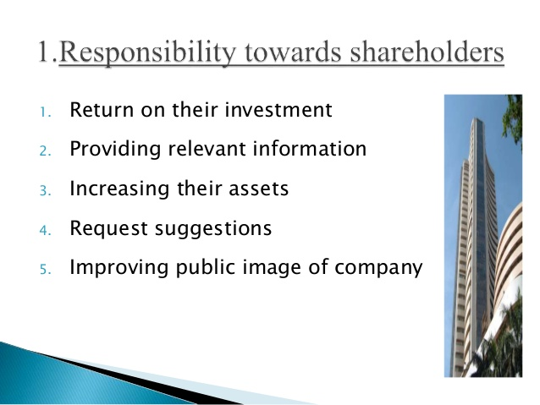

Slide 30
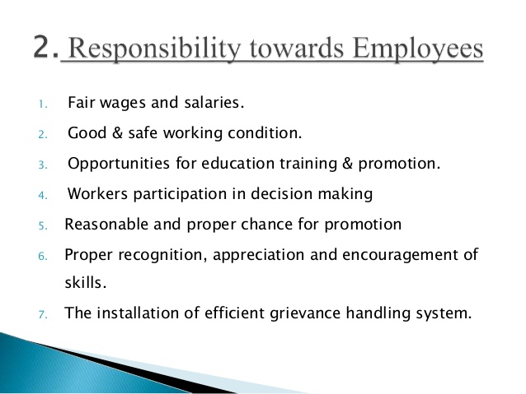

Slide 31
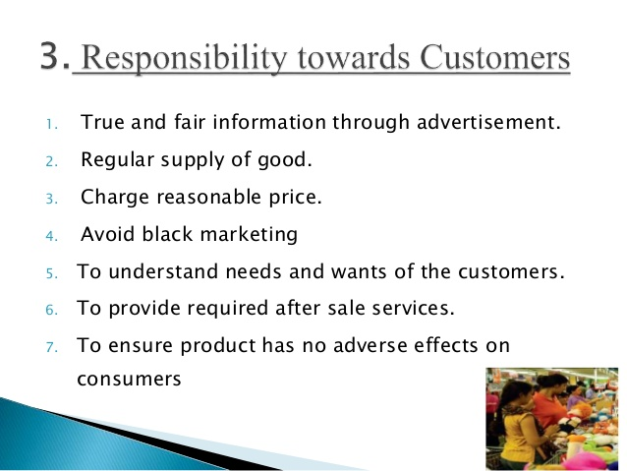

Slide 32
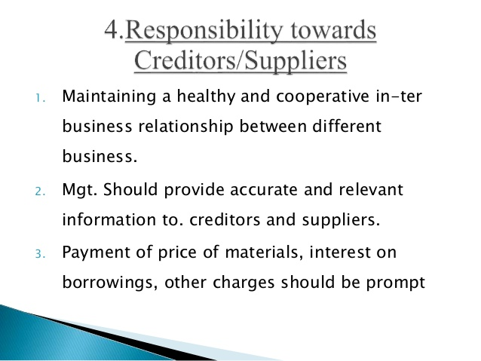

Slide 33
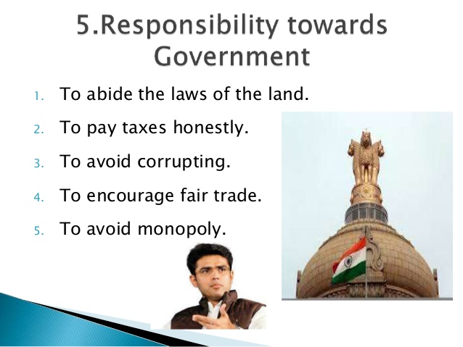

Slide 34


Slide 35
THANK YOU

