Slide 1
WORKING CAPITAL MANAGEMENT
Subject : Management Accounting
Sub.Code:16CCBB14
Semester :VI
By
Sumathi. V

Slide 2
CONCEPTS OF WORKING CAPITAL
Gross Working Capital Concept
Gross working capital is the capital invested in total current assets of the business concern.
Gross Working Capital = Current Asset

Slide 3
Net Working Capital Concept
  Net Working Capital is the excess of current assets over the current liability of the concern during a particular period.
  Net Working Capital= Current Asset – Current Liabilities

Slide 4
KINDS OF WORKING CAPITAL
FIXED/PARMANENT WORKING CAPITAL
It is the capital, the business concern must maintain certain amount of capital at minimum level at all times. The level of Permanent Capital depends upon the nature of the business. Permanent or Fixed Working Capital will
not change irrespective of time or volume of sales.
2. VARIABLE/TEMPORARY WORKING CAPITAL
It is the amount of capital which is required to meet the Seasonal demands and some special purposes.

Slide 5
ADVERSE CONSEQUENCES OF INADEQUATE WORKING CAPITAL
Due to non-availability of funds, it may become difficult for the company to undertake profitable projects.
It may become difficult to execute plans.
Difficulty in meeting day to day commitments. This would further create operational inefficiency.
Due to insufficient working capital fixed asset may not be efficiently utilized.
Inadequacy of working capital may also prevent the company from availing attractive credit facilities.

Slide 6
DANGERS OF EXCESSIVE WORKING CAPITAL
When there is a redundant working capital, it may lead to unnecessary purchasing and accumulation of inventories causing more chances of theft, waste and losses.
Excessive Working Capital means idle funds which earn no profits for the business and hence the business cannot earn a proper rate of return on its investments.
Increased bad debts due to defective credit policy.
Leads to managerial inefficiency.
It may result into overall inefficiency in the organisation.

Slide 7
Factors determining the working capital requirement of a firm
Nature of business: A transport company maintains lesser amount of Working Capital while a construction company maintains larger amount of Working Capital.
Production cycle: If the production cycle length is small, they need to maintain
lesser amount of Working Capital. If it is not, they have to maintain large amount of Working Capital.
Business cycle: During boom, the Working Capital requirement is larger and in the depression condition, requirement of Working Capital will reduce. Better business results lead to increase the Working Capital requirements.
Production policy: If the company maintains the continues production policy, there is a need of regular Working Capital.

Slide 8
Credit policy: If the company maintains liberal credit policy to collect the payments from its customers, they have to maintain more Working Capital. If the company pays the dues on the last date it will create the cash maintenance in hand and bank.
Growth and expansion: During the growth and expansion of the business concern, Working Capital requirements are higher, because it needs some additional Working Capital and incurs some extra expenses at the initial stages.
Availability of raw materials: If the raw material is not readily available, it leads to production stoppage. So, the concern must maintain adequate raw material; for that purpose, they have to spend some amount of Working Capital.
Earning capacity: If the business concern consists of high level of earning capacity, they can generate more Working Capital, with the help of cash from operation.

Slide 9
OPERATING CYCLE CONCEPT
The time period between purchase of inventory and conversion into cash is known as operating cycle.
Operating Cycle = Material Storage period
+ Production/Conversion Period
+ Finished Goods Holding Period
+ Average Collection Period
- Average Payment Period

Slide 10
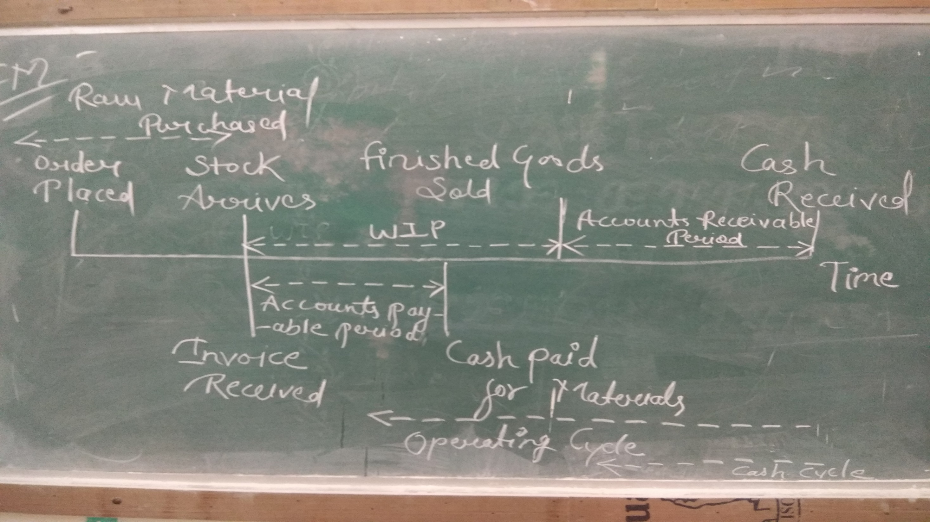
Courtesy: Ankita Namdev

Slide 11
Operating cycle method of forecasting working capital
Estimation of total operating expenses in the year.
  All material, labour and overheads
Number of operating cycle in the year
  Dividing 365 days by duration of one operating cycle.

Slide 12

1. Material Storage Period (days) = $\frac{Average Stock of Raw Material}{Daily Average Consumption}$
Average Stock of Raw Material = $\frac{Opening Stock+Closing Stock}{2}$
Daily Average Consumption = $\frac{Consumption for the year}{365/360}$

Slide 13
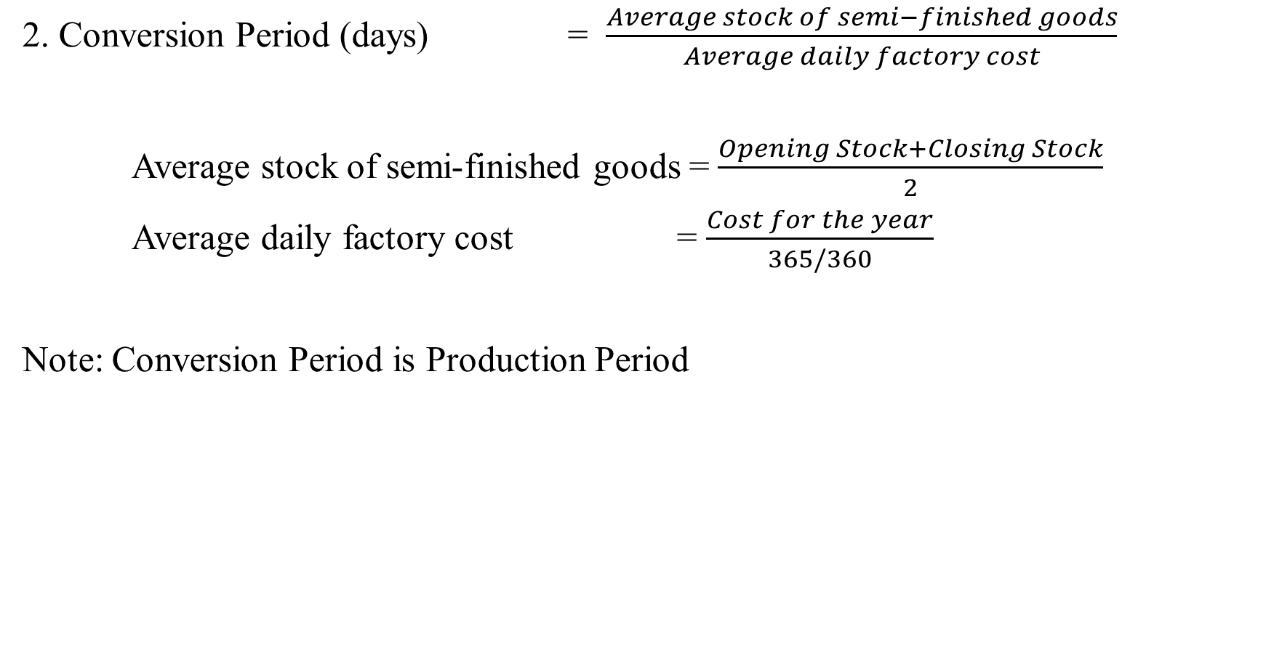
2. Conversion Period (days) = $\frac{Average stock of semi−finished goods}{Average daily factory cost}$
Average stock of semi-finished goods = $\frac{Opening Stock+Closing Stock}{2}$
Average daily factory cost = $\frac{Cost for the year}{365/360}$
Note: Conversion Period is Production Period

Slide 14

3. Finished Goods Storage Period (days) = $\frac{Average stock of finished goods}{average daily cost of sales}$
Average stock of finished goods = $\frac{Opening Stock+Closing Stock}{2}$
Average daily cost of sales = $\frac{Average daily for the year}{365/360}$

Slide 15

4. Average Collection Period (days) = $\frac{Average debtors/BR}{Net credit sales per day}$
Average Debtors = $\frac{Opening Debtors+Closing Debtors}{2}$
Net Credit Sales per day = $\frac{Total credit sales for the year}{365/360}$

Slide 16
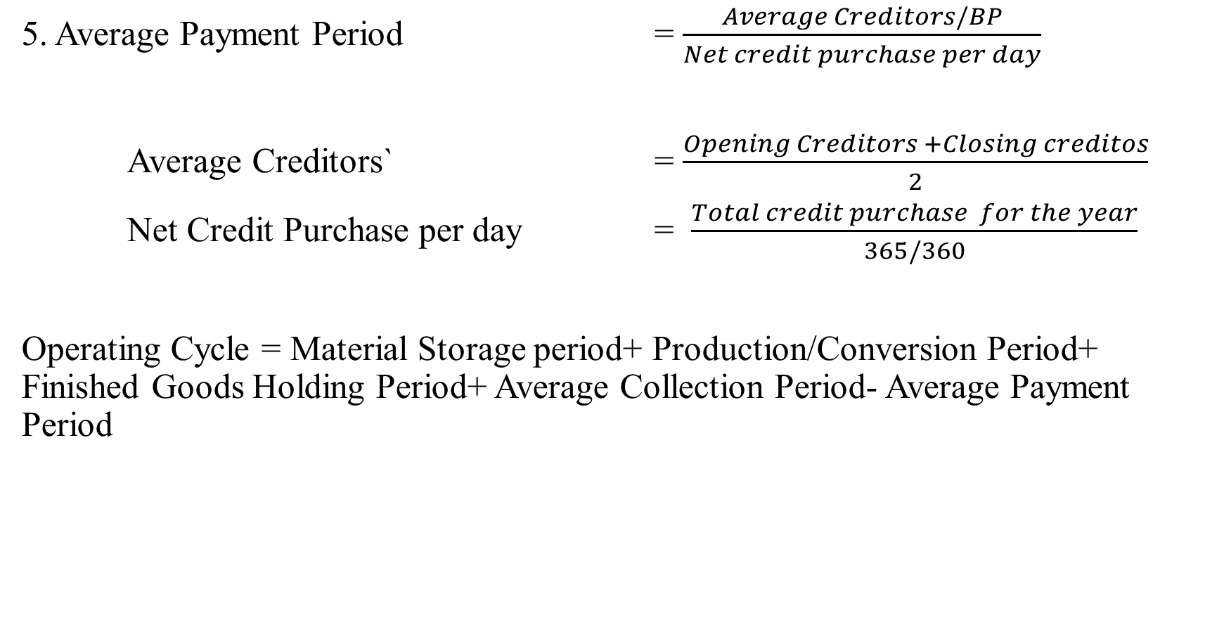
5. Average Payment Period = $\frac{Average Creditors/BP}{Net credit purchase per day}$
Average Creditors` = $\frac{Opening Creditors +Closing creditos}{2}$
Net Credit Purchase per day = $\frac{Total credit purchase for the year}{365/360}$
Operating Cycle = Material Storage period+ Production/Conversion Period+ Finished Goods Holding Period+ Average Collection Period- Average Payment Period

Slide 17

6. No. of Operating Cycle = $\frac{365}{Duration of one operating cycle}$
7. Working Capital = $\frac{Total Operating Expenses}{Number of Operating Cycles}$
  Total Operating Expenses = All material, labor and overheads

Slide 18
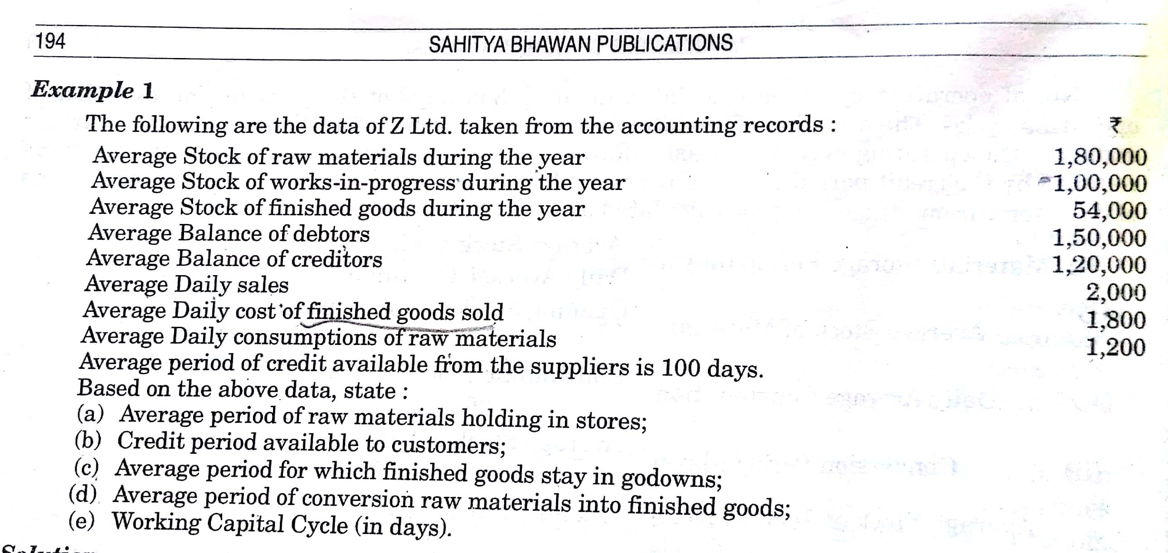

Slide 19
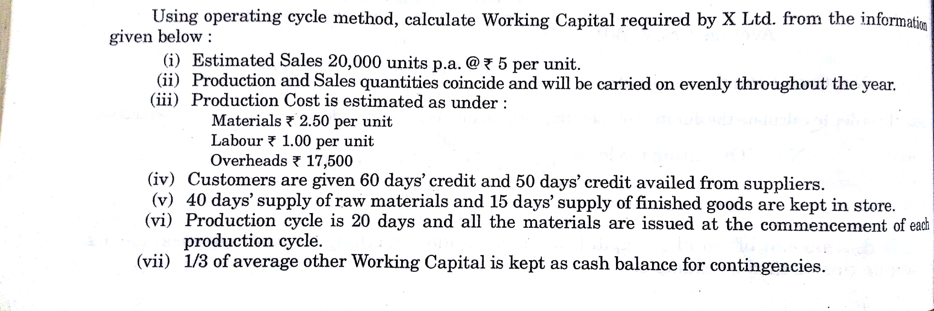

Slide 20
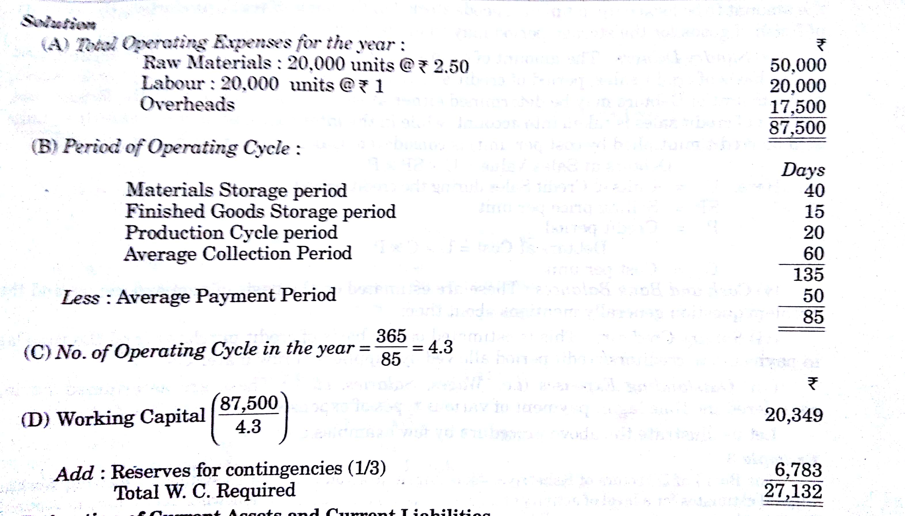

Slide 21
SOURCES OF FINANCING WORKING CAPITAL
Long Term Sources
Owned Sources
  Issue of Shares
  Retained Earnings
  Reserves
  Sale of fixed assets
  Borrowed Sources
  Debentures
  Long-term loans

Slide 22
Short-term sources
Trade Credit
Bank loans
Certificate of Deposit
Advance from customers

Slide 23
New Sources
Factoring
Convertible Debentures
Commercial Papers

Slide 24
STRATEGIES FOR FINANCING WORKING CAPITAL

Slide 25
CONSERVATIVE STRATEGY
In this strategy, apart from the fixed assets and permanent current assets, a part of temporary working capital is also financed by long-term financing sources.
Long Term Funds will Finance >> FA + PWC + Part of TWC
Short Term Funds will Finance >> Remaining Part of TWC

Slide 26
AGGRESSIVE STRATEGY
The complete focus of the strategy is in profitability. It is a high-risk high profitability strategy.
In this strategy, the dearer funds i.e. long term funds are utilized only to finance fixed assets and a part of the permanent working capital.
Complete temporary working capital and a part of permanent working capital also are financed by the short-term funds.
Long Term Funds will Finance >> FA + Part of PWC
Short Term Funds will Finance >> Remaining Part of PWC + TWC

Slide 27
HEDGING (MATURITY MATCHING) STRATEGY
This is a meticulous strategy of financing the working capital with moderate risk and profitability.
Hedging strategy works on the cardinal principle of financing i.e. utilizing long-term sources for financing long-term assets i.e. fixed assets and a part of permanent working capital and temporary working capital are financed by short-term sources of finance.
Long Term Funds will Finance >> FA + PWC
Short Term Funds will Finance >> TWC

Slide 28
