Slide 1
Subject Title : FOOD SERVICE MANAGEMENT-II
Subject Code : 16SCCND9

Slide 2
UNIT - II
QUALITIVE STANDARDS
& CONTROL

Slide 3
a) FORECASTING
Prediction of food need for a day.
To plan a budget.
Eradicates problem of left over foods.
Ex: hospital (data of patients)
Hotel (past meal records)
b) Quantities to produce
Quantity of menu item to be prepare & purchasing food should be calculated.
Its based on no. of portions to be served,

Slide 4
c) Production schedule
Called as production sheet or work sheet
Lists in detail all the items to be produce.
It includes menu, cooking time, method, spl. Instruction for prep. & serving.
d) Quality standards & control
Def. as “degree of excellence”
Quality is not only taste & texture
But also, it s’d be safe for consumption
Qual. Can be enhanced by
qual. Purchasing,
using std. recipe,
continuous supervision.

Slide 5
Good Food Depends Upon…
Quality food products purchased
How food is stored
Recipes used
Amount of ingredients
Preparation procedures
Holding
Service
Notes:
We can have a great menu, but if the food is not good the kids may not eat. So our job is to ensure that meals are produced according to standards.

Slide 6
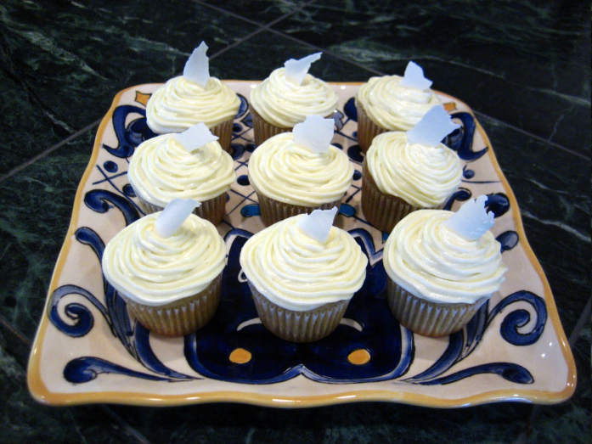
Standardized Recipes
Notes:
As you watch the video you have a note page for key points. Jot down the things you should remember from this video.

Slide 7
What is a standardized recipe?
One that has been tried, adapted and retried several times for use.
Produces consistent results and yield every time when exact procedures are used.
Written formula for producing a food item in a specified quan. & qual.

Slide 8
DEFINITION
STANDARDIZED RECIPE
According to West et al. (1977) a recipe is considered as standardized when it has been tried in a given situation and has repeatedly produced good results in all expected terms ( portion, number, texture, flavour, taste, doneness etc.)

Slide 9
OBJECTIVES
1. To yield consistent quality
- resuts – usually same.
- by looks- yield high qual. Food
- Elimination of guess work
2. Better cost control
- food cost – per portion – to be serve
- quan. of Ingr. for particular dish
3. Cooking time & labour saved
- helps in org. work
- eliminating untested recipe (cooking time)

Slide 10
4. Efficiency in serving
- knowing the size of serving
5. Pre-determine yield obtained from recipe
6. pre- determine qual. & quan. Ingrs. to be used
7. Facilitates in menu planning & food prep.
8. Facilitate in portion control
9. Facilitate in purchase
10. Pre- determine nutritive value

Slide 11
Importance of Standardiza-tion recipe
Accuracy
Customer satisfaction
Eliminate guess work
Portion control

Slide 12
Procedure for standardization of recipe
Testing & Developing new recipe
Develop separate file of recipes
Sources of information (quan. Work books, magazines)
Recipe Development Procedure
Analyse & select a recipe
Consider suitability for customer
The amount & kind of labour involved
Necessary of equipments

Slide 13
Test the Original Recipe
Prepare amount given in original recipe
Use accurate measurements
Taste at appropriate stages of production
Record accurately details of method
Have taste panel to judge (sensory evaluation)
Repeat till you get desired quan. & qual.
When you get std. recipe prepare in small amount & serve to the customer & do popularity study by questionnaire.
Keep accurate count for portion control
Figure portion cost of recipe.

Slide 14
Parts of a Standardized Recipe
Recipe Title
Recipe Category
Ingredients
Weight/Volume of each ingredient
Preparation Instructions
Cooking Temperatures & Time
Serving Size
Recipe Yield
Equipment & Utensils to be used
HACCP

Slide 15
Parts of a Standardized Recipe
Recipe Title – Name that adequately describes the recipes.
Recipe Category – defined categories, i.e., main dishes, snacks, grains/breads.
Ingredients – Products lists used in recipe.

Slide 16
Parts of a Standardized Recipe
Weight/Volume of each ingredient – The quantity of each ingredient listed in weight and/or volume.
Preparation Instructions – Directions for preparing the recipe.
Cooking Temperatures & Time – The cooking temperature and time, if appropriate.
Serving Size – The amount of a single portion in volume and/or weight.

Slide 17
Parts of a Standardized Recipe
Recipe Yield – The amount (weight or volume and number of servings) of product at the completion of production that is available for service.
Equipment & Utensils to be used – The cooking and serving equipment to be used in preparing and serving the recipe.
HACCP – CCP information

Slide 18
Sample Standard Recipe: Chicken (Turkey) Tetrazzini
UTENSILS NEEDED: Stock pot, cutting YIELD: 96 portions
board, French knife, wire whip, mixing bowl, OVEN TEMP: 350ºF (176.6ºC)
gallon/quart/cup measures, measuring spoons, BAKING TIME: 30 minutes
plastic gloves, clean foodservice cloths, PORTION SIZE: 1/24 pan
4 – 12”x 20”x 2” steam table pans PORTION TOOL: Spatula/Spoon
Ingredients | Quantity/Volume | Procedure
Spaghetti Margarine Celery, cut fine Onions, cut fine Flour, pastry Salt Pepper, black Chicken (turkey) stock Chicken (turkey) cooked & cubed Mushrooms, fresh/chopped Green Pepper, chopped Total Weight Topping Bread Crumbs, fine Sharp Cheddar Cheese, grated | 6 lb. 2 lb. 2 qt. 2 qt. 1 lb. 4 oz. ¼ c 1 tsp 2 gal. 2 c 12 lb. 8 oz 2 c 3 c 48 lb. 2 qt. 2 qt. | 1. Cook spaghetti in salted water. Rinse and drain. Do not overcook. 2. Cook onions and celery in margarine until transparent. 3. Make roux by adding flour, salt and pepper to above. Cook 5 minutes. 4. Add chicken (turkey) stock and cook until thick, stirring as necessary. 5. Add cubed chicken (or turkey) and mushrooms; mix. 6. Add spaghetti; mix well. 7. Add green peppers just before panning. 8. Scale 12 lb. into each of 4 (12" x 20" x 2") pans. 9. Mix topping. Top pan with 1 qt. topping. 10. Bake at 350ºF (176.6 ºC) for 30 minutes. 11. Portion: Divide into portions by cutting pan contents 6 (length) x 4 (width). Example: Holding: Hold prepared product at 135º F (57ºC) until service.
SPECIAL INSTRUCTIONS:
OH – 9.4

Slide 19
Standard Recipe Evaluation Form
Standard Recipe Name: Recipe Category:
Evaluation Date(s): Recipe No.:
Instructions: Check the box that best represents your analysis of each factor.
Evaluation Factor | Your Analysis Poor Excellent | Comments
Portion Size | ❑    
Color | ❑    
Texture | ❑    
Taste | ❑    
Aroma | ❑    
General Appearance | ❑    
Ingredients | ❑    
Compatibility | ❑    
Garnish | ❑    
Other: | ❑    
Other: | ❑    
Should we use this recipe?  Yes  No Comments: Name of Evaluator:
OH – 9.6

Slide 20
Quantity Adjustment Phase
Adjust the recipe to the desired number of servings. Different methods:
  Factor method
  Direct reading tables method
  Percentage method
  Computerized recipe adjustment

Slide 21
Factor Method (most common)
Determine the “factor” to be used
  Desired yield / Current yield = Factor (RCF)
  Recipe Conversion Factor
  30/10 = 3 (RCF)
Multiply each ingredient quantity by the “factor”
  Original amount X Factor = Amount needed
  85 * 3 = 255
  85 *3 =255
  5.5 * 3 = 16.5
  25 * 3 = 75
  20 * 3 = 60
  10* 3 = 30

Slide 22
Factor method or Recipe adjustment
Ingredients | Original recipe (OR) | STEP-I O.R in their wt. measurement | STEP-II O.R in gram | STEP-III Step-II * RCF | STEP-IV New recipe in gram | STEP-V New recipe rounded in wg.
Flour | 85 gm | 85 gm | 85 gm | 255 | 255 | 255 gm
Butter | 85 gm | 85 gm | 85 gm | 255 | 255 | 255 gm
Sugar | 5.5 gm | 5.5 gm | 5.5 gm | 16.5 | 16.5 | 16 gm
Corn flour | 25 gm | 25 gm | 25 gm | 75 | 75 | 75 gm
Cocoa | 2 tbsp | 2 tbsp | 20 | 60 | 60 | 6 tbsp
Vanilla | 1 tsp | 1 tsp | 5 | 30 | 30 | 6 tsp
Total |  |  | 225.5 gm | 691.5 gm | 691.5 gm
1 tsp = 5 gm
1 tbsp = 10 gm

Slide 23
Percentage Method
Convert all ingredients from measure or pounds & ounces to grams.
Total the weight of ingredients in a recipe after each ingredient has been converted to weight in the edible portion.
Calculate the percentage of each ingredient in the recipe in relation the total weight.
Check the ratio of ingredients.

Slide 24
Percentage Method
Establish the weight needed to provide the desired number of servings.
Add handling loss to the weight needed.
Multiply each ingredient percentage number by the total weight to give the exact amount of each ingredient needed.
Convert to pounds & ounces or to measures.

Slide 25

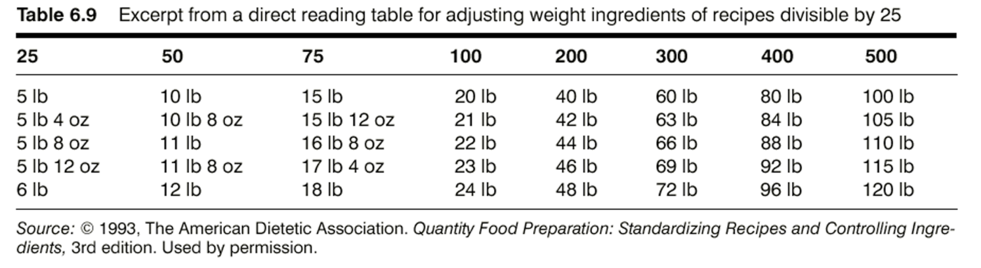
Direct Reading Measurement Tables
Quick to use & require no mathematical calculations.
Used to adjust weight & volume of ingredients in recipes that are divisible by 25.

Slide 26
Computerized Recipe Adjustment
Advantages to using:
  Recipe adjustment is done much faster
  Menu planning is more flexible because menus can be analyzed and modified easily
  Food information is specific
  Menus can be analyzed and evaluated for specific nutrients

Slide 27
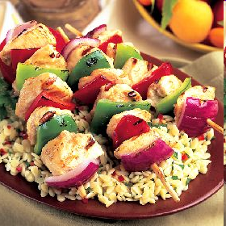
THANK YOU

Slide 28
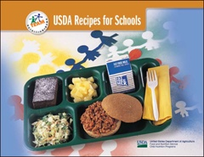
Types of Recipes
USDA recipe
Other quantity
District recipes
Site recipes
www.NFSMI.org
Notes:
At www.NFSMI.Org you can download each individual recipe. They are listed alphabetical by category.
There are other sources of quantity recipes. Foods for 50 is a popular one. But USDA recipes are modified for fat.
District recipes should be written and tested. The same is true for site specific recipes.

Slide 29
USDA Recipes
Taco Salad (pg 20)
  CCP
  1 Salad provides 2oz equivalent meat/meat alternate, ¾ cup of vegetable, and 1 serving of grains/breads
  Nutrients Per Serving

Slide 30
Changes to USDA Recipes
  Make note of any changes on the recipe
    This information is used in SMI
  Substitute commodity Turkey Taco Meat?
    NSLP Fact Sheets (pg 23)
    http://www.fns.usda.gov/fdd/facts/schfacts/NslpRptHome.htm

Slide 31
Weights & Measures

Slide 32
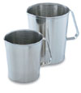


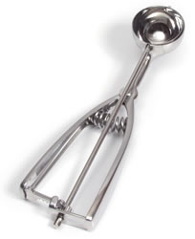

Types of Measuring Devices
Notes:
You should have all of these measuring devices in your kitchen. What do you have in your kitchen that you do not see on this slide? But lets review the proper usage

Slide 33
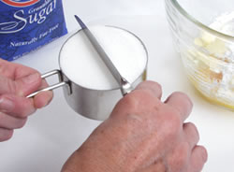
Measuring Dry Ingredients
Notes:
When using dry measures, spoon in the ingredient and level off the top. Dry ingredients that are considered loose such as flour, sugar, cornmeal should not be packed or do not shake the cup to fill completely. This add more than should be put in the measure. Spoon in and level off loose dry ingredients. Items such as brown sugar should be packed. When it is more than one cup, it is best to weigh the dry ingredient.

Slide 34
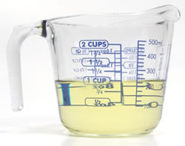
Measuring Liquid Ingredients
Notes:
Liquid measures should be filled just to the line. It is much easier to measure liquids in clear containers.

Slide 35
Practice, Practice, Practice
6 tsp (3 tsp.=1T)
  2T
4 pts (2 pts=1 qt) & (2qts=1/2 gallon)
  ½ gallon
16 fl oz (8oz = 1c) & (2 c= ½ qt)
  ½ qt
8 qts (4qts = 1gal)
  2 gallons
34 oz (16oz = 1lb)
  2lbs 2oz

Slide 36
Basics at a Glance
Poster by NFSMI
http://www.nfsmi.org/Information/basicsindex.html
Notes:
Review each section of the poster and discuss portion control tools and tips

Slide 37
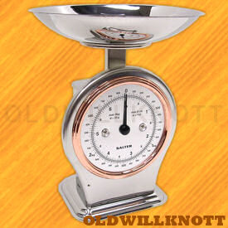
Use of Scales
Capacity of scale 32 oz
Increment ¼ oz
Reading 3 ½ oz
Capacity of scale 50 lb
Increment 4 oz
Reading 6 lb 8 oz
Capacity of scale 25 lbs
Increment 2 oz
Reading 1 lb 4 oz
Capacity of scale 25 lb
Increment 2 oz
Reading 23 lb 8 oz

Slide 38
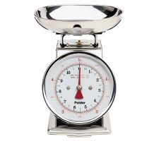
What is the quickest way to measure dry ingredients for a cake?
  Bowl on scale
  Zero the scale
  Add shortening
  Zero scale
  Add sugar
  Zero scale
  Add flour

Slide 39
Tips to Remember
Calibrate scale before measuring
Weigh when possible
Use the largest measure

Slide 40
Just a little…
Can make a BIG difference
If the serving of one item costs 8 cents more than planned, what would be the total cost increase?
For the day? 300 x .08 = $24.00
For the week? 300 x .08 x 5 days = $120.00
For the month? 300 x .08 x 20 days = $480.00
For the year? 300 x .08 x 180 days = $4200.00

Slide 41
Recipe Verification Phase
Review the Recipe
Prepare the Recipe
Verify Yields
Record Changes

Slide 42
Product Evaluation Phase
Informal Evaluation
  Involves the CNP managers and employees assessing whether the efforts to standardize the recipe should continue
Formal Evaluation
  When CNP staff believes a recipe has potential for service

Slide 43
Product Evaluation Phase
Formal Evaluation
  Select a group of people to taste the recipe
  Choose an evaluation form
  Prepare the recipe
  Set up the sampling area
  Have participants taste and evaluate the food
  Summarize the results
  Determine future plans for the recipe based on evaluation results

