Slide 1
Presentation
by
Mr. R. PRABAKARAN., MA., MA(Soci.). MBA., M.PHIL., PGDCA.,
ASSITANT PROFESSOR OF COMMERCE
ARC VISVANATHAN COLLEGE

Slide 7
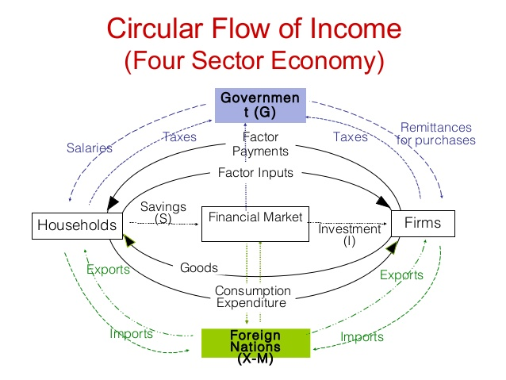

Slide 17
