Slide 1
IDHAYA COLLEGE FOR WOMEN KUMBAKONAM
Semester : VI
Subject : HUMAN RESOURCE MANAGEMENT
Subject code : 16CCBB13
Class : III BBA
Unit : V
Faculty Name : Mrs. Radhika R M. Com,B.Ed.,MBA.,M.Phil, (PhD).
Assistant Professor,
Department of Management,
Idhaya College For Women, Kumbakonam.

Slide 3
CONTENT
PERFORMANCE EVALUATION
MEANING
IMPORTANCE
METHODS
DICILPINE AND DICIPLINARY PROCEDURE
GREVANCES
STEPS IN GREVANCES HANDLING

Slide 4
PERFORMANCE EVALUATION
MEANING:
Performance Evaluation is defined as a formal and productive procedure to measure an employee's work and results based on their job responsibilities.
Ideally, employees are graded annually on their work anniversaries based on which they are either promoted or are given suitable distribution of salary raises.

Slide 5
PERFORMANCE EVALUATION
DEFINITION:
Performance evaluation means many things to many people.
It is a measurement process it is an exercise in observation and judgment it is a feedback process.

Slide 8
Methods of performance evaluation

Slide 9
Discipline and disciplinary procedures
Meaning
The purpose of a disciplinary code and procedure is to regulate standards of conduct and incapacity of employees within a company or organization.
The aim of discipline is to correct unacceptable behavior and adopt a progressive approach in the workplace.

Slide 11
Disciplinary
Discipline is an approach used by management to modify undesirable performance and behavior through the use of a corrective action process.
At the onset of any employee performance or conduct issues, supervisors are strongly encouraged to contact Employee Relations staff for assistance.

Slide 12
Disciplinary Process

Slide 13
GRIEVANCE
Meaning
A grievance is a complaint. It can be formal, as when an employee files a grievance because of unsafe working conditions, or more of an emotional matter, like a grievance against an old friend who betrayed you.
A grievance is a complaint that may or may not be justified.

Slide 17
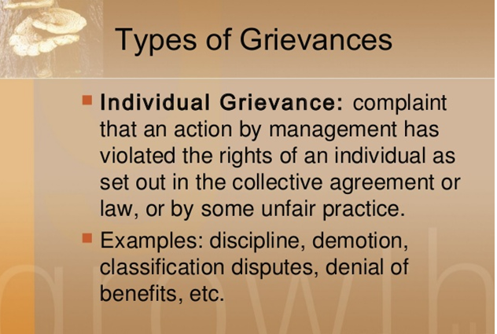

Slide 20
THANK YOU

