Slide 1
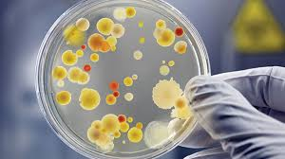
PLANT GROWTH HORMONES
IDHAYA COLLEGE FOR WOMEN,KUMBAKONAM
DEPARTMENT OF MICROBIOLOGY
Course : B.Sc , Year: I, Semester : II, Sub. Code: 16SACBC2
Unit - V
Course Material on:
Prepared by
Dr. R. Krishnaveni, M.Sc., M.Phil., M.Phil.,B.Ed., Ph.D., DMLT.,
Assistant Professor and Head
PG and Research Department of Microbiology
Idhaya College for Women , Kumbakonam.

Slide 2
Hormone
DEFINITION: A hormone which stimulates
growth in animal or plant cells
Plant growth substances are biochemical produced in plant (endogenous) or synthetic substances applied to plants externally (exogenous) which cause modifications in plant growth and development.
Plant growth substances produced by the plant are referred to as phytohormones.

Slide 3
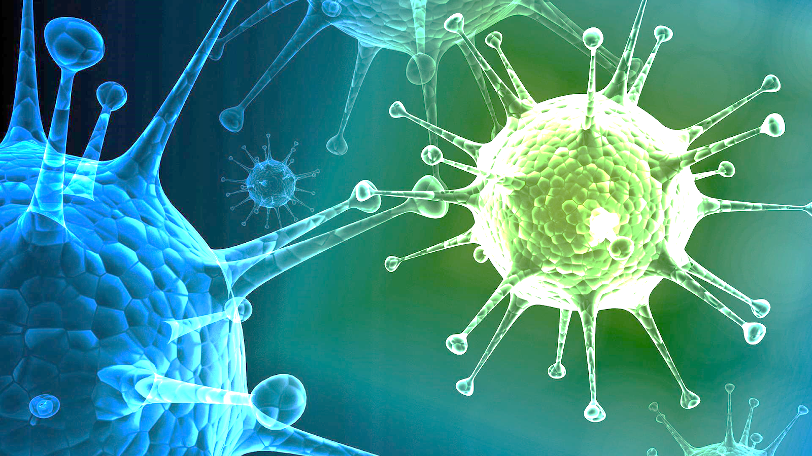
Types of growth hormone
Auxin
2. Gibberellins
3. Cytokines
4. Ethylene
5. Inhibitors
6. Growth retardants

Slide 4
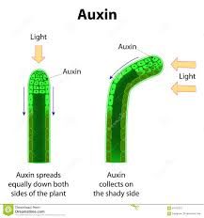
Auxins
Auxins are produced in the meristem of shoot tips and move down the plant
Auxins are effectively used in rooting of difficult to root plants.
This has a wide application in vegetative propagation of plants. IBA at 250 ppm and NAA (1- Naphthalene Acetic Acid) were found to increase root development in the propagation of stem cuttings.
Some of the synthetic auxins can be used in removing weeds growing in the farms and agricultural fields. Certain hormones specifically weed out monocots, like grasses and some destroy dicots.
for example- 2.2. Dichloro propionic acid removes grasses, while 2, 4 Dichlorophenoxy acetic acid (2, 4-D) & (2, 4, 5 Trichloro phenoxy acetic acid) 2, 4, 5-T) are employed in weeding out the dicots.

Slide 5
2,4-D stimulates excessive uncontrolled growth in broadleaf plants for which it is used as a herbicide
Application of NAA reduces flower and fruit drop in Mango.
Auxins like Naphthalene acetic acid (NAA) are used in prolonging the dormancy period, thus the storage and shelf life of food in potatoes, corms, bulbs, etc., is prolonged.
NAA application brings uniform flowering and fruit set by inducing ethylene formation in pineapple.
NAA application at 10-100 ppm during fruit setting period controls boll shedding in cotton.

Slide 6
Auxins and Gibberellins are used in inducing parthenocarpy. Parthenocarpic fruits are seedless, at the same time they are larger and sweetish.
These qualities of fruits have greater commercial value.
Spraying of auxins to fruit plants like orange,lemon apple etc prevents the premature falling of the fruits by formation of abscission layers premature falling cause greater economic loss to cultivators.
This can be prevented by the use of auxins.
Examples
1. IAA (Indole Acetic Acid)
2. IBA (Indole Butyric Acid)
3. NAA (Naphthalene Acetic Acid)
4. 2, 4-D (2, 4 – Dichlorophenxy Acetic Acid)
5. 4-CPA (4-Chloropenoxy Acetic Acid).

Slide 7
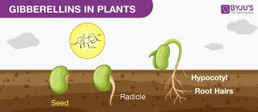
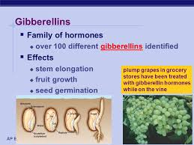
GIBBERELLINS
Gibberellins first isolated from fungal culture. Since then number of gibberellins have been isolated from both the fungus and plants.
Gibberellins (GAs) are plant hormones that regulate growth and influence various developmental processes, including stem elongation, germination, dormancy, flowering, sex expression, enzyme induction, and leaf and fruit senescence.

Slide 8
GA is used extensively on seedless grape varieties to increase the size and quality of the fruit.
Pre-bloom spray of 20 ppm induces rachis of the fruit cluster to elongate.
This creates looser clusters that are less susceptible to disease during the growing season.
GA is used to increase the yield of barley malt and to decrease the time required for this process to occur
Application of GA to germinating barley supplements the endogenous content of this hormone and accelerates the production and release of hydrolytic enzymes
They can easily degrade the stored carbohydrates.

Slide 9
Foliar spray of GA at 100 ppm during panicle initiation stage enhances the panicle exertion and increases seed weight and yield in hybrid rice.
GA has also been used to control flower sex expression in cucumbers and squash
GA application tends to promote maleness in these plants
GA is also applied to citrus crops, through the actual use depends on the particular crop
For example GA3 is sprayed onto oranges and tangerines to delay or prevent or prevent rind-aging, so that fruit can be harvested later without adverse effects on rind quality and appearance
For lemons and limes, GA3 synchronizes ripening and enhances fruit size

Slide 10
GA is used extensively to increase the sucrose yield of sugarcane
Sugarcane, a normally fast growing C4 member of the Phocaea is sensitive to cooler winter temperatures, which reduce internode elongation and subsequent sucrose yield
The adverse effects of cooler temperature can be counteracted by the application of GA3
Ethylene is most widely used plant hormone in agriculture because it regulates so many physiological processes.
Auxins and ACC can trigger the natural biosynthesis of ethylene and in several cases are used in agricultural practice.
1-aminocyclopropane-1-carboxylic acid (ACC)

Slide 11
ETHYLENE

Slide 12
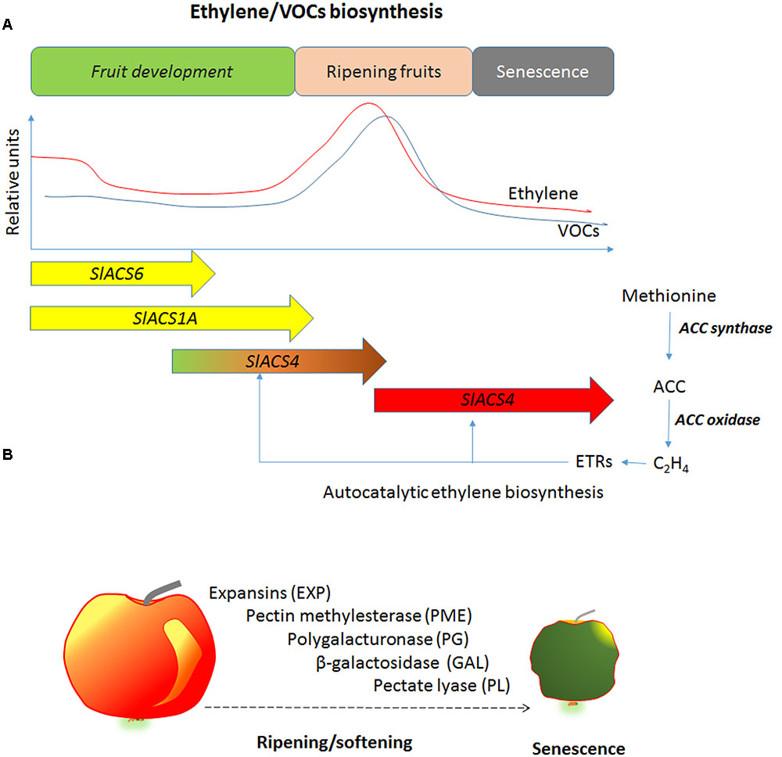

Slide 13
A colorless, flammable gas, C2H4 (Ethane gas), having a sweet, unpleasant odor and taste, the first member of the ethylene series, usually obtained from petroleum and natural gas: used as an agent to improve the color of citrus fruits, in the synthesis of polyethylene, ethylene bromide and ethylene oxide
Ethylene is very difficult to apply in the field as a gas
This limitation can be overcome if an ethylene compound is used
The most widely used such compound is ethephon or 2- chloral ethyl phosphoric acid (CEPA) (trade name ethrel)
Ethrel at 100-250 ppm sprayed at 2-3 leaf stage induce femaleness in cucumber and melons

Slide 14
Ethylene can be used for quick ripening of fruits for marketing
It helps in degreasing of citrus and banana which increases its market acceptability
Storage facilities developed to inhibit the ethylene production and promote preservation of fruits have a controlled atmosphere of low O2 concentration and low temperature that inhibits ethylene biosynthesis
A relatively concentration of CO2 (3-5%) prevents ethylene action as a ripening promoter

Slide 15
CYTOKINES

Slide 16
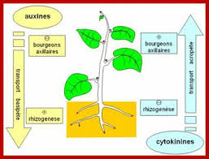

Slide 17
The most common form of naturally occurring cytokinin in plants is zeatin, which was isolated from maize (Zea mays)
Cytokinins have recently been found to play a role in plant pathogenesis.
For example,
Cytokinins have been described to induce resistance against Pseudomonas syringae in Arabidopsis thaliana and Nicotiana tabacum
Cytokinins Stimulate cell division prolong storage life of flowers and vegetables and stimulate bud initiation

Slide 18
Cytokine’s is their ability to stimulate chlorophyll synthesis and accelerate chloroplast differentiation in the detached cotyledons in light.
Cytokine's are important in seed germination
Cytokines promote hermaphrodite flower
Example: Grape
Externally applied CK’s are known to exert spectacular effects on the growth and development of plants and excised plant tissue

Slide 19
Growth retardants
Slow cell division and cell elongation.
Examples
2,4 DNC (2,4 Dichlorobenzyl)
CCC (Cycocel)
Alar
Synthetic inhibitors
1. MH- Maleic hydrazide.
2. TIBA- Tri- iodobenzoic acid.

Slide 20
Actions
Regards stem elongation
Prevents cell division
Accelerate flower initiation
Inhibits root development
Inhibitors: Suppers the growth of plants

Slide 21
Other growth regulators
Abscissic acid can be used to obtain uniform harvesting of citrus fruits and cotton balls
AMO 1618 (a quaternary ammonium salt) is used in the cultivation of ornamental plants and causes a bushy shape and a study growth of the treated plants
Paclobutrazol reduces the problem of biennial bearing in mango

Slide 22
Mapiquat chloride, chlormequat chloride (cycocel): used in ornamental plants for shorter internodes and thicker stems (used in poinsettias)
It also prevents lodging and increases tillering in cereals
Malichydrazide (MH) prevents premature sprouting of onion and potato
2,3,5-T or Triiodo benzoic acid (TIBA): Increases flowering in chrysanthemum

Slide 23
Other hormones
Florigen these hormones are synthesized in the older leaves and then transferred to the growing region where it initiates the floral and bud initiation
It is mainly responsible for flowering in plants
It also called flowering hormones

Slide 24
Anthesins its newly discovered hormones responsible for flower formation which horticulturists use to induce the early flowering in some plants
Morphactins they are synthetic growth regulators which have the various roles and functions as natural growth regulators
It has been effective in flowering stimulation, sequence of flowering, position and number of flowers, formation of flowers, inflorescence parthenocarpy, etc

Slide 25
Roll of growth hormone in crop production
Seed Germination GA significantly accelerates
seed germination in many plant species
Pre soaking the seed with GA Such as bhindi
and sugar beet increase germination
Sex Expression plant growth regulators can change the sex of the flowers. Male sterility can be induced in corn by MH (malic hydrozide)
It is used in plant breeding for induction of male sterility
Application of NAA, IAA and GA at 50 to 100 ppm increases female flowers in pumpkin, cucumber to get more yield

Slide 26
Pre Harvest Drop of Fruits flower and fruit drop is a problem in many fruit crops
Application of NAA 10- 50 ppm in mango,
citrus and chilies reduce fruit drop by
preventing formation of abscission layer
Braking of Dormancy GA, Ethrel, NA are used in breaking dormancy in seeds and buds
Physiological process plant growth substances have key role in different physiological processes related to growth and development of crops.

Slide 27
It is obvious that changes in the level of endogenous hormones due to biotic and abiotic stress alter the crop growth and any sort of manipulation including exogenous application of growth substances would help for yield improvement or at least sustenance of the crop
Plant growth hormones are organic substances produced naturally in the higher plants,controlling growth or other physiological functions at a site remote from its place of production, and active in minute amounts

Slide 28
Improved and disease resistant crops could easily be made available to farmers if the use of synthetic growth hormones for plantlet regeneration is vigorously pursued.
In this technique, hormones like auxins, cytokinines and gibberellins could be made available at reduced cost to users for rapid multiplication of cultivated crops.
Plant hormones have been extensively studied for their importance in innate immunity particularly in the dicotyledonous model plant Arabidopsis thaliana (flowering plant )

Slide 29
Emerging evidence showed that salicylic acid(SA) plays a role in rice basal defense but is differentially required by rice pattern recognition
receptor (PRR) and resistance (R) protein mediated immunity, and its function is likely dependent on the signaling pathway rather than the change of endogenous levels
The plant hormones ethylene, jasmonic acid, and salicylic acid (SA) play a central role in the regulation of plant immune responses
In addition, other plant hormones, such as auxins, abscisic acid (ABA), cytokinins, gibberellins, and brassinosteroids, that have been thoroughly described to regulate plant development and growth, have recently emerged as key regulators of plant immunity

Slide 30
Plant growth regulator class, associated function(s) and practical uses
Class | Function(s) | Practical uses
Auxins A | Shoot elongation | Thin tree fruit, increase rooting and flower formation
Gibberellins | Stimulate cell division and elongation | Increase stalk length, increase flower and fruit size
Cytokines | Stimulate cell division | Prolong storage life of flowers and vegetables and stimulate bud initiation and root growth
Ethylene generators | Ripening | induce uniform ripening in fruit and vegetables
Growth inhibitors | Stops growth | Promote flower production by shortening Internodes
Growth retardants | Slows growth | Retard to bacco sucker Growth

Slide 31
