Slide 1
IDHAYA COLLEGE FOR WOMEN
KUMBAKONAM – 612 001
DEPARTMENT OF PHYSICS
SEMESTER | : | IV
CLASS | : | II B.Sc., PHYSCIS
SUBJECT- INCHARGE | : | Mrs. T. KAVITHA
SUBJECT NAME | : | ELECTRICITY MAGNITISM & ELECTRO MAGNETISM
SUBJECT CODE | : | 16SCCPH4
TOPIC | : | MAGNETIC MATERIALS

Slide 2
Magnetism Magnetism is a phenomenon by which a material exerts either attractive or repulsive force on another. Bohr magneton Magnetic moment due to spin of an electron is known as Bohr magneton,it is denoted by mB mB=eℏ/2me where q is the charge on the electron, h – Planck’s constant, me – mass of electron.

Slide 3
Why not all materials are magnets? There are two reasons for it. 1) According to Pauli exclusion rule, two electrons with same energy level must have opposite spins –so their magnetic moments, which cancel each other. 2) orbital moments of electrons also cancel out each other

Slide 4
Magnetic dipoles A magnetic dipole is a small magnet composed of north and south poles. Magnetic forces are produced by moving charged particles Magnetic Field The space around the magnet is known as Magnetic field

Slide 5
TYPES OF MAGNETISM Dia-magnetism: very weak; exists in presence of an external field. Para-magnetism: slightly stronger; When an external field is applied dipoles line-up with the field, resulting in a positive magnetization. Ferro-magnetism: very strong; When an external field is applied dipoles line-up permanently with field.

Slide 6
TYPES OF FERRO MAGNETISM It has two sub-classes: Anti-ferro-magnetism: dipoles line-up, but in opposite directions, resulting in zero magnetization. Ferri-magnetism: dipoles line –up ,but dipoles of varying strength cannot cancel each other.

Slide 7
COMPARISION OF DIA,PARA &FERROMAGNETIC MATERIALS
S. No | DIA MAGNET | PARAMAGNET | FERROMAGNET
1 | weak, negative susceptibility | small, positive susceptibility | large, positive susceptibility
2 | It is a material in which there is no permanent magnetic moment. | It has permanent magnetic moment. | It has enormous permanent magnetic moment.
3 | slightly repelled | Slightly attracted | Strongly attracted
4 | Opposite to the external magnetic field | Same direction as the external magnetic field | Same direction as the external magnetic field
5 | No spin alignment | Random alignment | Parallel and orderly alignmen

Slide 9
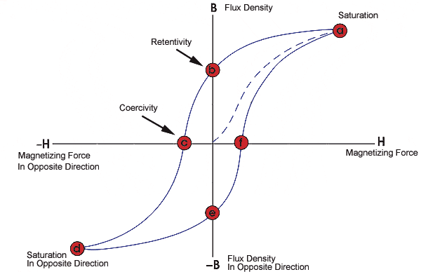
HYSTERESIS LOOP
HYSTERESIS If an alternating magnetic field is applied to the material, its magnetization will trace out a loop called a hysteresis loop

Slide 10
From the hysteresis loop,
1.Retentivity
It is a material's ability to retain a certain amount of residual magnetic field when the magnetizing force is removed after achieving saturation.
2. Residual Magnetism or Residual Flux The magnetic flux density that remains in a material when the magnetizing force is zero.
3.Coercive Force The amount of reverse magnetic field which must be applied to a magnetic material to make the magnetic flux return to zero
4. Reluctance Is the opposition that a ferromagnetic material shows to the establishment of a magnetic field. Reluctance is analogous to the resistance in an electrical circuit.

Slide 11
Difference between Soft & Hard Magnetic Materials
S.No. | Soft Magnet Hard Magnet
1 | They are easily magnetised &demagnetised | They are not easily magnetised &demagnetised
2 | They have low coercivity | They have high coercivity
3 | Hysteresis loss is less | Hysteresis loss is higher
4 | Eddy current loss is less | Eddy current loss is more
5 | Used in transformer cores, motors, generators, electromagnets, etc. | Used in making permanent magnets, magnetic separators, magnetic detectors, speakers, microphones, etc.
6 | They have low remnant magnetization | They have high remnant magnetization
3.Coercive Force The amount of reverse magnetic field which must be applied to a magnetic material to make the magnetic flux return to zero . 4. Reluctance Is the opposition that a ferromagnetic material shows to the establishment of a magnetic field. Reluctance is analogous to the resistance in an electrical circuit.

