Slide 1
PRODUCTION PLANNING AND CONTROL
Dr.A.Antonyraj
Assistant Professor
Dept. Of Management Studies
Bon Secours College for Women
Thanjavur

Slide 2
What is ppc?
“The highest efficiency in production is obtained by manufacturing the required quality of product , of required quantity ,at the required time by the best and cheapest method” - Hence, PPC is a tool to coordinate all manufacturing activities in a production system.

Slide 3
Objectives of ppc
To deliver required goods in required quantities to the customer in the required delivery schedule to achieve maximum customer satisfaction and minimum cost
To ensure maximum utilization of the available resources
To ensure production of quality products
To minimize the manufacturing time

Slide 4
Continued………….
To maintain optimum inventory levels
To maintain flexibility in manufacturing operation
To coordinate between labor and machines and various supporting documents
To plan for plant capacities for future requirements
To remove bottle neck at all stages of production and to solve problems related to production
To ensure effective cost reduction and cost control

Slide 5
Functions of ppc
PPC
PLANNING PHASE
ACTION PHASE
CONTROL PHASE
PROGRESS REPORTING
PRIOR PLANNING
ACTIVE PLANNING
FORECASTING
ORDER WRITING
PRODUCT DESIGN
PROCESS PLANNING AND ROUTING
MATERIAL CONTROL
TOOL CONTROL
LOADING
SCHEDULING
DISPATCHING
CORRECTIVE ACTION
DATA PROCESSING
EXPEDITING
REPLANNING

Slide 6
PLANNING PHASE
PRIOR PLANNING
FORECASTING
PRODUCT DESIGN
ACTIVE PLANNING
PROCESS PLANNING AND ROUTING
MATERIAL CONTROL
ORDER WRITING
TOOL CONTROL
LOADING
SCHEDULING
Estimation of type, quality & quantity of future work
Giving authority to one or more person to undertake a particular job
Collection of information regarding speifications,BOM,drawings etc
Finding the most economical process of doing a work and deciding where and how work will be done
Involves determining the requirements and control of materials
Involves determining the requirements and control of tools used
Assignment of work to manpower, machinery etc
Determines when and in what sequence the work will be carried out. It fixes the starting as well as ending time for the job

Slide 7
ACTION PHASE
ACTION PHASE
DISPATCHING
It is the transition from planning to action phase. In this phase the worker is ordered to start the work

Slide 8
CONTROL PHASE
PROGRESS REPORTING
DATA PROCESSING
CORRECTIVE ACTION
EXPEDITING
REPLANNING
Data regarding the job process is collected
It is interpreted with the present level of performance
Taking action if the progress reporting indicates the deviation of the plan from the originally set targets
Re planning of the whole affair becomes essential, in case expediting fails to bring the deviated plan to its actual path

Slide 9
Stages/steps in ppc
Related to production planning
SEQUENCING
Related to production planning
ROUTING
SCHEDULING
Related to production control
DISPATCHING
Related to production control
FOLLOW UP
Related to production control

Slide 10
1. routing
Routing is the first step in production planning and control.
Routing can be defined as the process of deciding the path (route) of work and the sequence of operations.
In short, routing determines ‘What’, ‘How much’, ‘With which’, ‘How’ and ‘Where’ to produce.
Notes:
Routing may be either very simple or complex. This depends upon the nature of production. In a continuous production, it is automatic, i.e. it is very simple. However, in a job order, it is very complex.
Routing is affected by the human factor. Therefore, it should recognize human needs, desires and expectations. It is also affected by plant-layout, characteristics of the equipment, etc.
The main objective of routing is to determine (fix) the best and cheapest sequence of operations and to ensure that this sequence is followed in the factory.

Slide 11
Advantages of routing
Routing gives a very systematic method of converting raw-materials into finished goods.
It leads to smooth and efficient work.
It leads to optimum utilization of resources; namely, men, machines, materials, etc.
It leads to division of labor.
It ensures a continuous flow of materials without any backtracking.

Slide 12
Continued……
It saves time and space.
It makes the work easy for the production engineers and foremen.
It has a great influence on design of factory's building and installed machines.

Slide 13
Steps /procedure of routing
Product analysis determines what to manufacture and purchase
Product analysis is done again to determine materials required for production
Fix the maufacturing operations and their sequences
Decide the number of units to be manufactured in each lot of production
Analyse the production cost
Prepare the production control forms for effective routing
Prepare a separate route sheet for each order
Estimate the margin of scrap in each lot of production
Notes:
1. Product analysis
Product analysis is the first step in the routing procedure. This is done to find out what parts (goods) should be manufactured and what parts should be purchased. This depends mainly on the relative cost. It also depends on other factors such as technical consideration, purchase policies, availability of personnel, availability of equipment, etc. Generally, during less-busy periods; most of the parts are manufactured in the factory. However, during the busy period, many parts are purchased from outside.
2. Determine required materials
Product-analysis is done again to find out what materials are required for production and their quantity and quality.
3. Fix manufacturing operations
The next step in the routing procedure is to fix (decide) the manufacturing operations and their sequences. The detailed production procedure is then scheduled (planned). Information required for this is derived from technical experience and by analyzing the machine capacity.
4. Determine size of batch
The number of units to be manufactured in any one lot (group or batch) should be decided. This is done concerning customers' orders. Necessary provision should also be made for rejections during the production process.
5. Estimate margin of scrap
The amount of scrap in each lot, should be estimated. Generally, a scrap margin is between 2% to 5% of production.
6. Analyze the production cost
Estimating the cost of manufactured goods is actually the function of costing department. However, the routing section provides necessary data to the costing department that enables it to analyze the production cost.
7. Prepare production control forms
Production Control forms such as Job Cards, Inspection Cards, Tool Tickets, etc. should be prepared. These forms should contain complete information for effective routing.
8. Prepare route sheet
Route sheet is prepared on a production control form. It shows the part number, description of the part and the materials required. It is prepared by a route clerk. Separate route-sheet is required for each part of a customer's order.

Slide 14
TECHNIQUES OF ROUTING
Route card
Work sheet
Route sheet
Notes:
Techniques of Routing While converting raw material into required goods different operations are to be performed and the selection of a particular path of operations for each piece is termed as ‘Routing’. This selection of a particular path, i.e. sequence of operations must be the best and cheapest to have the lowest cost of the final product.
Route card: This card always accompanies with the job throughout all operations. This indicates the material used during manufacturing and their progress from one operation to another. In addition to this the details of scrap and good work produced are also recorded
Work sheet: It contains
Specifications to be followed while manufacturing.
Instructions regarding routing of every part with identification number of machines and This sheet is made for manufacturing as well as for maintenance.
Route sheet: It deals with specific production order. Generally made from operation sheets. One sheet is required for each part or component of the order. This includes the following:
Number and other identification of order.
Symbol and identification of part.
Number of pieces to be made.
Number of pieces in each lot if put through in lots.
Operation data which includes:
List of operation on the part.
Department in which operations are to be performed.
Machine to be used for each operation.
Fixed sequence of operation, if any.
Move order: Though this is document needed for production control, it is never used for routing system. Move order is prepared for each operation as per operation sheet. On this the quantity passed forward, scrapped and to be rectified are recorded. It is returned to planning office when the operation is completed.

Slide 15
1. Route card
This card always accompanies with the job throughout all operations.
This indicates the material used during manufacturing and their progress from one operation to another.
In addition to this the details of scrap and good work produced are also recorded.

Slide 16
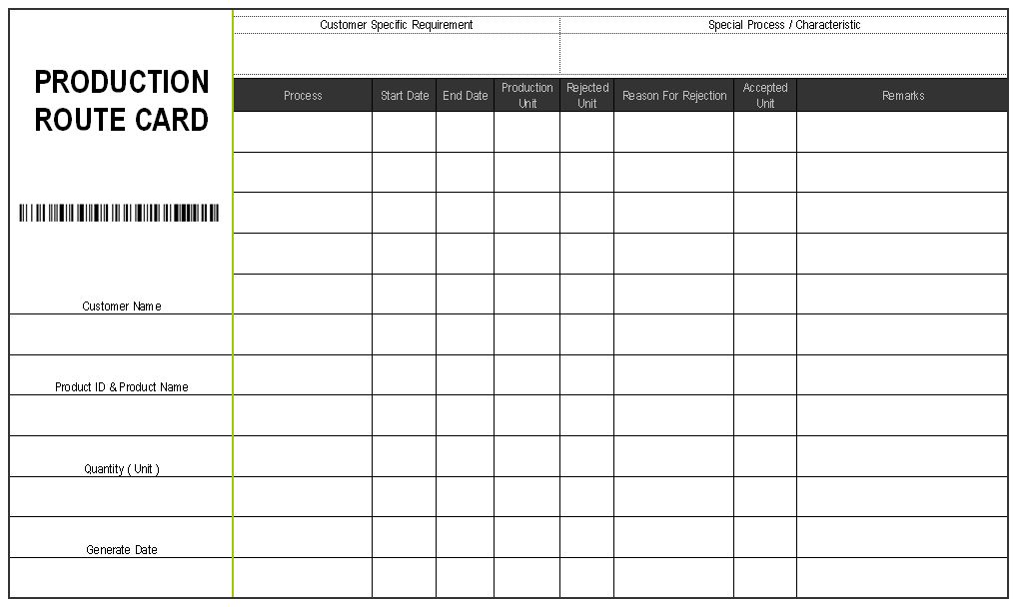
Route card

Slide 17
2. worksheet
It contains
Specifications to be followed while manufacturing.
Instructions regarding routing of every part with identification number of machines.
This sheet is made for manufacturing as well as for maintenance.

Slide 18
3. route sheet
It is also called as route card
It lists the manufacturing operations in the decided sequence along with the machines associated with each operation
It also indicates the department in which the operation is to be done and the part will go for the next operation
It also consists of the information such as part name, part number and product number
It gives information about the material specification and cutting tools,jigs,fixtures and necessary devices for each operation.

Slide 19
Route sheet
ROUTE SHEET
PART NAME : - PART NO. : QUANTITY : |  | MATERIAL : _____________ HARDNESS : ____________ DUE DATE : _____________ |  |  | PART DRAWING :
OPERATION NO. | OPERATION DESCRIPTION | MACHINE | DEPT | TOOLS REQUIRED | TIME (MIN)
 |  |  |  |  | SET UP TIME | OPERATION TIME |  | TOTAL TIME

Slide 20
2. SEQUENCING
Defined as the order in which jobs pass through machines or work stations for processing
The main aim is to find out such sequence out of the possible sequence that will complete the work in shortest time
Sequencing problems becomes tedious as the number of jobs and machines increases

Slide 21
3. scheduling
Scheduling means setting of starting and finishing dates for each operation, assembly and the finished product. It also means to :
Fix the amount of work to do.
Arrange the different manufacturing operations in order of priority.
Fix the starting and completing, date and time, for each operation
Notes:
Scheduling is also done for materials, parts, machines, etc. So, it is like a time-table of production. It is similar to the time-table, prepared by the railways.
Time element is given special importance in scheduling. There are different types of schedules; namely, Master schedule, Operation schedule and Daily schedule.
Scheduling helps to make optimum use of time. It sees that each piece of work is started and completed at a certain predetermined time. It helps to complete the job systematically and in time. It brings time coordination in production planning. All this helps to deliver the goods to the customers in time. It also eliminates the idle capacity. It keeps labor continuously employed.
So, scheduling is an important step in production planning and control. It is essential in a factory, where many products are produced at the same time.

Slide 22
4. dispatching
It’s the next step after scheduling
Also means starting the actual production of a particular work which has been planned in routing schedule.
It provides the necessary authority to start the work.
It is based on route-sheets and schedule sheets.

Slide 23
Dispatching includes the following:
Issue of materials, tools, fixtures, etc., which are necessary for actual production.
Issue of orders, instructions, drawings, etc. for starting the work.
Maintaining proper records of the starting and completing each job on time.
Moving the work from one process to another as per the schedule.
Starting the control procedure.
Recording the idle time of machines.
Notes:
Dispatching may be either centralized or decentralized:
Under centralized dispatching, orders are issued directly by a centralized authority.
Under decentralized dispatching, orders are issued by the concerned department.

Slide 24
4. Follow up
Follow-up or Expediting is the last step in production planning and control. It is a controlling device. It is concerned with evaluation of the results.
Follow-up finds out and removes the defects, delays, limitations, bottlenecks, loopholes, etc. in the production process. It measures the actual performance and compares it to the expected performance. It maintains proper records of work, delays and bottlenecks. Such records are used in future to control production.
Notes:
Follow-up is performed by ‘Expediters’ or ‘Stock Chasers’.
Follow-up is necessary when production decreases even when there is proper routing and scheduling. Production may be disturbed due to break-downs of machinery, failure of power, shortage of materials, strikes, absenteeism, etc.
Follow-up removes these difficulties and allows a smooth production.

Slide 25
Gantt chart
It’s a type of bar chart that illustrates a project schedule.
It is the graphical representation of the duration of tasks against the progression of time.
Its shows the comparison between the planned and actual progress of job through several activities of departments.

Slide 26
AN EXAMPLE
TASK | START DAY | DAYS TO COMPLETE
TASK 1 | 22-May | 13
TASK 2 | 31-May | 9
TASK 3 | 5-Jun | 9
TASK 4 | 15-Jun | 14
TASK 5 | 21-Jun | 9
TASK 6 | 1-Jul | 5
TASK 7 | 8-Jul | 7
TASK 8 | 15-Jul | 12

