Slide 1
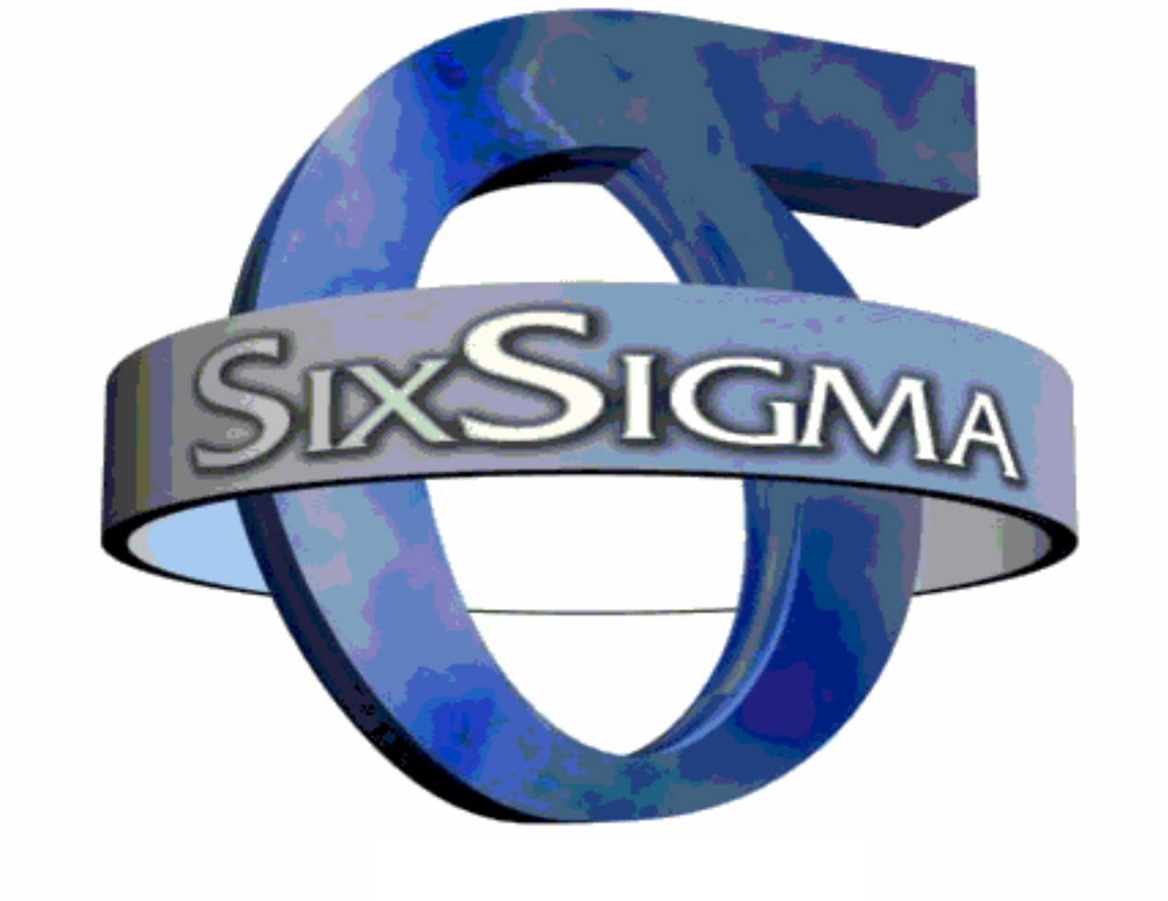
Dr.A.Antonyraj
Assistant Professor
Department of Management studies,
Bon Secours College for women, Thanjavur.

Slide 2
Introduction
Six Sigma is a set of techniques, and tools for process improvement. It was developed by Motorola in 1986.
Sir Bill Smith, “ the Father of six sigma” introduce this quality
improvement Methodology to Motorola.
Six Sigma is now an enormous 'brand' in the world of corporate
development.

Slide 3
History
Since the 1920's the word “sigma”(s) has been used by
mathematicians and engineers as a symbol for a unit of
Measurement in product quality variation.
In the mid-1980's engineers in Motorola in the USA used
“Six Sigma”(S) an informal name for an in-house initiative for reducing defects in production processes, because it represented a suitably high level of quality.

Slide 4
In the late-1980's Motorola extended the Six Sigma methods to its critical business processes, and significantly Six Sigma became a formalized in-house 'branded' name for a performance improvement methodology, i.e, beyond purely 'defect reduction.‘
In 1991 Motorola certified its first 'Black Belt' Six Sigma experts, which indicates the beginnings of the formalization of the accredited training of Six Sigma methods.

Slide 5
In 1995, Six Sigma became well known after Mr. Jack Welch made
it a central focus of his business strategy at General Electric, and
today it is used in different sectors of industry.
(General Electric, or GE, is an American multinational conglomerate
corporation incorporated in New York )
By the year 2000, Six Sigma was effectively established as an industry in its own right, involving the training, consultancy and implementation of Six Sigma methodology.

Slide 6
Definition
Six Sigma seeks to improve the quality of process outputs by identifying and removing the causes of defects.
Six Sigma approach is a collection of managerial and statistical
concept and techniques that focuses on reducing variation in
processes and preventing deficiencies in product.
The concept of Variation states “NO two items will be perfectly
identical.”

Slide 7
In a process that has achieved six sigma capability, the variation is
small compared to the range of specification limit.
A six sigma process is one in which 99.9999966% of the products
manufactured are statistically expected to be free of defects
(3.4 defects per million).
Six Sigma is a very clever way of branding and packaging many
aspects of Total Quality Management (TQM).
( TQM is a management approach to long–term success through customer satisfaction.)
Manufacturing methods of six sigma are used in Batch production, Job production & Mass production.

Slide 8
Father of Six Sigma
Sir Bill Smith
“ the Father of six sigma”

Slide 9
The Characteristics of Six Sigma
Statistical Quality Control
Six Sigma is clearly derived from the Greek letter σ (Sigma) from the Greek alphabet, which is used to denote Standard Deviation
in Statistics. Standard Deviation is used to measure variance, which is an important tool for measuring non-conformance as far as the quality of the output is concerned.
Methodical Approach
The Six Sigma is not merely a quality improvement strategy in theory, as it features a well defined methodical approach of application in DMAIC and DMADV which can be used to improve the quality of production. DMAIC is an acronym for Design-Measure-Analyze-Improve-Control. The alternative method DMADV stands for Design-Measure-Analyze-Design-Verify.

Slide 10
Fact and Data Based Approach
The statistical and methodical aspects of Six Sigma show the scientific basis of the technique. This accentuates an important aspect of Six Sigma that it is fact and data based.
Project and Objective Based Focus
The Six Sigma process is implemented for an organization’s project tailored to its specifications and requirement. The process is flexed to suit the requirements and conditions in which a project is operating to get the best results. Apart from that, the Six Sigma is also objective based.
The management needs some incentive to invest in the Six Sigma
process. It is aimed to enhance profitability and to generate financial.

Slide 11
The Customer Focus The customer focus is fundamental to the Six Sigma approach. The quality improvement and control standards are based on the explicit customer requirements.
Teamwork Approach to Quality Management The Six Sigma process requires organizations to get organized when it comes to controlling and improving quality. Six Sigma actually involves a lot of training depending on the role of an individual in the Quality Management team.

Slide 12
Six Sigma Objectives
Overall Business Improvement
Six Sigma methodology focuses on business improvement. Beyond reducing the number of defects present in any given number of products.
Remedy Defects/Variability
Any business seeking improved numbers must reduce the number of defective products or services it produces. Defective products can harm customer satisfaction levels.

Slide 13
Reduce Costs
Reduced costs equal increased profits. A company implementing Six Sigma principles has to look to reduce costs wherever it possibly can--without reducing quality.
Improve Cycle Time
Any reduction in the amount of time it takes to produce a product or perform a service means money saved, both in maintenance costs and personnel wages. Additionally, customer satisfaction improves when both retailers and end users receive products sooner than expected. The company that can get a product to its customer faster may win her business.

Slide 14
Increase Customer Satisfaction
Customer satisfaction depends upon successful resolution of all Six Sigma’s other objectives. But customer satisfaction is an objective all its own.

Slide 15
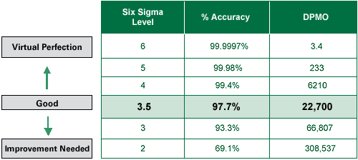
Levels of Six Sigma

Slide 16
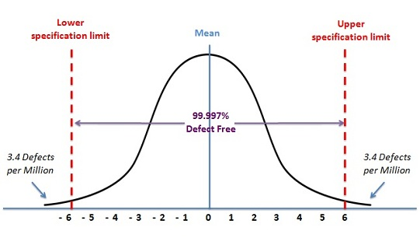
Learning Curve

Slide 17
Methodologies
Six Sigma projects follow two project methodologies :
1. DMAIC
2. DMADV
These methodologies, composed of five phases.

Slide 18
1. DMAIC
DMAIC is used for projects aimed at improving an existing business process.
2. DMADV
DMADV is used for projects aimed at creating new product or process designs.

Slide 19
1. DMAIC
The DMAIC project methodology has Five phases:
1. Define
2. Measure
3. Analyze
4. Improve
5. Control

Slide 20
1.Define
Define the system, the voice of the customer and
their requirements, and the project goals, specifically.
2.Measure
Measure key aspects of the current process and
collect relevant data.

Slide 21
3.Analyze
Analyze the data to investigate and verify cause-and
effect relationships. Determine what the
relationships are, and attempt to ensure that all
factors have been considered. Seek out root cause
of the defect under investigation.
4.Improve
Improve or optimize the current process based upon
data analysis using techniques such as design of
experiments, poka yoke or mistake proofing,
and standard work to create a new, future state
process. Set up pilot runs to establish process
capability.

Slide 22
5.Control
Control the future state process to ensure that any
deviations from target are corrected before they
result in defects. Implement control systems such
as statistical process control, production boards,
visual workplaces, and continuously monitor the
process.

Slide 23
2. DMADV
DMADV project methodology has Five phase:
1. Define
2. Measure
3. Analyze
4. Design
5. Verify

Slide 24
1.Define :
Define design goals that are consistent with
customer demands and the enterprise strategy.
2.Measure
Measure and identify CTQs (characteristics that
are Critical To Quality), product capabilities,
production process capability, and risks.

Slide 25
3.Analyze
Analyze to develop and design alternatives.
4. Design
Design an improved alternative, best suited per
analysis in the previous step

Slide 26
5. Verify
Verify the design, set up pilot runs,
implement the production process and
hand it over to the process owner(s).

Slide 27
Implementation roles
Six Sigma identifies several key roles for its successful implementation:-
Executive Leadership, includes the CEO and other members of top management. They are responsible for setting up a vision for Six Sigma implementation.
Champions, take responsibility for Six Sigma implementation across the organization in an integrated manner
Master Black Belts, identified by champions, act as in-house coaches on Six Sigma. They devote 100% of their time to Six Sigma. They assist champions and guide Black Belts and Green Belts.
Black Belts, operate under Master Black Belts to apply Six Sigma methodology to specific projects.
Green Belts, are the employees who take up Six Sigma implementation along with their other job responsibilities, operating under the guidance of Black Belts.

Slide 28
Learning Curve

Slide 29
Software used for Six Sigma
Arena
ARIS Six Sigma
Bonita Open Solution BPMN2 standard and
KPIs for statistic monitoring
JMP
Mathematical
MATLAB or GNU Octave
Microsoft Visio
STATA
STATISTICA
And Many more…..

Slide 30
Some of the Explanation are :
Arena
is a discrete event simulation and automation software developed by Systems Modeling and acquired by Rockwell Automation in 2000.
ARIS Six Sigma
(Architecture of Integrated Information Systems) is an approach to enterprise modeling. It offers methods for analyzing processes and taking a holistic view of process design, management, work flow, and application processing.
Microsoft Visio
is a diagramming and vector graphics application and is part of the Microsoft Office suite. The product was first introduced in 1992, made by the Shapeware corporation. It was acquired by Microsoft in 2000.

Slide 31
Criticism
Role of consultants
The use of "Black Belts" as itinerant change agents has (controversially) fostered an industry of training and certification. Critics argue there is overselling of Six Sigma by too great a number of consulting firms, many of which claim expertise in Six Sigma when they have only a rudimentary understanding of the tools and techniques involved, or the markets or industries in which they are acting.

Slide 32
PPPpotential negative effects
AFortune article stated that number of 58large companies have announced sSix sSigma programs (”Sstandard & Ppoor's 500“, is a stock market index based on the market capitalizations of 500 large companies having common stock.)
lack of originality
Noted quality expert Mr. Joseph M. Juran has described Six Sigma as "a basic version of quality improvement", stating that "there is nothing new there.

Slide 33
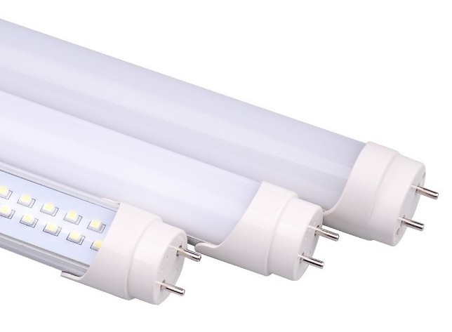
Case Study 1
Six Sigma was introduced into Korea in 1997.
The First National Quality Prize of Six Sigma was given to two companies. One is Samsung and other is LG electronics ; which are virtually the leader of six sigma in Korea.
Samsung SDI was founded in 1970 as a producer of the
black/white Braun tube.
It began to produce the color Braun tube from 1980, and now it is the number one company for braun tubes in the world. The market share of Braun tubes is 22%. The major products are CDT (color display tube), CPT (color picture tube), LCD (liquid crystal display), VFD
(vacuum fluorescent display), C/F (color filter), li-ion battery and PDP (plasma display panel). The total sales volume is about $4.4 billion and the total number of employees is about 18,000 including 8,000 domestic employees. It has six overseas subsidiaries in Mexico, China, Germany, Malaysia and Brazil.

Slide 34
The necessity of Six Sigma in Samsung
WHY?
STRATEGY FOR TOTAL CHANGE
Direction of
problem-solving
Scientific &
statistical
approaches are
necessary
Elimination of
waste elements
Continuous
learning
Problems
PRODUCT
PROCESS
PEOPLE
1. Big quality
variation
2. Occurrence of
same defects
High quality cost
Not enough
provision of unified information
1. High quality cost
2. Not enough
provision of
unified
information

Slide 35
The problems were in the large quality variations in many products, repeated occurrences of the same defects, high quality costs(in particular, high failure costs), insufficient unified information for quality and productivity, manufacturing-oriented small group activities, and
infrequent use of advanced scientific methods.
The company concluded that the directions for solving these problems lay in scientific and statistical approaches for product quality, elimination of waste elements for process innovation, and continuous learning system for people. These directions in turn demanded a firm strategy for a complete overhaul, implying a new paradigm shift to Six Sigma.
Samsung SDI made a contract with SBTI (Six Sigma Break-through Inc.) for Six Sigma consultation in 1999. It was a one-year, $3.4 million contract in which SBTI was supposed to help the company in every aspect of Six Sigma.

Slide 36
The vision of Six Sigma
TRUE LEADER IN DIGITAL WORLD
World-best
profit realization
• World no.1 products
• Achievement of 6σ
quality level
Reduction of
quality cost
Cultivation of
global professionals
PRODUCT
• 4 world #1 products
• Improvement of R&D power
• Customer-oriented quality
PROCESS
• Global standard
• Improvement of
process effectiveness
PEOPLE
• Learning organization
• Good working habit
• 7 values
Well equipped with Six Sigma philosophy, systems and methodologies
• Project team activities • Belt system
• Six Sigma academy (education) • Reward system

Slide 37
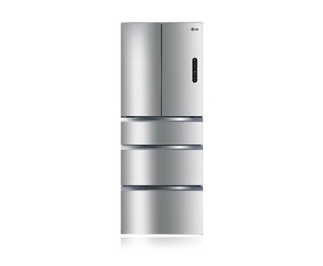
Case Study 2
Six sigma in Digital Appliance Company of LG Electronics
The Digital Appliance company of LG Electronics is another company which received the first national Six Sigma quality prize in 2000.
LGE was founded in 1958 under the name of Gold star, and later became LGE in 1995. LGE consists of three companies:
Digital Appliance, Digital Media, and Digital Multimedia.
LGE-DA received the first national Six Sigma quality award. The major products of LGE-DA are air conditioners, washing machines, vacuum cleaners, microwave ovens, air compressors, refrigerators and motors.
As of 2000, the company had 4,800 employees with total sales of
$2.5 billion. LGE now has 30 different overseas subsidiaries in China, Turkey, England, Mexico, Hungary, India, Vietnam, Indonesia, and other countries

Slide 38
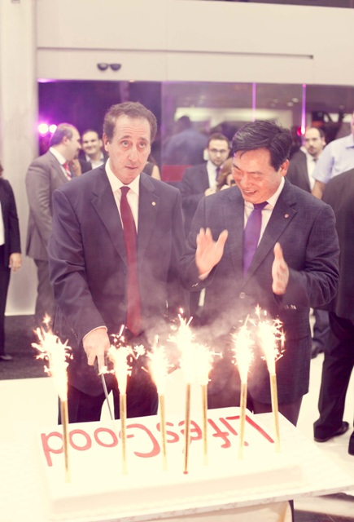
In early 1990s, for business reasons the company concentrated on cooperation of capital and labor, since there were numerous labor strikes in the late 1980s. After they overcame the labor problems, the price reduction movement became the major business issue for competitiveness in the international market.
LGE-DA adopted the Six Sigma concept from 1996.
From 2000 Six Sigma and e-business strategies became the major innovation activities for this company. As far as quality management is concerned, the AQL was approximately at the 3σ level until 1991. Owing to the 100PPM movement since 1992, the company became
successful in enhancing its quality level to 4σ. In 1996 it adopted Six Sigma, challenging itself to achieving the goal of 6σ quality level in a few years.

Slide 39
Case Study 3
Catalent Pharma Solutions, is a leader in developing solutions for the pharmaceutical, veterinary, biological and consumer health industries. The company was faced with high numbers of defects after producing millions of units. The process flow was slow because of the time required to analyze the samples. Six Sigma processes were applied to address these issues.
The company specifically required a solution for their proprietary product known as Zydis. The company needed new systems that would help to predict the process variation. The improvements are also supposed to help operators understand statistical analyses.
Zydis tablets

Slide 40
The project team devised a database to collect information. Control charts were also completed and entered automatically. The programming language used for automation was flexible and easy to replicate. The efficiency was improved by making these changes. After two weeks of implementing Six Sigma processes, the company prevented the loss of two batches of product, which was worth 50,000 pounds.(5101500.00 Indian Rupee)
Which is ”Five million one hundred one thousand Five hundred“
This case study demonstrates how companies can improve processes to meet Six Sigma standards, prevent loses and save money. Companies that save money can reallocate the funds towards research and design or improvement of other processes. Every company should try six sigma processes.

Slide 41
Thank You

