Slide 1
VICEROYS OF INDIA
Dr.AGHALYA.,M.A.,M.Ed.,M.PHIL.,Ph.D., Head & Asst.Professor Department of History Bon Secours College for Women Thanjavur

Slide 2
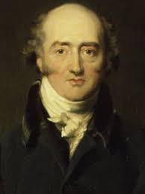
LORD CANNING 1856-1862
He was the first viceroy of India
He withdrew doctrine of lapse
Indian council act was passed in 1861

Slide 3
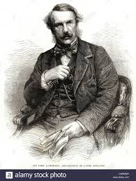
Lord lawrence 1864-1862
High court was established at calcutta,bombay, madras in 1865.
He created Indian Forest Department.
He was know as the saviour of punjab.

Slide 4
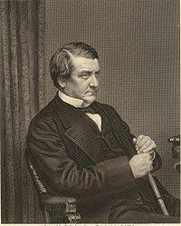
LORD MAYO 1869-1872
First census of India was held during his time in 1871
He organized statistical survey of India

Slide 5
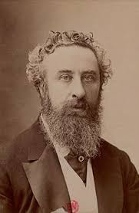
LORD LYTTON 1876-1880
* Vernacular press act was passed in 1878

Slide 6
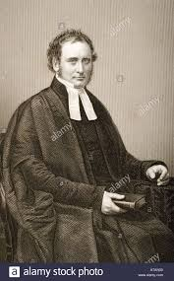
Lord Rippon 1880-1884
First factory act was passed by him.
Illbert bill in 1883 was passed by him.
Passed local self government act in 1882.

Slide 7
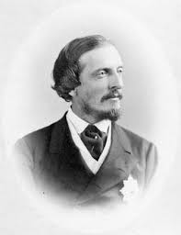
Lord dufferin 1884-1888
* He formed the Indian national congress

Slide 8
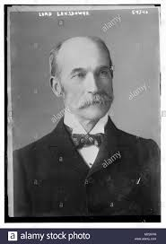
Lord lansdowne 1888-1894
* Indian council act was passed in 1892

Slide 9
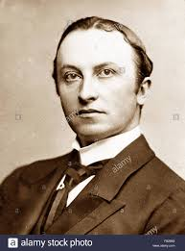
Lord curzon 1899-1905
Partition of Bengal (1905) was done during his period.
Passed the ancient monuments act 1904.
He established archeological survey of India.

Slide 10
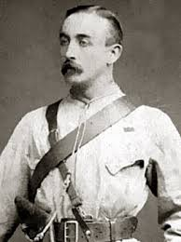
Lord minto 1905-1910
Morley-minto reform was passed in 1909.

Slide 11
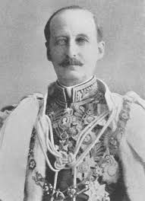
Lord hardinge 1910-1916
Partition of Bengal was cancelled and capital shifted from Calcutta to Delhi in1911.
Home rule moment was launched by Annie Beasant.

Slide 12
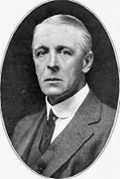
Lord chlemsford 1916-1921
Jallianwala Bagh massacre 1919 took place during his time.
Non- cooperation and khilafat movement took place.
Women’s university was founded at poona in 1919.

Slide 13
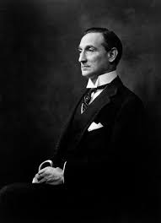
Lord Reading 1921-1926
Formation of swaraj party.
Ahmedabad session of ins held in 1921.

Slide 14
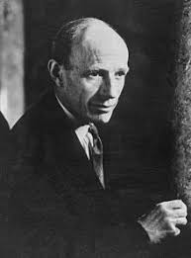
Lord irwin 1926-1931
Gandhi Irwin pact was signed and first round table conference was held in 1931.

Slide 15
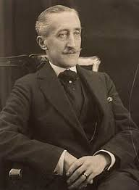
Lord willingdon 1931-1936
Government of India act was passed in 1935.

Slide 16
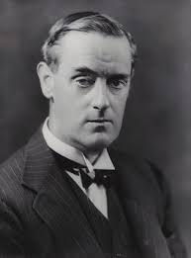
Lord linlithgow 1936-1944
Quit India movement was started in 1942.

Slide 17
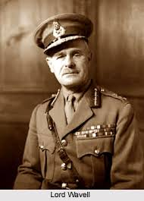
Lord wavell 1944-1947
Cabinet mission plan was launched in 1946.
On december 09, 1946, first meeting of constituent assembly was held.

Slide 18
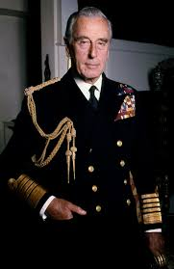
Lord Mountbatten Mar 1947-Aug 1947
Last viceroy and first governor general of free India.
Independent act was passed on july 4, 1947 by British parliament.

Slide 19
Thank you
HAPPY DAY

