Slide 1
PRODUCTION
M. MARIA JESSICA
PG AND RESEARCH DEPARTMENT OF COMMERCE
BON SECOURS COLLEGE FOR WOMEN
THANJAVUR

Slide 2
Contents
ISO – QUANT ANALYSIS
- Meaning
- Shift of ISO – quants
- Difference between indifference curve analysis and ISO – quant analysis.
- Properties of ISO – quants
- Principles of Diminishing Marginal Rate of Technical Substitution.
- Types of ISO – quants.

Slide 3
ISO – QUANT ANALYSIS
Meaning :
- The producer chooses only that combination which is the most economical.
- This is stated as the equilibrium position for the producer.
- This technique for the study of equilibrium position of the producer is known as the analysis of “ Iso –product curves”. (Iso – quant means equal quantity).

Slide 4
Example
How different pairs of labour and capital result in the same output?
Factor combination | Labour (units) | Capital (units) | Output (units)
A | 1 | 5 | 50
B | 2 | 4 | 50
C | 3 | 3 | 50
D | 4 | 2 | 50
E | 5 | 1 | 50

Slide 5
CONTD…
Let us assume a production function with two variable inputs,
Labour [L] Capital [C]
Thus: Q = F [L,C]
Now, if the firm can combine labour and capital in different proportions and can maintain a specified level of output say, 50 units of product X, under the prevailing state of technology and given organizational ability of the entrepreneur, units of labour [L] and capital [C] may combine alternatively, as follows:

Slide 6
CONTD…
Now, if the firm can combine labour and capital in different proportions and can maintain a specified level of output say, 50 units of product X, under the prevailing state of technology and given organizational ability of the entrepreneur, units of labour [L] and capital [C] may combine alternatively, as follows:
Factor combination
Factor combination | Labour (units) | Capital (units) | Output (units)
A | 1 | 5 | 50
B | 2 | 4 | 50
C | 3 | 3 | 50
D | 4 | 2 | 50
E | 5 | 1 | 50

Slide 7
Contd…
The first combination implies greater use of capital and less of labour to attain a given level of output [say 50 units of X as we assumed].
In this factor combination , we have relative capital intensity while even by the last combination, by using more labour and less capital, we can produce the same level of output.
Only five alternative combinations of labour and capital have been given.
However, there can be innumerable such combinations for producing the same quantity of output.
This relationship, when shown graphically, results in an Iso – quant.

Slide 8
Contd…
If we plot all these combinations graphically and join the labour capital of their points, we drive a curve called iso – quant, tracing all the combinations of the two factors of that yield the same output, as shown in the figure.
Y
6 IQ
5 .A
4 .B
3 .C
2 .D
1 . E
X 50
On IQ output level is same on each combination of factors
0
1
2
3
4
5
6
x
labour

Slide 9
Contd…
Combination of A, B, C, D and E inputs yield the same output.
The entrepreneur can select any combination and produce the maximum output.
Iso – Quant means equal quantity.

Slide 10
SHIFT OF ISO - QUANTS
The Iso – product curve can shift to a higher level or to a lower level as in the case of demand curves.
A catalogue of different combinations of inputs with different levels of output can be indicated in a graph which is called Equal Product Map or Equal Product Contours.
Y IQ1 IQ2 IQ3
On IQ output level is same on each combination of factors
Capital
X 150
X 100
X 50
Labour
X
Higher Iso – quant indicates higher output.

Slide 11
Difference between Indifference curve and Isoquant
a) - Under indifference curve analysis, the curves are indicated as first curve, second curve and so on, as precise measurement of satisfaction of the consumer is not possible.
- But in Iso – quant analysis, each curve represents a particular level of output and so it is represented in terms of output.
b) - In Indifference Curve analysis, we can only say whether the consumer gets more satisfaction or less satisfaction but not exactly how much more or how much less.
- But under the Iso – quant analysis, comparison between lower and higher levels of output is possible, as each Iso – quant represents a particular level of output.

Slide 12
Properties of Iso -quants
An Iso – quants slopes downwards from left to right, i.e. negatively inclined.
This implied that for the same level of output, the quantity of one variable will have to be reduced in order to increase the quantity of other variable.
The Iso – quant cannot i) slope upwards, ii) be vertical and iii) be horizontal.
No two Iso – quants can cut each other or intersect.
If it happens so, this would mean that there will be a common point on the two curves, and this would imply that the same amount of two inputs can produce two different levels of output, which is not possible.

Slide 13
Contd…
Iso – quants are convex to the origin.
Because, as we increase the application of one input that of the other declines.
This should result in a downward sloping curve.
Higher Iso – quant indicates higher level of output and lower Iso –quant indicates lower level of output.
In other words, Iso – quants lying to the right represent a larger output than those lying to the left, which indicate lower output.

Slide 14
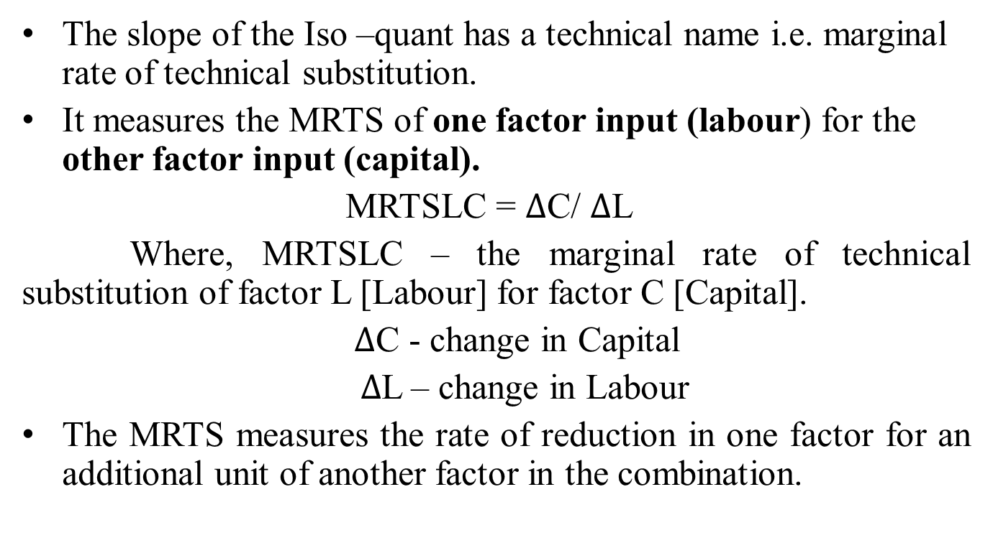
Principles of Diminishing Marginal Rate of Technical Substitution
The slope of the Iso –quant has a technical name i.e. marginal rate of technical substitution.
It measures the MRTS of one factor input (labour) for the other factor input (capital).
MRTSLC = $∆$C/ $∆$L
Where, MRTSLC – the marginal rate of technical substitution of factor L [Labour] for factor C [Capital].
$∆$C - change in Capital
$∆$L – change in Labour
The MRTS measures the rate of reduction in one factor for an additional unit of another factor in the combination.

Slide 15
Contd…
This is just sufficient to produce the same quantity of output.
The convexity of Iso – quant suggests that MRTS is diminishing which means that as quantities of one factor, labour, is increased, the less of another factor, capital, will be given up, if output level is to be kept constant.

Slide 16
TYPES OF ISO - QUANTS
- An important assumption in the iso – quant diagram is that the inputs can be substituted for each other.
- The shape of the curves depends upon the degree of substitutability of inputs.
Linear Iso – quants
Right – angle Iso – quant
Convex Iso – quant

Slide 17
LINEAR ISO - QUANTS
In this, there is perfect substitutability of inputs.
For Example: Given a power plant equipped to burn either oil or gas, various amounts of electric power can be produced by burning gas only, oil only or varying amounts of each. Gas and oil are perfect substitutes here. Hence, the iso-quants are straight lines.
y
Q1 Q2 Q3 Q4 Q5
o x
Oil
Gas

Slide 18
Right – Angle Iso - quant
Here, there is complete non – substitutability between the inputs [ or strict complimentary].
For example, Exactly two wheels and one frame are required to produce a bicycle and in no way can wheels be substituted for frames or vice versa.
Q₃ = 3 cycle
Q₂ = 2 cycle
Q₁ = 1 cycle
o
This is also known as Leotief Iso – quant or Input – output Iso – quant.
Frames
Wheels

Slide 19
Convex Iso – quant
This form assumes substitutability of inputs but the substitutability is not perfect.
For Example: A shirt can be made with relatively small amount of labour (L1) and a large amount of cloth (C1).The same can be as well made with less cloth [C2], it more labour [L2] is used because the tailor will have to cut the cloth, more carefully and reduce wastage. Finally, the shirt can be made with still less cloth [c3] but the tailor must take extreme pains so that labour input requirement increases to L3. So, while a relatively small addition from L1 to L2 allows the input of cloth to be reduced from C1 to C2, a very large increase in labour from L2 to L3 is needed to obtain a small reduction in cloth from c2 to c3. Thus the substitutability of labour or cloth diminishes from L1 to L2 to L3.

Slide 20
Contd…
Y
( Should be convex)
c1
c2
Q2
c3 Q1
L1 L2 L3 X
Labour

Slide 21
THANK YOU

