Slide 1
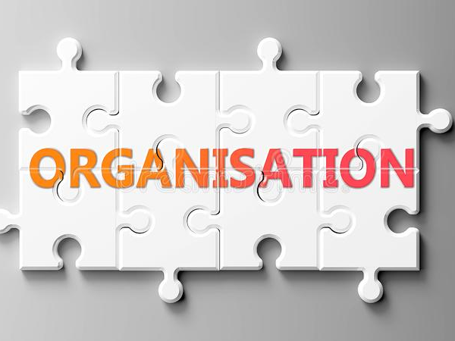
SSS
S.JAYALAKSHMI
Assistant Professor
BON SECOURS COLLEGE FOR WOMEN, THANJAVUR.

Slide 2
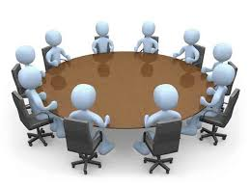
Meaning
An organization or organisation is an entity, such as a company, an institution, or an association, comprising one or more people and having a particular purpose.
The word is derived from the Greek word organon, which means tool or instrument, musical instrument, and organ.

Slide 3
Definition: George R. Terry who defines management as “a process consisting of planning, organising, actuating and controlling performed to determine and accomplish the objectives by the use of people and resources”.

Slide 4
Organizational Structure
Organizational structure affects organizational action and provides the foundation on which standard operating procedures and routines rest.
It determines which individuals get to participate in which decision-making processes, and thus to what extent their views shape the organization's actions.
Organizational structure can also be considered as the viewing glass or perspective through which individuals see their organization and its environment.

Slide 5
TYPES OF ORGANISATIONAL STRUCTURE
1 Hierarchical Structure. The hierarchical model is the most popular organizational chart type.
2) Matrix Structure.
3) Horizontal/Flat Structure.
4) Network Structure.
5) Divisional Structure.
6) Line Organizational Structure.
7) Team-based Organizational Structure.

Slide 6
PROCESS OF ORGANISATION
IDENTIFICATION OF ACTIVITIES
GROUPING OF ACTIVITIES
DELEGATION OF AUTHORITY
ASSESSMENT OF DUTIES

Slide 7
Importance of Organising
Benefits of Specialisation
Clarity in Working Relationship
Optimum Utilisation of Resources
Adaptation to Change:
Effective Administration
Development of Personnel
Expansion and Growth

Slide 8
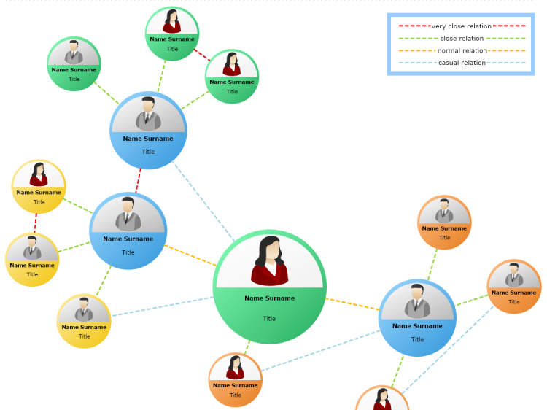
MODERN ORGANISATRIONAL CHART
C

