Slide 1
CREATION OF EMAIL ID

Slide 2
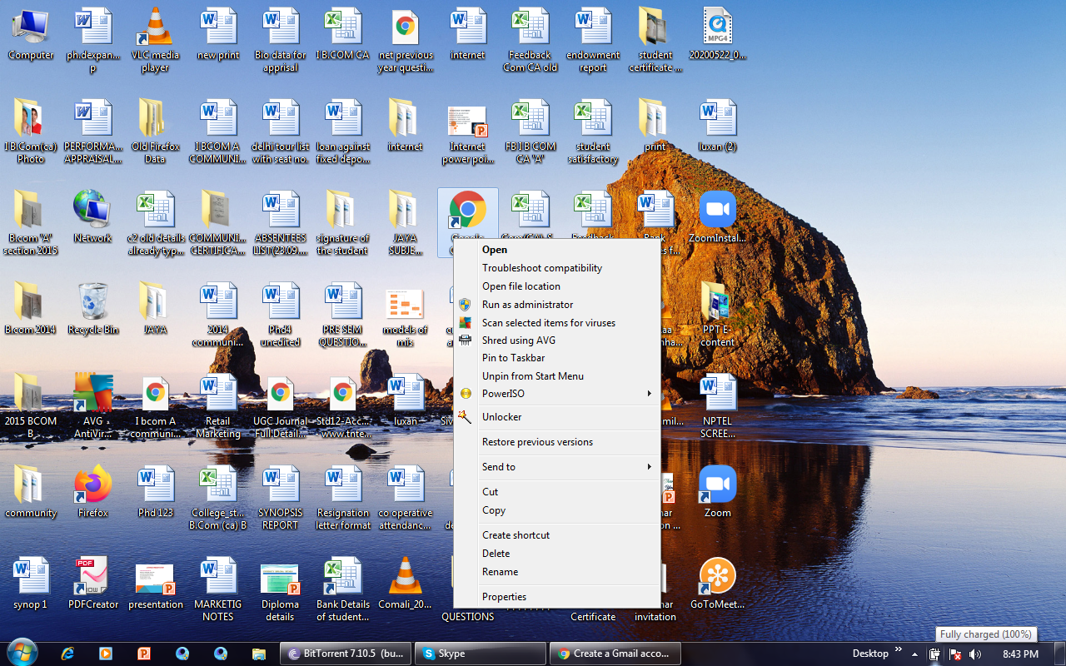
OPEN YOUR FAVOURET BROWSER

Slide 3
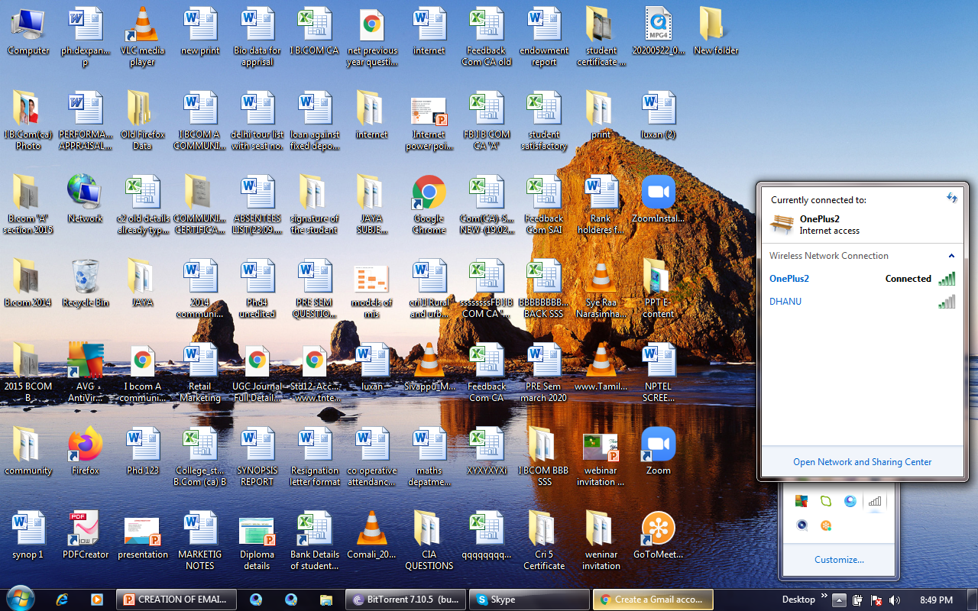
Switch on the internet connection
Open the G-mail account creation website. Go to http://www.google.com/gmail/about/# in your web browser. This will open a page with information regarding G-mail

Slide 4
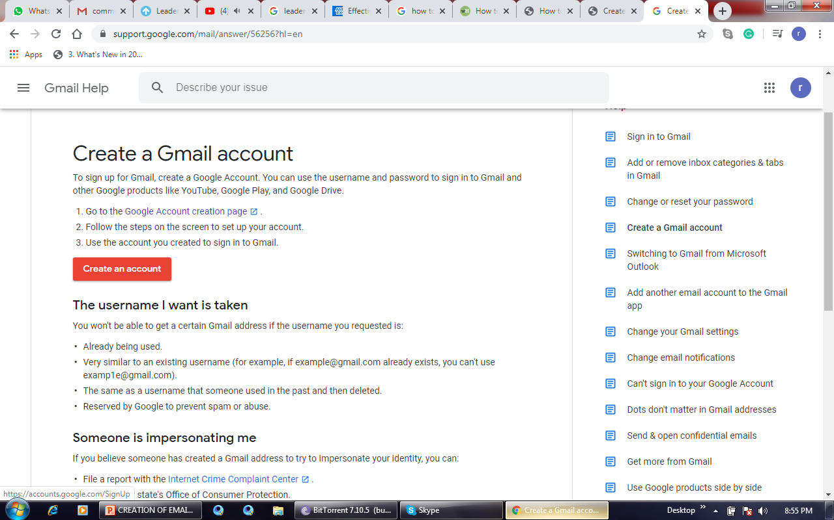
Click CREATE AN ACCOUNT. It's a red button in the the window. Doing so takes you to the first page in the account creation section.

Slide 5
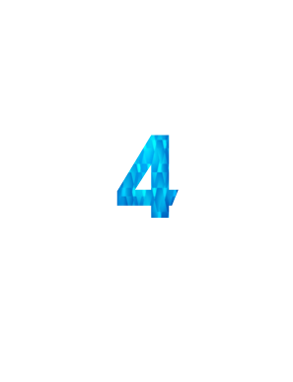
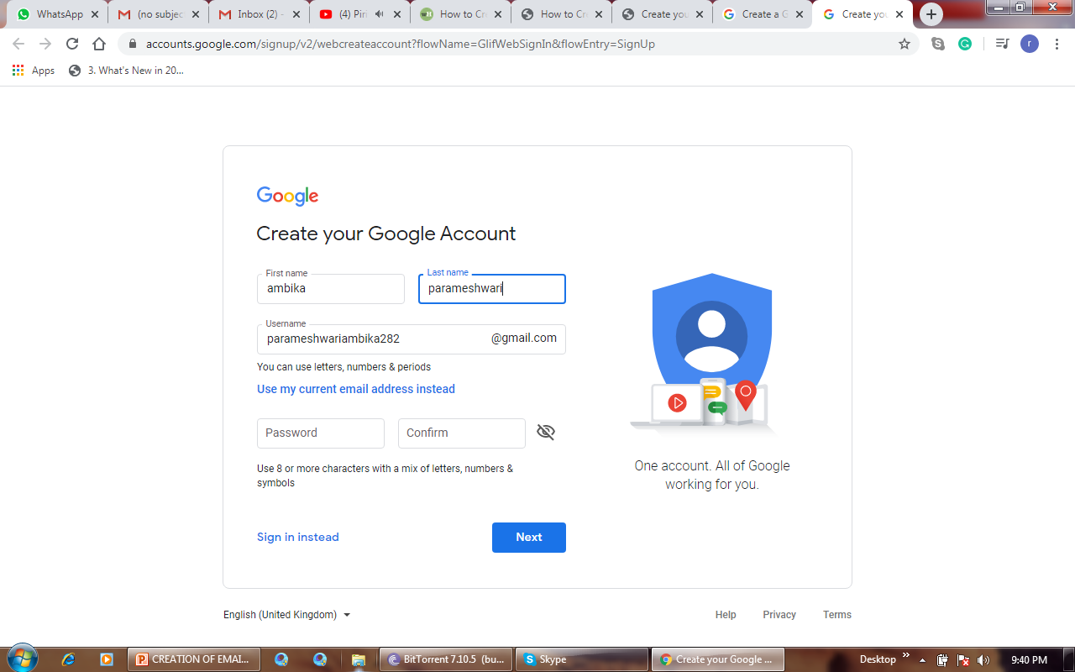
3
Enter your first and last name. Type your first name into the "First name" text box near the top of the page, then enter your last name in the "Last name" box next to it.
Create a Gmail username. In the "Username" text box, type in the username you want to use for your email address. This is the name which appears before the "@gmail.com" section of the address.
If your selected username is already taken, you'll be asked to choose a different one upon clicking a different text box on the page.

Slide 6
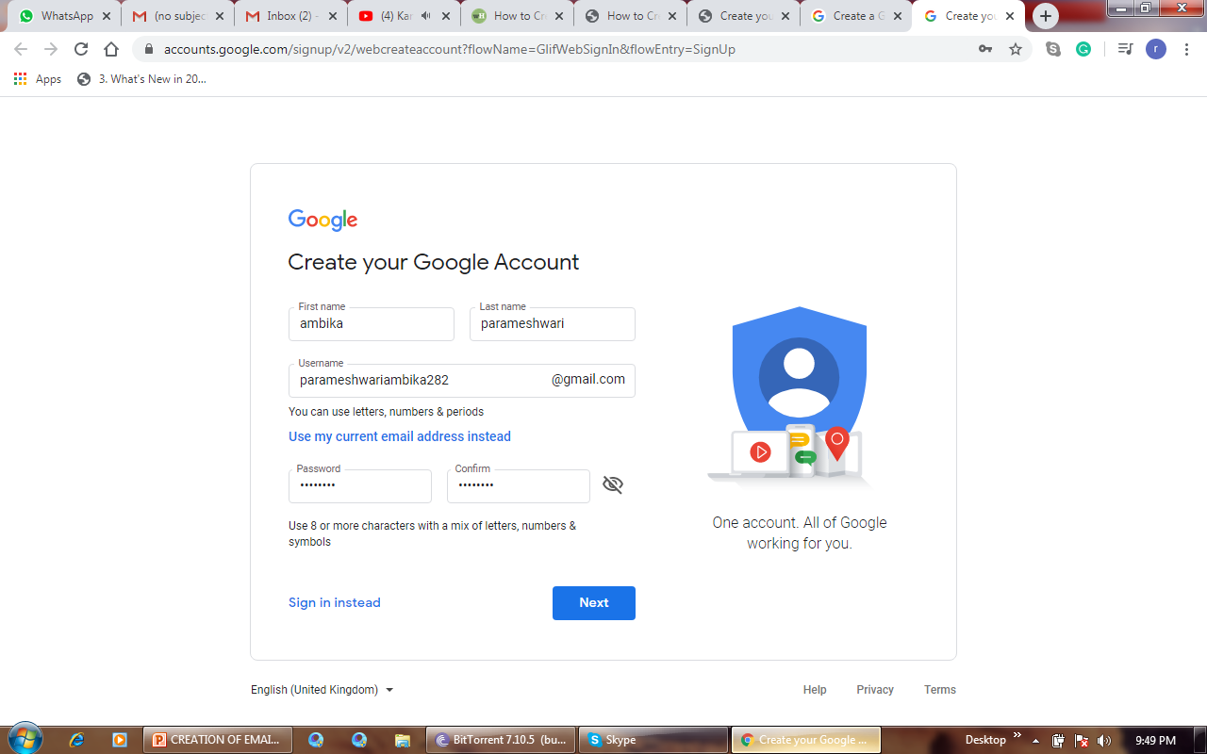
5
Enter a password twice. Type your preferred password into the "Password" text box near the bottom of the page, then type the same password into the "Confirm password" box to the right of the first password box. These passwords must match before you can proceed.
Click NEXT. It's a blue button at the bottom of the page.

Slide 7
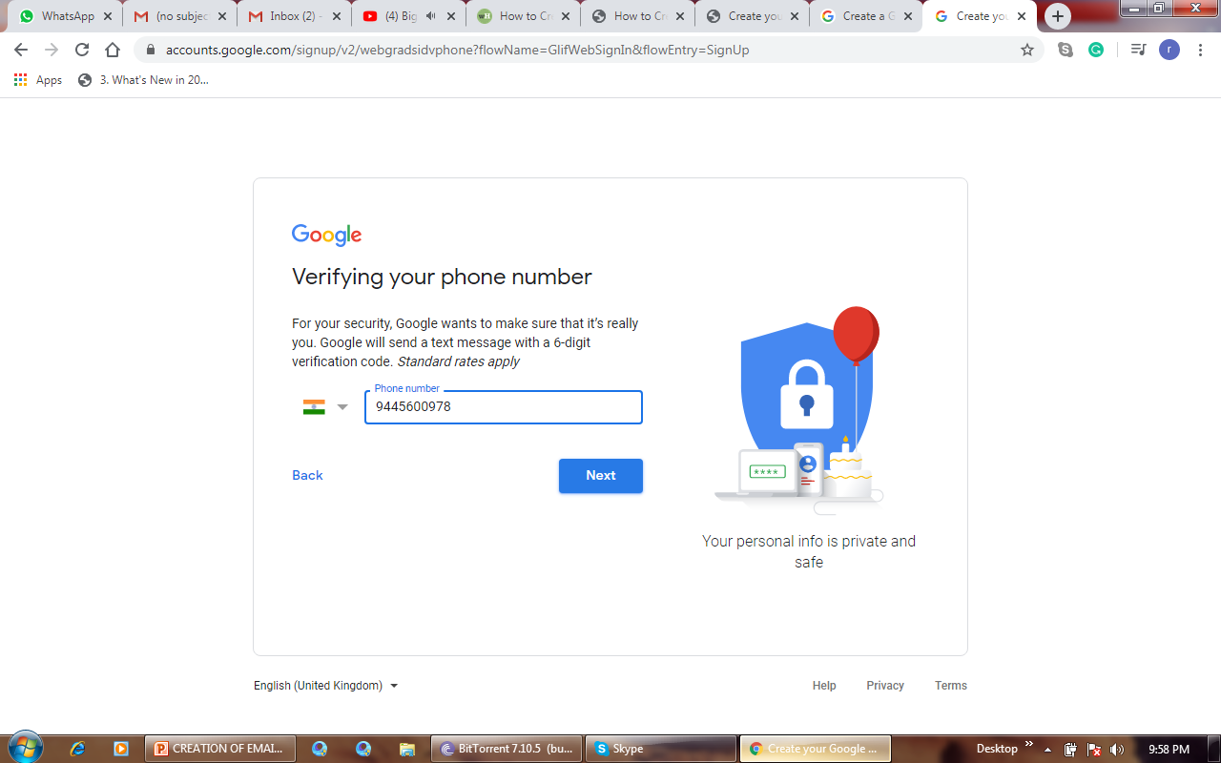
Enter account recovery option
While not mandatory, you can add up to two types of account recovery options to your Gmail profile.
Phone number — Type your phone number into the "Phone number" text box near the top of the page.
Recovery email address — Type any other email address into the "Recovery email address" text box near the top of the page.
6

Slide 8
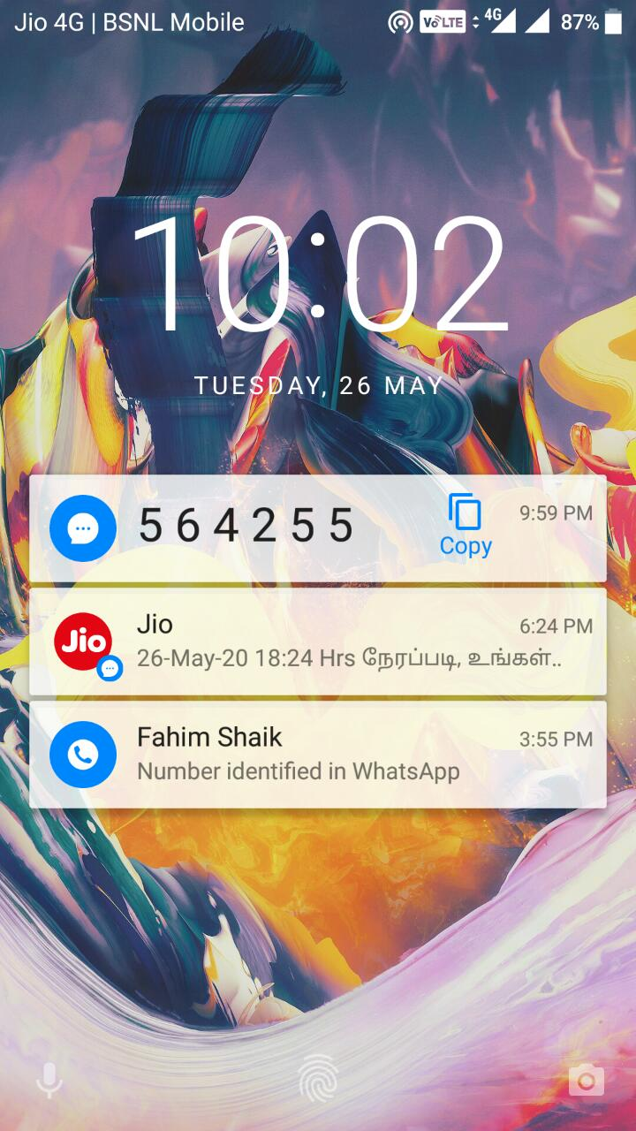
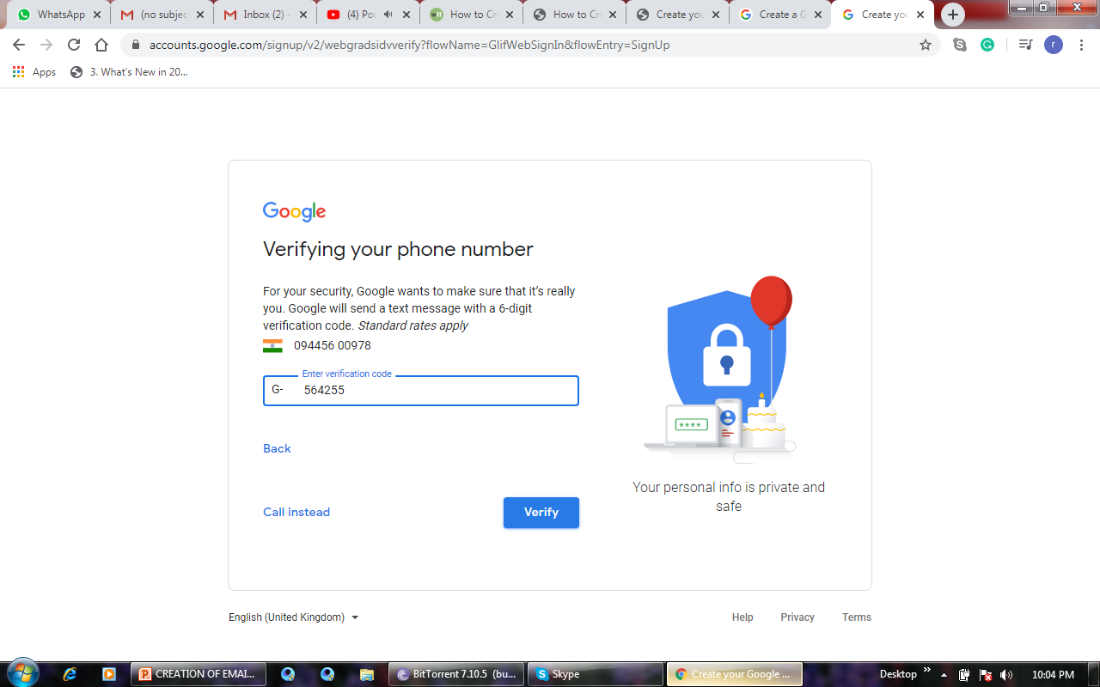
7

Slide 9
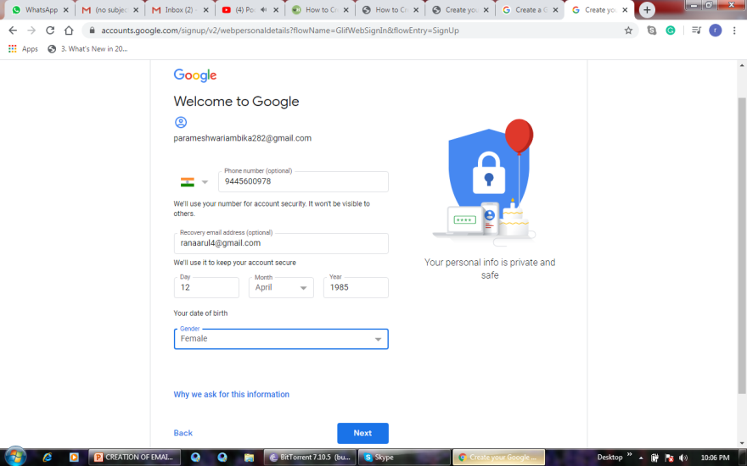
Add your date of birth. Click the "Month" drop-down box and select the month of your birthday, then type the day and year into the "Day" and "Year" text boxes, respectively.
8
Click the "Gender" drop-down box, then select one of the gender options in the resulting drop-down menu.

Slide 10
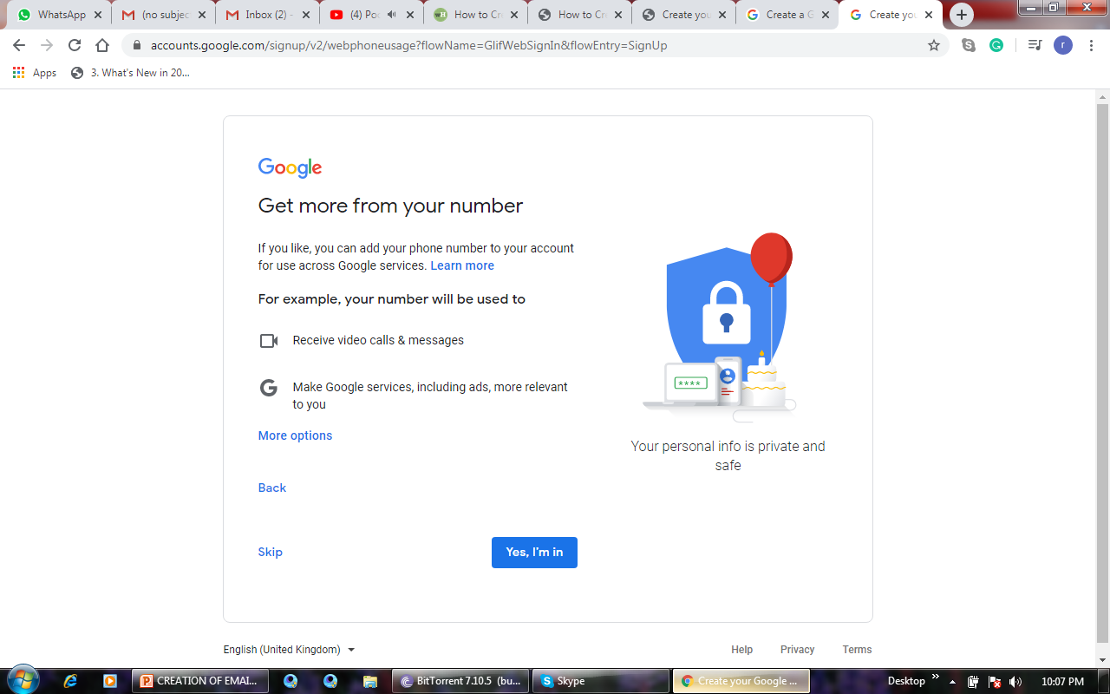
9
Click the “yes I am" box.

Slide 11
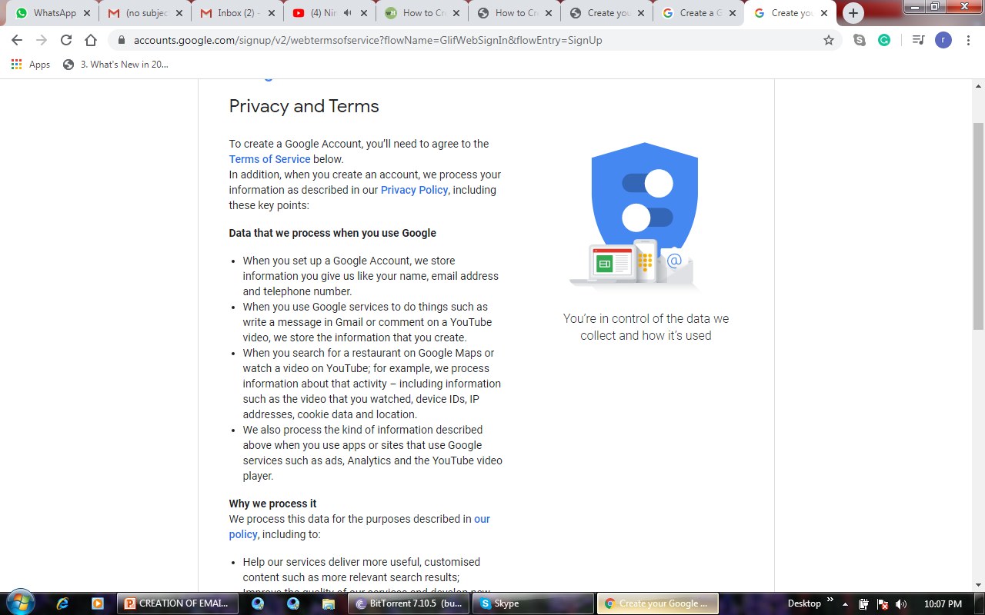
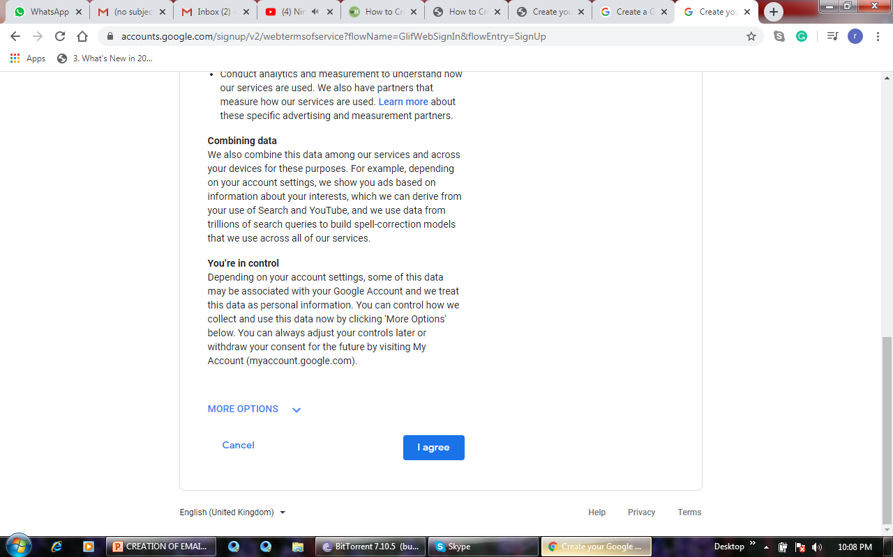
10
Scroll down and click I AGREE. It's at the bottom of the terms of service list on the left side of the page. Doing so will accept the terms of service and sign you into your Gmail account.

Slide 12
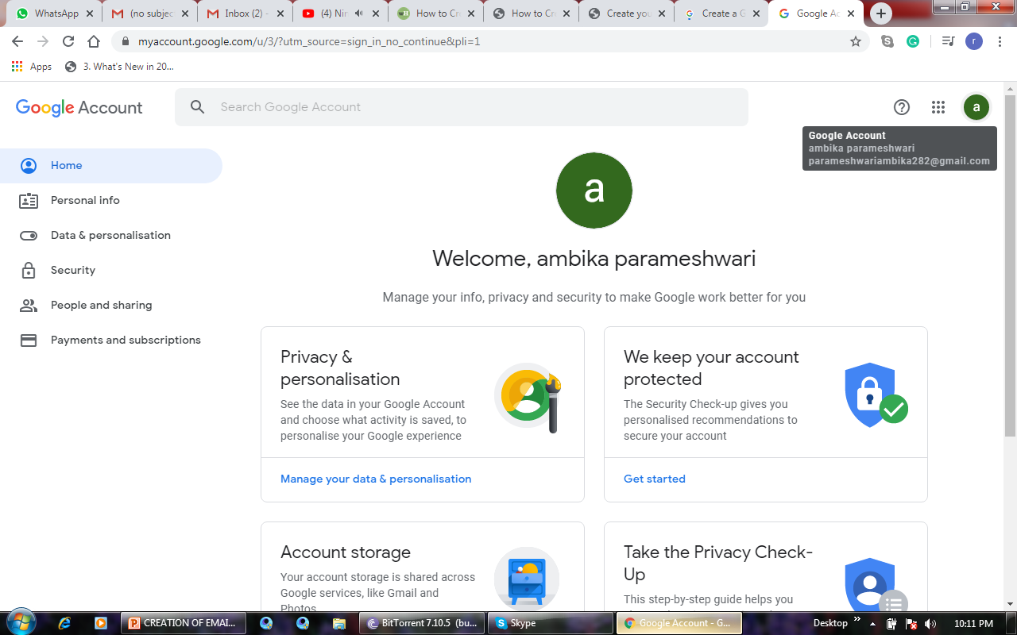
Congratulations! your account has been created. From now onwards every time you sign in you just have to enter your email id and password. And every time you sign-in don't forget to sign-out because it prevents others from viewing your emails.
11

