Slide 1
CRYSTALLOGRAPHY
MRS.S.AMIRTHAM
ASSISTANT PROFESSOR
PG & RESEARCH DEPARTMENT OF BIOTECHNOLOGY
BON SECOURS COLLEGE FOR WOMEN
THANJAVUR

Slide 2
Introduction:
Crystallography is the experimental science of determining the arrangement of atoms in crystalline solids.
. The word "crystallography" is derived from the Greek words crystallon "cold drop, frozen drop", with its meaning extending to all solids with some degree of transparency, and graphein "to write"

Slide 3
Discovery:
The field of crystallography started with thediscovery of X-rays by Röntgen who was awarded the Nobel Prize in Physics for thisdiscovery in 1901.
Max von Laue followed this by investigating the interaction of X-rays with crystals producing a diffraction pattern and he received the Nobel Prize for Physics in 1914

Slide 4
Types of crystal:
There are in total 7 groups, collectively calledCrystal Systems:
Tricinic,
Monoclinic,
Orthorhombic,
Tetragonal,
Trigonal,
Hexagonal, and
Cubic.
The symmetry of each group is described by the relationship between the lattice sides a, b, and c and angles α, β and γ.

Slide 5
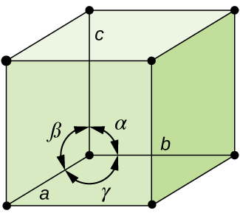
Unit cell:
The unit cell is defined as the smallest repeating unit having the full symmetry of the crystal structure.
The geometry of the unit cell is defined as a parallelepiped, providing six lattice parameters taken as the lengths of thecell edges (a, b, c) and the angles between them (α, β, γ).

Slide 6
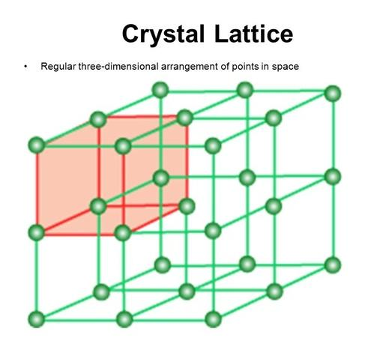
Space lattice:
A space lattice is an array of points showing how
particles (atoms, ions or molecules) are arranged at different sites in three dimensional spaces

Slide 7
Types of cubic cells:
There are three main varieties of these crystals:
Primitive cubic (abbreviated cP and alternatively called simple cubic)
Body-centered cubic (abbreviated cI or bcc)
Face-centered cubic (abbreviated cF or fcc, and alternatively called cubic close-packed or ccp)

Slide 8
Diagramatic view:

Slide 9
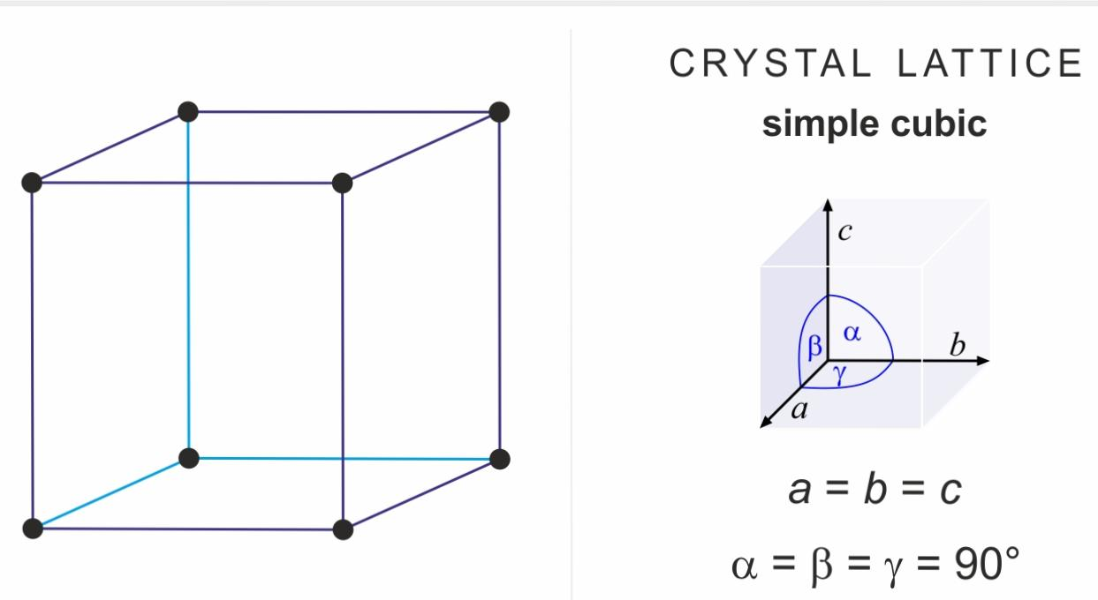
Arrangements of identical spheres in a simple cubic cell:
Total no. Of atom per simple cubic cell is 8(1/8)= 1 atom

Slide 10
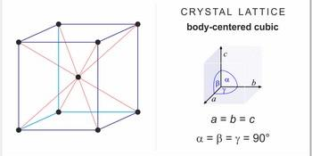
Arrangements of identical spheres in body centred cube:
Total no.of atom per BCC unit cell is 8(1/8)+1 =2 atoms

Slide 11
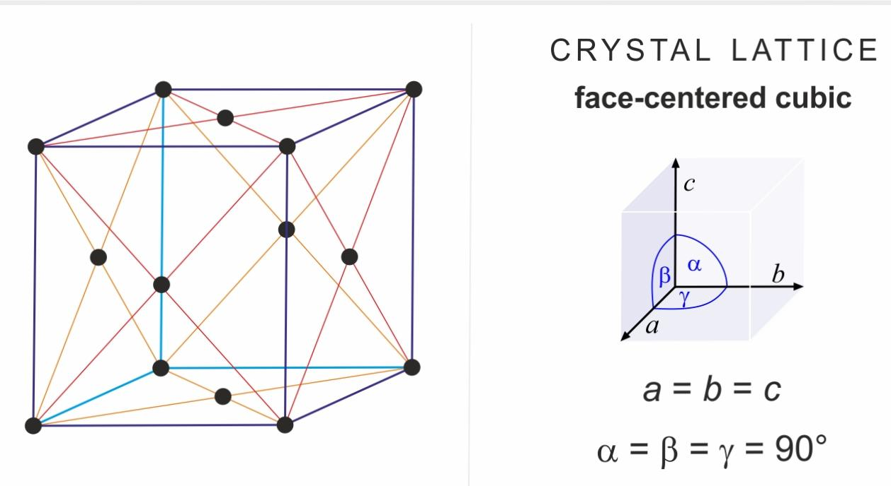
A corner atom and a face centred atom:
Total no.of atom per FCC unit cell is 8(1/8)+6(1/2)= 4 atoms.

Slide 12
7 crystal systems:

Slide 13
Principle
The underlying principle is that the crystalline atoms cause a beam of X-rays to diffract into many specific directions.
By measuring the angles and intensities of these diffracted beams, a crystallographer can produce a 3D picture of the density of electrons within the crystal.

Slide 14
X ray diffraction:
a scattering of X-rays by the atoms of a crystal that produces an interference effect so that the diffraction pattern gives information on the structure of the crystal or the identity of a crystalline substance.
Since X-rays have a smaller wavelength than visible light, they have higher energy and are more penetrative. Its ability to penetrate matter, however, is dependent on density of the matter. Therefore, X-rays are useful in exploring structures of atoms.

Slide 15
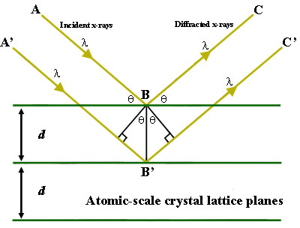
BragG’s law:
Bragg's law, or Wulff–Bragg's condition, a special case of
Laue diffraction, gives the angles for coherent and incoherent
scattering from a crystal lattice. When X-rays are incident on
an atom, they make the electronic cloud move, as
does any electrom.sgnetic wave.
Braggg’s equation : n λ = 2d sinΘ

Slide 16
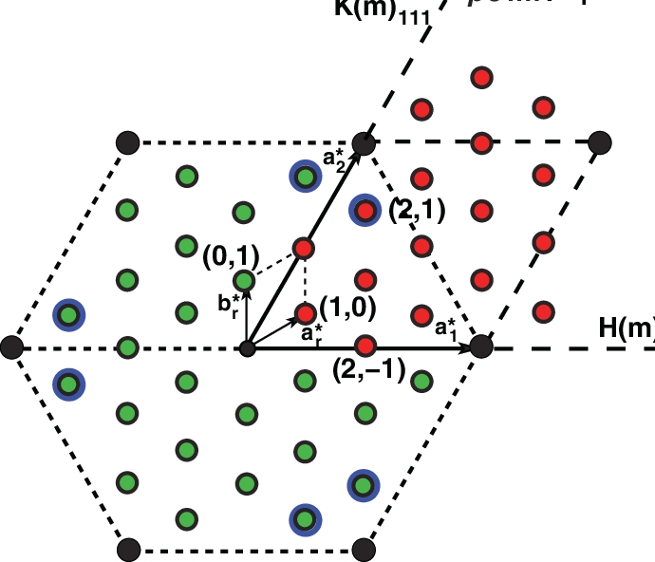
Reciprocal lattice space:
The reciprocal space lattice is a set of imaginary points
constructed in such a way that the direction of a vector
from one point to another coincides with the direction
of a normal to the real space planes and the
separation of those points (absolute value of the
vector) is equal to the reciprocal of the real

Slide 17
Miller indices:
any of a set of three numbers or letters used to indicate the position of a face or internal plane of a crystal and determined on the basis of the reciprocal of the intercept of the face or plane on the crystallographic axes.

Slide 18
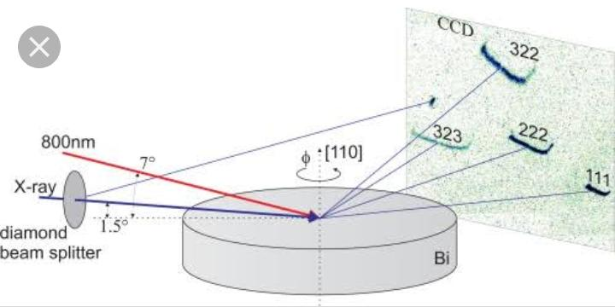
Rotating crystal method:
The rotation method is the most common method to determine steady state crystal structures.
The orientation of the rotation axis and the rotation range can be chosen to select a subset of diffraction peaks fulfilling the Bragg condition Δk = k − k = Hhkl(r,φ).

Slide 19
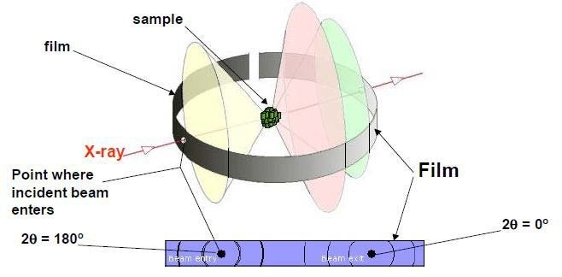
Powder method:
The powder method is used to determine the value of the lattice parameters accurately. ... A sample of some hundreds of crystals (i.e. a powdered sample) show that the diffracted beams form continuous cones. A circle of film is used to record the diffraction pattern as shown.

