Slide 1
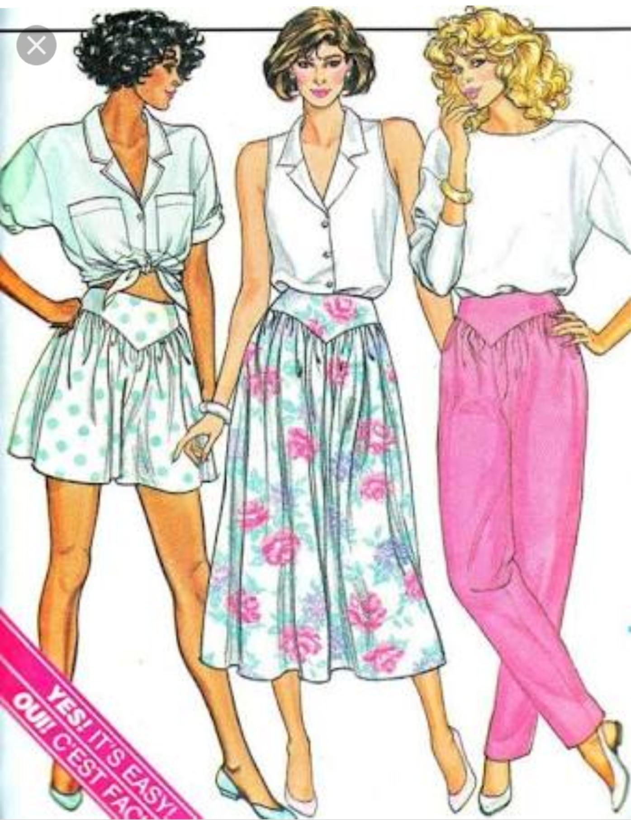
Yokes
S.Manohari , m.sc .,
Asst professor
Dept .of fashion technology & costume design
Bon secours College of women,
Thanjavur.

Slide 2
Yokes
A Yoke is shaped pattern piece which forms part of a garment , usually fitting around the neck and shoulders , or around the hips to provide support for looser parts of the garment .

Slide 3
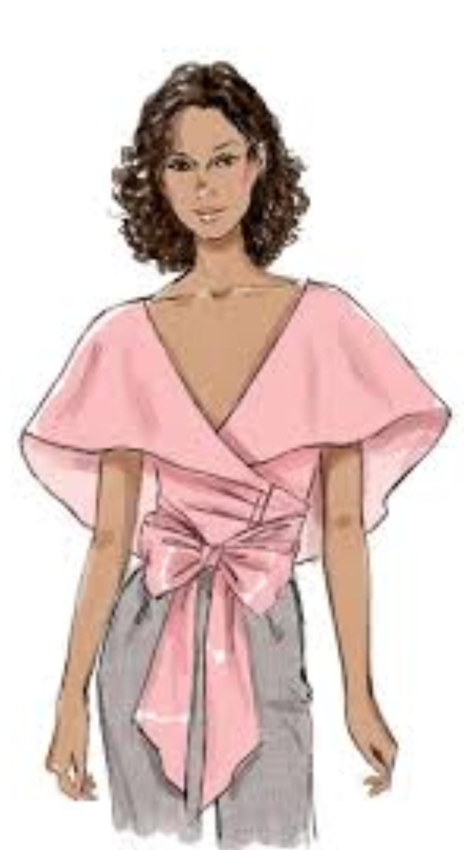
Selection of Yoke design:
Design of the fabric:
The form of the yoke should be go along with the fabric design. For fabric designs such as large checks or stripes, yokes with round or curved shapes are not well suited. Instead , straight line yokes are more appropriate. Floral designs or curved line fabric will go in harmony with round or curved yokes.
2. Design of the garment:
It also influence the designing the yoke. It is preferable to design yokes that are similar in shape to the design details of the dress like collars, cuff ,pockets,etc. But with slight Variation to avoid a monotonus display.
3. Purpose and use of the garment :
Yokes find best utility in school uniforms and home – wear apparel . For part wear garments , Innovative and fancy yoke designs like scalloped, asymmetrical shapes,etc. With contrasting material and decorative edging can be implemented.

Slide 4
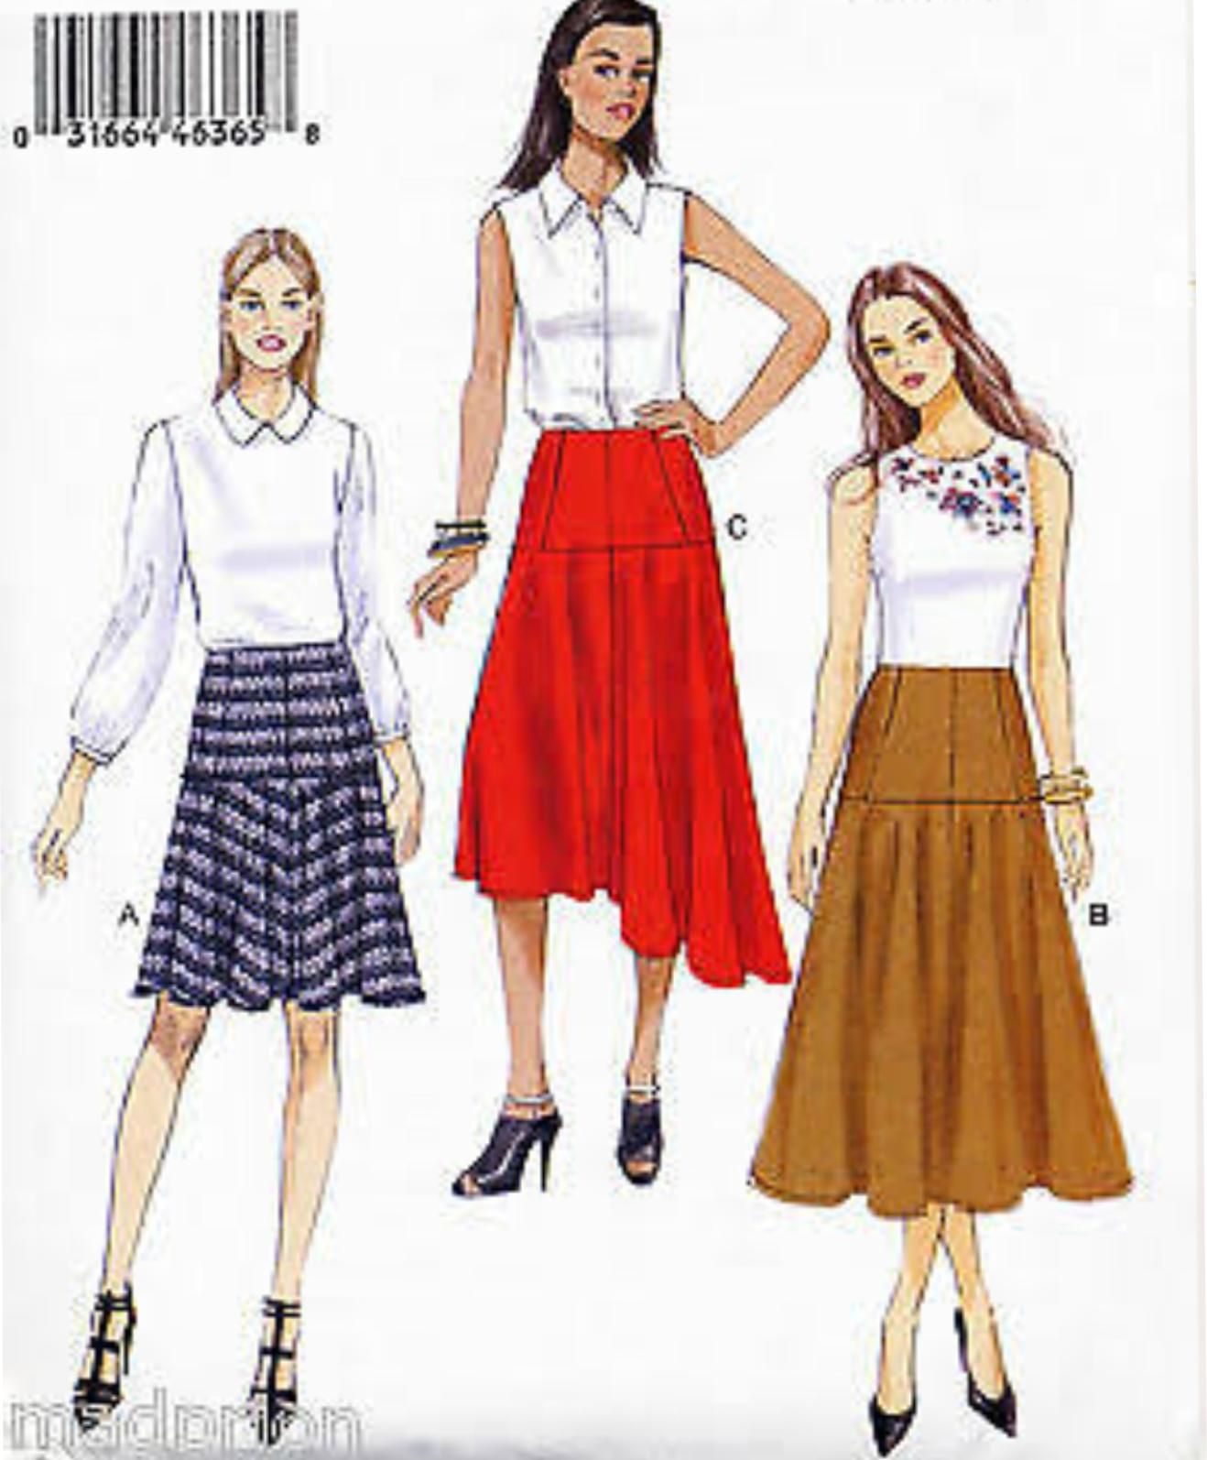

Slide 5
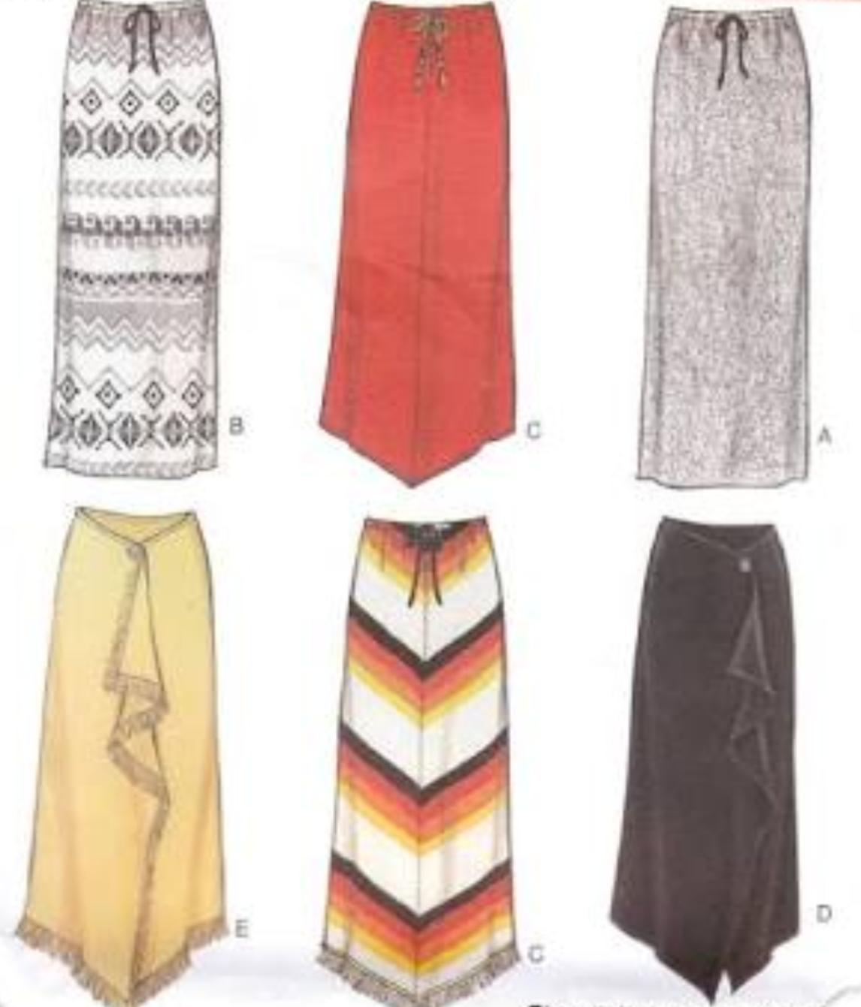
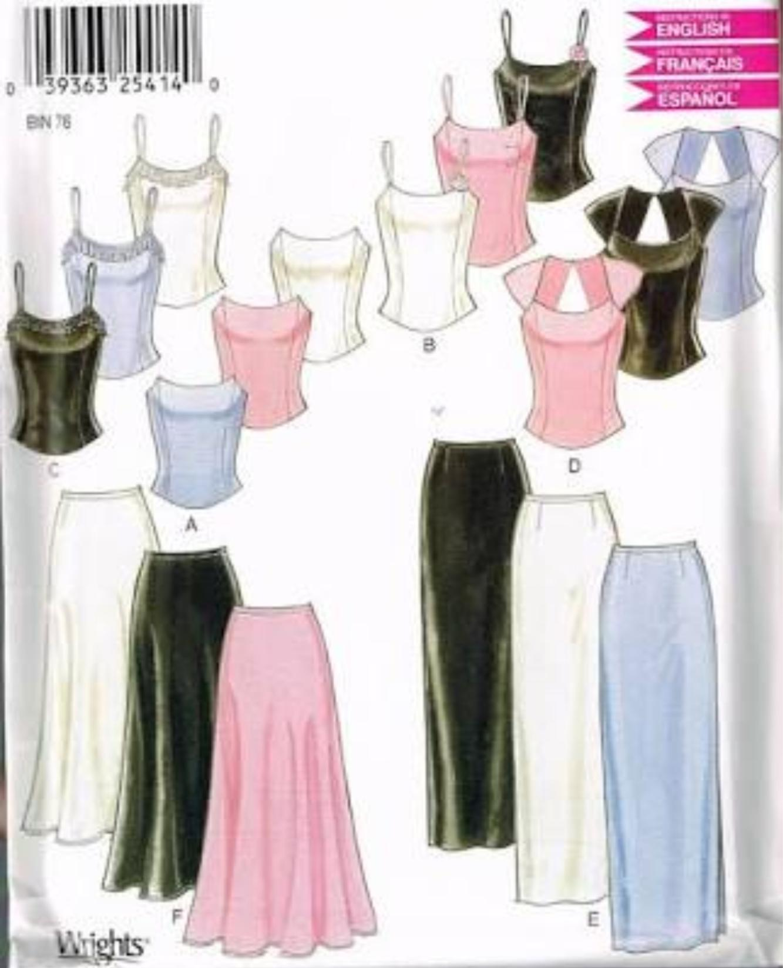

Slide 6
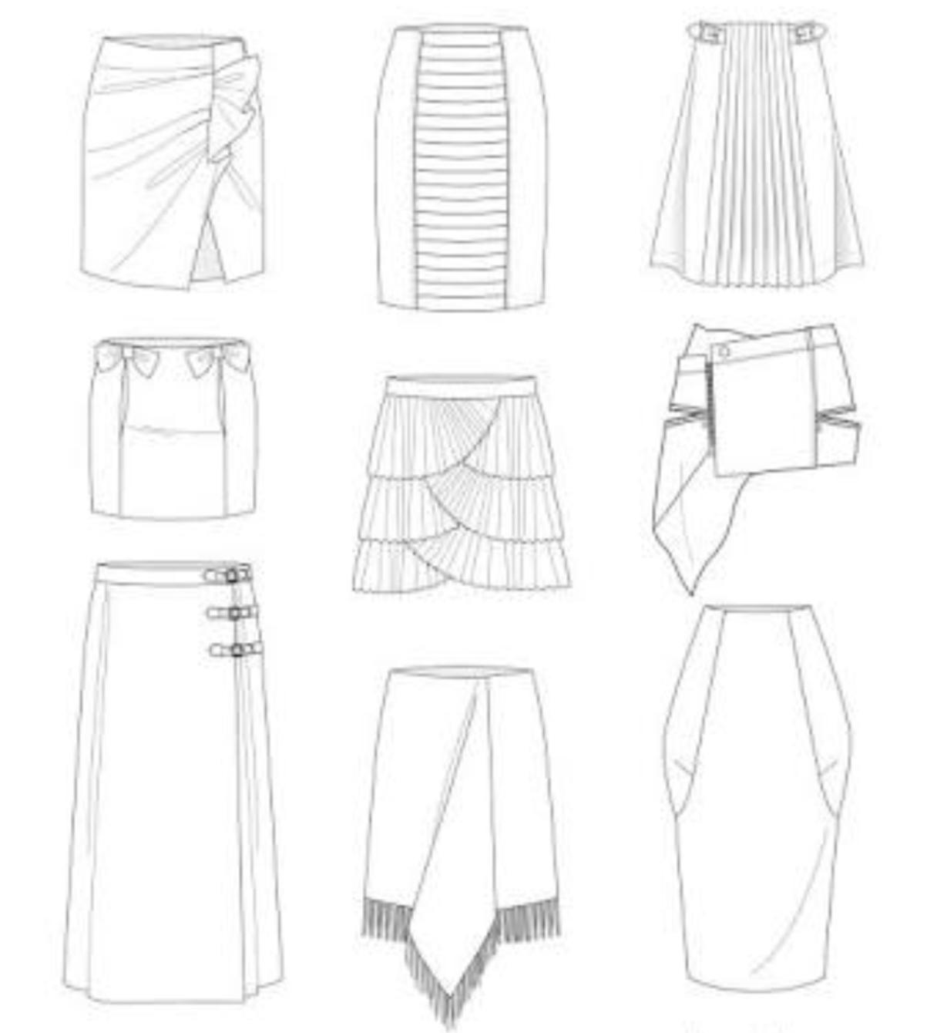
Sex and of the wearer:
Round and curved yokes go well with girls while straight yokes are more suited to boys. Simple yoke designs without decorations are preferred by the older generation.
5. Figure and personality of the wearer :
The physical structure of a person also decided the nature of the yoke. In the case of a short , Plump figure , deep narrow yokes with vertical decorations should be adopted . This causes a vertical eye movement giving an impression of added height and reduced width, thus making the person look taller shorter and flatter and are suitable for thin figures. Also, a yoke that is wide at the shoulder and pointed toward the waistline gives an idea of a narrow waist and wide shoulder.

Slide 7
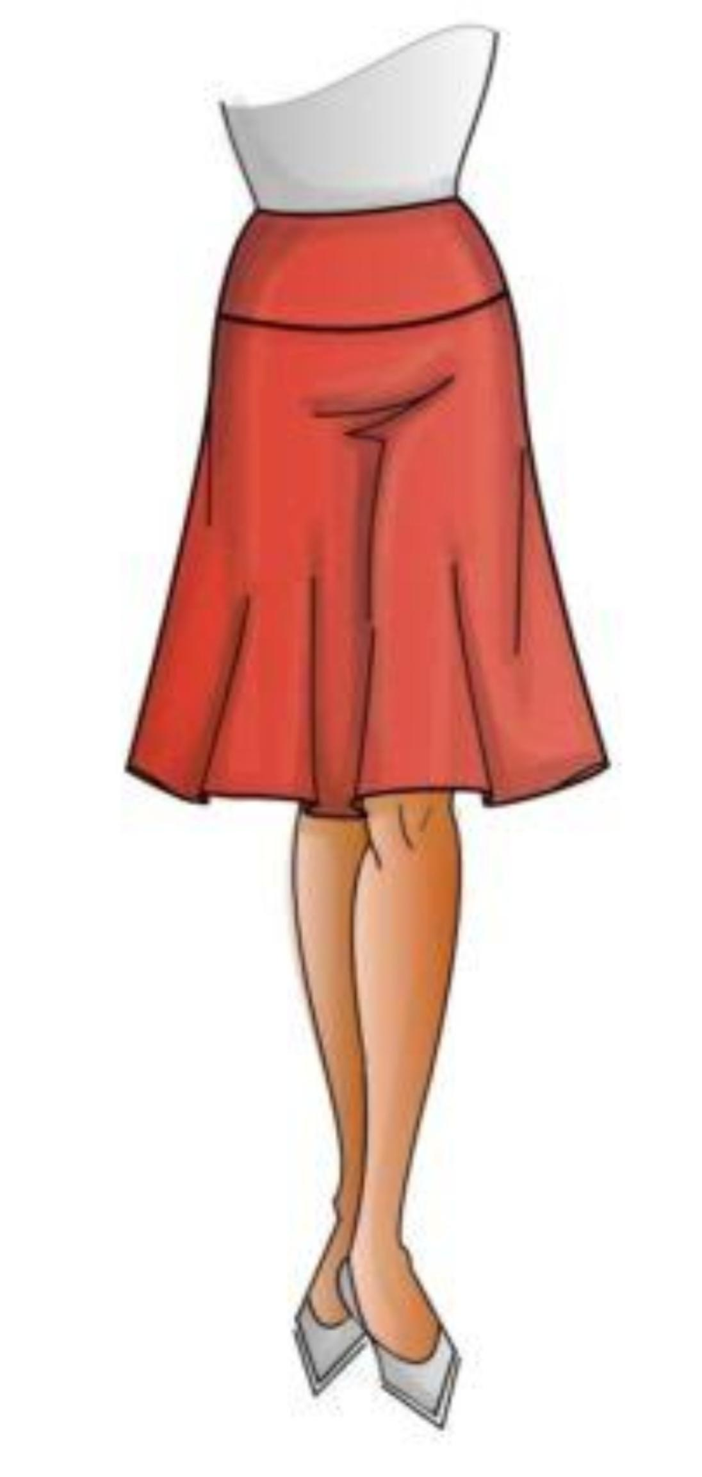
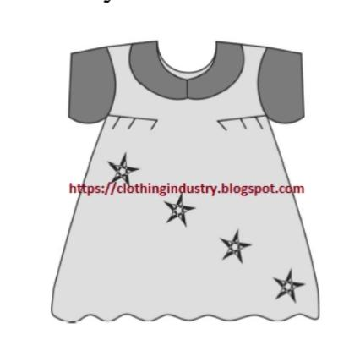
Creating variety in yoke design:
Variety in shape and size:
A yoke can be designed with a number of shapes like squares , round , straight line , scalloped , traingular asymmetrical . The width and depth of the yoke can be changed to produce desired effects . The yokes with a panel has a part of the yoke stretching out to the full length of the garment. Wheareas in partial yoke , the yoke may extend into the sleeve or it may extend for a certain part of the garment.

Slide 8
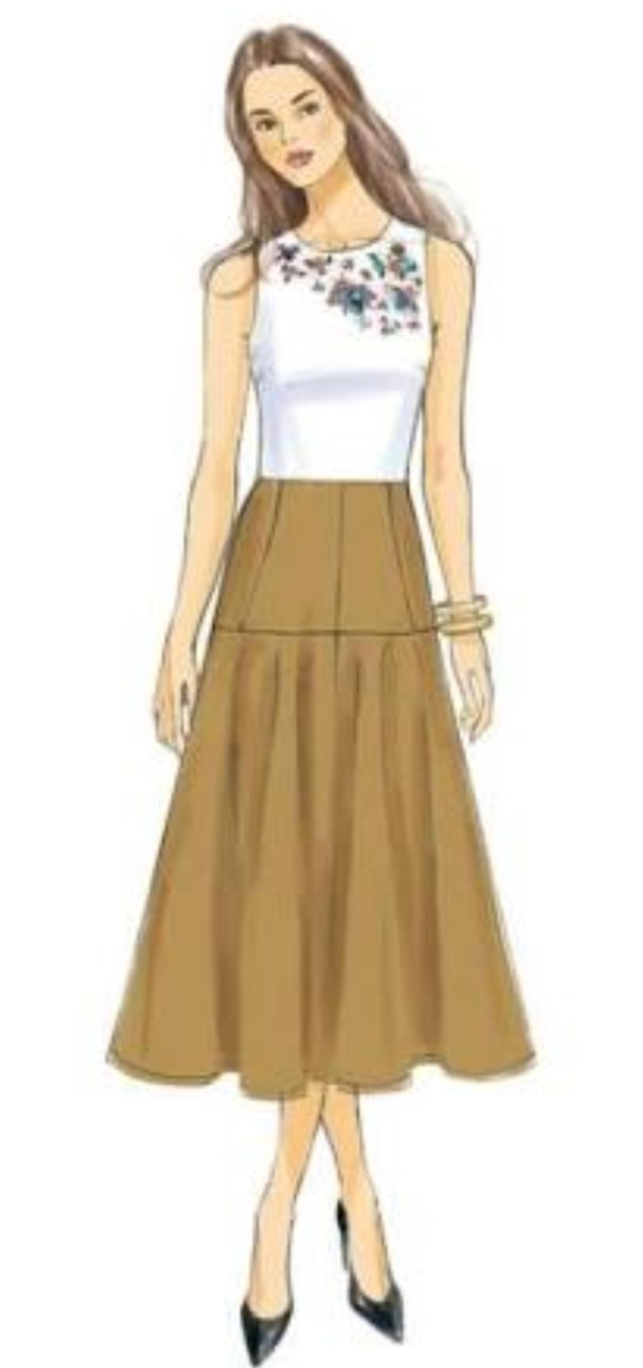
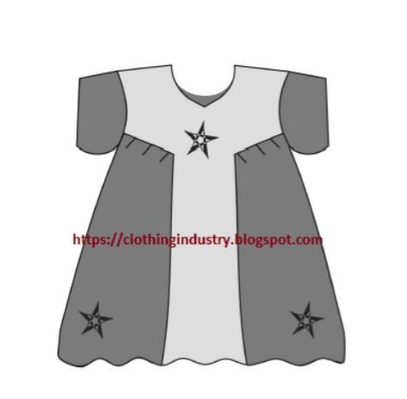
2 . Variety in material and grain :
For garments with light shades ,yokes with contrasting colours are used and vice versa . Likewise , yokes with prints can be attached to plain garments to provide a good appearance . With respect to grain, the yokes is cut in an inclined direction to the lengthwise grain while the garment is along the lengthwise grain.

Slide 9
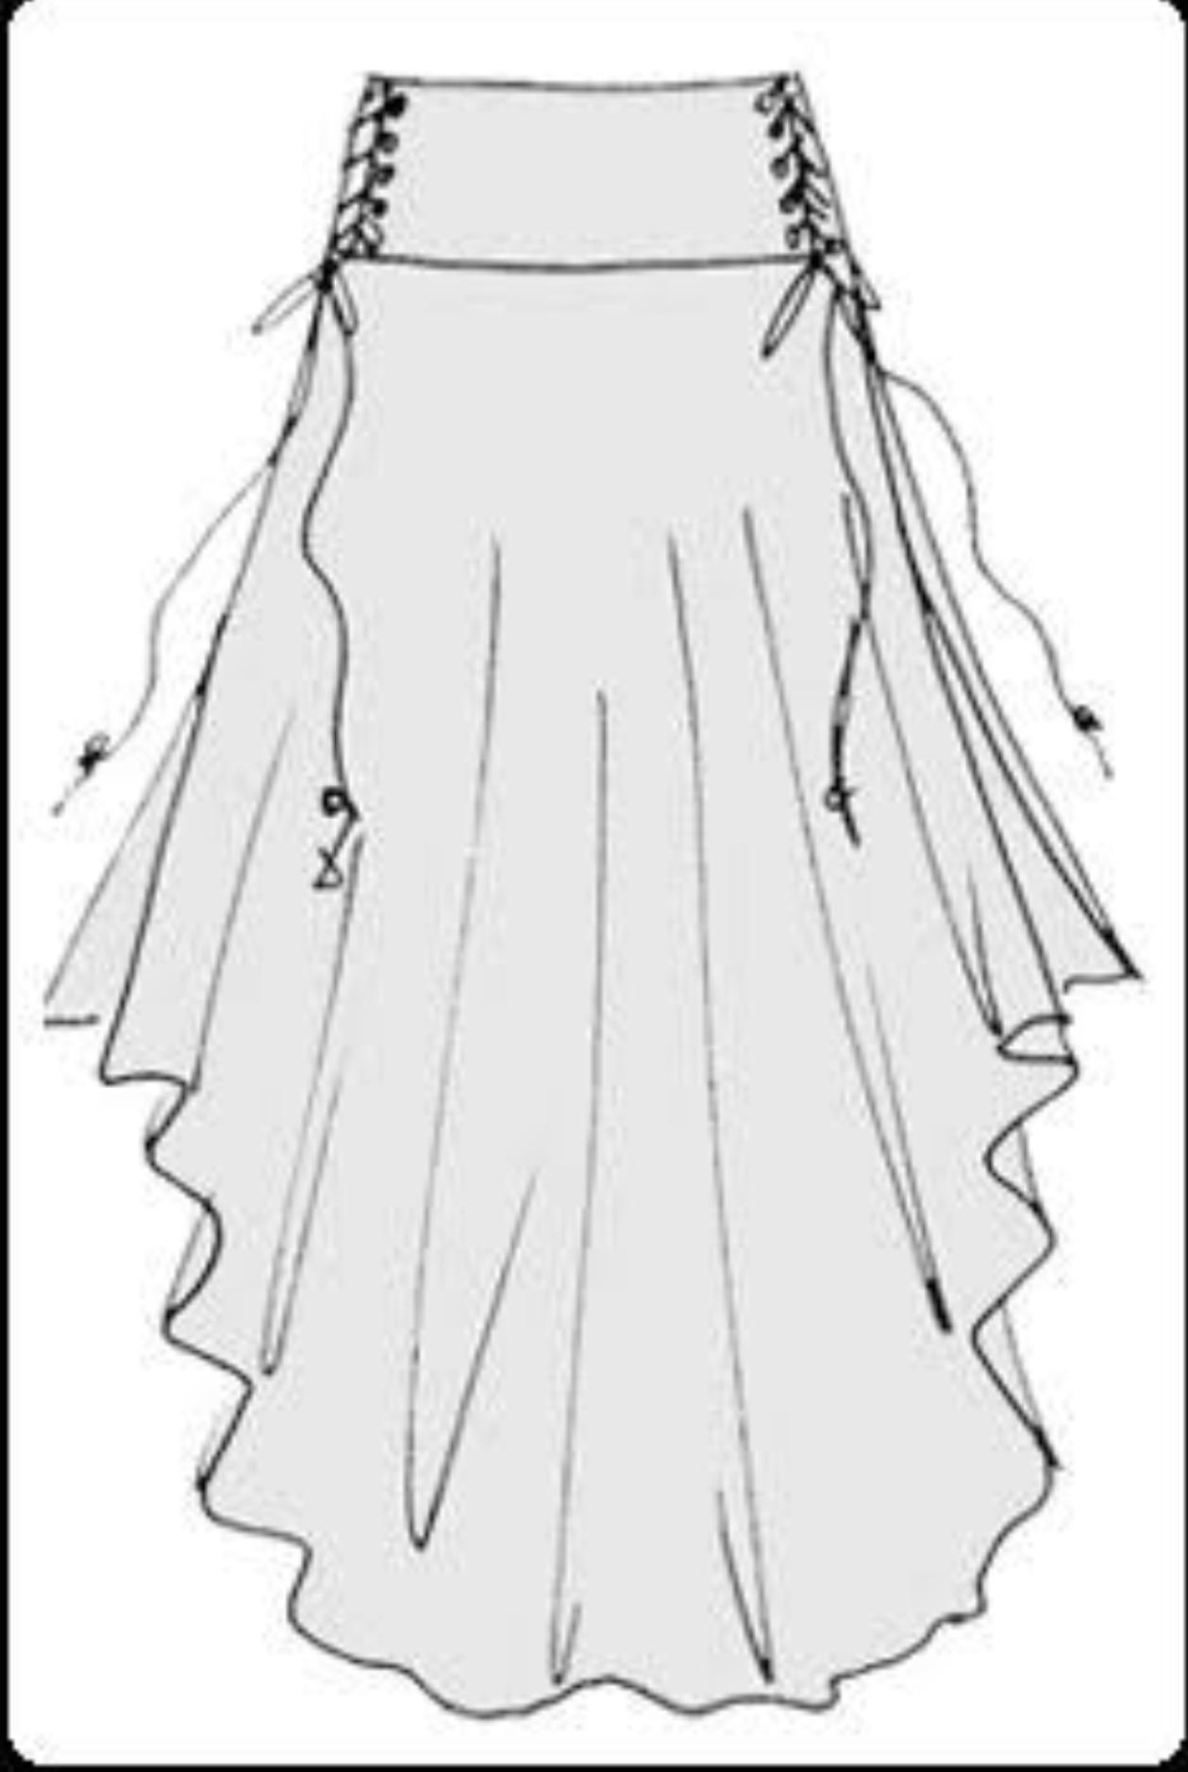
3. Designing seam line of yoke
The yokes attached to the main panel of the garment can be carried out in a decorative manner by inserting ruffles , lace , faggoting , decorative stitches or top stitches with contrasting coloured threads.
4. Decoration within the yoke :
Additionally ,the yoke can be beaded ,quilted , embroidered , shirred , smocked , tucked or pleated to enhance the appearance.

Slide 10
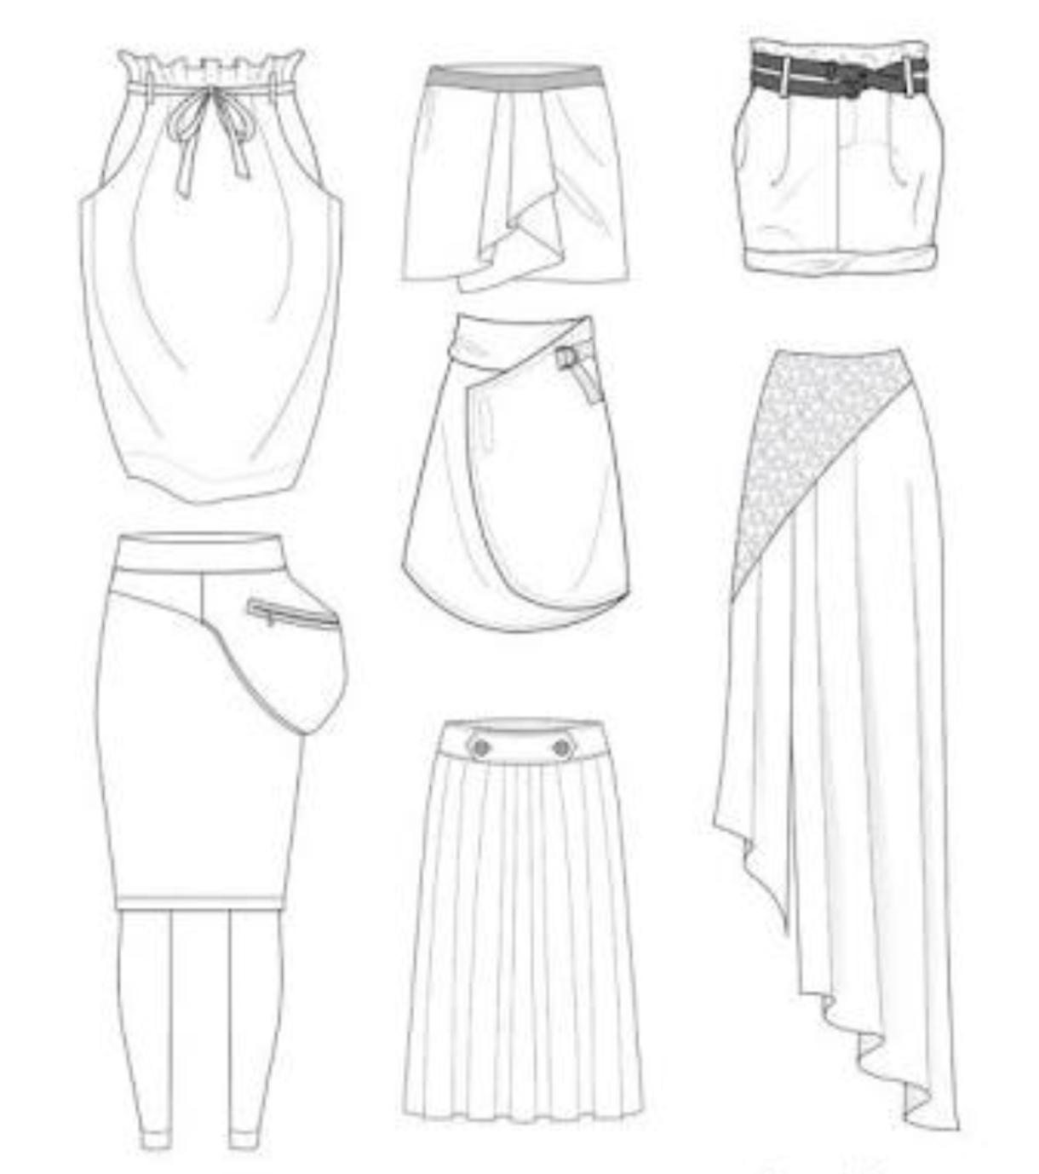
5. Introducing the yoke at different positions:
Basically ,the yoke can be introduced in three position :. At the top of the garment
(Shoulder yoke ) , above. The waistline (midriff yoke) or below the waist line ( hip yoke).

Slide 11
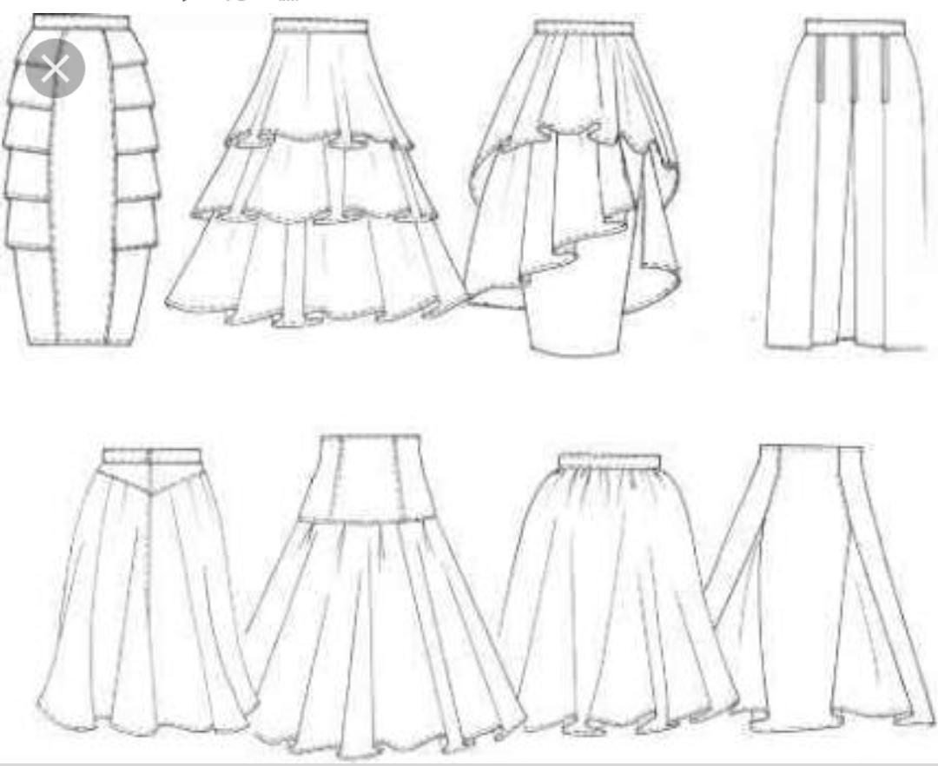
6. Designing yokes which release fullness in various forms :
The fullness in the body of the garment can be released in the formnof gathers, pleats and tucks originating from the edge oftheyo

Slide 12
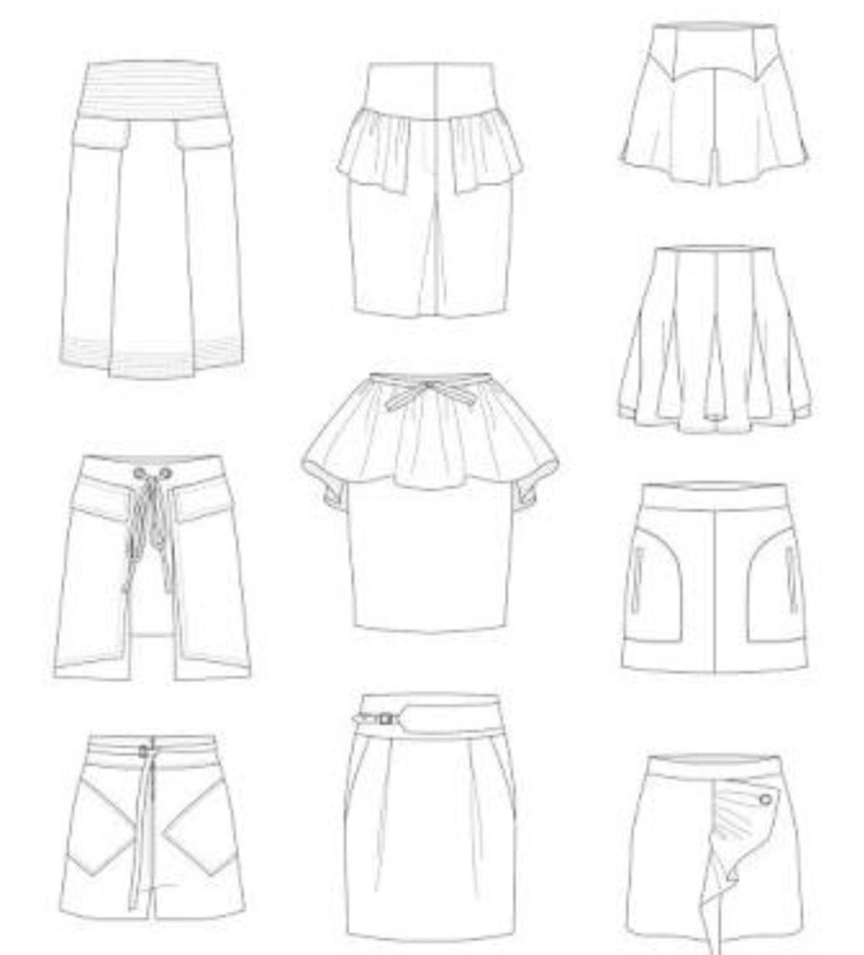
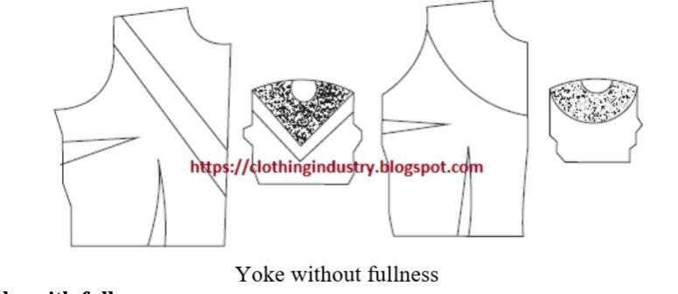
Preparing patterns of different types of yokes :
This type of yoke comes in a wide range of shapes and sizes . The pattern for such yokes can be prepared by two methods. For a curved “ V “ shaped yoke the yoke line from the shoulder to the center front is constructed in the front Bodice as desired . In the case of a line straight
Line yoke, a line is drawn from the armhole to the centre front of the bodice pattern and both sections are labelled.

Slide 13
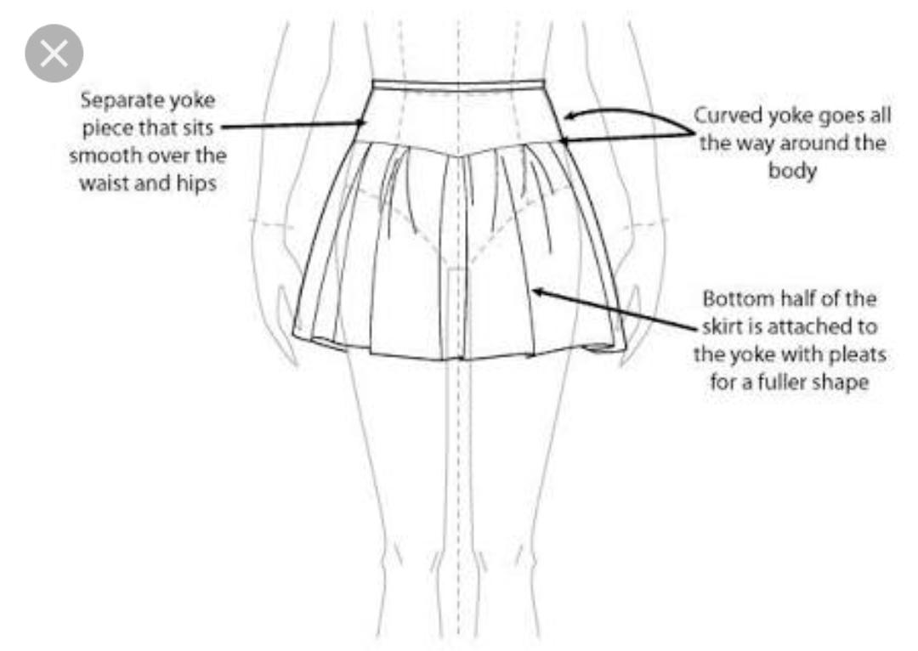
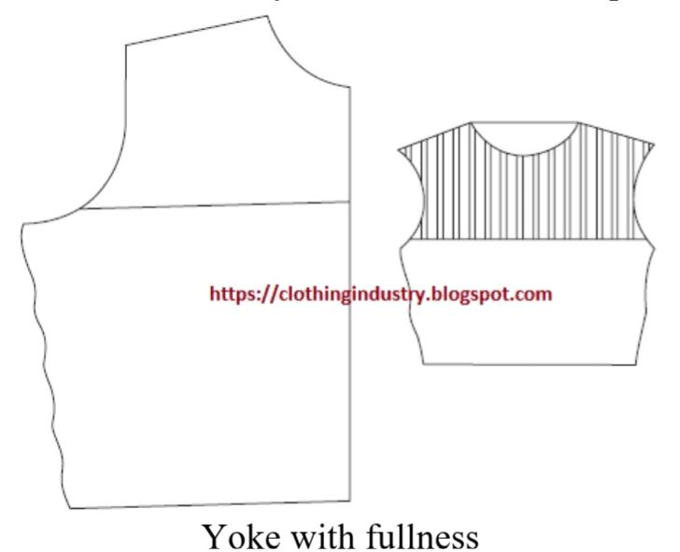
2. Yoke with fullness:
These yokes involve decoration of the fabric with any fullness ( tucks , pleats , gathers , shirring and embroidery) . The fullness must be completed prior to the attachment of the yoke pattern . The required amount of fabric is cut and desired types of tucks are stitched according to the design . Now , the paper
Pattern is placed over the tucked fabric and the iscut with required seam allowance .

Slide 14
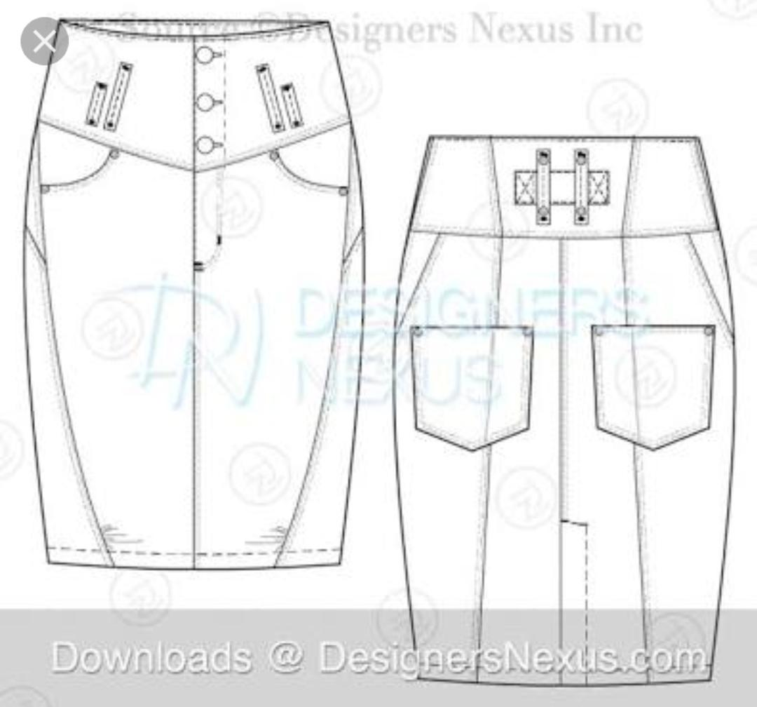
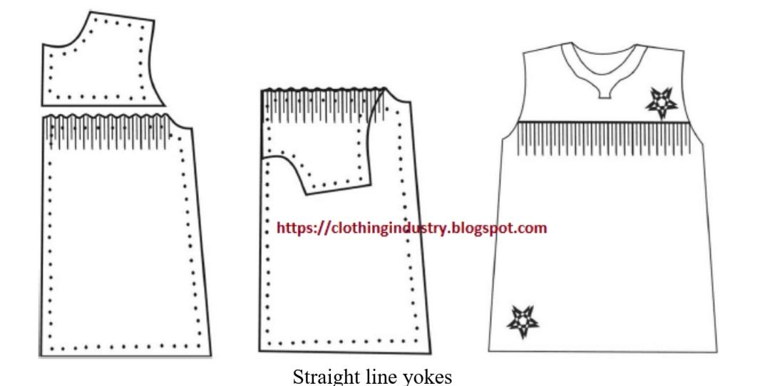
Attaching yokes :
A plain seam or lapped seam can be used to append the yoke to the lower section. The skirts is gathered such that the width of the gathered Skirts is the same as the width of the yoke. The yoke is now placed over the skirt right side facing up and , subsequently , the notches are matched . Pinning and tacking should be removed.
The yoke is tuned up on the right side and pressed . The straight and decorative yokesare shown in figures -6&7,. respectively.

Slide 15
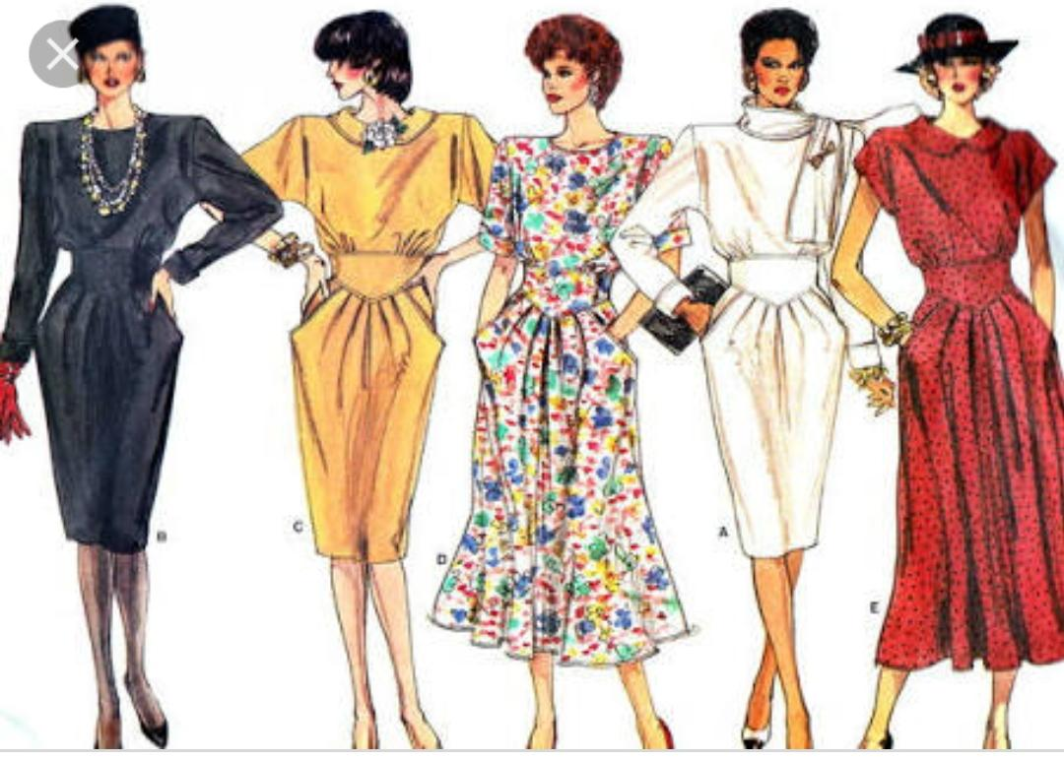

Slide 16
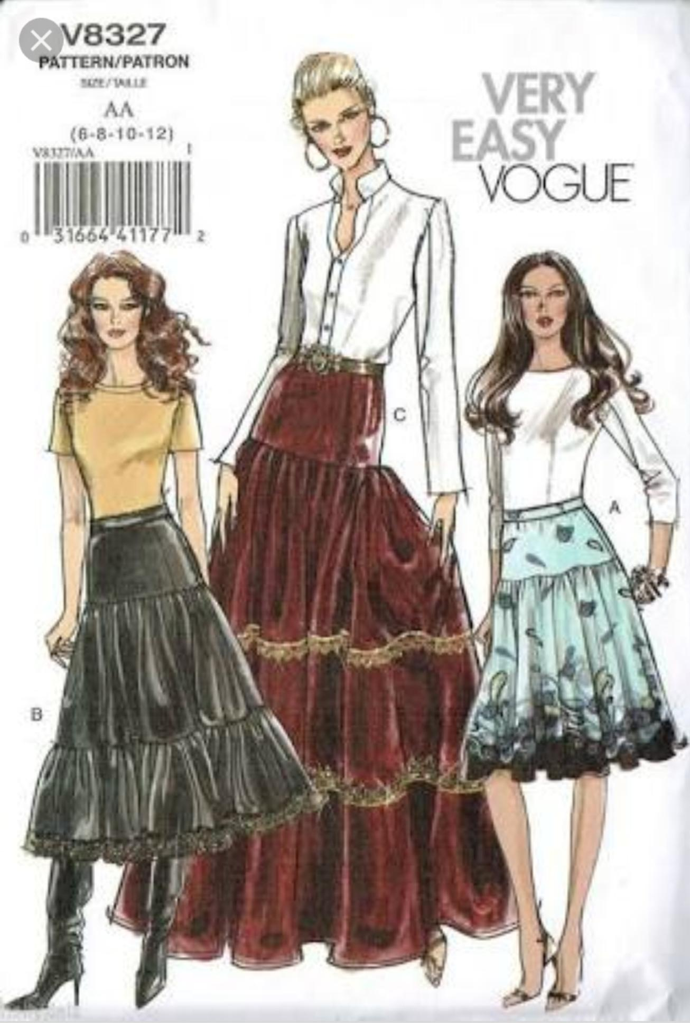
In yokes consisting of both curved and straight lines as in a skirt with panel ,the seamruns almost at right angles to the corner . The lower segment of the garment is gathered and stitched Initailly . In the Yoke , stitiches are made nearer to the seam line and the corners are reinforced. Now ,the seam allowance is folded to the back side and tacked with small stitches close to the fold . To make a flat seam , cuff the notches into the seam allowance.
By placing the yoke over the top of the blower section,the seam lines are matched. Tacking followed by top stitching close to the folded edge of the yoke is done.

Slide 17
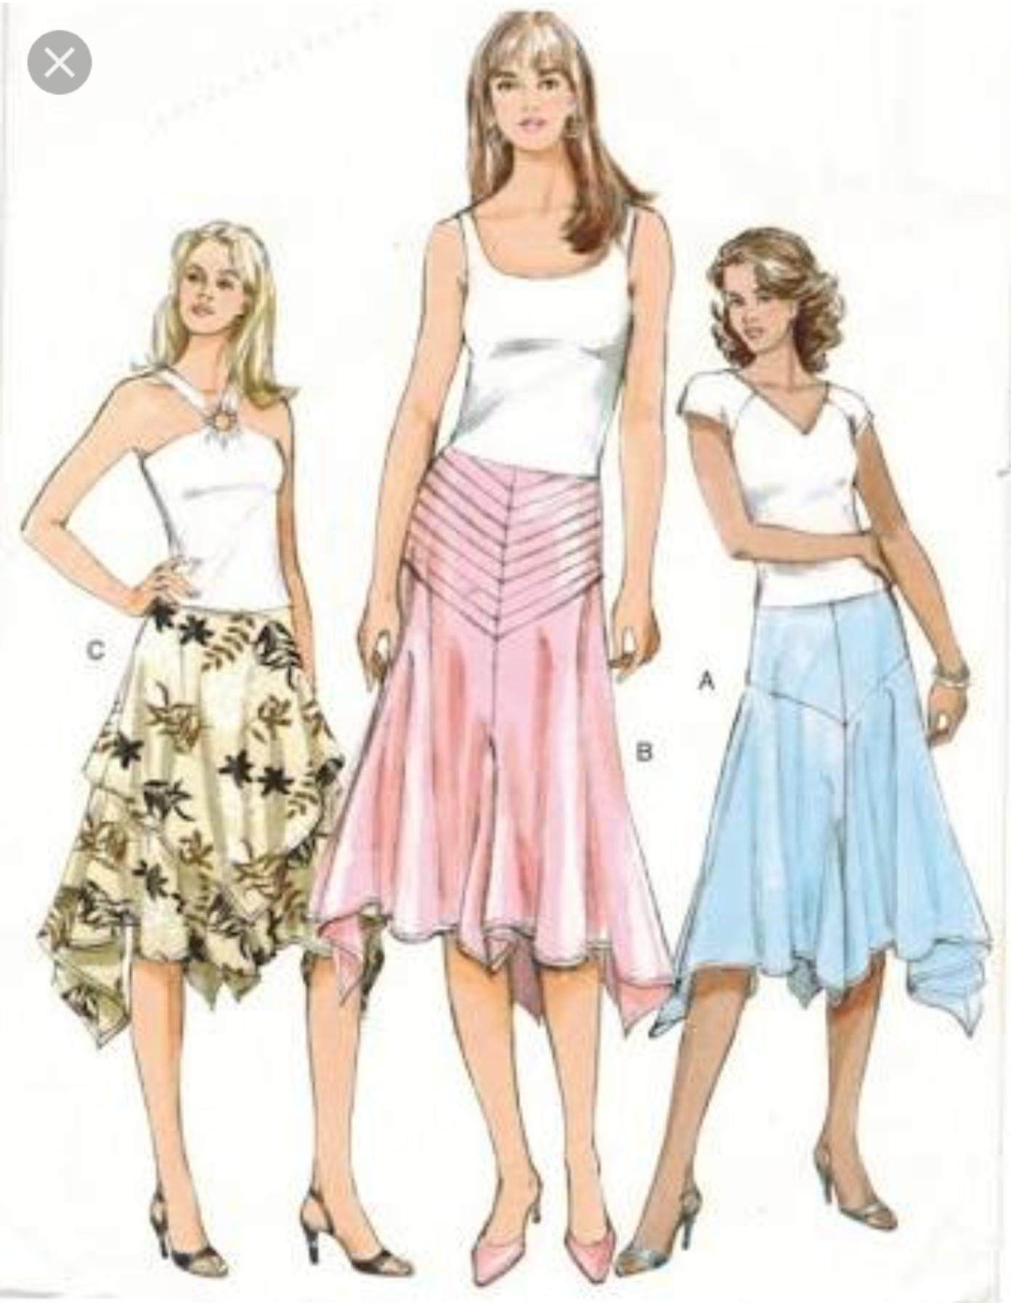
If necessary ,studied seam effect can be obtained by doing the top stitching away from the folded edge of the yoke. Apart from skirts , yokes frequently appear in men’s shirts, trousers and coats. Depending on the form of the shoulder line , the yikes on shirts , tops or coats can be cut in two variants. In the first type , the yoke is cut As a single pattern piece, thus the back and front Pieces could be merge along the shoulder line . The other variant includes theback and frontyokes astei separate pieces, especially for drop shoulders as two separate Pieces are rquired to retain the curve of the shoulder line . Alternatively, the yoke can be cut in one pieces and darts can be provided along the shoulder line to impact the necessary curved shaping. Moreover , on trousersand skirts , the yoke region facilitates the dart value to be absorbed into a single panel.

Slide 18
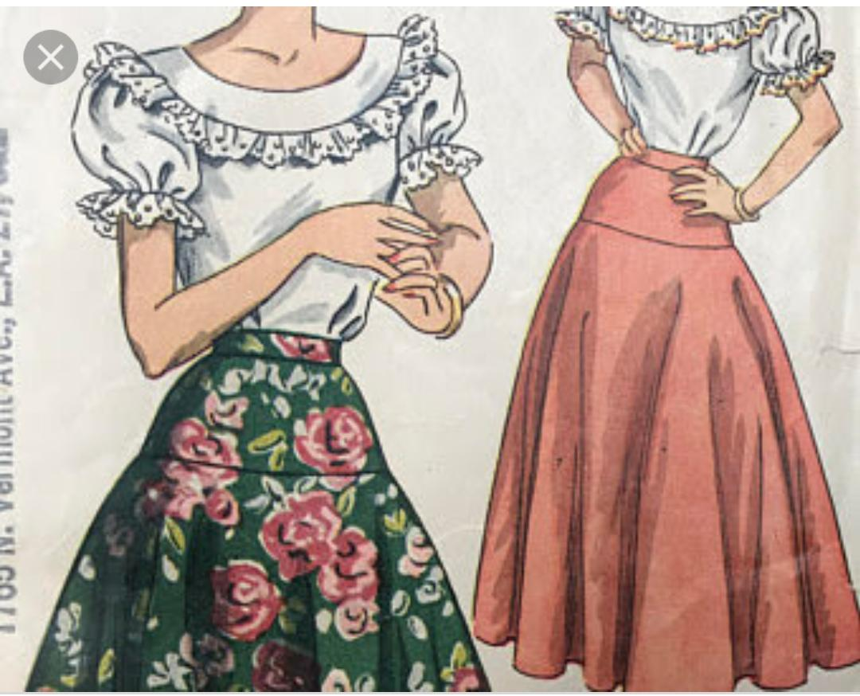
Hip yoke

Slide 19
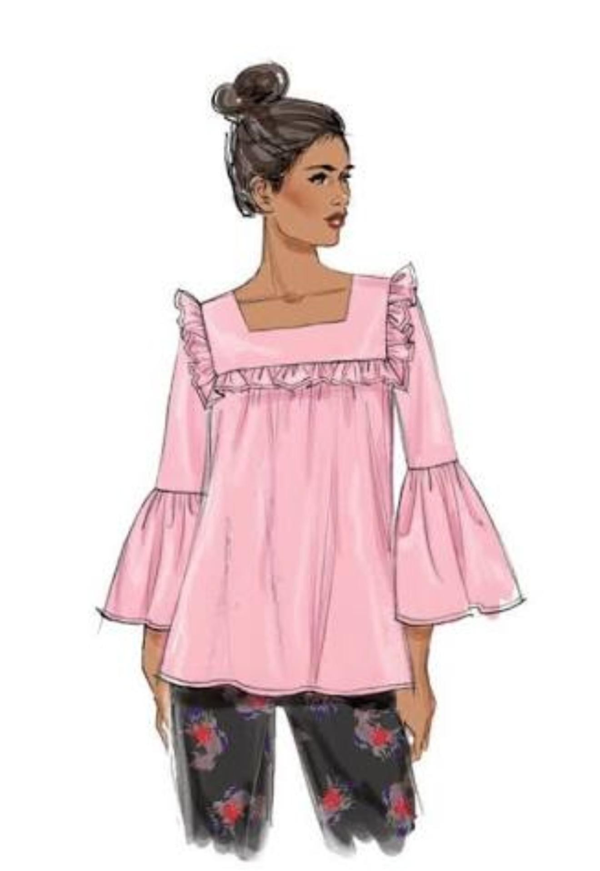
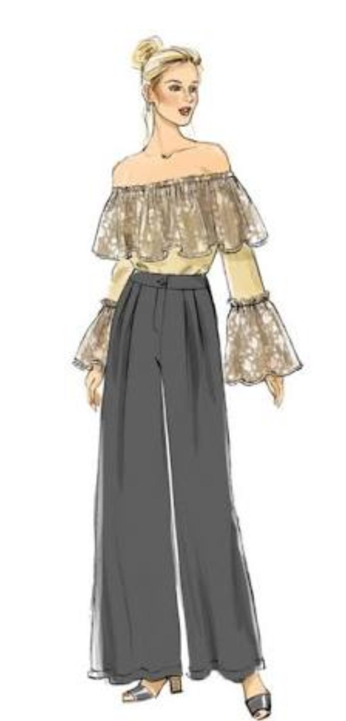
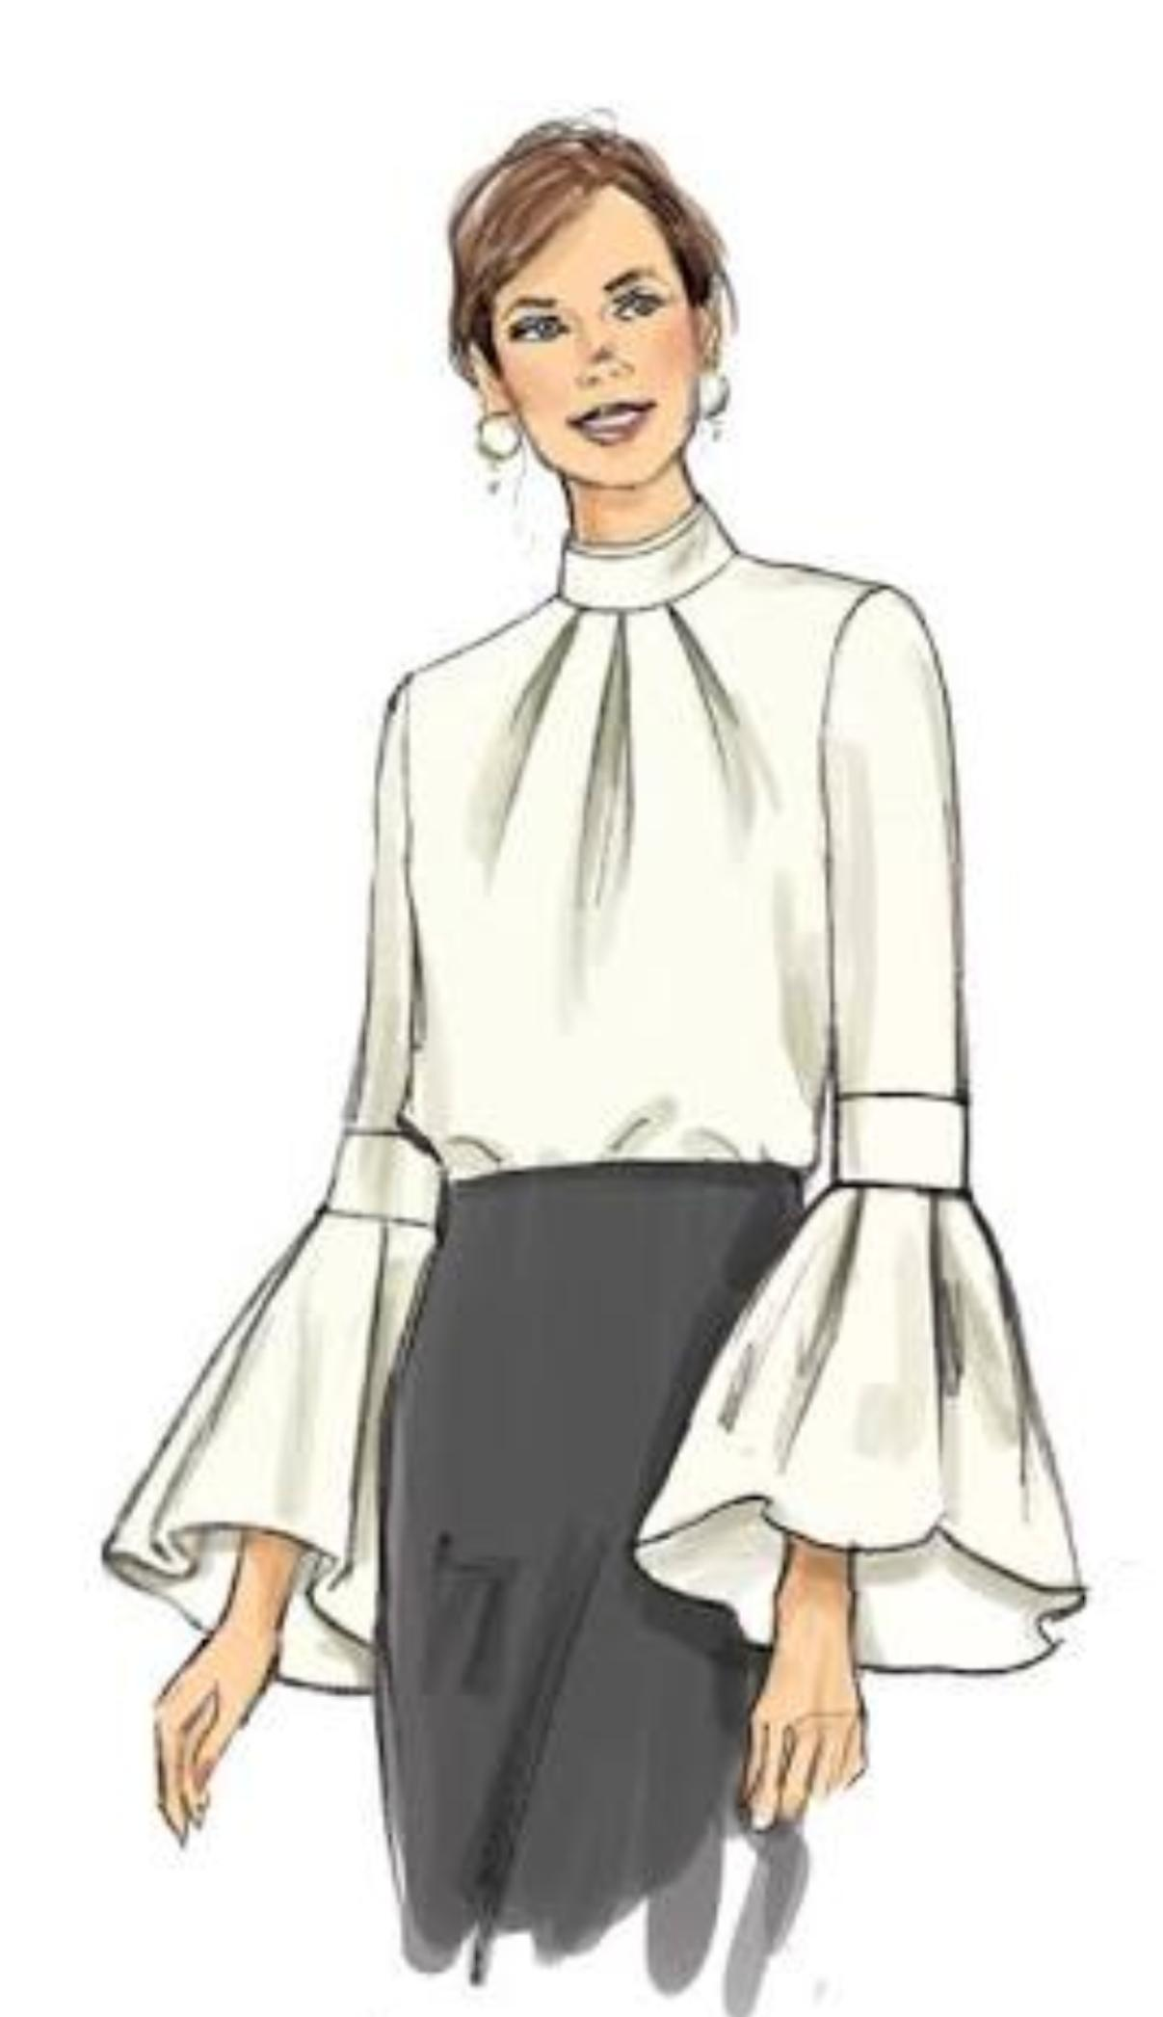
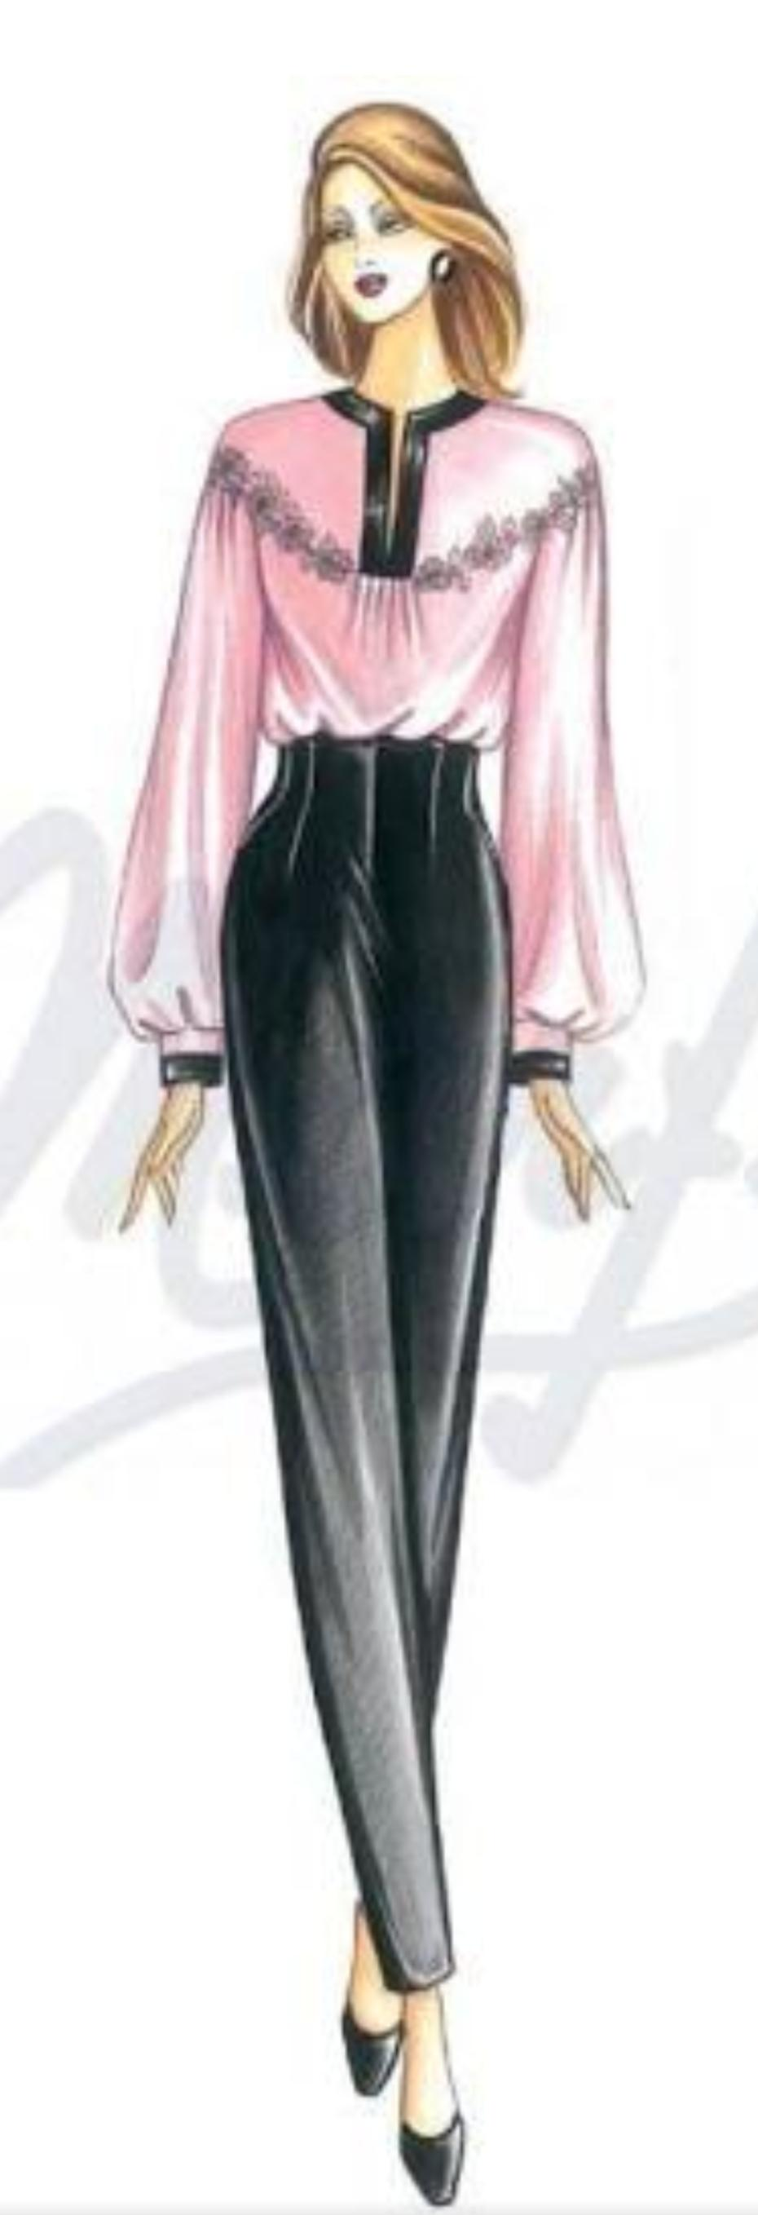

Slide 20
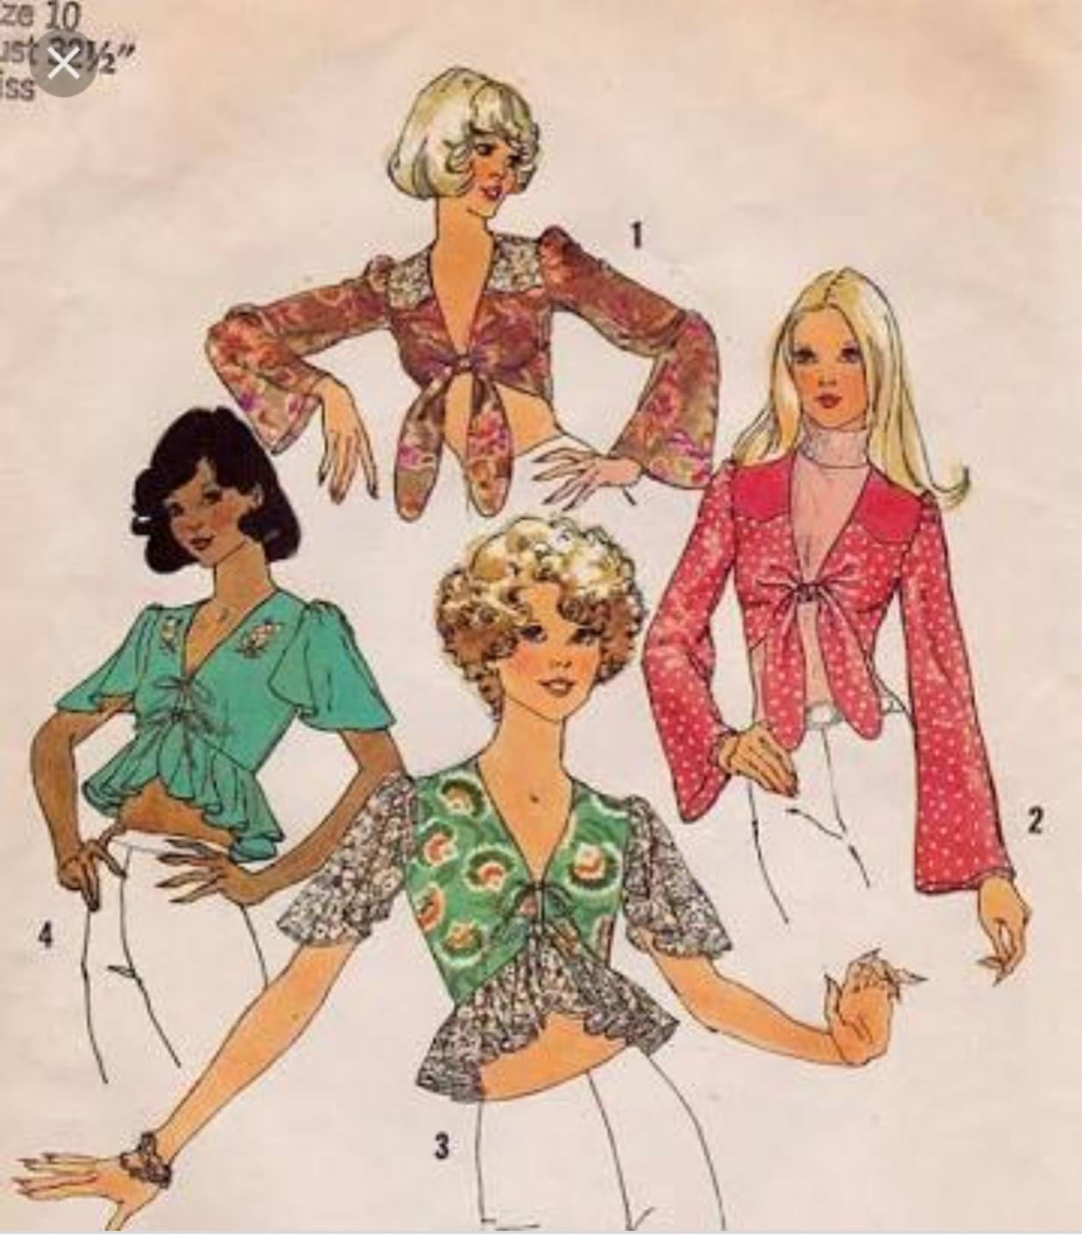
Thank
You

