Slide 1
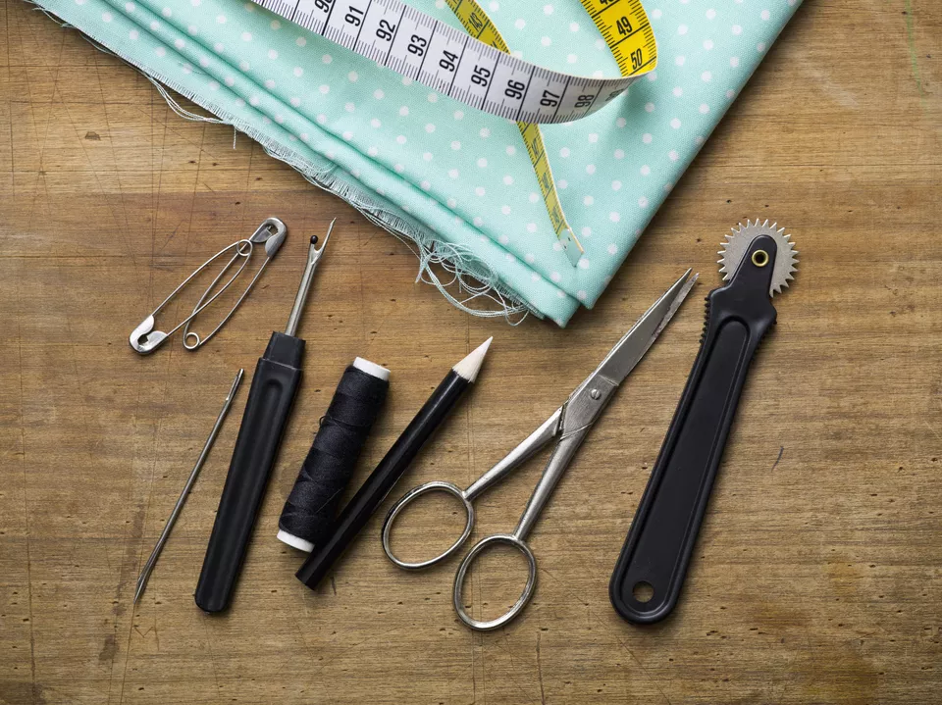
TRANSFERRING PATTERN MARKINGS FROM PAPER
S.SUGANTHI M.Sc., M.Phil.
ASSISTANT PROFESSOR
DEPARTMENT OF FASHION TECHNOLOGY
BON SCOURS COLLEGE FOR WOMEN
THANJAVUR

Slide 2
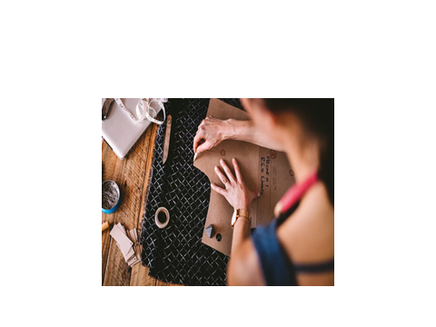
TRANSFERRING PATTERN MARKINGS FROM PAPER
Once the pattern is ready, the details on the pattern should be transferred to the cloth by marking. Accuracy in marking and cutting is necessary to construct a well fitted garment. The various methods of transferring patterns markings onto the fabric is done using
Dressmaker’s Carbon
Tailor’s tacks
Tailor’s chank

Slide 3
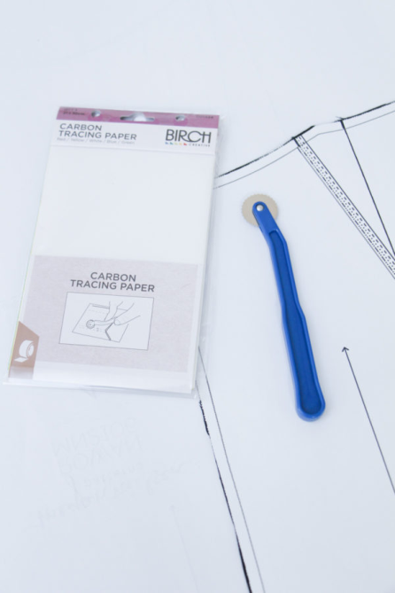
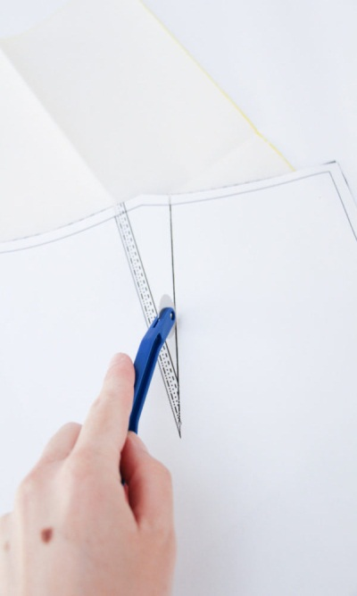
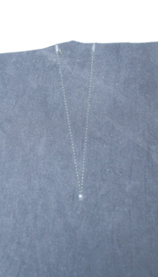
DRESSMAKER’S CARBON The carbon paper method requires dressmaker’s carbon, tracing wheel, ruler and pins. The carbon marks must not be visible on the right side of fabric being cut. This method is suitable on any firm fabric.
Place carbon paper between fabric and pattern, with the waxed sides of carbon facing the wrong side of the cloth.
Mark lightly and only once with a tracing wheel

Slide 4
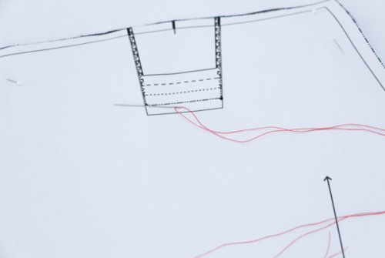
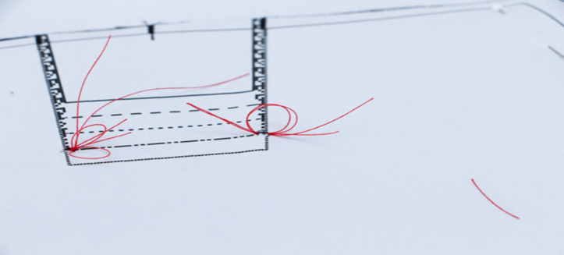
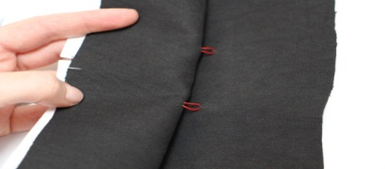
TAILOR’S TACKS This method uses a double strand machine thread to transfer pattern markings onto the fabric. It is good for silks and sheer fabrics.
Use double thread
Do not knot the thread end.
Take a stitch through both layers of fabric, leaving 1 ½” of thread at the beginning of the stitch.
Take a second stitch at the same point with a 1” loop
Repeat the same process along pattern lines (darts)
To remove the pattern from the fabric, cut the threads between tailor’s tacks and pull gently and cut threads between two fabric layers

Slide 5
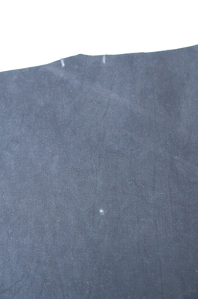
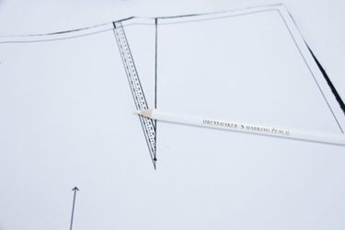
Tailor’s chalk can also be used to transfer the pattern markings. Only the outer edges can be transferred while the marks on the pattern can be transferred using through carbon paper and tracing wheel.
Tailor's Chalk, marking pens or marking pencils
Place a straight pin straight through the dot on the pattern piece. Mark the fabric with the chalk where the pin is in the fabric.

Slide 6
Method of Marking | Advantages | Disadvantages
Dressmaker’s carbon | Quick, easy and accurate Entire stitch line details transferred Identical marks on both layers | Shows on right side if fabric is flimsy or if marked heavily Difficult to remove by washing Markings distort on stretchy fabrics
Tailor’s tacks | Easily removed Visible on both sides of each fabric layer | Time consuming Threads are to be removed after all construction processes Danger of snipping fabric while cutting threads between fabric layers
Tailor’s chalk | Inexpensive Easy to rub off the marks | Difficult to achieve accuracy Need to sharpen chalk edge for fine lines

Slide 7
Thank you
Notes:
Thank you

