Slide 1
Alcohols
Ms. J. Princess gracia, M.Sc.,M.Phil.,
Assistant professor,
Department of chemistry
Bon secours college for women, thanjavur

Slide 2
DEFINITION
Any organic compound whose molecule contains one or more hydroxyl groups attached to a carbon atom.
The term alcohol originally referred to the primary alcohol ethanol (ethyl alcohol), which is used as a drug and is the main alcohol present in alcoholic beverages

Slide 3
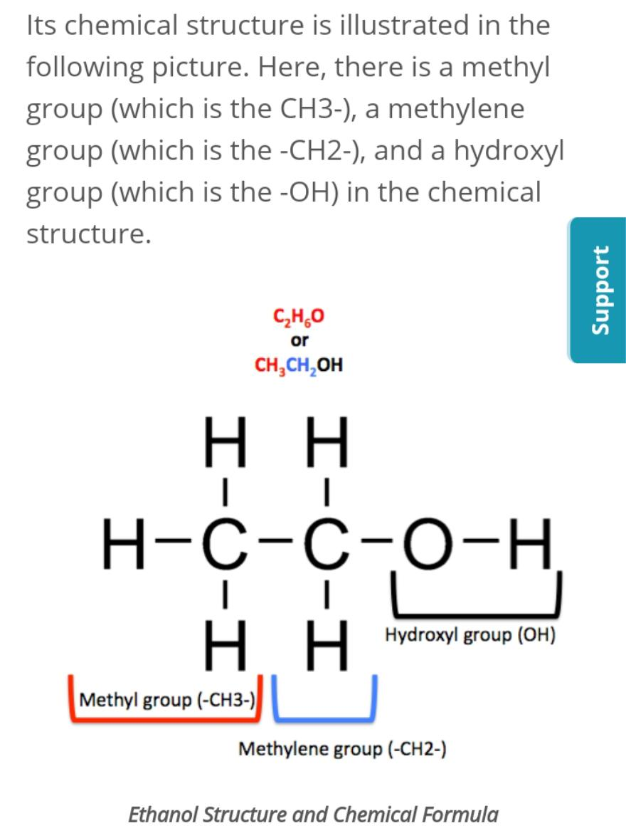
Structure and formula.

Slide 4

Types of alcohols
Alcohols are classified into different groups depending on where the hydroxyl group is placed in the molecule. this results in some differences in chemical properties.
Primary alcohols
In a primary alcohol, the carbon with the hydroxyl group is only attached to one alkyl group.
Some examples of primary alcohols:
* Methanol is an exception to this. It is still a primary alcohol even though the carbon which has the hydroxyl group attached does not have another alkyl group attached to it.

Slide 5

Secondary alcohols
In a secondary alcohol, the carbon with the hydroxyl group is attached to two alkyl groups.
Some examples of secondary alcohols:

Slide 6

Tertiary alcohols
In a tertiary alcohol, the carbon with the hydroxyl group is attached to three other alkyl groups.
Some examples of tertiary alcohols:

Slide 7
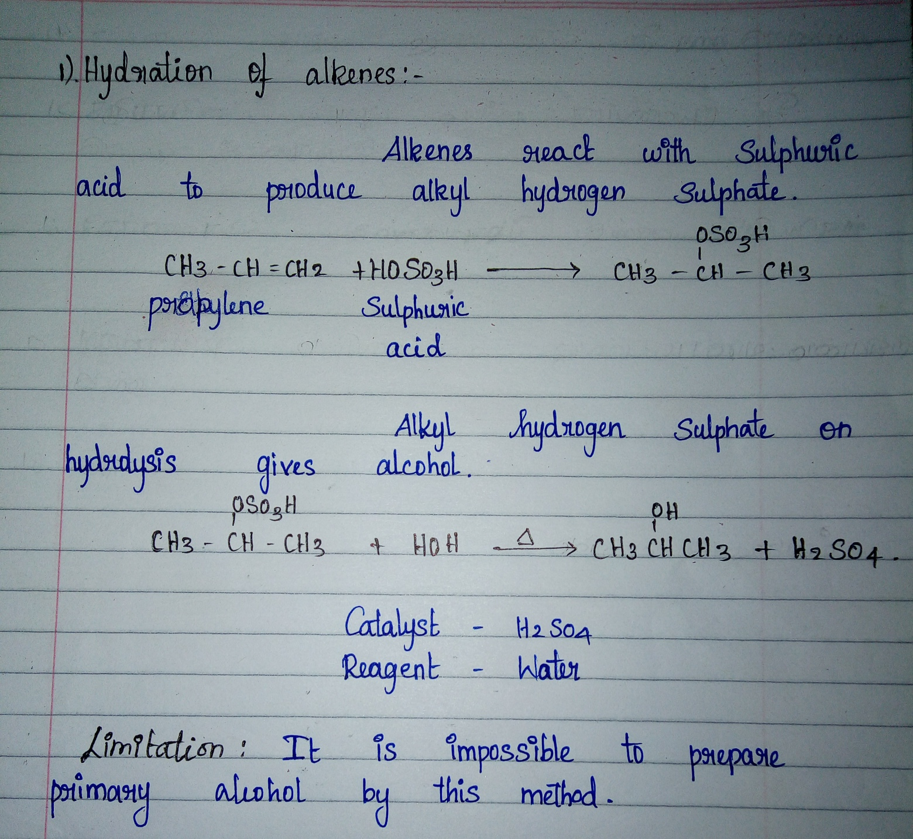
Preparation of alcohol.

Slide 8
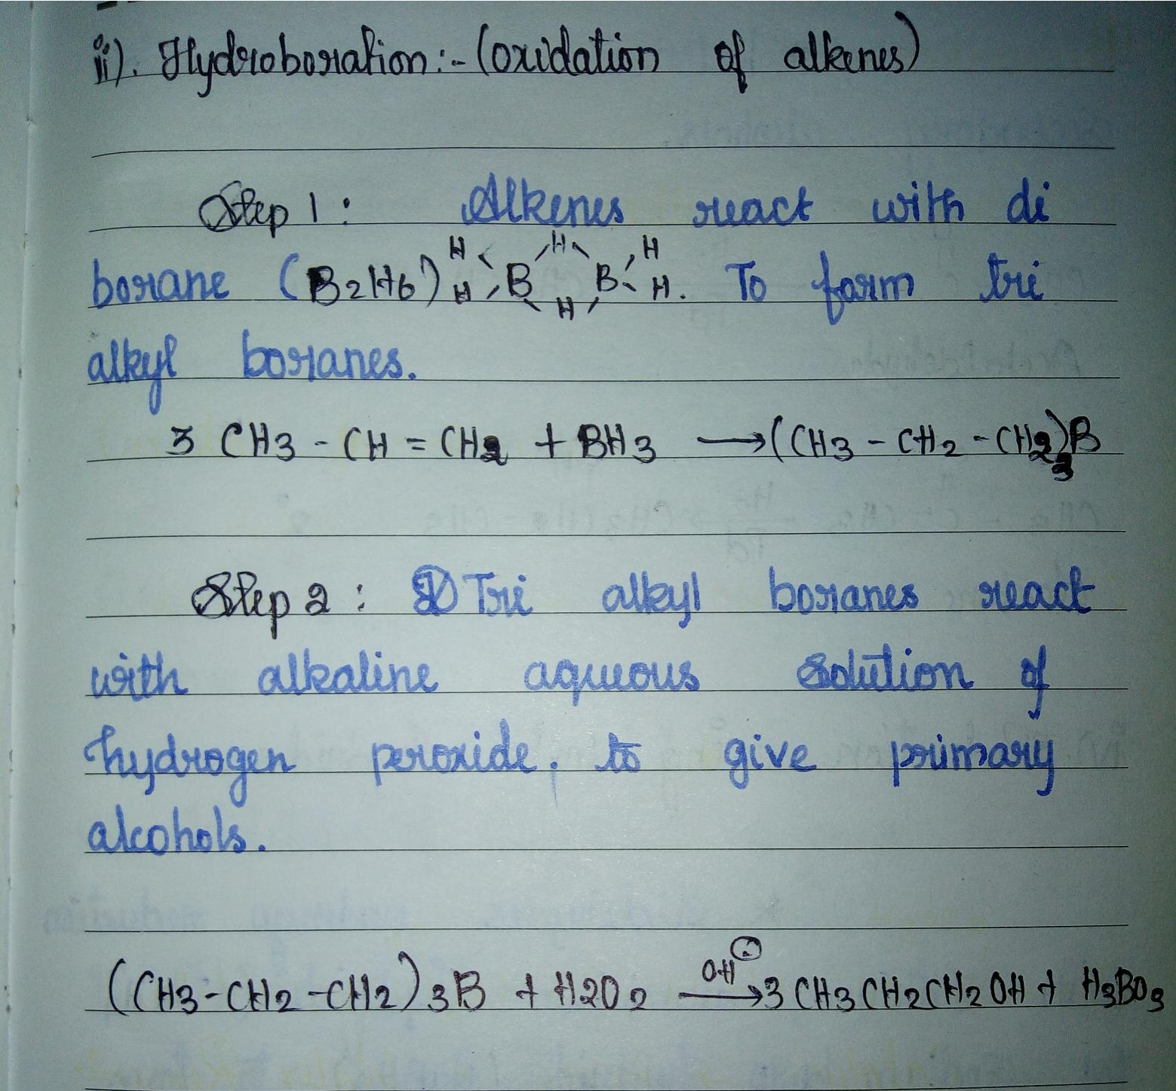

Slide 9
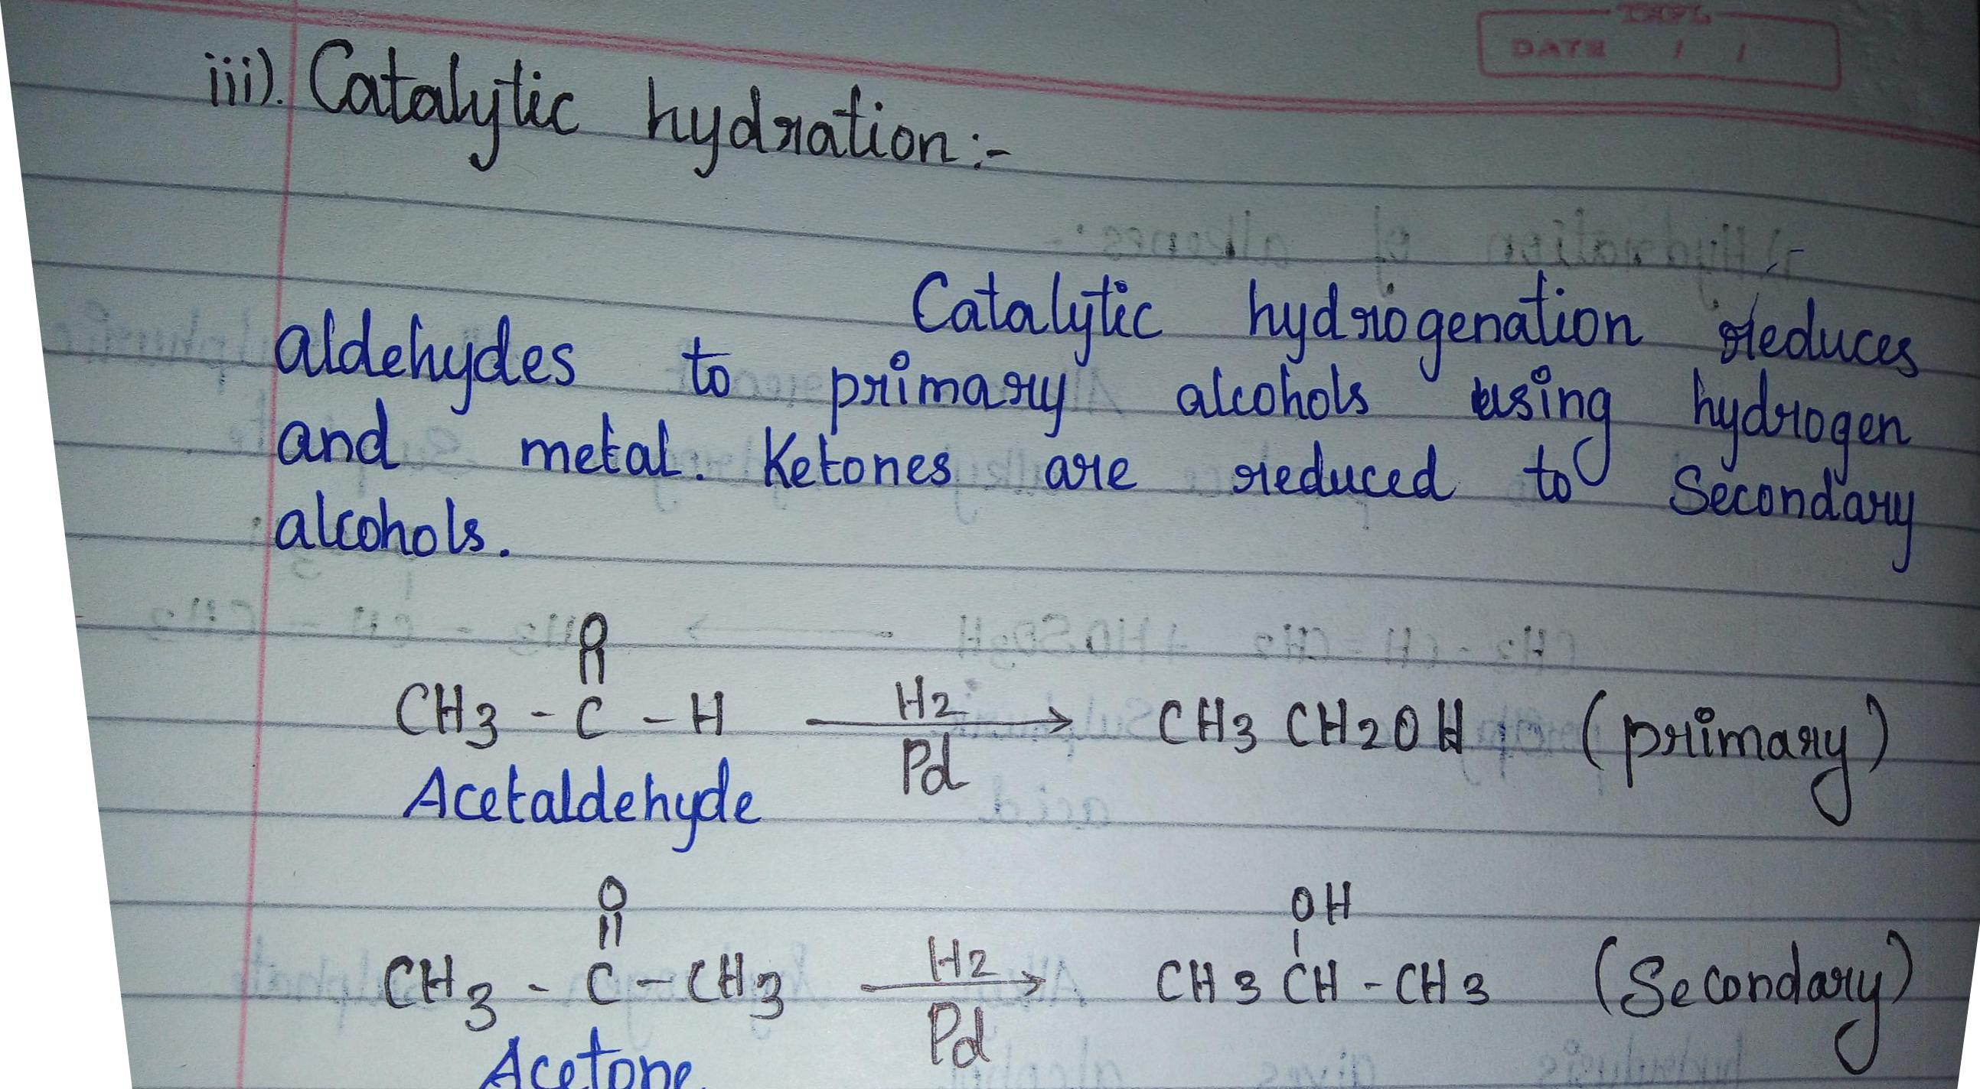

Slide 10
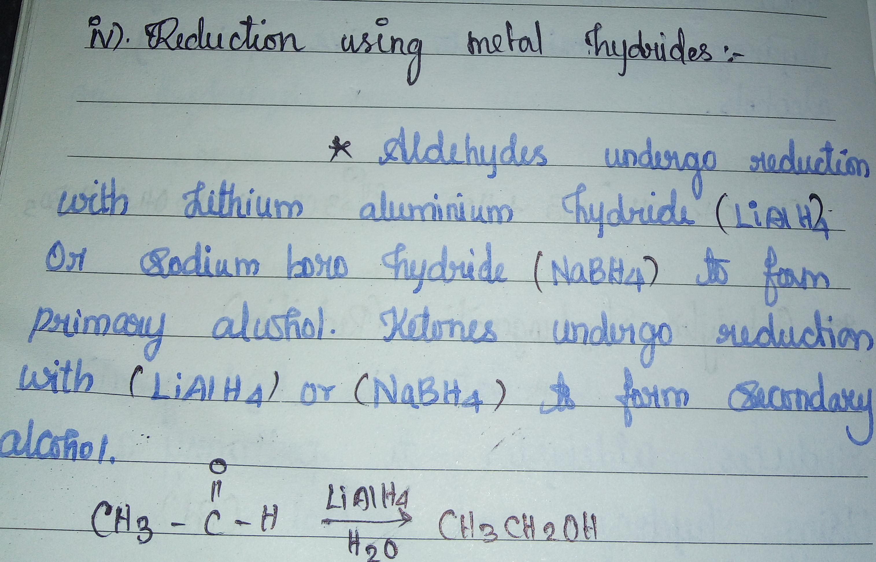

Slide 11
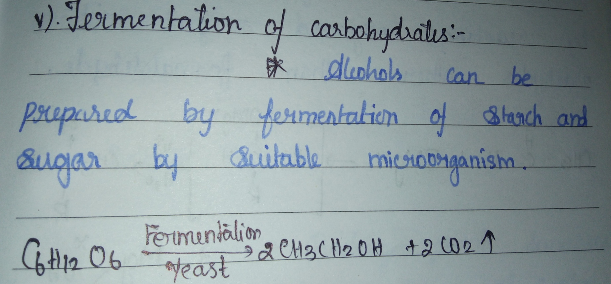

Slide 12
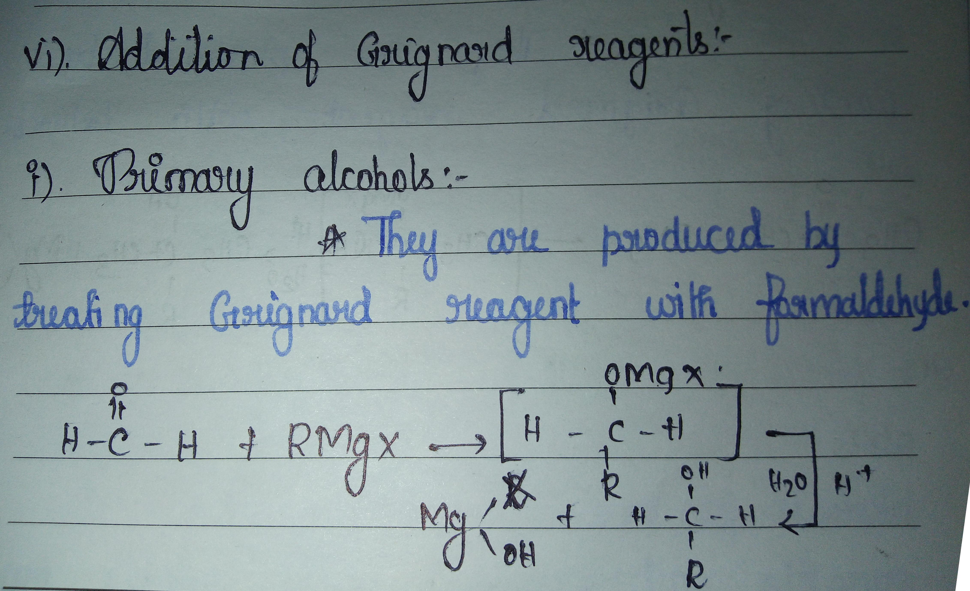

Slide 13
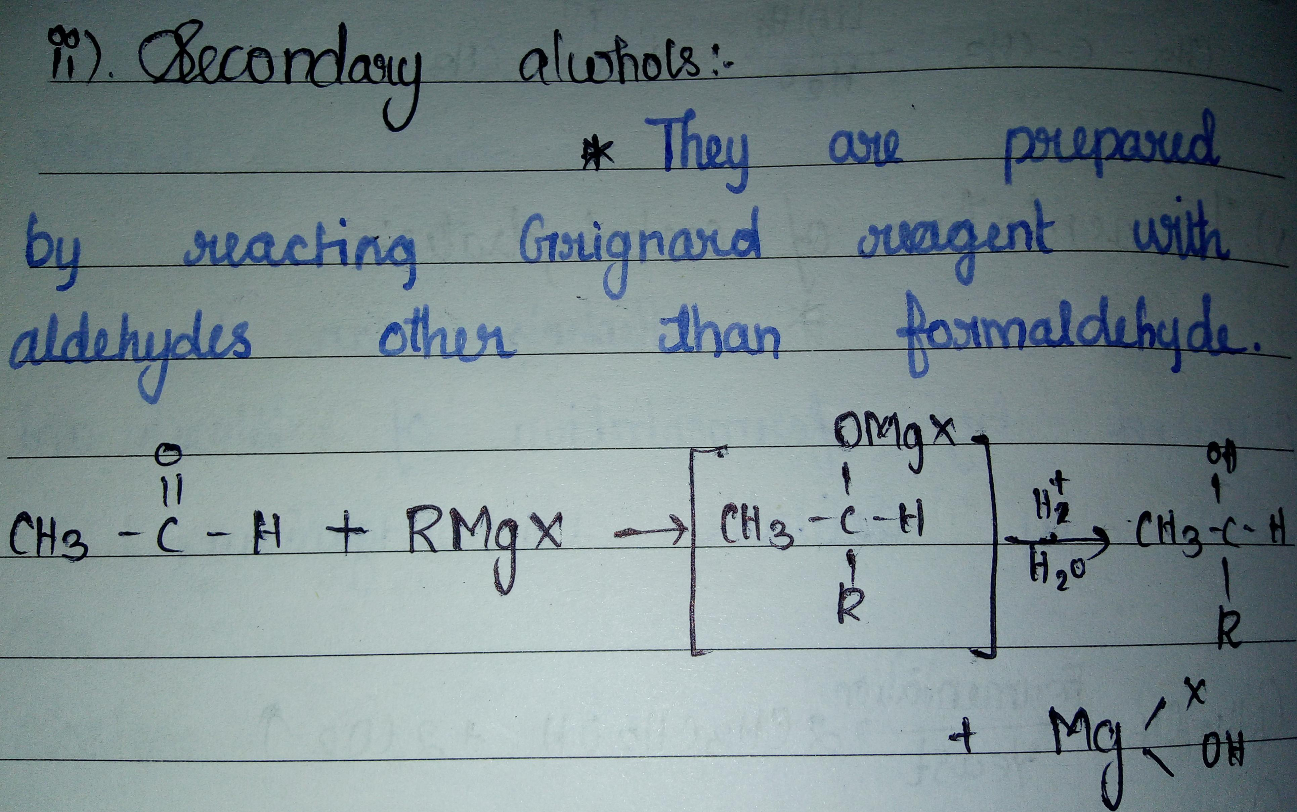

Slide 14
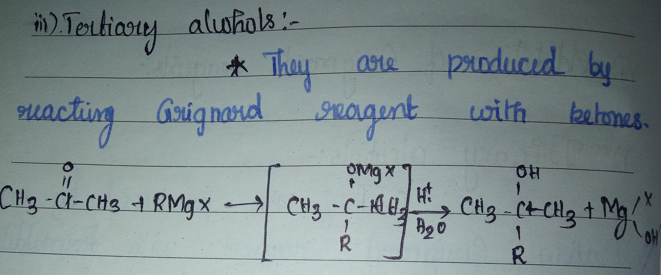

Slide 15
PHYSICAL PROPERTIES.
Boilng point of alcohols are higher than corresponding alkanes due to hydrogen bonding.
Lower alcohols are completely soluble in water.
Lower alcohols are colourless and toxic liquids.
Lower alcohols have characteristic smell.
Boiling point increases with increase in number of carbon.
CH3OH < CH3CH2OH < CH3CH2CH2OH
Among isomeric alcohols boiling point decreases with increase in branching.
CH3CH2CH2CH2OH>CH3CH2CHOHCH3>CH3COHCH3CH3

Slide 16
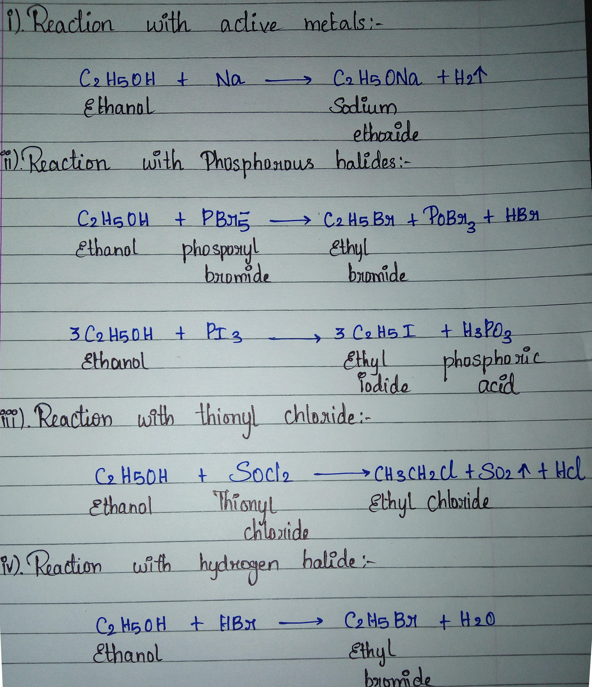
Chemical properties.

Slide 17
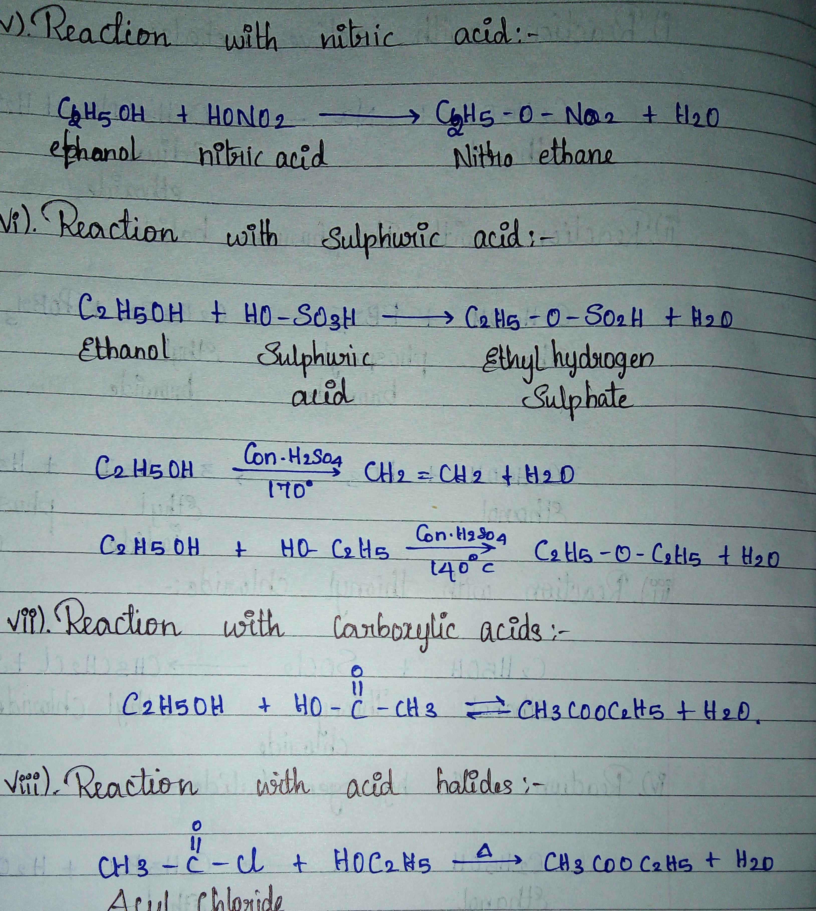

Slide 18
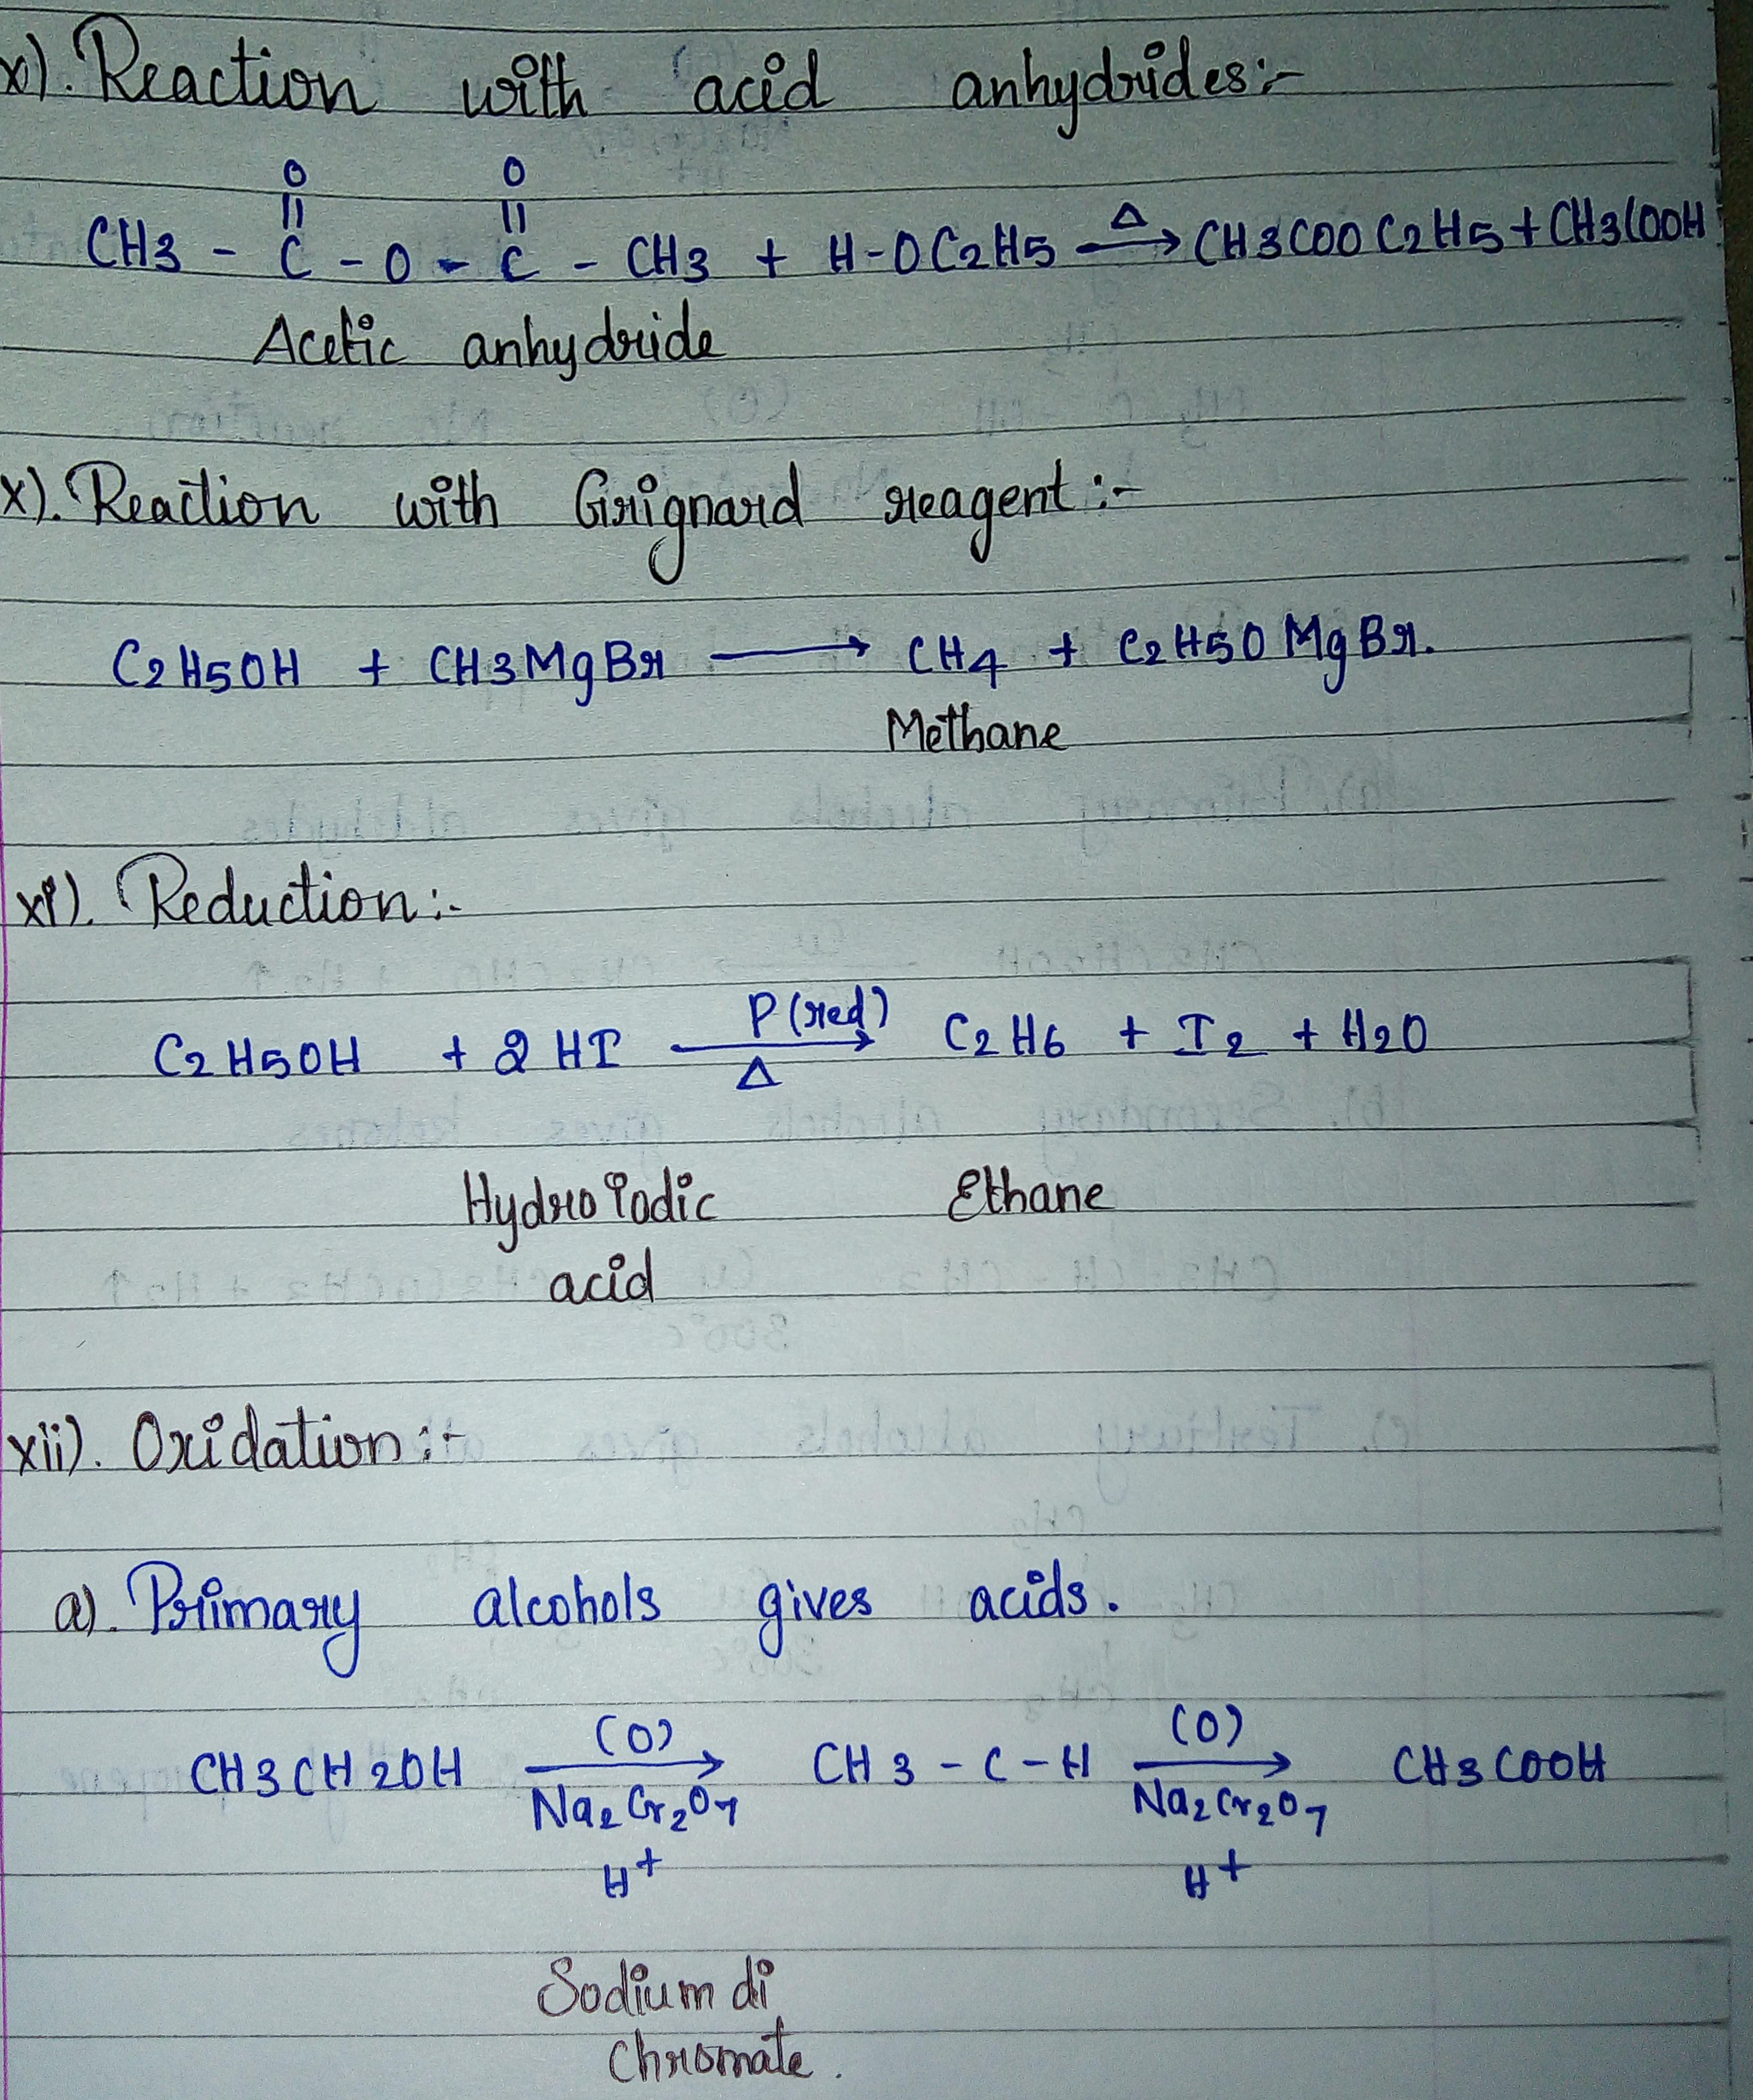

Slide 19
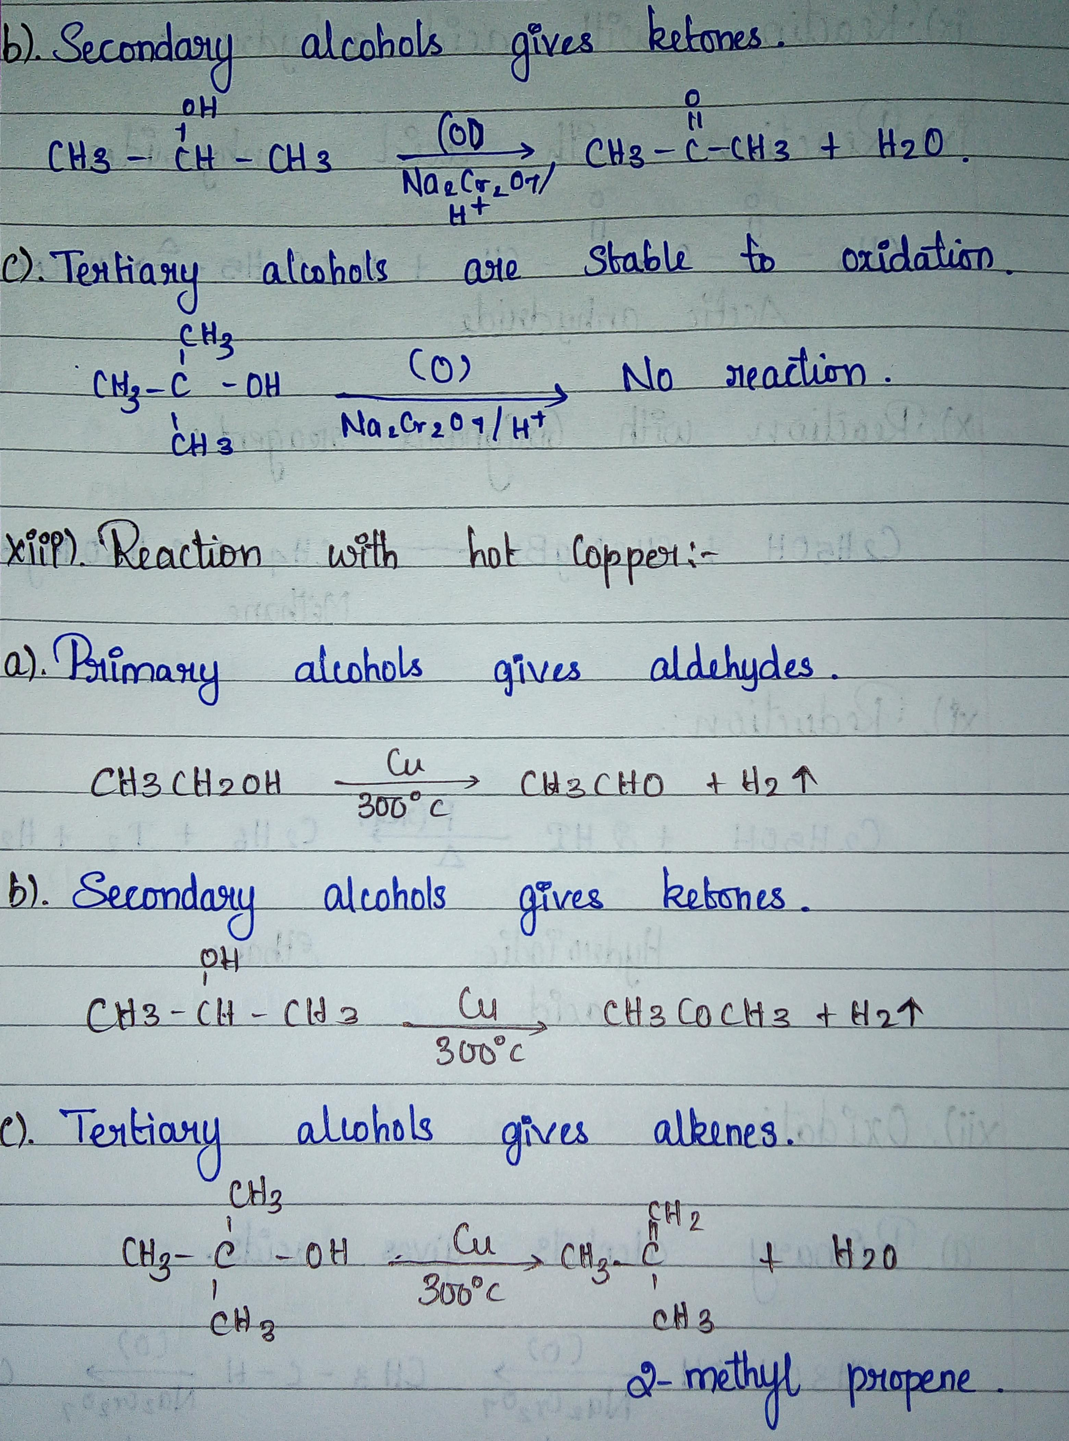

Slide 20
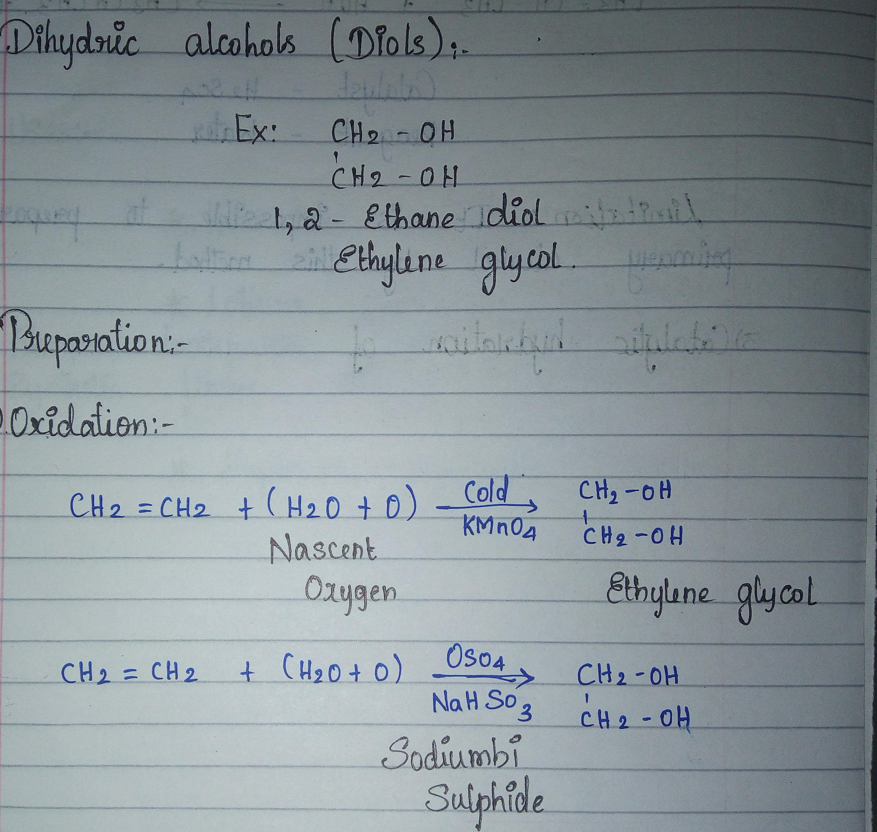
_{DIHYDRIC ALCOHOLS.}

Slide 21
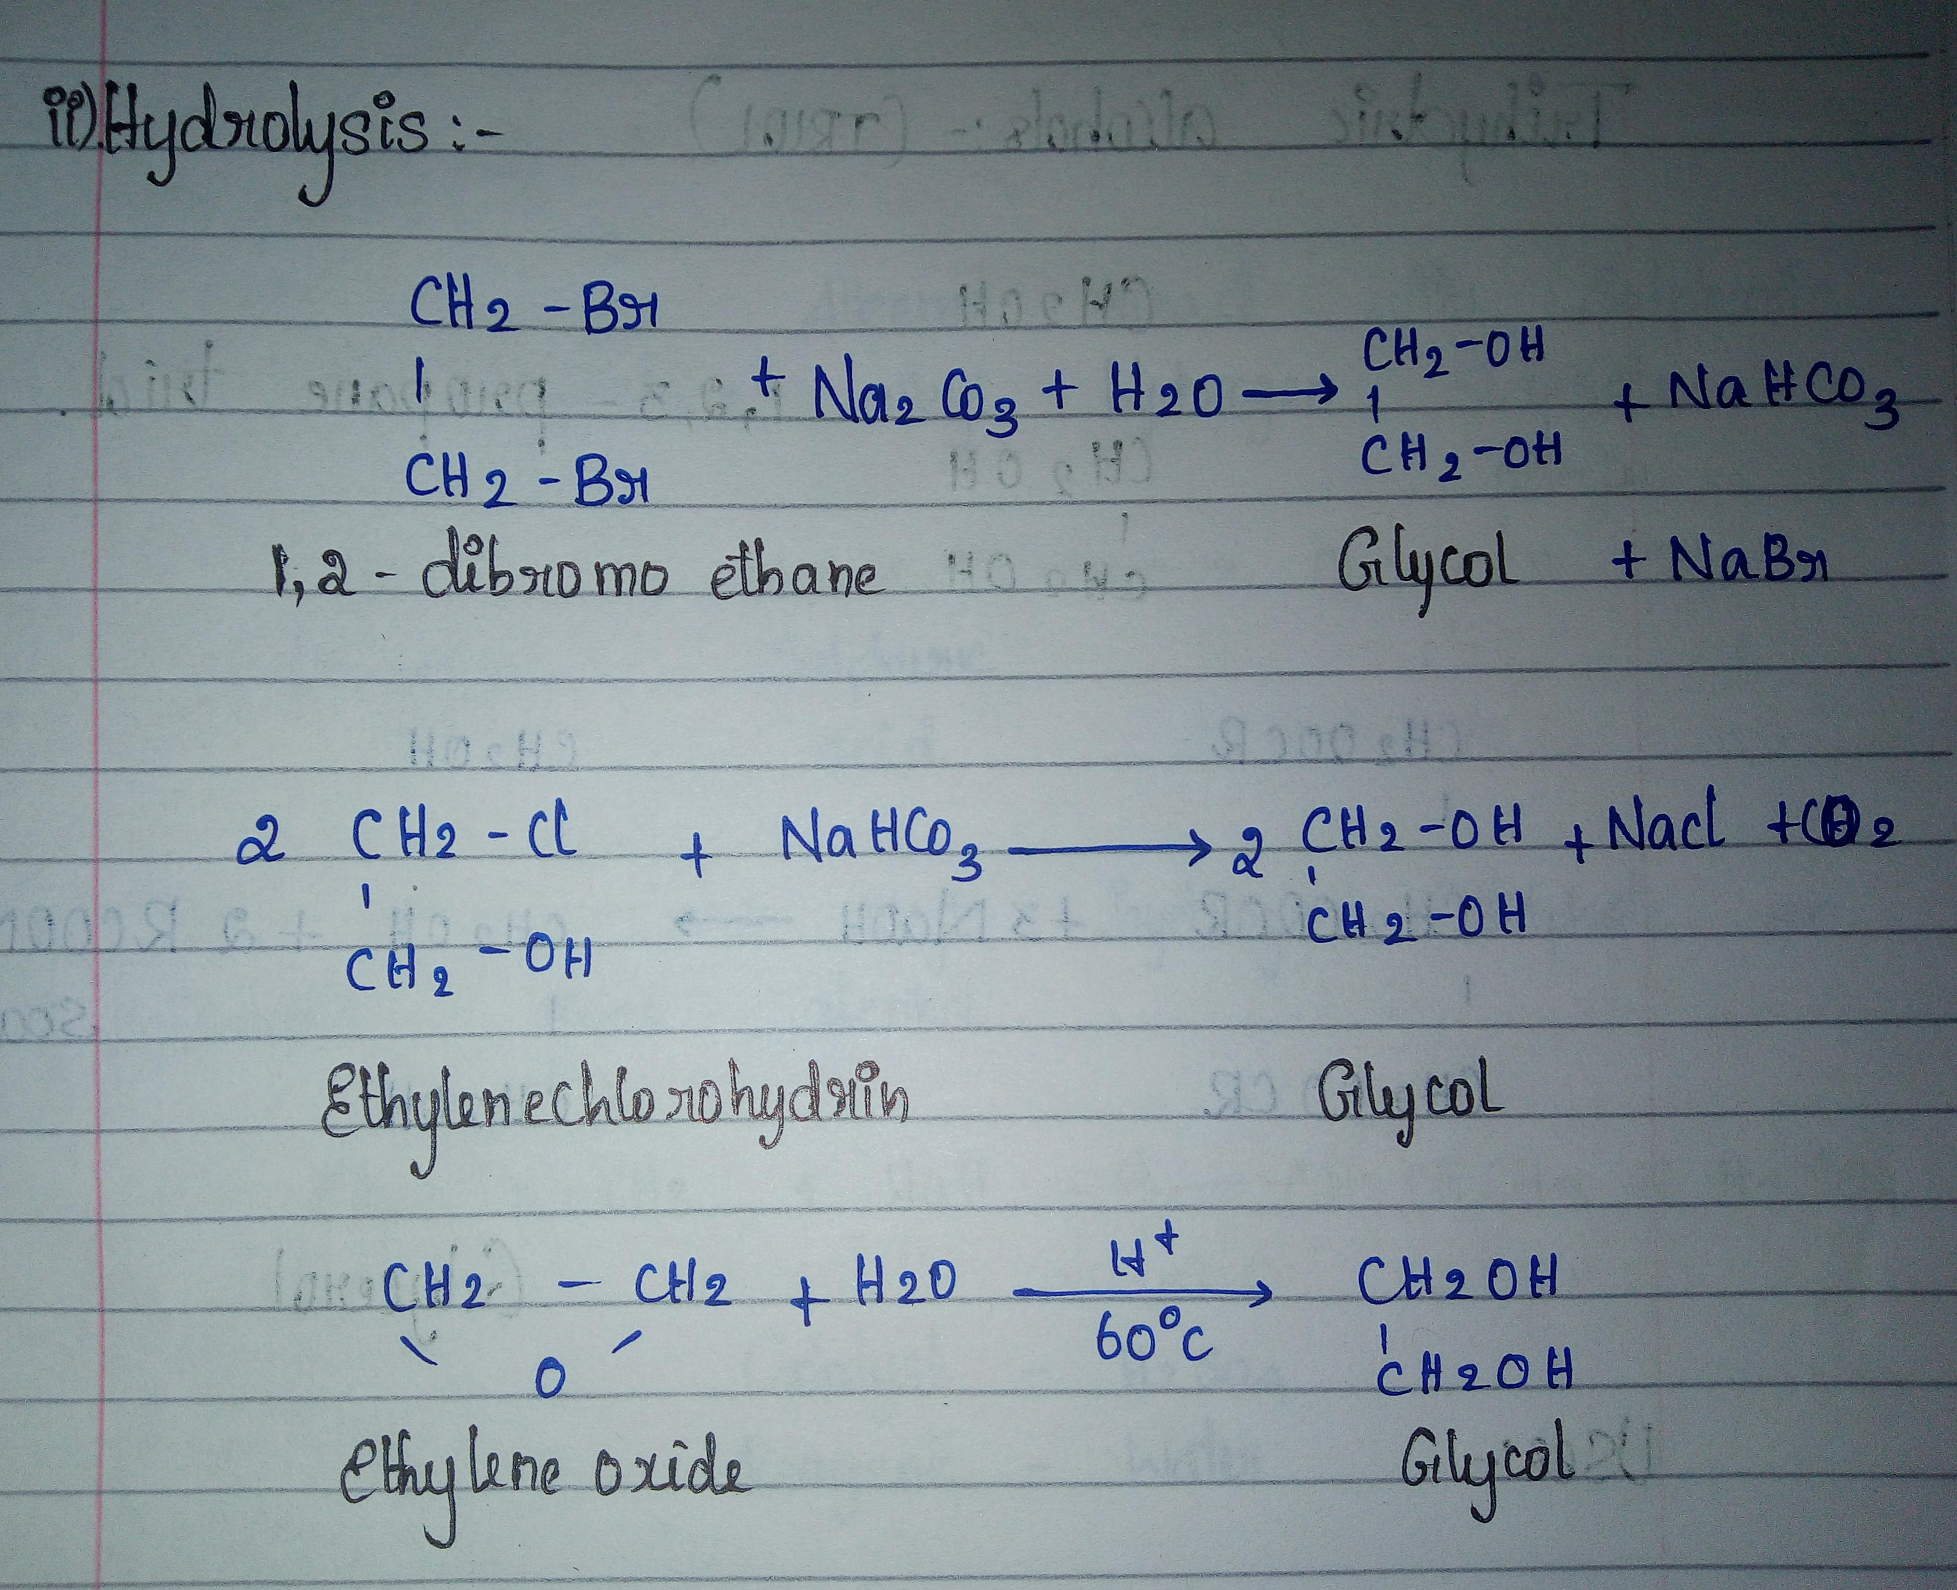

Slide 22
Uses of DIHYDRIC ALCOHOLS.
Antifreeze for car radiators.
Deicing fluid in aeroplane.
Manufacture of DACRON, DIOXANE, ETHYLENE OXIDE.
It is used as coolant.

Slide 23
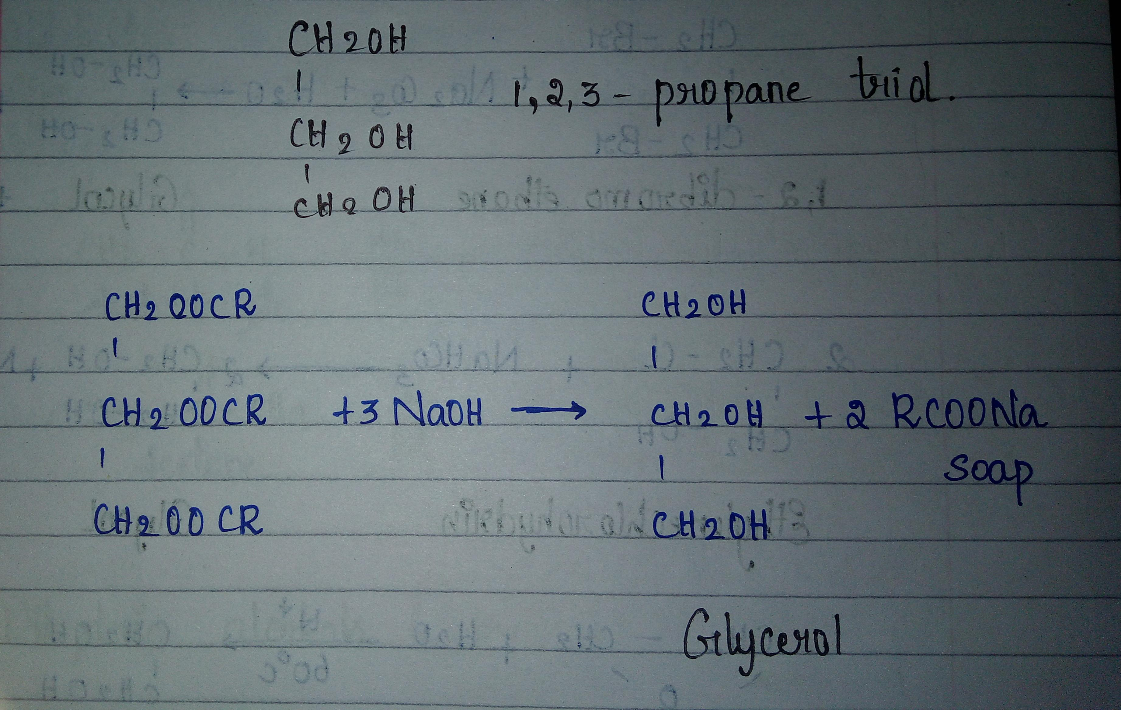
Trihydric alcohols.

Slide 24
Uses of trihydric alcohols.
Humectant (moisture retaining agent).
Used in lotions, vanishing creams, shaving soaps, toothpastes, bakery products, plastics, synthetic fiber,surface coatings.
Explosives:dynamite, cordite.

Slide 25
Uses of alcohols.
It is used as a solvent for paints and varnishes.
It is used as an antifreeze for automobile radiators.
It is used to denature ethyl alcohol.
It is used as a motor fuel.
20% mixture of methyl alcohol and gasoline makes a good motor fuel.
It is used in the manufacture of formaldehyde.
It is used in the manufacture of alcoholic beverages.
It is used as an industrial solvents.

Slide 26
It is used in the manufacture of drugs, flavoring extracts and perfumes.
Antiseptic in hospitals.
It is used as an low freezing point and mobile liquid in scientific apparatus such as thermometers and spirit levers.
Antifreeze in automobile radiators.
It is used in lacquers and varnishes.
It is used as a preservatives for biological speciments.
It is used in the manufacture of acetaldehyde, acetic acid, ethyl chloride and ethyl acetate.
It is used in the manufacture of synthetic rubber.

Slide 27
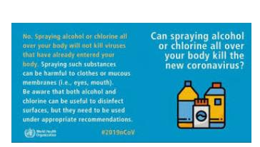

Slide 28
THANK YOU

