Slide 1
Counter trade
By
s.nagasundari,
asst.,prof,dept.of fashion technology and costume designing,
Bon secours college for women

Slide 2
INTRODUCTION
Trading between nations has been happening since time began. In ancient time nations traded silk, spices, cloth and animals of all kinds.
Today nation trade food items, defense equipment, metals, electronics etc.
The products might have changed but the basic concept is still the same as the underlining need which brings together two nations in a trade relationship still exists.
One such method of trading between nations is called counter trade.

Slide 3
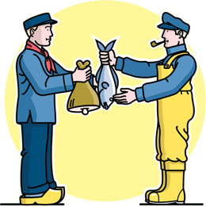
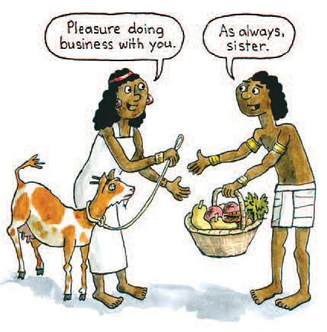
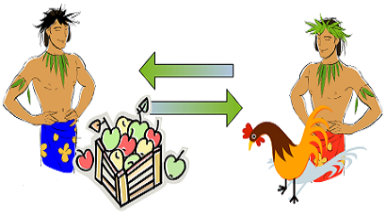
COUNTER TRADE

Slide 4
COUNTER TRADE
Countertrade is a reciprocal form of international trade in which goods or services are exchanged for other goods or services rather than for hard currency.
This type of international trade is more common in developing countries with limited foreign exchange or credit facilities.
Countertrade is often used when a foreign currency is in short supply or when a country applies foreign exchange controls, which are limits imposed on the availability of foreign currencies to importers for the purchase of foreign products.
Countertrade is often used by developing countries to control trade and as a development technique.

Slide 5
Some of the examples of counter trade are given below,

Slide 7
TYPES OF COUNTER TRADE
There are main 4 types of counter trade. They are as follows,
Barter
Compensation deals
Counter purchase
Buyback

Slide 8
BARTER TRADE
Bartering is the oldest countertrade arrangement.
It is the exchange of goods and services for goods and services without any use of money.
Like the trade relationship between China and Thailand where fruit has been traded by Thailand for buses made by China.

Slide 9
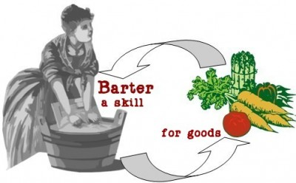
BARTER TRADE

Slide 10
COMPENSATION DEAL
A type of countertrade that involves the exports of goods in one direction. The payment of the goods is split into two parts:
Part payment in cash by the importer.
For the rest of the payment the original exporter makes an obligation to purchase some of the buyer´s goods.
The products of the compensation deal can be used in the exporter´s internal production or they may be sold on in the wider market.

Slide 12
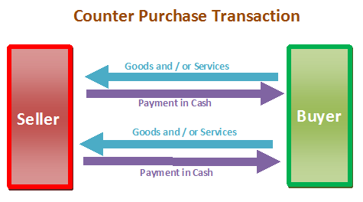
COUNTER PURCHASE
A counterpurchase refers to the sale of goods and services to a company in a foreign country by a company that promises to make a future purchase of a specific product from the same company in that country.

Slide 14
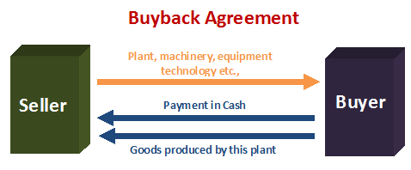
BUYBACK
A buyback is a countertrade occurs when a firm builds a manufacturing facility in a country—or supplies technology, equipment, training, or other services to the country and agrees to take a certain percentage of the plant's output as partial payment for the contract.

Slide 16
Thank you

