Slide 1
HORTICULTURE
* Horticulture has been defined as the agriculture of plants, mainly for food materials, comfort and beauty for decoration.
*Horticulture is the growing of flowers, fruits and vegetables, and of plants for ornament and fancy.
* A more precise definition can be given “ The cultivation, Processing, and sale of fruits, nuts, vegetables, and ornamental plants as well as many additional services.

Slide 2
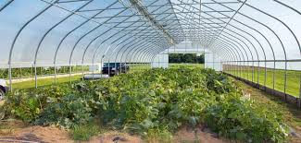

Slide 3
* Horticulture includes plant conservation, landscape restoration, soil management, landscape and garden design, construction and maintenance and arboriculture.
* In contrast to agriculture, horticulture does not include large-scale crop production or animal husbandry.
* Horticulture is derived from Latin word “Hortus” meaning garden and “cultura” meaning cultivation.

Slide 4
* At present horticulture may be defined as the science and technique of production, processing and merchandising of fruits, vegetables, flowers, species, plantations medicinal and aromatic crops.
* Horticulture apply knowledge, skill and technologies to grow intensively produced plants for human food and non-food uses and for personal or social needs.
* Their work involves plant propagation and cultivation with the aim of improving plant growth, yields, quality, nutritional value and resistance to insects, diseases and environmental stresses.

Slide 5
* They work as gardeners, growers, therapists, designers and technical advisor in the food and non-food sectors of horticulture.
* Horticulture primarily differs from agriculture in two ways.
* First, it generally encompasses a smaller scale of cultivation, using small plots of mixed crops rather than large fields of single crops.
*Secondly, horticultural cultivations generally include a wide variety of crops, even including fruit trees with ground crops.

Slide 6
* Horticulture is divided into the cultivation of plants for food (pomology and olericulture) and plant for ornament (floriculture and landscape horticulture).
* Pomology deals with fruit and nut crops.
* Olericulture deals with herbaceous plants for the kitchen, including for (e.x) carrots (edible root), asparagus (edible stem), lettuce (edible leaf), cauliflower (edible flower buds), tomatoes (edible fruit), and peas (edible seed).

Slide 7
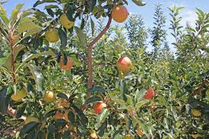
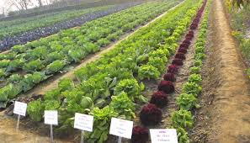
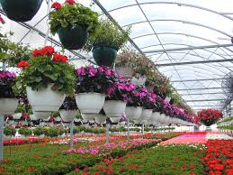
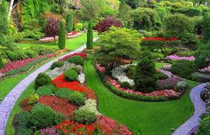
Pomology
Olericulture
Floriculture
Landscape in Horticulture

Slide 8
* Floriculture deals with the production of flowers and ornamental plants generally cut flowers, pot plants and greenery.
* Landscape horticulture is a broad category that includes plants for the landscape, including lawn turf but particularly nursery crops such as shrubs, trees and vines.
*The specialization of the horticulturist and the success of the crop are influenced by many factors. Among these are climate, terrain and other regional variations.

Slide 10
THANK YOU

