Slide 1
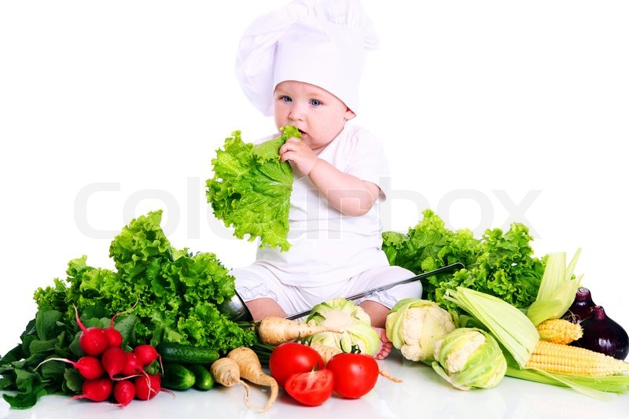
CHILD NUTRITION
Mrs.A.Denis Rani,
Assistant Professor,
Department of Hospital Administration,
Bon Secours College for Women.

Slide 2
Definition of child:
◆ Biologically a child (plural: children) is generally a human between the stages of birth and puberty.
◆ A person between birth and puberty.
◆ A person who has not attained maturity or the age of legal majority.

Slide 3
Different age of child-hood:
◆ 1st day = neonatal
◆ 2-30 days = new born
◆ 2 month- 2 years = infant
◆ 2-6 years = early childhood
◆ 6-3 years = childhood/pre-adolescent
◆ 13-18 years = adolescents.

Slide 4
Definition of child nutrition:
◆ Proper weight for age/height
◆ Develop of internal & external organ
◆ Overall malnutrition of digestive system
◆ Normal physical and neuropsychic development of the child
◆ Strong immunity power.

Slide 5
Requirement:
Nutrient | 0-6 month | 7-12 month | 1-5 years
k. Calories | 120 | 100 | 1000 – 1500
Protein | 2.3-1.8gm/kg | 1.8-1.5gm/kg | 17-22 gm
Calcium (ca) | 0.5-0.6 mg | 0.5 – 0.6mg | 0.4-0.5mg
Iron (fe) | 6mg | 10mg | 10mg
Vit A | 400mg | 300mg | 250-300mg
Thiamine (B1) | 0.3mg | 0.3mg | 0.6-0.8mg
Riboflavin (B2) | 0.4mg | 0.4mg | 0.7-0.8mg
Vit C | 30mg | 30mg | 30-40mg
Folic acid | 25mg | 25mg | 50-100mg

Slide 6
Colostrum (1st vaccine):
◆ A thin white opalescent fluid, the first milk secreted at the termination of pregnancy; it differs from the milk secreted later by containing more lactalbumin and lactoprotine.
Health benefit to colostrum:
◆ Strengthens the immune system against fungi, bacteria, viruses and candida.
◆ Help against depression and enhance mood.
◆ Increases your muscle mass and BMR& lymphoid.
◆ Reduces allergic reactions like hay fever. Helps tone down allergic responses for people with asthma which otherwise may bring an attack.
◆ Balances the blood sugar, which helps control insulin levels in diabetes.

Slide 7
More benefit:
◆ Supports healthy joint and cartilage function colostrum is a very effective anti- inflammatory compound which can help people with arthritis.it can also help other forms of inflammation from the digestive system which may be linked to arthritis.
◆ Promotes healthy intestinal flora in your digestive system.
◆ Accelerates healing in the case of injury or trauma, as well as helping in recovery from cancer treatments. It does that by turning white blood cells into functionally active T cells in patients, thus aiding in recuperation, healing and strengthening of the immune system.
◆ Improves endurance and workload capacity. Allows for greater aerobic and anaerobic performance, as well as shorter recovery time between training sessions.

Slide 8
What is weaning food:
◆ Complementary foods are foods other than breast milk or formula(liquid, semisolids, and solids) introduced to an infant to provide nutrients.
Recommendations on the introduction of complementary foods provided to caregivers infants should take into account:
The infants developmental stage and nutritional status.
Coexisting medical conditions.
Social factors.
Cultural, ethic, and religious food.
Preferences of the family.
Financial considerations; and other patient factors discovered through the nutrition assessment process.

Slide 9
From 4 to 6 months of age, the following developmental changes occur the allow the infant to tolerate complementary foods:
◆ The infants ability to digest and absorb proteins, fats, and carbohydrates.
◆ Other than those in breast milk and formula, increases rapidly.
◆ The infants kidneys develop the ability to excrete the waste products from foods with a
high renal solute load, such as meat.
◆ The infant develops the neuromuscular mechanisms needed for recognizing.
◆ Accepting a spoon, masticating, swallowing.
◆ Nonliquid foods, and appreciating.
◆ Variation in the taste in the taste and Color of foods.

Slide 10
Multimix:
Staple food
rice-40gm
Breast feeding
Protein pulse-25gm. Fish-10gm egg
Fat-5gm.
Vit-/min- 30mg vegetable/ fruits.

Slide 11
Feeding pattern:
Self feeding
Cup feeding
Spoon feeding
Breast/ bottle feeding

Slide 12
Importance of gradually introducing each new food:
◆ Introduction new foods one at a fine.
◆ Introduce “single-ingredient” foods initially to determine the infant’s acceptance to each
food (e.g., try plain rice cereal before rice cereal mixed with fruit).
◆ Allow at least 7 days between the introduction of each new “single- ingredient” food.
◆ Introduce a small amount (e.g., about 1 to 2 teaspoons) of a new food at first.
◆ Observe the infant closely for adverse reactions such as rash, wheezing, or diarrhea after
feeding a new food.

Slide 13
Definition of malnutrition:
◆ Malnutrition is the condition that develops when the body does not get the right amount of the vitamins, minerals, and other nutrients it needs to maintain healthy tissues and organ function.
Symptoms:
Anemia
Diarrhea
Disorientation
Night blindness
Irritability, anxiety, and attention deficits
Goiter (enlarged thyroid gland)
Loss of reflexes and lack of muscular coordination.
Muscular twitches.
Amenorrhea(Cessation of menstrual periods).
Scaling and cracking of the lips and month.

Slide 14
Complication of weaning food:
Hyposensiti
-zation
Allergy
Elimination of causative food
Food
intolerance
Alternative
food
Food intoxicati on
Digestive problem

Slide 15
Big concern in malnutrition:
Marasmus
3 types
kwashiorkor
Marasmus kwashiorkor

Slide 16
Causes of child nutrition:
◆ Malnourished mother.
◆ Colostrum rejection.
◆ Improper weaning food.
◆ Rejection of exclusive breast-feeding.
◆ Low-birth weight (2-2.5kg).
◆ Pre-mature child.
◆ Un- hygiene environmental.
◆ Inadequate dietary intake.
◆ Inadequate maternal care.
◆ Superstition.

Slide 17
Malnutrition is one of the leading cause of MDG (millennium development goal):
Age | Disease | Frequency
1-5 years | Diarrhea | 3-4 Times
1-5 years | Fever | 1-3 Times
1-5 years | A.R.I | 7-9 Times

Slide 18
Fate of malnutrition:
Still- birth
Pre mature child
Decrease brain develop
Low blood circulation
malnutrition
Mentally retarded
Decrease immunity
Inadequa
-te bone health
Anemia

Slide 19
conclusion
◆ Nutrition affects growth and development of a person. At least the development of international standards and national legislation. Are essential to protect and promote national food security and public health. Civil society will have to pay more active role. The concept of food security must be recaptured and reframed in public and environment terms.

