Slide 1
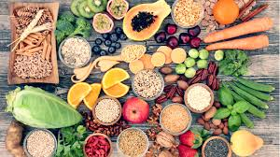
DIETARY FIBer
PRESENTED BY:
Ms.A.Denis Rani,
Assistant Professor,
Bon Secours College for Women,
Thanjavur.

Slide 2
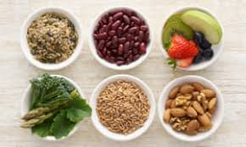
DIETARY FIBRE
Dietary fibre is a type of carbohydrates that cannot be digested by our bodies enzymes.
It is found in edible plant foods such as cereals,fruits,vegetables,nuts,grains. fibre is grouped by its physical properties and is called soluble,insoluble or resistant.
It is also known as roughage or bulk includes the parts of plant foods your body cannot digest or absorb.

Slide 3
TYPES OF FIBER
Soluble fiber
Insoluble fiber

Slide 4
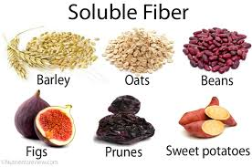

Slide 5
SOLUBLE FIBRE
This type of fibre dissolves in water to form a gel like material.
It can help lower blood cholestrol and glucose levels.
Soluble fibre is found in oats, peas,beans,apples, citrus fruits,carrot and barley.

Slide 6
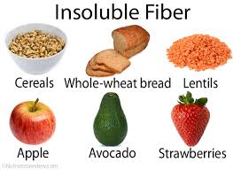

Slide 7
INSOLUBLE FIBRE
This type if fibre promotes the movement of material through out the digestive system and increases the stool bulk.
It can be benefits to those who struggle with constipation or irregular stool.
Such as cauliflower,green,peas and potato are good sources of insoluble fibre.

Slide 8
HIGH FIBRE ON
FRUITS
NUTS

Slide 10
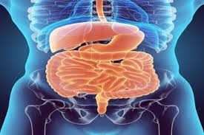
NORMALIZES BOWEL MOVEMENT
Dietary fibre increases the weight and size of your stool and softens it.
If you have loose and watery stool,fibre may help to solidify the stool because it absorbs water and adds bulk to stool.

Slide 11
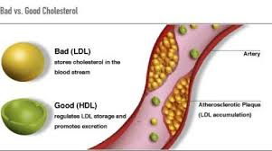
LOWER CHOLESTROL LEVEL
Soluble fibre found in beans,oats,flaxseed and oat bran may help lower total blood cholestrol levels by low-density lipoprotein or bad cholestrol levels.

Slide 12
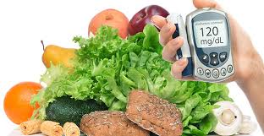
HELPS TO CONTROL BLOOD SUGAR LEVEL
In people with diabetes fibre-particularly soluble fibre can slow the absorption of sugar and help improve blood sugar levels.

Slide 13
AIDS IN ACHEIVING HEALTHY WEIGHT
High fibre foods tend to be more filling than low fibre foods,to eat less and stay satisfied longer.
Which means they have fewer calories for the same volume of blood.

Slide 14
HELPS YOU LIVE LONGER
Increasing your dietary fibre intake-especially cereal-fibre is associated with a reduced risk of dying from cardiovascular disease and all cancers.

Slide 15
FUNCTIONS OF FIBRE
Lower total and LDL cholestrol.
Regulate blood pressure.
Speeds the passage of foods through the digestive system.
Add bulk to stool.
Balance intestinal PH and stimulate intestinal fermentation production of short-chain fatty acids.
Adds bulk to the diet,making feel full faster.

Slide 16
FIBRE FOR ADULTS
MEN
Age 50 or younger : 38 grams
Age 51 or older : 30 grams

Slide 17
WOMEN
Age 50 or younger : 25 grams
Age 51 or older : 21 grams

