Slide 1
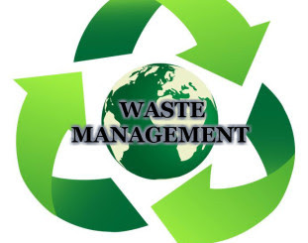

Slide 2
Contents:
Introduction
Waste
Classification
Sources
Magnitude of the problem
Public health importance of waste management
Ideal waste management
Present status of waste management in India
Integrated solid waste management
E-waste-effects , sources , mg
Hazardous waste
Biomedical waste
Liquid waste
Challenges faced in management of waste
conclusion

Slide 3
Introduction:
Waste is being generated everywhere.
Waste comes from our home, school, college, hospital, market, industries, agriculture and commercial places.
Rabid urbanization
Constant change in consumption pattern and school behavior
Problem of high volumes of waste, the costs involved , the disposal technologies and methodologies, and the impact of wastes on the local and global environment.

Slide 4
Waste:
Waste includes all items that people no longer have any use for, which they either intend to get rid of or have already discarded.
Any material which is not needed by the owner, producer or processor.

Slide 5
Types of waste on the basis of their physical state:
Solid waste
Liquid waste
Gaseous waste

Slide 6
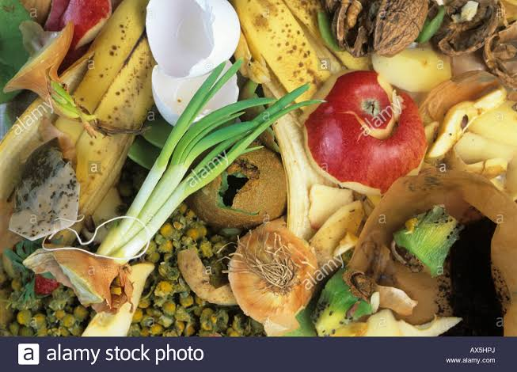
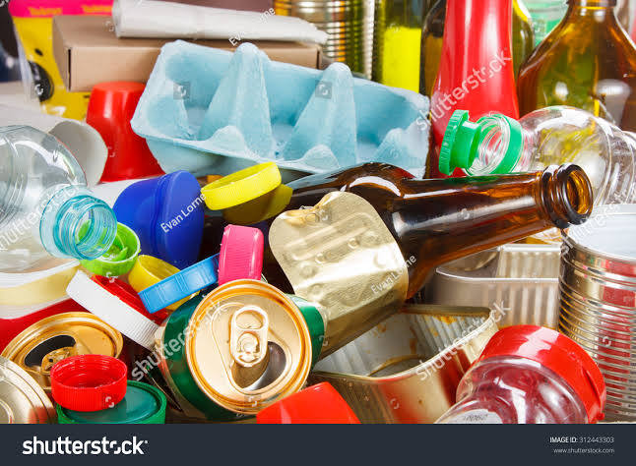
On the basis of bio- degradability:
Biodegradable waste Non- Biodegradable

Slide 7
On basis on effects on human health:
Hazarded waste
Non hazarded waste

Slide 8
Sources:
Residential
Commercial
Institutional
Municipal solid waste
Treatment facilities
Agriculture

Slide 9
Solid waste:
Solid waste is commonly called garbage.
It includes only non- liquid waste.
Three types of solid waste:
House hold or municipal solid waste.
Industrial waste or hazardous waste.
Hospital waste or biomedical waste.

Slide 10
Magnitude of problem(INDIA):
Per capita waste generation increasing by 1.35% annum.
With urban population increasing between 3-3.5% per annum.
Yearly increasing in waste generation is around 5% annually.
Per capita generation of waste varies from 200 gm to 600 gm of the solid waste generated.
Crude dumping of waste in most of the cries.

Slide 11
Public health importance of waste management:
Poor waste handing and disposal- environmental pollution- breeding of disease vector insects, animal scavengers and rodents- disease.
Public or community nuisance due to foul odour and unsightliness.
Obstruction of drainage system.
Fire hazards.

Slide 12
The ideal waste management system:
Provide a customized and robust handling of all waste with a minimum of effort for the customer.
Result in the lowest possible load on the environment.
Provide a maximum of disease of resource recovery from the waste while minimizing use of resources in the waste handing.
Provide only little impact on the city with respect to traffic vehicle exhaust, nose, traffic accidents and spill of waste.
Include proper architectural consideration in establishing waste collection facilities.
Economically acceptable.

Slide 13
Present status of waste management:
Domestic waste thrown on streets.
Trade waste on road / streets.
Construction debris left unattended .
Biomedical waste disposed in municipal waste stream.
Industrial waste disposal off in open areas.
Segregation and storage of waste at sources not done inappropriate, resulting in littering of garbage.
Street sweeping not done in everyday.
Waste transportation done in open vehicles.
Final disposal done through crude dumping.
Rag pickers collect recyclable from municipal bins / dumpsites and litter the waste causing insanitary conditions.

Slide 14
Integrated solid waste management (ISWM):
Comprehensive waste prevention, recycling, composition, and disposal program.
To minimize the initial generation of waste materials through source reduction, then through reusing and recycling to further reduce the volume of the material being sent to landfills or incineration compared to the conventional approach of simply focusing on disposal of solid waste.

Slide 15
Focus of the ISWM program includes:
Assignment of present condition and organizational set up.
Reduce, reuse and recycle solid waste to the greatest extend possible.
Co- operate to the extend practicable in recycling program conducted by the civilian community.
Facilitating ty community participation in solid waste management activity intellectual input- research on design, material, concept.
Financial support towards infrastructure and maintenance.
Privatize solid waste management facilities or contract for waste disposal services, including recycling.
Complying with applicable regulations regarding solid waste management and recycling.
Overall monitoring and co-ordination.

Slide 16
Solid waste disposal:
On-site disposal.
Composting.
Incineration.
Open dumps.
Sanitary landfills.

Slide 17
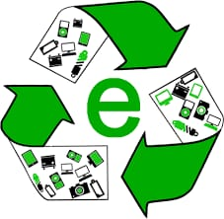

Slide 18
E waste:
E-waste comprises of waste electronics goods which are not fit their originally intended use.
Such electronics goods may be television, telephone, radio, computers, printer, fax machines, DVDs and CDs etc.
Sources of e-waste :
It and telecom equipments.
Large and small household appliances.
Consumer & lighting equipment.
Toys, leisure & sports equipment.
Medical devices.
Monitoring & control instruments.

Slide 19
Health effects:
Electronics products like computers and cell phones contain a lot of differents toxins.
Electronic products like computer and cell phone contain a lot of different toxins.
For example, cathode ray tubes (CRTs)contain heavy martial such as lead, barium and cadmium, which can damage human nervous and respiratory system if they enter the water system.

Slide 20
Effects of e- waste:
On Environment
Pollution of ground water.
Acidification of soil.
Air pollution
E-waste accounts for 40 percentage of the lead and 75 percent for the heavy metals found in landfills.
On Human Health:
DNA damage.
Lung cancer.
Damage to heart, liver and spleen.
Chronic damage to the brain.
Asthmatic bronchitis.

Slide 21
E-waste management:
The major components of e-waste management are :
E-waste collection, sorting and transportation.
E-waste recycle.
In industries, management of e-waste is done by waste minimization techniques. It involves:
Inventory management.
Production process modification.
Volume reduction.
Recovery and reuse.

Slide 22
Hazardous waste:
Consist of toxic substances that are chemical nature.
Highly dangerous to human, plants, animals and the overall environment.

Slide 23
Hazardous waste management:
Minimizing.
collection and packaging.
Labelling.
Storage.
Disposal.

Slide 24
Minimizing:
Reuse old chemical containers.
Helps in resources conservation, economic efficiency & environmental protection.
Collection and packaging:
Never mix incompatible materials.
Sealed containers.
Liquid waste containers should only be fill to 75% of expansion.
Labeling:
Proper labeling

Slide 25
Storage:
Waste should be segregated and stored according to compatibility.
Make sure container are source and check for leaks in storage area.
Treatment:
Physical: screening, sedimentation, centrifugation, floatation, adsorption.
Chemical: neutralization, precipitation, oxidation and reduction.
Biological: different types of microorganisms.
Disposal:
Incineration- able to achieve 99.99% destruction & removal efficiency of hazardous components in waste.
Land disposal, underground disposal & deep well injection.

Slide 26
Biomedical waste:
Bio-medical waste means any waste, which is generated during the diagnosis, treatment or immunization of human beings or animals or in research activities or in the production or testing of biologicals.
Steps in BMW management:
Generation
Segregation
Storage and collection
Transportation
Treatment
Disposal

Slide 27
Steps in BMW management:
Survey of waste generated:
Quality
Types
source
Level of disinfection

Slide 28
Segregation and collection:
Done at point of generation of waste.
Process where wastes of different types, hazardous nature and consisyency are separated.
As per the categories.
Colour coded containers.
Local languages.

Slide 29
Colour coding and types of containers for disposal of bio-medical wastes:
Colour coding | Types of containers | Waste category | Treatment options as per schedule : 1
yellow | Plastic bag disinfected | 1,2,3,6 | Incineration/ deep burial
red | Disinfection container/plastic bag | 3, 6, 7 | Autoclaving/ micro waving / chemical treatment.
Blue/white | Plastic bag /puncture | 4 , 7 | Autoclaving/micro waving/chemical.
Black | Plastic bag | 5, 9, 10(solid) | Disposal in second landfill.

Slide 30
Storage of waste:
Holding of biomedical waste for such period of time, at the end of which waste is treatment and disposal of.
Safe from tampering and access to rag-pickers.
Not beyond a period of 48 hours.
Biohazard symbol.

Slide 31
Transportation of waste:
Vital link.
Source - interim storages site - final disposal.
Minimal effort, spillage or disturbances to the waste.
Frequency and timings of transport should be informed.
Keep proper documentation of the frequency.

Slide 32
Technologies for waste treatment:
Reduce its bulk and make it free from pathogenic organisms.
Changes the physical, chemical or biological characteristics or composition.
Hazardous – non-hazardous.
Chemical disinfection technology.
Thermal technology.
Mechanical technology.
Irradiation technology.

Slide 33
Final disposal methods:
Incineration.
Deep burial.
Landfill.

Slide 34
Liquid waste:
Sewage.
Sullage.
Industrial waste.
Runoff.

Slide 35
Sewage:
Waste water from the community which contains solid and liquid excreta.
99.9% - water.
0.1 – solids.

Slide 36
Sewage management:
Basis requirement:
Surface water must not be contaminated.
There should be no contamination of groundwater that may, contaminate springs or wells.
Excreta should not be accessible to files or other animals.
There should be no handling of excreta; where this is unavoidable, it should be kept to a minimum.
There should be no odours or unsightly conditions.
The method used should be simple and inexpensive in construction and operation
The method should last for at least five years to be cost-effective.

Slide 37
Waste water management:
Physical
Chemical
Biological
Pre-treatment:
Pre-treatment removes martials that can be easily collected from the raw waste water before they damage or clog the pumps and skimmers of primary treatment clarifiers (trash, tree limbs, leaves, etc..,
Screening and grit removal.

Slide 38
Primary treatment:
“Primary sedimentation tanks”.
Settle sludge while grease and oils rise to the surface and are skimmed off.
50-70% of solids settle.
Biological action.
Complex organic – simpler substances.
Secondary treatment:
Degrade the biological content of the sewage.
Aerobic biological processes.
Secondary treatment systems are classified as fixed-films or suspended growth systems.
Fixed film – trickling filters and rotating biological contactors.
Suspended growth systems – activated sludge.

Slide 39
Challengers:
Absence of segregation of waste at source.
Lack of technical expertise and appropriate institutional arrangement.
Unwillingness LSGI to introduce proper collection, segregation, transportation and treatment/ disposal systems.
Lack of management.
Lack of planning for waste management while planning towards.
Indifferent attitude of citizens towards waste management due to lack of waste.
Lack of awareness creation mechanisms.
Lack of community participation toward waste management and hygienic conditions.

Slide 40
Conclusion:
Thus refuse disposal cannot be solved without public education.
Individual participation is required.
Municipality and government should pay importance to disposal of waste economically.
Start disposing waste first from within your home, then out side home, then neighborhood, then your street, your area, city and then the nation and the world.

Slide 41
