Slide 1
HOSPITAL INFECTION CONTROL MANAGEMENT
BY:
T.PUSHPA LATHA,
ASSISTANT PROFESSOR, DEPARTMENT OF HOSPITAL
ADMINISTRATION, BON SECOURS COLLEGE FOR WOMEN,THANJAVUR

Slide 2


Slide 3
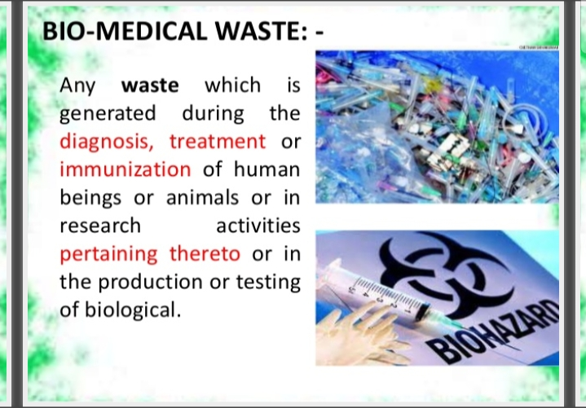

Slide 4
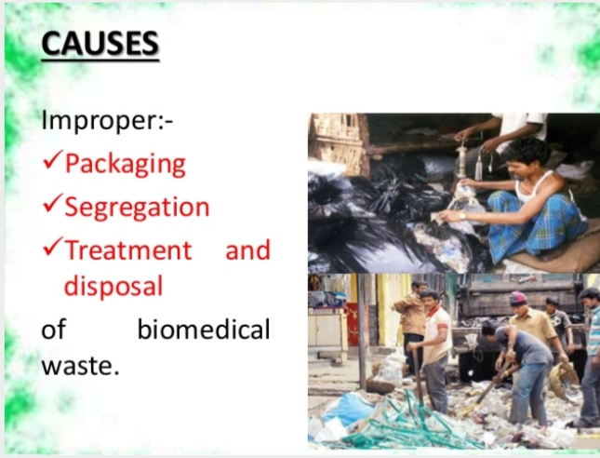

Slide 5
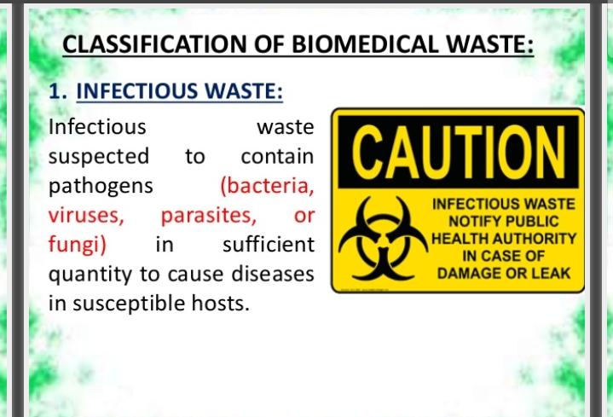

Slide 6
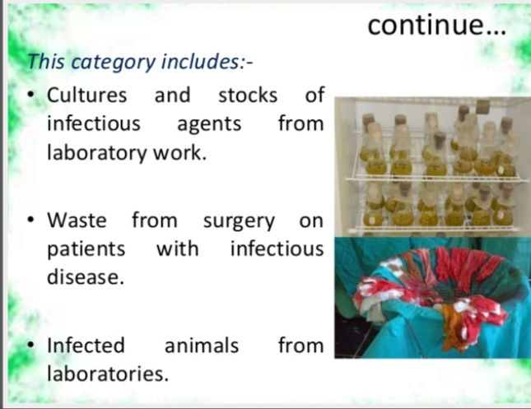

Slide 7
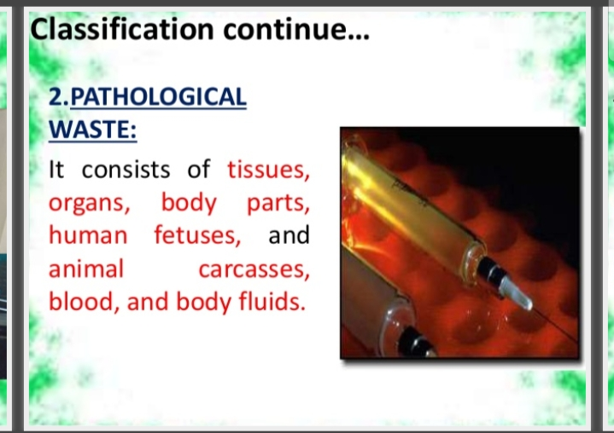

Slide 8
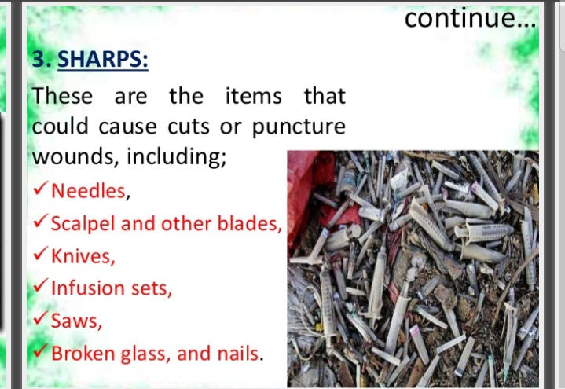

Slide 9
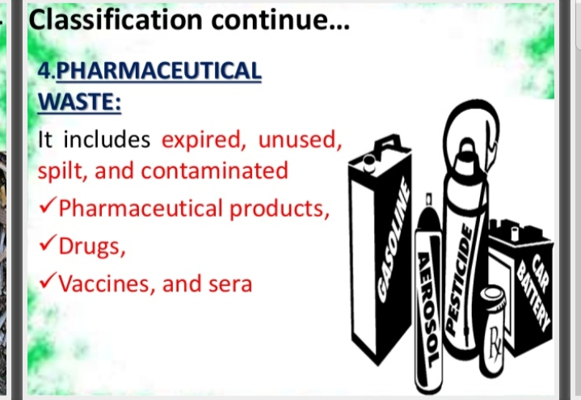

Slide 10
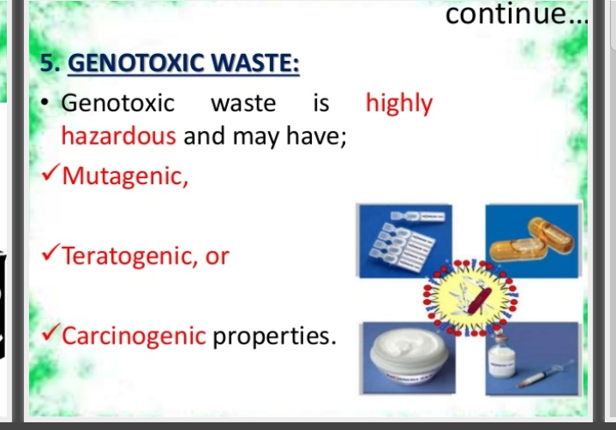

Slide 11
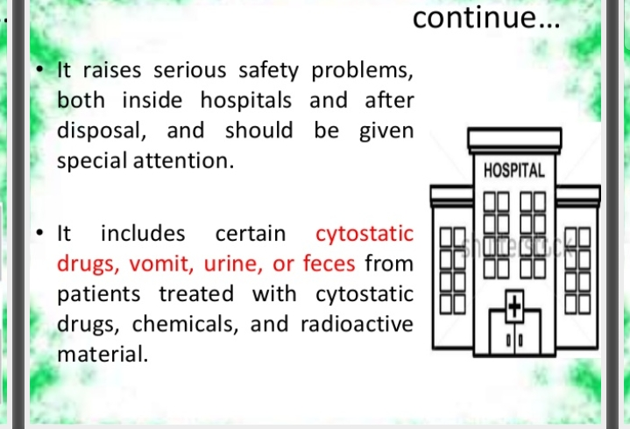

Slide 12
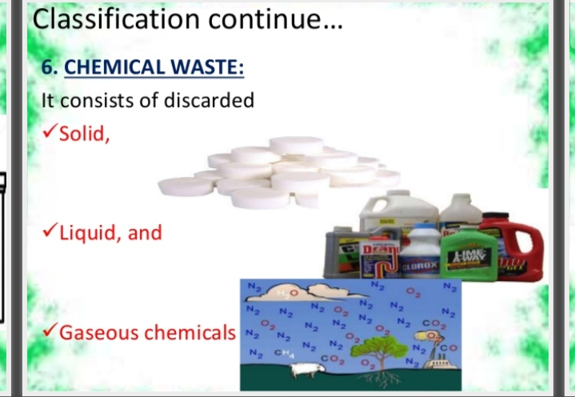

Slide 13
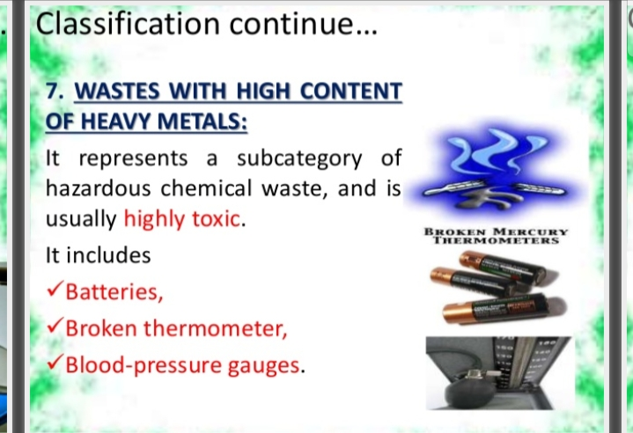

Slide 14
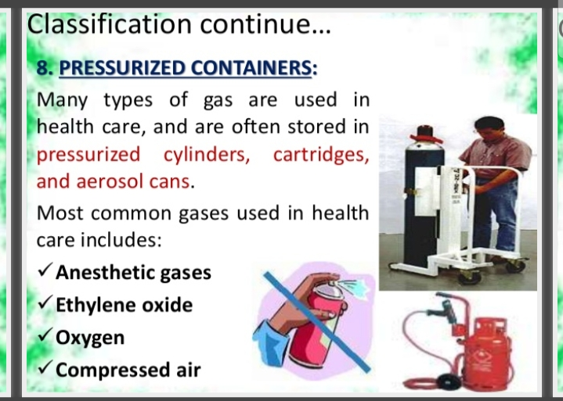

Slide 15
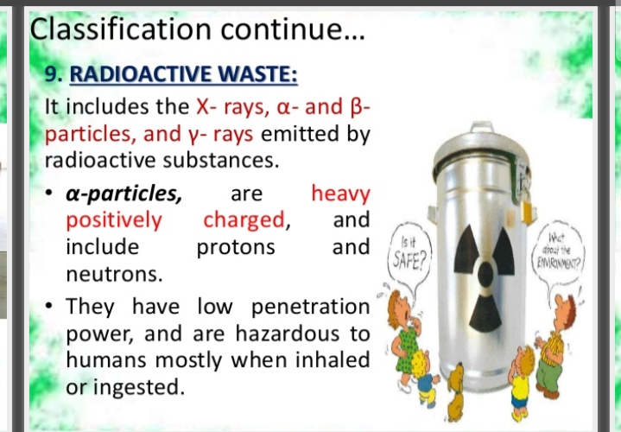

Slide 16
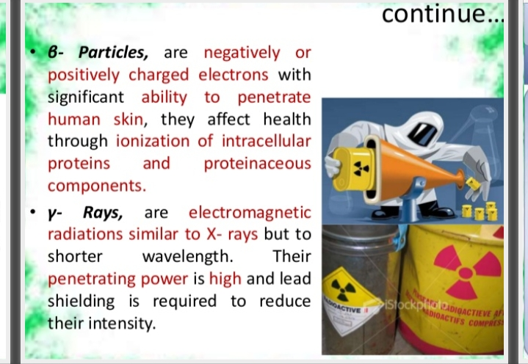

Slide 17
