Slide 1
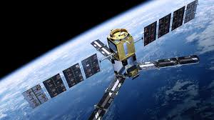
A.RAJALAKSHMI ASSISTANT PROFESSOR OF PHYSICS Department of physics Bon Secours College For Women
SATELITE COMMUNICATION(Types)

Slide 2
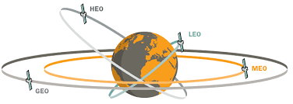
TYPES OF SATELLITE COMMUNICATION
GEO- Geostationary earth orbit
LEO- Low earth orbit
MEO- Medium earth orbit
HEO- Highly earth orbit

Slide 3
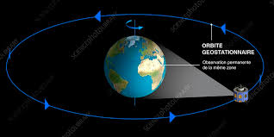
Geostationary earth orbit
A circular orbit positioned approximately 35,900 km (22,258 mi) above earth's equator and having a period of the same duration and direction as the rotation of the earth. An object in this orbit will appear stationary relative to the rotating earth.
Advantages of GEO satellite
Receivers and senders can use fixed antenna positions, no adjusting is needed. GEOs are ideal for TV and radio broadcasting.
Geostationary satellites have a 24 hour view of a particular area. GEOs typically do not need handover due to the large footprints.
GEOs don't exhibit any Doppler shift because the relative movement is zero.
Disadvantages of GEO satellite
These satellites can't be used for small mobile phones.
Transferring a GEO into orbit is very expensive.

Slide 4
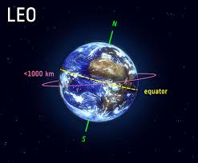
low earth orbit
Leo (low earth orbit) at about 500-1500km above the earth’s. Additionally, LEO systems try to ensure a high elevation for every spot on earth to provide a high quality communication link. Each LEO satellite will only be visible from the earth for about ten minutes
Advantages of LEO satellite
A LEO satellite smaller area of coverage is less of a waste of bandwidth.
Smaller footprints of LEOs allow for better frequency.
GEOs don't exhibit any Doppler shift because the relative movement is zero.
Disadvantages of GEO satellite
The problem is the need for many
satellites if global coverage is to be reached.
High complexity.

Slide 5
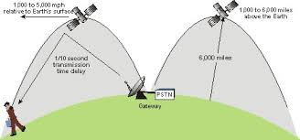
Medium Earth Orbit
A MEO satellite situates in orbit somewhere between 6,000 km to 40,000 km above the earth's surface. Using orbits around 10,000km, the system only requires a dozen satellites which is more than a GEO system, but much less than a LEO system
Disadvantages of GEO satellite
Advantages of MEO satellite
Larger distance to the earth, delay increases to about 70-80 ms.
The satellites need higher transmit power and special antennas for smaller footprints
MEO satellites have a larger coverage area than LEO.
Visible for much longer periods GEOs between 2 to 8 hours.

Slide 6
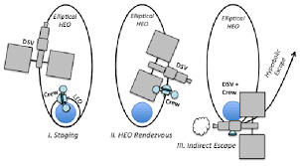
High Earth Orbit
HEO is one of the non-circular orbit of the four types. It operates in an eppiptical move which is similar to GEO with maximum altitude and LEO with minimum altitude
Disadvantages of GEO satellite
Advantages of HEO satellite
Longer signal delays
The coverage can be done of high latitude locations
Fewwer satelites can be required

Slide 7
References
Google sites
https://www.Google.Com/search?Q=types+of+satelite+orbits&oq=types+of+&aqs=chrome.0.69i59j69i57j35i39l2j0l3j69i61.4334j1j7&sourceid=chrome&ie=utf-8

Slide 8
THANK YOU

