Slide 1
BON SECOURS COLLEGE FORWOMEN NAAC Accredited with ‘A’ Grade Recognized by UGC under section 2(F) & 12(B) Affiliated to Bharathidasan University, Tiruchirappalli. VILAR BYPASS, THANJAVUR – 613 006. PG & RESEARCH DEPARTMENT OF ENGLISH
A.BHUVANESHWARI
ASSISTANT PROFESSOR
DEPT. OF ENGLISH
ENVIRONMENTAL STUDIES
19UGCES

Slide 2
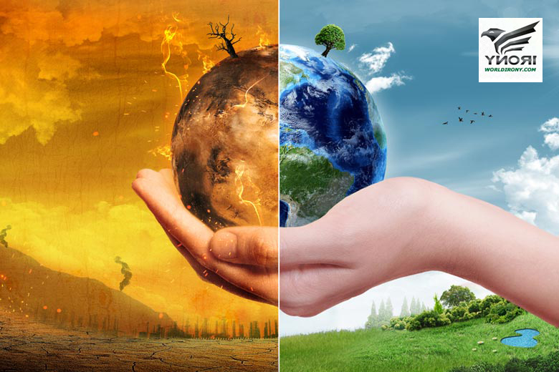
ENVIRONMENTAL POLLUTION
Environmental pollution is defined as "the contamination of the physical and biological components of the earth/atmosphere system to such an extent that normal environmental processes are adversely affected."

Slide 3
TYPES OF POLLUTION
Water pollution
Thermal pollution
Land pollution
Radiation Pollution
Noise pollution
Air pollution

Slide 4
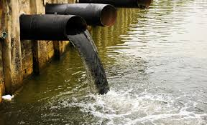
WATER POLLUTION
Water pollution is the introduction into fresh or ocean waters of chemical, physical, or biological material that degrades the quality of the water and affects the organisms living in it.

Slide 5
Categories of Water Pollution
Groundwater
Surface water
Ocean water
Point source

Slide 6
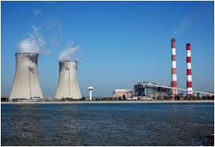
Thermal pollution
Thermal pollution, sometimes called "thermal enrichment," is the degradation of water quality by any process that changes ambient water temperature. A common cause of thermal pollution is the use of water as a coolant by power plants and industrial manufacturers.

Slide 7
the types of thermal pollution
Five Causes of Thermal Pollution
Power, Industrial, and Manufacturing Plants. .
Erosion from Soil.
Water Runoff.
Deforestation.
Natural Disasters and Causes.

Slide 8
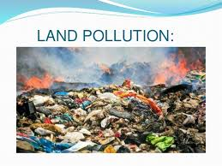
Land Pollution
Land Pollution refers to the deterioration of the earth's land surfaces. Furthermore, it occurs mainly due to the indirect and direct effects of human activities. ... For instance, even the garbage on the streets is a kind of land pollution only.

Slide 9
Types of land pollution
These include all the various kinds of rubbish we make at home, school, hospitals, market and workplaces. Things like paper, plastic containers, bottles, cans, food and even used cars and broken electronic goods, broken furniture and hospital waste are all examples of solid waste.

Slide 10
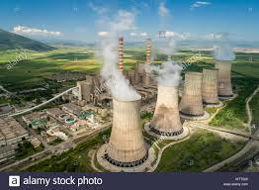
Radioactive Pollution
Radioactive Pollution is defined as the increase in the natural radiation levels caused by human activities. It is estimated that about 20% of radiation we are exposed to is due to human activities.

Slide 11
Types of radioactive pollution
Alpha particles, beta particles, and gamma rays are the most commonly encountered forms of radioactive pollution.

Slide 12
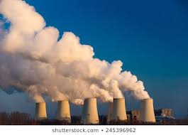
Air pollution
Air pollution occurs when harmful or excessive quantities of substances are introduced into Earth's atmosphere. Sources of air pollution include gases (such as ammonia, carbon monoxide, sulfur dioxide, nitrous oxides, methane and chlorofluorocarbons), particulates (both organic and inorganic), and biological molecules. It may cause diseases, allergies and even death to humans; it may also cause harm to other living organisms such as animals and food crops, and may damage the natural or built environment. Both human activity and natural processes can generate air pollution.

Slide 13
types of air pollution
The six common air pollutants are:
Particle Pollution (particulate matter)
Ground-level ozone.
Carbon monoxide.
Sulfur oxides.
Nitrogen oxides.
Lead.

Slide 14
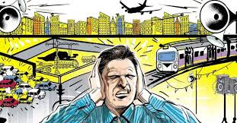
Noise pollution
Noise pollution, also known as environmental noise or sound pollution, is the propagation of noise with ranging impacts on the activity of human or animal life, most of them harmful to a degree. The source of outdoor noise worldwide is mainly caused by machines, transport, and propagation systems.

Slide 15
Types of Noise Pollution
The three types of pollution:
Transport Noise
Neighbourhood Noise
Industrial Noise

Slide 16
thANK
YOU

