Slide 1
Unit -4
SERVICE PROCESS AND SERVICE DESIGN

Slide 2
MEANING
Process in services refers to the actual procedures, mechanisms and flow of activates by which the service is delivered- the service delivery and operating systems.
In fast food outlets the process comprises buying the coupons at one counter and piking up the food against that at another counter.

Slide 3
CLASSIFICATION OF SERVICE OPERATING SYSTEMS
Service operating system may be classified in a number of ways. Two considered here for illustrative purposes are according to:
A) Type of process
B) The degree of contact
A) Type of process
Line operations - service delivery passes through a number of processes before finalizing the transaction.
Job shop operations-This type of service model provides customer satisfaction by tailoring the service to the client’s needs. For example, a professional organization such as a law firm
C) Intermittent operations-Some service projects are unique and seldom repeated. For example, construction projects or branding initiatives would fall under this category

Slide 4
THE DEGREE OF CONTACT
a) High contact systems are more difficult to control since the customer can make an input to the process or even disrupt the process;
(b) In high contact systems the customer can affect the timing of demand and it is more difficult to balance the capacity of the system to meet demands placed upon it;
(c) Workers in high contact systems can have a great influence upon the customers’ view of the service provided;
(d) In high contact systems production scheduling is more difficult;
(e) It may be more difficult to rationalize high contact systems (e.g. by substituting technology);
(f) It may be beneficial to separate high contact and low contact elements of a service system and encourage staff specialization in these different functions because of the varying skills required.

Slide 5
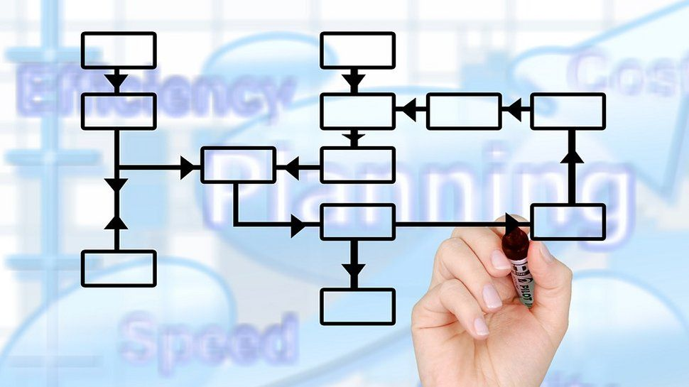
POLICIES AND FLOWCHARTING
What steps are involved in the process?
Are they arranged logically?
Can some steps be eliminated or combined?
Are the capacities of each step balanced?
Where are customers involved in the process?
Can unnecessary customer contact be reduced or eliminated?
Can technology be used to speed up the process?
Can some steps in the process be transferred elsewhere?

Slide 6
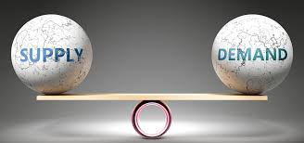
BALANCING SUPPLY AND DEMAND
Inventory wherever possible(e.g.spare capacity,people,etc) | Have customer wait in favourable environment
Schedule workers according to demand( e.g.shift working, part-time employee) | Schedule customers( e.g. appointment systems)
Subcontract work to other service organisatons | Provide substitute goods or services (e.g. automatic tellers)
Have peak-time efficiency routines (e.g.only do essential jobs) | Diversity demands(e.g.enter counter seasonal markets)
Increase customer participation in the production process(e.g. self-service) | Turn customers away during peak demand period (e.g. differential pricing)
Share services/facilities with other service organisations | Use marketing to shift demand (e.g. advertising campaigns)
Improve the service system(e.g. use technology where possible) | Change customer expectations of service (e.g. through usage)

Slide 7
THE PURCHASE PROCESS FOR SERVICESS
Seeking information from respected personal sources (family, friends, peers)
Relying on a firm with a good reputation
Looking for guarantees and warranties
Visiting service facilities or trying aspects of the service before purchasing
Asking knowledgeable employees about competing services
Examining tangible cues or other physical evidence
Using the Web to compare service offerings One strategy to help reduce the risk perceived by customers is to educate them about the features of the service, describe the types of users who can most benefit from it, and offer advice on how to obtain the best results

Slide 8
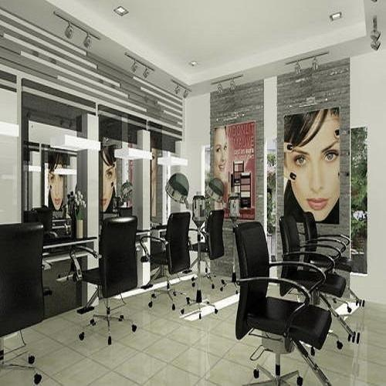
What is Service Design?
Service design is a process in which the designer focuses on creating optimal service experiences. This requires taking a holistic view of all the related actors, their interactions, and supporting materials and infrastructures. Service design often involves the use of customer journey maps, which tell the story of different customers’ interactions with a brand, thus offering deep insights.

Slide 9
Marc Stickdorn and Jakob Schneider, authors of the bestselling book This is Service Design Thinking, provide five basic principles that underlie service design:
User-centered, through understanding the user by doing qualitative research
Co-creative, by involving all relevant stakeholders in the design process
Sequencing, by partitioning a complex service into separate processes
Evidencing, by visualizing service experiences and making them tangible
Holistic, by considering touchpoints in a network of interactions and users

Slide 10
THANK YOU

