Slide 1
_{EMBRYO TYPES}
Dr. M. BASTIN
Assistant Professor
Dept. of Botany
Annai Vailankanni Arts and Science College
Thanjavur – 613 007.

Slide 2
Introduction
Endosperm is the tissue produced inside the seeds of most flowering plants around the time of fertilization. It surrounds the embryo and provides nutrition in the form of starch, though it can also contain oils and protein.
This can make endosperm a source of nutrition in human diet. For example, wheat endosperm is ground into flour for bread (the rest of the grain is included as well in whole wheat flour), while barley endosperm is the main source for beer production.

Slide 3
Endosperm formation
There are three types of Endosperm development:
Nuclear endosperm formation - where repeated free-nuclear divisions take place; if a cell wall is formed it will form after free-nuclear divisions. Commonly referred to as liquid endosperm. Coconut juice is an example of this.
Cellular endosperm formation - where a cell-wall formation is coincident with nuclear divisions. Coconut meat is cellular endosperm. Acoraceae has cellular endosperm development while other monocots are helobial.perm types

Slide 4
Helobial endosperm formation - Where a cell wall is laid down between the first two nuclei, after which one half develops endosperm along the cellular pattern and the other half along the nuclear pattern.

Slide 5
Evolutionary origins
The evolutionary origins of double fertilization and endosperm are unclear, attracting researcher attention for over a century of research. There are the two major hypothesis:
The double fertilization initially used to produce two identical, independent embryos ("twins"). Later these embryos acquired different roles, one growing into mature organism and another merely supporting it. Hence the early endosperm was probably diploid, same as another embryo.

Slide 6
Endosperm is the evolutionary remnant of the actual gametophyte, similar to the complex multicelular gametophytes found in gymnosperms. In such case acquiring the additional nucleus from sperm cell is the later evolutionary step.
Some gymnosperms, such as Ephedra(genus), do may produce twin embryos by double fertilization. Any of these two embryos are capable of filling in the seed but normally only one develops further (another eventually aborts). Also, the most basal angiosperms still contain the four cell embryo sac and produce diploid endosperms.

Slide 7
This nucleus may provide the parental (not only maternal) organism with some control over endosperm development. Then becoming triploid or polyploid are later evolutionary steps of this "primary gametophyte". Non-flowering seed plants (conifers, cycads, Ginkgo, Ephedra) form a large homozygous female gametophyte to nourish the embryo within a seed.

Slide 8
Role of endosperm in seed development
In some groups (e.g. grains of the family Poaceae) the endosperm persists to the mature seed stage as a storage tissue, in which case the seeds are called "albuminous" or "endospermous", and in others it is absorbed during embryo development (e.g., most members of the family Fabaceae, including the common bean, Phaseolus vulgaris), in which case the seeds are called "exalbuminous" or "cotyledonous" and the function of storage tissue is performed by enlarged cotyledons ("seed leaves").

Slide 9
In certain species (e.g. corn, Zea mays); the storage function is distributed between both endosperm and the embryo. Some mature endosperm tissues store fats (e.g. castor bean, Ricinis communis) and others (including grains, such as wheat and corn) store mainly starches.

Slide 10
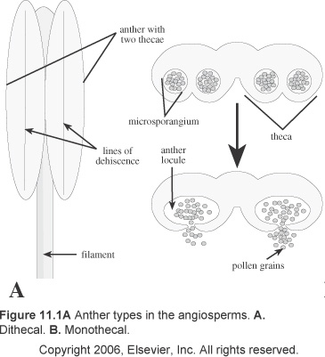
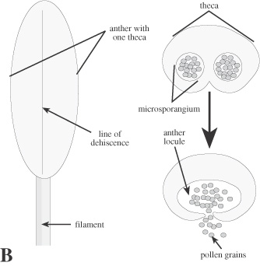
Anther Type
Bithecal
Monothecal

Slide 11
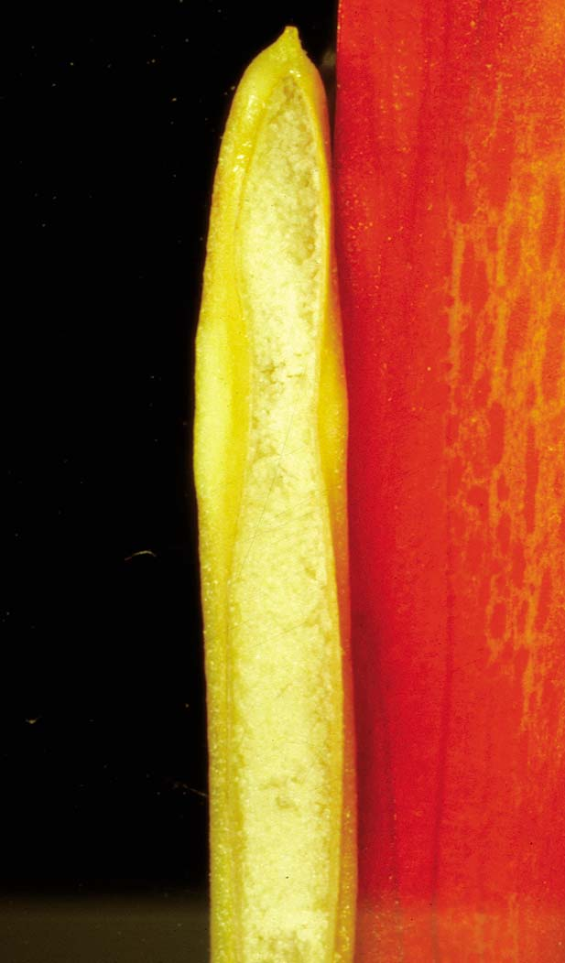
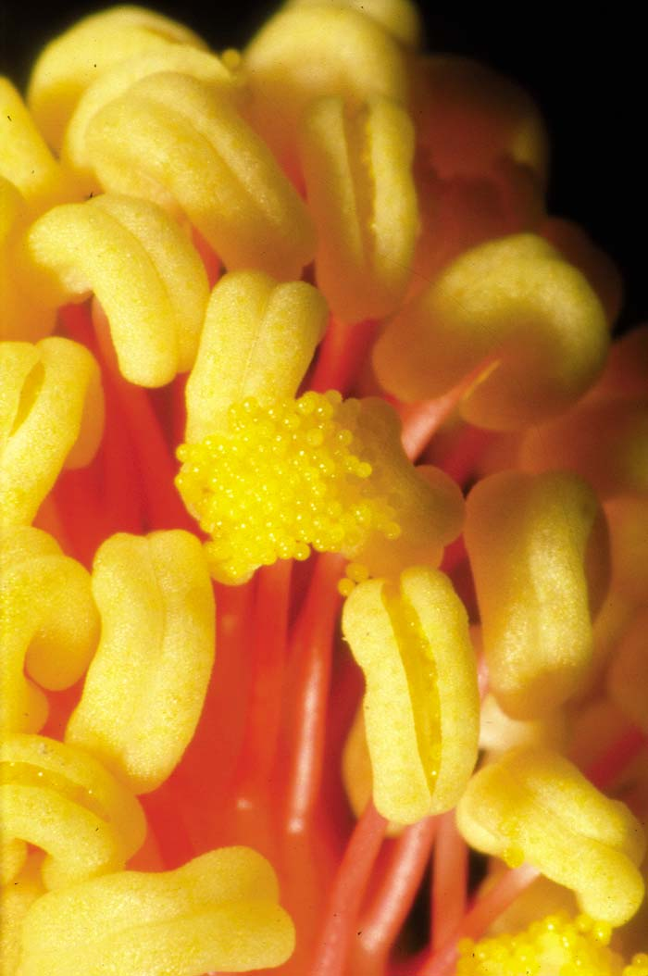
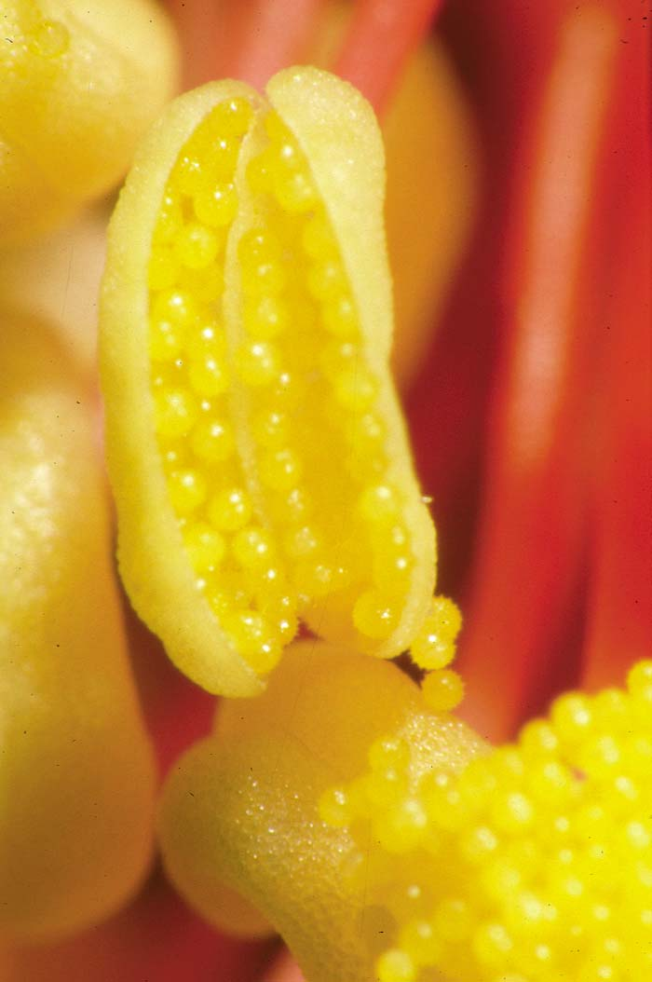
Monothecal
Canna
Hibiscus

Slide 12
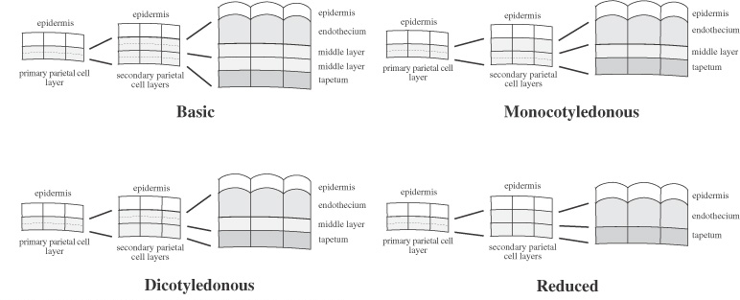
Anther Wall Development

Slide 13
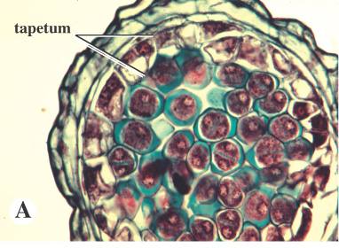
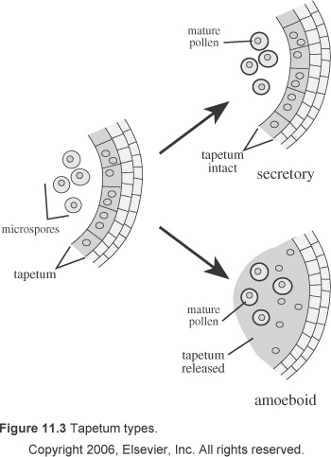
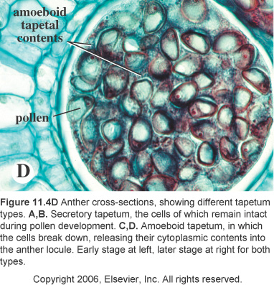
Tapetum type

Slide 14
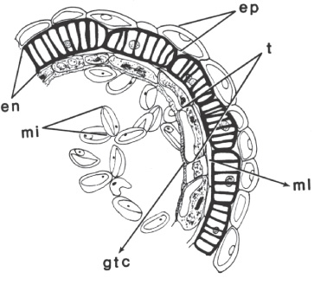
Endothecium type

Slide 15
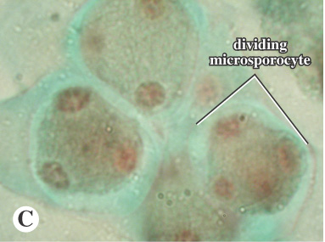
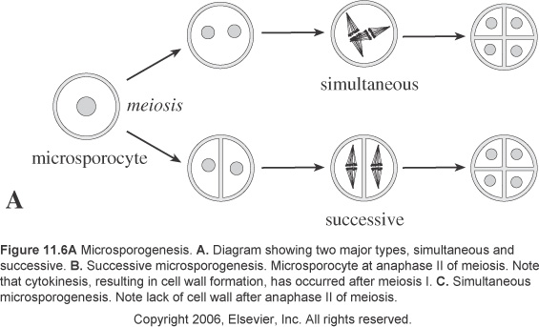
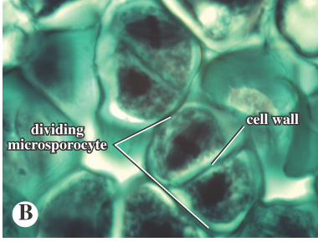
Microsporogenesis

Slide 16
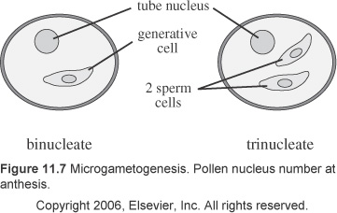
Pollen Nucleus Number

Slide 17
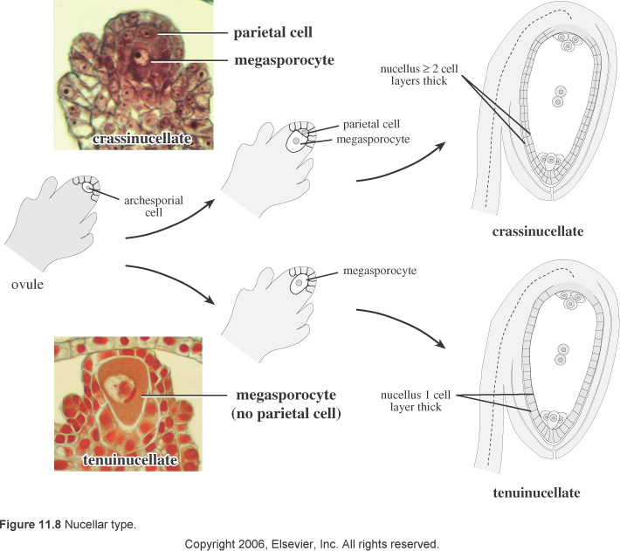
Ovule Nucellus (Megasporangium) Type

Slide 18
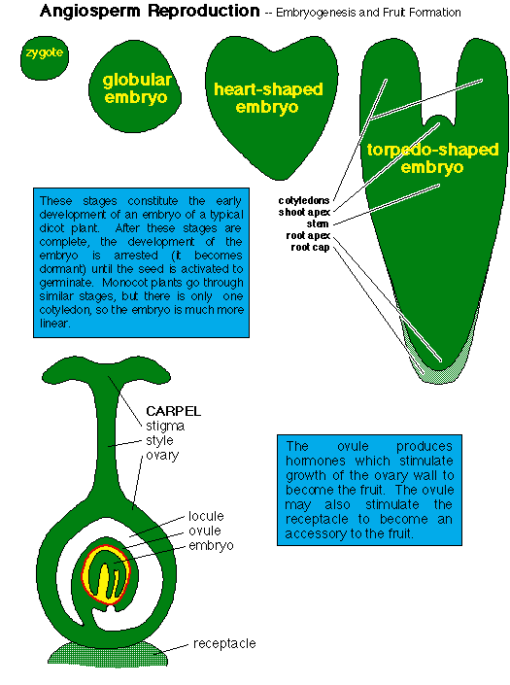
Angiosperm Reproduction – Embryogenesis and fruit formation

Slide 19
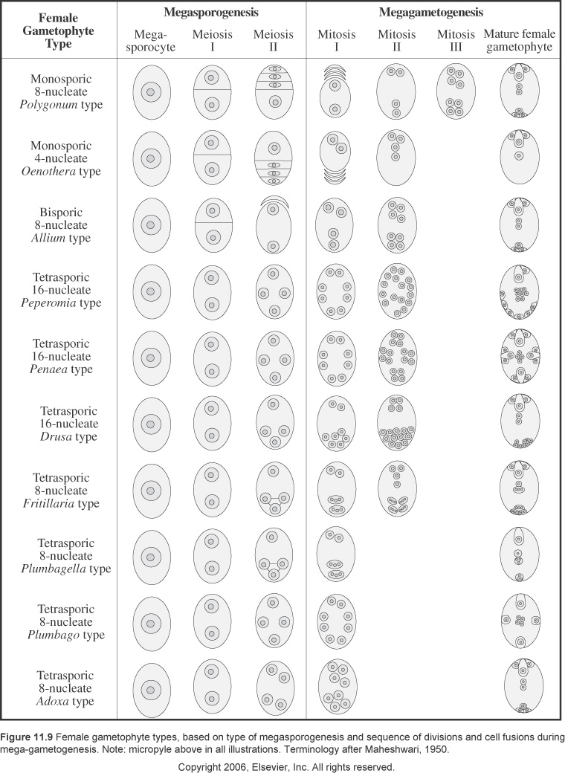
Megasporogenesis & Megagametogenesis

Slide 20
Megasporogenesis & Megagametogenesis

Slide 21
Megasporogenesis & Megagametogenesis

Slide 22
Megasporogenesis & Megagametogenesis

Slide 23
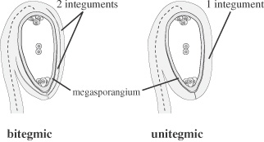
Ovule Integument Types

Slide 24
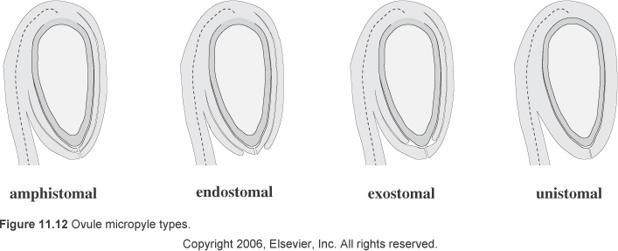
Ovule Micropyle Types

Slide 25
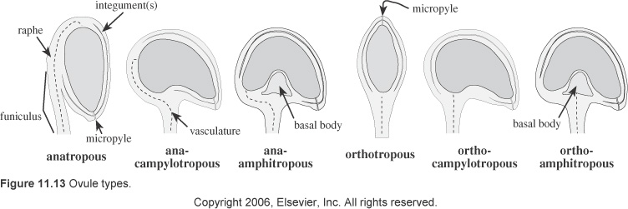
Ovule Types

Slide 26
Ovule Position

Slide 27
THANK YOU
Notes:
Thank You (Basic) To reproduce the video effects on this slide, do the following:
On the Home tab, in the Slides group, click Layout, and then click Blank.
On the Insert tab, in the Media group, click Video, and then click Video from File.
In the left pane of the Insert Video dialog box, click the drive or library that contains the video. In the right pane of the dialog box, click the video that you want and then click Insert.
Under Video Tools, on the Format tab, in the Sizing group, click the arrow to the right of Size launching the Format Video dialog box, select Size from the left pane and under Size in the right pane do the following:
Click the Lock Aspect Ratio box.
In the Height box, enter 6.03”.
In the Width box enter 8.03”.
Also in the Format Video dialog box, click Border Color in the left pane, under Border Color in the right pane select Solid Line, and then click the arrow to the right of Color, and under Theme colors select Black, Text 1, Lighter 25% (fourth row, second option from left).
Also in the Format Video dialog box, select Border Style in the left pane, under Border Style in the right pane set the Width to 15 pt.
Also in the Format Video dialog box, select Shadow in the left pane, under Shadow in the Right pane, click the arrow to the right of Colors and under Theme Colors, select Black, Text 1 (first row, second option from left), and then do the following:
In the Transparency box, enter 60%.
In the Size box, enter 100%.
In the Blur box, enter 21 pt.
In the Angle box, enter 40 degrees.
In the Distance box, enter 19 pt.
Also in the Format Video dialog box, select 3-D Format in the left pane, under Bevel in the right pane click the arrow to the right of Top and under Bevel, select Relaxed Inset (first row, second option from left), and then do the following:
To the right of Top, in the Width box, enter 6 pt.
To the right of Top, in the Height box, enter 16.5 pt.
On the Home tab, in the Drawing group, click Arrange, point to Align, and then do the following:
Click Align Center.
Click Align Middle.
Under Video Tools, on the Playback tab, in the Video Options group, select Loop until Stopped.
On the Animations tab, in the Animation group, select Play.
On the Animations tab in the Timing group, click the arrow to the right of Start and select With Previous.
To reproduce the text effects on this slide, do the following:
On the Insert tab, in the Text group, click Text Box, and then on the slide drag to draw a text box.
Type text in the text box (“Thank You” – or whatever text suits your message).
Select the text, on the Home tab, in the Font group, select Garamond from the Font list, select 88 pt from the Font Size list, and then click on the Bold icon.
Also in the Home tab, in the Font group, select the arrow to the right of the Font Color Icon, and then under Theme Colors, select White, Background 1 (first row, first option from left).
With the text box selected, under Drawing Tools, on the Format tab, click the arrow in the bottom right corner of the WordArt Styles group, click the arrow opening the Format Text Effects dialog box.
In the Format Text Effects dialog box, click 3-D Format on the left pane, under Bevel on the right pane, click the arrow next to Top and under Bevel select Relaxed Inset (first row, second option from left). Set the Width to 5 pt and the Height to 3 pt.
Also in the 3-D Format right pane, under Surface, click the arrow next to Material and under Special Effect select Dark Edge (first row, first option from left).
Also in the 3-D Format right pane, under Surface, click the arrow next to Lighting and under Neutral select Soft (first row, third option from left).
Also in the 3-D Format right pane, under Surface, set the Angle to 290 Degrees.
Close the Format Text Effects dialog box.
To reproduce the background effects on this slide, do the following:
On the Design tab, in the bottom right corner of the Background group, click the arrow at the bottom right corner launching the Format Background dialog box.
In the Format Background dialog box, select Fill in the left pane, and under Fill in the right pane select Solid fill, then click the arrow to the right of Color and under Theme Colors select White, Background 1, Darker 50% (sixth row, first option from left).
Close the Format Background dialog.

