Slide 1
DATABASE SYTEMS
UNIT I
Dr.S.Chitra,
Assistant Professor,
Department of Computer Science,
Annai Vailankanni Arts and Science College,Thanjavur

Slide 2
Database Management System (DBMS) Introduction
DBMS contains information about a particular enterprise
  Collection of interrelated data
  Set of programs to access the data
  An environment that is both convenient and efficient to use
Database Applications:
  Banking: transactions
  Airlines: reservations, schedules
  Universities: registration, grades
  Sales: customers, products, purchases
  Online retailers: order tracking, customized recommendations
  Manufacturing: production, inventory, orders, supply chain
  Human resources: employee records, salaries, tax deductions
Databases can be very large.
Databases touch all aspects of our lives
Notes:
2

Slide 3
University Database Example
Application program examples
  Add new students, instructors, and courses
  Register students for courses, and generate class rosters
  Assign grades to students, compute grade point averages (GPA) and generate transcripts
In the early days, database applications were built directly on top of file systems
Notes:
3

Slide 4
Drawbacks of using file systems to store data
Data redundancy and inconsistency
  Multiple file formats, duplication of information in different files
Difficulty in accessing data
  Need to write a new program to carry out each new task
Data isolation
  Multiple files and formats
Integrity problems
  Integrity constraints (e.g., account balance > 0) become “buried” in program code rather than being stated explicitly
  Hard to add new constraints or change existing ones
Notes:
4

Slide 5
Drawbacks of using file systems to store data (Cont.)
Atomicity of updates
  Failures may leave database in an inconsistent state with partial updates carried out
  Example: Transfer of funds from one account to another should either complete or not happen at all
Concurrent access by multiple users
  Concurrent access needed for performance
  Uncontrolled concurrent accesses can lead to inconsistencies
    Example: Two people reading a balance (say 100) and updating it by withdrawing money (say 50 each) at the same time
Security problems
  Hard to provide user access to some, but not all, data
Database systems offer solutions to all the above problems
Notes:
5

Slide 6
View of Data : Data Abstraction
Physical level: describes how a record (e.g., instructor) is stored.
Logical level: describes data stored in database, and the relationships among the data.
  type instructor = record
  ID : string;
  name : string;
  dept_name : string;
  salary : integer;
        end;
View level: application programs hide details of data types. Views can also hide information (such as an employee’s salary) for security purposes.
Notes:
6

Slide 7
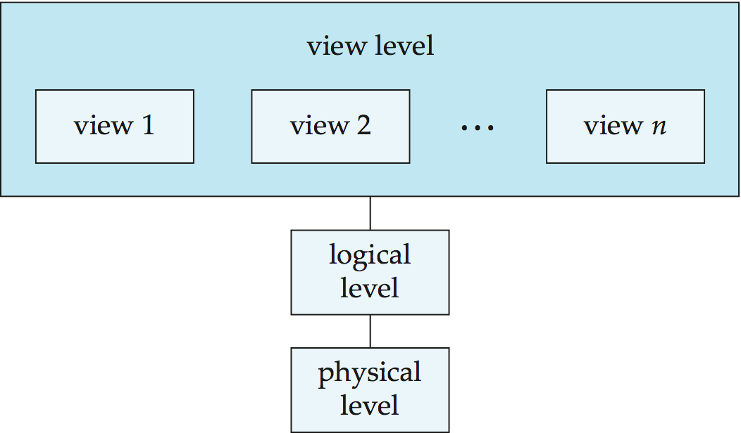
View of Data
An architecture for a database system
Notes:
7

Slide 8
Instances and Schemas
Similar to types and variables in programming languages
Logical Schema – the overall logical structure of the database
  Example: The database consists of information about a set of customers and accounts in a bank and the relationship between them
    Analogous to type information of a variable in a program
Physical schema– the overall physical structure of the database
Instance – the actual content of the database at a particular point in time
  Analogous to the value of a variable
Physical Data Independence – the ability to modify the physical schema without changing the logical schema
  Applications depend on the logical schema
  In general, the interfaces between the various levels and components should be well defined so that changes in some parts do not seriously influence others.
Notes:
8

Slide 9
Data Models
A collection of tools for describing
  Data
  Data relationships
  Data semantics
  Data constraints
Relational model
Entity-Relationship data model (mainly for database design)
Object-based data models (Object-oriented and Object-relational)
Semistructured data model (XML)
Other older models:
  Network model
  Hierarchical model
Notes:
9

Slide 10
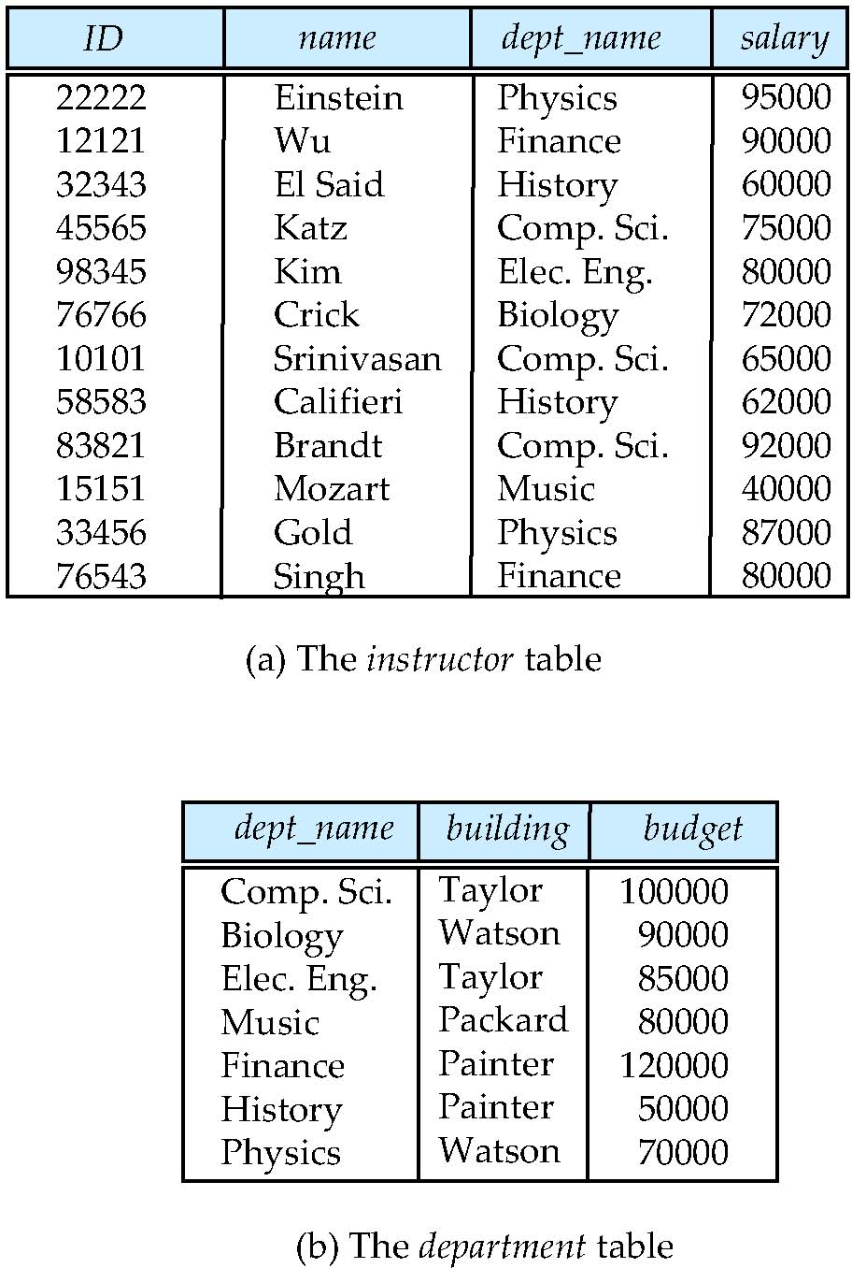
Relational Model
All the data is stored in various tables.
Example of tabular data in the relational model
Columns
Rows
Notes:
10

Slide 11
A Sample Relational Database
Notes:
11

Slide 12
Data Definition Language (DDL)
Specification notation for defining the database schema
  Example: create table instructor (
  ID char(5),
  name varchar(20),
  dept_name varchar(20),
  salary numeric(8,2))
DDL compiler generates a set of table templates stored in a data dictionary
Data dictionary contains metadata (i.e., data about data)
  Database schema
  Integrity constraints
    Primary key (ID uniquely identifies instructors)
  Authorization
    Who can access what
Notes:
12

Slide 13
Data Manipulation Language (DML)
Language for accessing and manipulating the data organized by the appropriate data model
  DML also known as query language
Two classes of languages
  Pure – used for proving properties about computational power and for optimization
    Relational Algebra
    Tuple relational calculus
    Domain relational calculus
  Commercial – used in commercial systems
    SQL is the most widely used commercial language
Notes:
13

Slide 14
SQL
The most widely used commercial language
SQL is NOT a Turing machine equivalent language
SQL is NOT a Turing machine equivalent language
To be able to compute complex functions SQL is usually embedded in some higher-level language
Application programs generally access databases through one of
  Language extensions to allow embedded SQL
  Application program interface (e.g., ODBC/JDBC) which allow SQL queries to be sent to a database
Notes:
14

Slide 15
Database Design
The process of designing the general structure of the database:
Logical Design – Deciding on the database schema. Database design requires that we find a “good” collection of relation schemas.
  Business decision – What attributes should we record in the database?
  Computer Science decision – What relation schemas should we have and how should the attributes be distributed among the various relation schemas?
Physical Design – Deciding on the physical layout of the database
Notes:
15

Slide 16
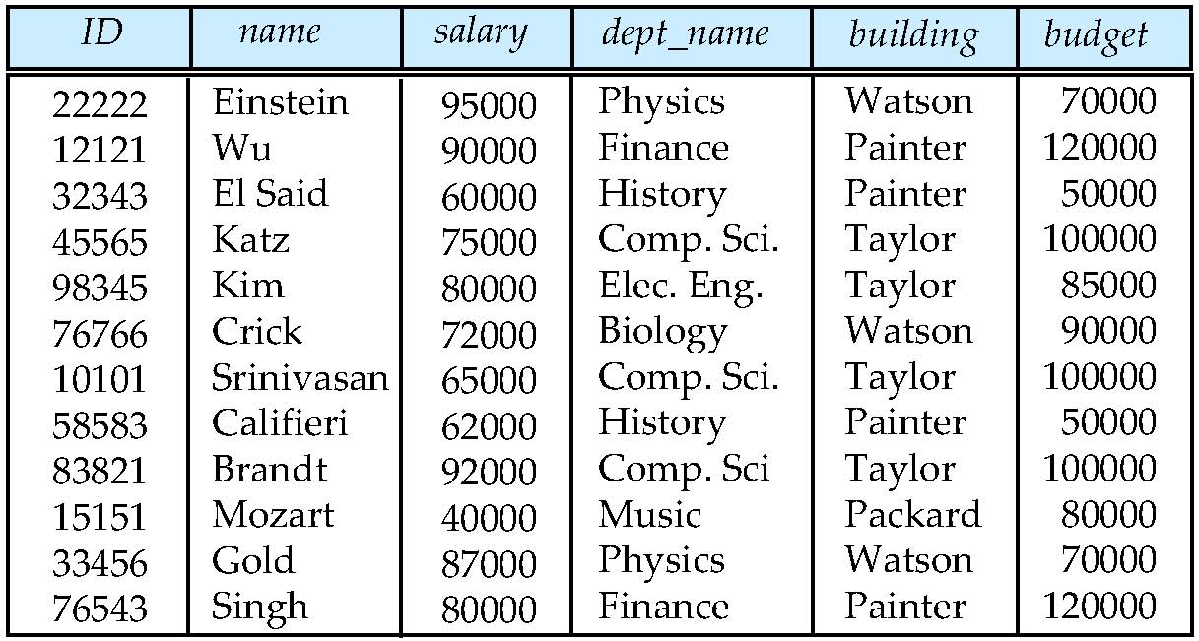
Database Design (Cont.)
Is there any problem with this relation?
Notes:
16

Slide 17
Design Approaches
Need to come up with a methodology to ensure that each of the relations in the database is “good”
Two ways of doing so:
  Entity Relationship Model (Chapter 7)
    Models an enterprise as a collection of entities and relationships
    Represented diagrammatically by an entity-relationship diagram:
  Normalization Theory (Chapter 8)
    Formalize what designs are bad, and test for them
Notes:
17

Slide 18
Object-Relational Data Models
Relational model: flat, “atomic” values
Object Relational Data Models
  Extend the relational data model by including object orientation and constructs to deal with added data types.
  Allow attributes of tuples to have complex types, including non-atomic values such as nested relations.
  Preserve relational foundations, in particular the declarative access to data, while extending modeling power.
  Provide upward compatibility with existing relational languages.
Notes:
18

Slide 19
XML: Extensible Markup Language
Defined by the WWW Consortium (W3C)
Originally intended as a document markup language not a database language
The ability to specify new tags, and to create nested tag structures made XML a great way to exchange data, not just documents
XML has become the basis for all new generation data interchange formats.
A wide variety of tools is available for parsing, browsing and querying XML documents/data
Notes:
19

Slide 20
Database Engine
Storage manager
Query processing
Transaction manager
Notes:
20

Slide 21
Storage Management
Storage manager is a program module that provides the interface between the low-level data stored in the database and the application programs and queries submitted to the system.
The storage manager is responsible to the following tasks:
  Interaction with the OS file manager
  Efficient storing, retrieving and updating of data
Issues:
  Storage access
  File organization
  Indexing and hashing
Notes:
21

Slide 22
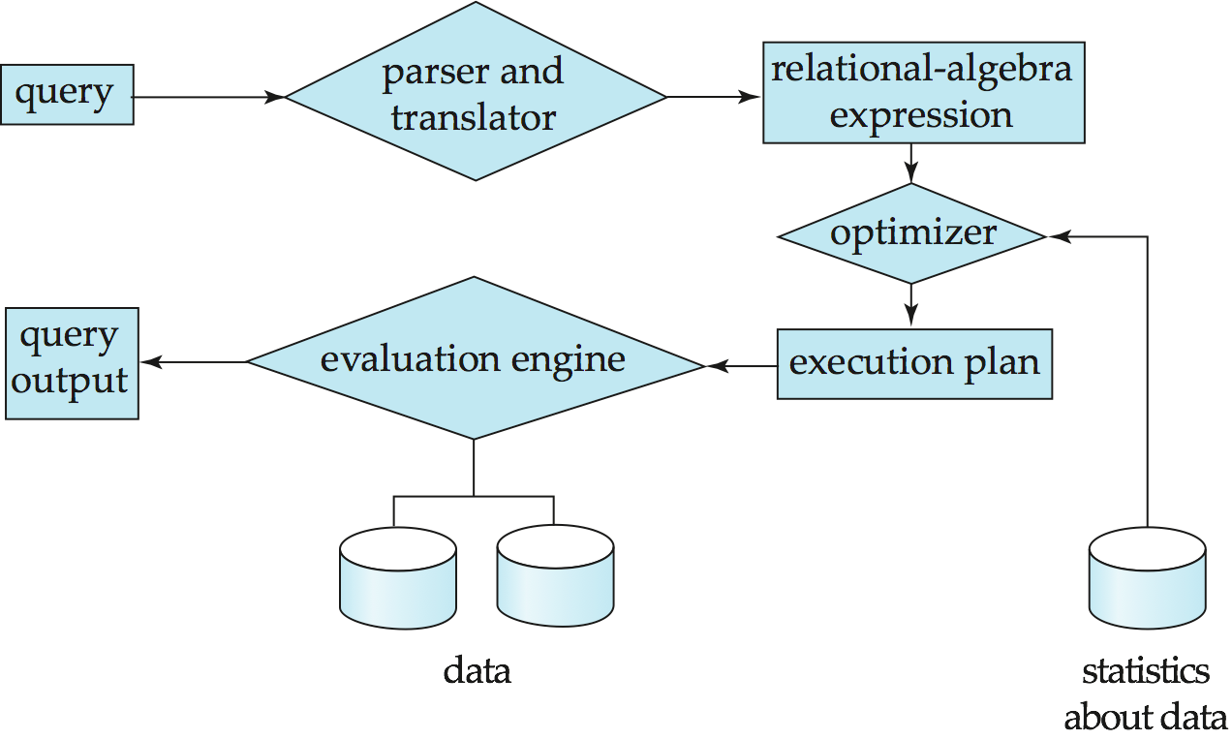
Query Processing
1. Parsing and translation
2. Optimization
3. Evaluation
Notes:
22

Slide 23
Query Processing (Cont.)
Alternative ways of evaluating a given query
  Equivalent expressions
  Different algorithms for each operation
Cost difference between a good and a bad way of evaluating a query can be enormous
Need to estimate the cost of operations
  Depends critically on statistical information about relations which the database must maintain
  Need to estimate statistics for intermediate results to compute cost of complex expressions
Notes:
23

Slide 24
Transaction Management
What if the system fails?
What if more than one user is concurrently updating the same data?
A transaction is a collection of operations that performs a single logical function in a database application
Transaction-management component ensures that the database remains in a consistent (correct) state despite system failures (e.g., power failures and operating system crashes) and transaction failures.
Concurrency-control manager controls the interaction among the concurrent transactions, to ensure the consistency of the database.
Notes:
24

Slide 25
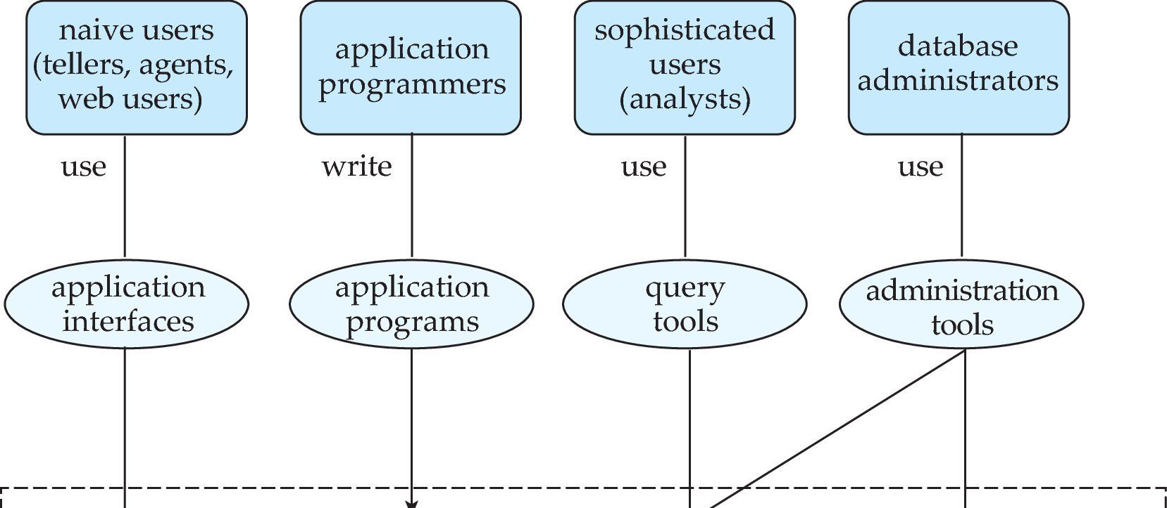
Database Users and Administrators
Database
Notes:
25

Slide 26
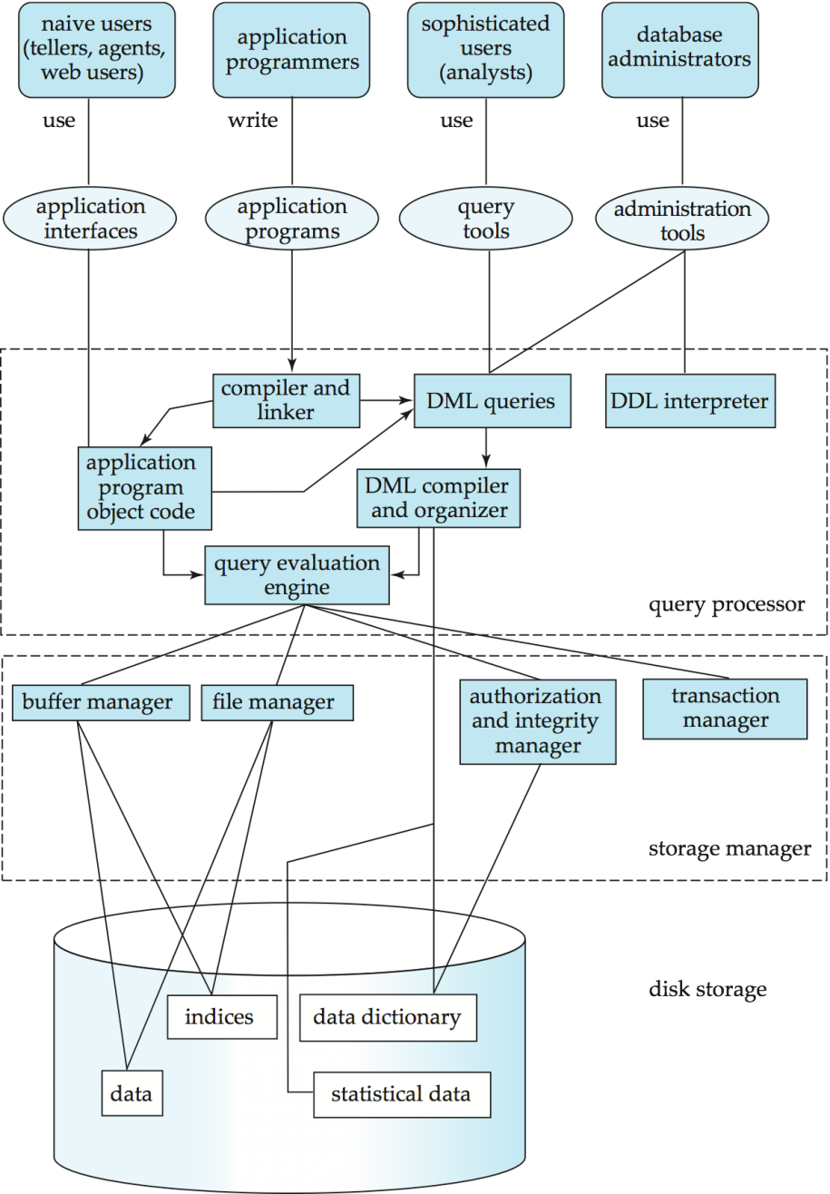
Database System Internals
Notes:
26

Slide 27
Database Architecture
The architecture of a database systems is greatly influenced by
the underlying computer system on which the database is running:
Centralized
Client-server
Parallel (multi-processor)
Distributed
Notes:
27

Slide 28
History of Database Systems
1950s and early 1960s:
  Data processing using magnetic tapes for storage
    Tapes provided only sequential access
  Punched cards for input
Late 1960s and 1970s:
  Hard disks allowed direct access to data
  Network and hierarchical data models in widespread use
  Ted Codd defines the relational data model
    Would win the ACM Turing Award for this work
    IBM Research begins System R prototype
    UC Berkeley begins Ingres prototype
  High-performance (for the era) transaction processing
Notes:
28

Slide 29
History (cont.)
1980s:
  Research relational prototypes evolve into commercial systems
    SQL becomes industrial standard
  Parallel and distributed database systems
  Object-oriented database systems
1990s:
  Large decision support and data-mining applications
  Large multi-terabyte data warehouses
  Emergence of Web commerce
Early 2000s:
  XML and XQuery standards
  Automated database administration
Later 2000s:
  Giant data storage systems
    Google BigTable, Yahoo PNuts, Amazon, ..
Notes:
29

Slide 30
PART – I Two Mark Question Bank
1. What is database?
A database is logically coherent collection of data with some inherent meaning, representing some
aspect of real world and which designed, built and populated with data for a specific purpose.
2. Define Database Management System.
A Database management System consists of a collection interrelated data and set of programs to access those data. The collection of data, usually referred to as the database, contains information
about one particular enterprises
3. Advantages of DBMS?
Redundancy is controlled
Unauthorized access is restricted.
Providing multiple user interface
Enforcesing integrity constraints.
Providing backup and recovery.

Slide 31
4. Disadvantages in File Processing System.
Data redundancy & inconsistency
Difficult in accessing data
Data isolation
Data integrity
Concurrent access is not possible.
Security Problems.
5. Define Data independence.
The ability to modify a schema definition in only level without affecting a Schema definition in the
next higher level is called as data independence.
6. Define Data Models and list the types of Data Model.
Underlying the structure of database is the data mode: a collection of conceptual tools for describing data, data relationships, data semantics and consistency constraints. The various data models can be classifies into four different groups such as Relational model, Object-based logical model, entity- relationship model and Semi structured data model.

Slide 32
7. What is E-R model?
The entity-relationship data model uses a collection of basic objects called entities, and relationships among these objects.
8. Define entity and entity set.
An entity is a “thing” or “object” in the real world that is distinguishable from other objects. For example, each person is an entity, and bank accounts can be considered as entities. The set of all entities of the same type and the set of all relationships of the same type are termed an entity set and relationship set.
9. What is Weak entity set?
An entity set that does not have sufficient attributes to form a primary key is termed a weak entity set.
10. Define relationship and relationship set.
A relationship is an association among several entities. For example, a depositor relationship associated a customer with each account. The set of all relationships of the same type are termed a relationship set.

Slide 33
11. What is object Oriented Data Model?
Object Oriented Data Model, a data model that combines features of the object oriented data model and relational data model. It extends the traditional relational model with a variety of features such as structured and collection types, as well as object orientation.
12. Define Relational data model.
The relational data model is based on a collection of tables. The user of the database system may query these tables, insert new tuples, delete tuples and update tuples. There are several languages for expressing these operations.
13. Define Network model.
Data in the networks model are represented by collection of records and relationships among data are represented by links, which can be viewed as pointers. The records in the database are organized as collections of arbitrary graphs.
14. Define Hierarchical Model
The hierarchical model is similar to the network models in the sense that data and relationship among data are represented by records and links respectively. It differ from the network model in that the records are organized as collection of trees rather that arbitrary graphs.

Slide 34
15. List the role of DBA.
The person who has central control over the system is called a database administrator. The functions of a DBA include the following:
Schema definition
Storage structure and access-method definition
Schema and physical-organization modification
Granting of authorization for data access
Integrity-constraint specification
16. List the different type of database system user.
There are four different types of database-system users, differentiated by the way they expect to interact with the system.
Application programmers
Sophisticated Users
Specialized user
Naïve users.

Slide 35
17. Write about the role of Transaction manager.
Transaction management ensures that the database remains in a consistent state despite system failures. The Transaction manager ensures that concurrent transaction executions proceed without conflicting.
18. Write about role of storage manager.
A Storage Manager subsystem provides the interface between the low-level data stored in the database and the application programs and queries submitted to the system. The Storage Manager is responsible for the interaction with the file manager.
19. Write a short note on Database Languages.
A database system provides a data-definition language to specify the database schema and a data manipulation language to express database queries and updates.
20. What is mean by Data-Manipulation language?
A data-manipulation language is a language that enables users to access or manipulate data as organized by the appropriate data model. The types of access are
Retrieval of information stored in the database.
Insertion of new information into the database.
Deletion of information from the database.
Modification of information stored in the database.

Slide 36
21. What are the two types of DML?
There are basically two types:
Procedural DMLs require a user to specify what data are needed and how to get those data.
Declarative DMLs (are also referred to as nonprocedural DMLs) require a user to specify what data are needed without specifying how to get those data.
22. Define query language.
A query is a statement requesting the retrieval of information. The portion of a DML that involves information retrieval is called a query language.
23. What is mean by Data-Definition Language?
We specify a database schema by a set of definitions expressed by a special language called a DDL. The DDL is also used to specify additional properties of the data.
24. What are the subsystems involved in database system?
The storage manager subsystem provides the interface between the low-level data stored in the database and the application programs and queries submitted to the system.
The query processor subsystem compiles and executes DDL and DML statements.

Slide 37
PART – II Big Question Bank
1. Explain about Database-System Applications.
2. Discuss about the architecture of database.
3. Describe about View of Data in DBMS.
4. Discuss about DBMS Schema and instance.
5. Explain about database user and interfaces.
6. Discuss about Database Administrator.
7. Discuss about database languages.
8. Describe about Purpose of Database Systems.

Slide 38
Thank You

