Slide 1
MODULATION AND DEMODULATION
What is modulation?
What is demodulation?
Carrier wave
a high-frequency electromagnetic wave modulated in amplitude or frequency to convey a signal
Electromagnetic wave
Electromagnetic waves or EM waves are waves that are created as a result of vibrations between an electric field and a magnetic field. In other words, EM waves are composed of oscillating magnetic and electric fields.

Slide 2
Modulation
converting data into radio waves
by adding information to an electronic signal.
A carrier signal
is one with a steady waveform
constant height, or amplitude, and frequency.

Slide 3
Need for modualation
1: Transmission of signal to longer distance :
To have maximum amplitude and frequency which is impossible to acquire from original signal.

Slide 4
Encoding and modulation
Encoding:
Converting digital or analog data to digital signal
Modulation:
Converting digital or analog data to an analog signal.
Encoding :
Used to ensure efficient transmission and storage
Modulation :
Used to send the signals to a long way

Slide 5
Modulation and Demodulation
Modulation
Encoding information in a transmitted signal
Demodulation
Extracting information from the transmitted signal.

Slide 6
Types of Modulation
Amplitude Modulation
Frequency Modulation
Phase Modulation

Slide 7
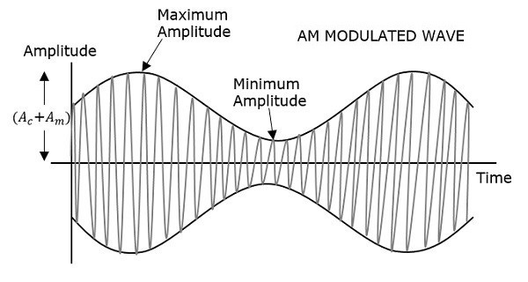
Amplitude Modulation

Slide 8
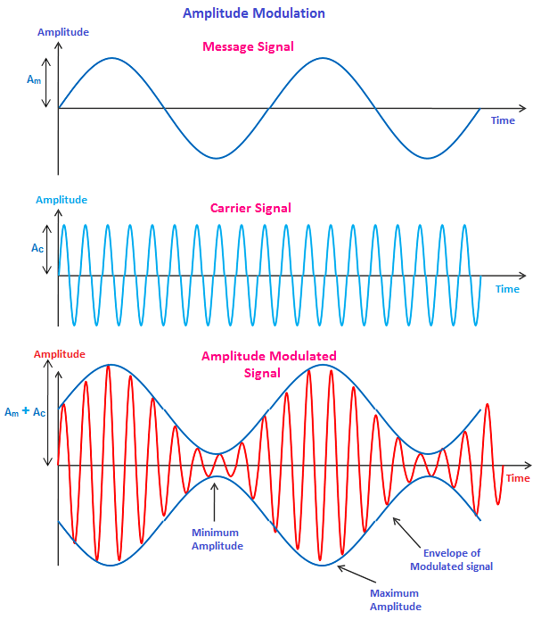
Frequency Modulation

Slide 9
Phase Modulation

Slide 10
Amplitude Modulation
Applications:
Used to carry message signals in early telephone lines.
Used to transmit Morse code using radio and other communication systems.
Used in Navy and Aviation for communications as AM signals can travel longer distances.

Slide 11
Amplitude Modulation வீச்சு
the amplitude of the carrier wave varies with proportion to the base waveform that is being transmitted.
Types
Double Sideband Suppressed Carrier(DSB SC)
Double side-band full carrier (Traditional Amplitude Modulation)
Quadrature Amplitude Modulation (QAM)
Single sideband (SSB)
Vestigial sideband (VSB)

Slide 12
Frequency Modulation அதிர்வெண்
Frequency modulation (FM)
Is a technique used to encode data on an alternating digital or analog signal. The method includes varying the frequency of the carrier wave on which useful information is imposed or impressed upon.

Slide 13
Phase modulation கட்டம்
Phase modulation
Used for transmitting radio waves and is an integral part of many digital transmission coding schemes that underlie a wide range of technologies like Wi-Fi, GSM and satellite television.

Slide 14
Superheterodyne receiver
The superheterodyne receiver
operates by taking the signal on the incoming frequency, mixing it with a variable frequency locally generated signal to convert it down to a frequency where it can pass through a high performance fixed frequency filter before being demodulated to extract the required modulation or signal.

Slide 15
Superheterodyne
is basically a process of designing and constructing wireless communications such as radio receivers by mixing two frequencies together in order to produce a difference frequency component called as intermediate frequency (IF), so as to reduce signal frequency prior to processing.

Slide 16
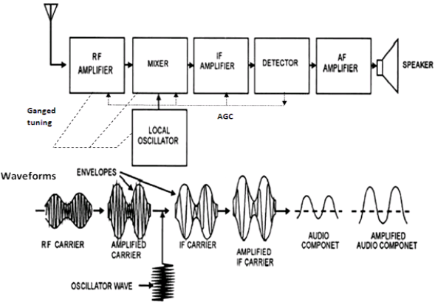

Slide 17
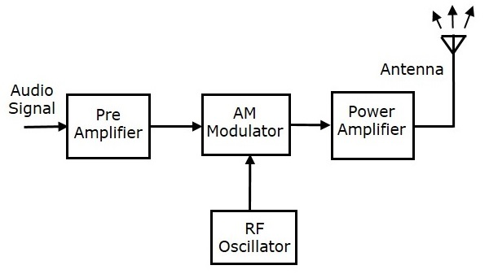
AM Transmitter
Amplitude modulation (AM) is a modulation technique used in electronic communication
used transmitting information via a radio carrier wave. ...

Slide 18
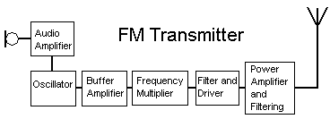
Frequency Modulation transmitter:
The transmitters are those devices which is used to send frequency modulated wave through a band and
receivers are the devices which received modulated signal then after demodulation it gives us the original signal.Jul 8, 2015

Slide 19
Receiver:
The heart of a typical home theater system. The receiver
sends the video on to your television
sends the audio to the decoder.
The decoder sorts out the different sound channels from the video signal
Then sends the information to amplifiers for each sound-channel output.

