Slide 1
Cauvery College for Women (Autonomous)
Nationally Accredited (III Cycle) with ‘A’ Grade by NAAC
Annamalai Nagar, Tiruchirappalli-18.

Slide 2
Name of the Faculty : Ms.K.Reka Designation : Assistant Professor Department : Computer Science Contact Number : 99940 11924 Programme : B.Sc Computer Science Batch : 2017-2018 Onwards Semester : VI Course Code : 16SCCCS8 Course Title : Operating Systems Unit : IV & V Topics Covered : Disk Handler seek Strategies, File Manager

Slide 3
Unit 4 Device Handler Seek Strategies
Overview
Introduction
Various Scheduling algorithms
FCFS
SSTF
SCAN
C-SCAN
LOOK
C-LOOK

Slide 4
Predetermined device handler
Determines device processing order
Goal: minimize seek time
Types
First-come, first-served (FCFS), shortest seek time first (SSTF), SCAN (including LOOK, N-Step SCAN, C-SCAN, and C-LOOK)
Scheduling algorithm goals
Minimize arm movement
Minimize mean response time
Minimize variance in response time

Slide 5
Disk Scheduling (Cont.)
Several algorithms exist to schedule the servicing of disk I/O requests.
We illustrate them with a request queue (0-199).
98, 183, 37, 122, 14, 124, 65, 67
Head pointer starts at 53

Slide 6
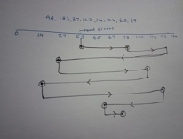
FCFS
On average: does not meet three seek strategy goals
Simplest, no reordering of work queue
Disadvantage: extreme arm movement
Total no.of tracks=640
Head Path | Track traversed
53 to 98 | 45
98 to 183 | 85
183 to 37 | 146
37 to122 | 85
122 to14 | 108
14 to124 | 110
124 to 65 | 59
65 to 67 | 02
Total | 640

Slide 7
SSTF (Shortest Seek Time First)
Selects request with minimum seek time from current head position
SSTF scheduling is a form of SJF scheduling
Reduces total seektime compared to FCFS
may cause starvation of some requests.
Illustration shows total head movement of 236 cylinders.

Slide 8
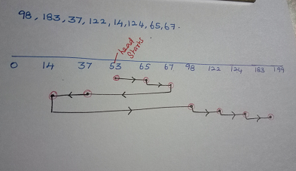
SSTF (Cont.)
Head Path | Track traversed
53 to 65 | 12
65 to 67 | 02
67 to 37 | 30
37 to 14 | 23
14 to 98 | 84
98 to 122 | 24
122 to 124 | 02
124 to 183 | 59
Total | 236

Slide 9
SCAN
Uses a directional bit to indicate whether the arm is moving toward the innermost disk track or away from it.
The algorithm moves the arm methodically from the outer to the inner track, servicing every request in its path.
When it reaches the innermost track, it reverses direction and moves toward the outer tracks, again servicing every request in its path.
Sometimes called the elevator algorithm.

Slide 10
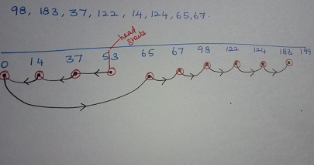
SCAN (Cont.)
Head Path | Track traversed
53 to 37 | 16
37 to 14 | 23
14 to 0 | 14
0 to 65 | 65
65 to 67 | 02
67 to 98 | 31
98 to 122 | 24
122 to 124 | 02
124 to 183 | 59
Total | 236

Slide 11
C-SCAN
With C-SCAN (an abbreviation for Circular SCAN), the arm picks up requests on its path during the inward sweep.
When the innermost track has been reached, it immediately returns to the outermost track and starts servicing requests that arrived during its last inward sweep.
The theory here is that by the time the arm reaches the highest- numbered tracks, there are few requests immediately behind it.
However, there are many requests at the far end of the disk and these have been waiting the longest.
Therefore, C-SCAN is designed to provide a more uniform wait time.

Slide 12
C-SCAN (Cont.)
Head Path | Track traversed
53 to 37 | 16
37 to 14 | 23
14 to 0 | 14
0 to 199 | 199
199 to 183 | 16
183 to 124 | 59
124 to 122 | 02
122 to 98 | 24
98 to 67 | 31
67 to 65 | 02
Total | 386

Slide 13
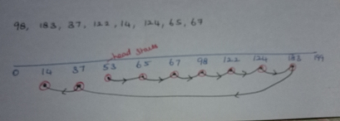
LOOK:
Arm does not go to either edge
LOOK is an optimization of SCAN
Head Path | Track traversed
53 to 65 | 12
65 to 67 | 02
67 to 98 | 31
98 to 122 | 24
122 to 124 | 02
124 to 183 | 59
183 to37 | 146
37 to 14 | 23
Total | 299

Slide 14
C-LOOK
Version of C-SCAN
Arm only goes as far as last request in each direction,
then reverses direction immediately,
without first going all the way to the end of the disk.
N-Step SCAN
Another variation of SCAN
Holds all new requests until the arm starts on its way back.
Any requests that arrive while the arm is in motion are grouped for the arm’s next sweep

Slide 15
Selecting a Good Algorithm
SSTF is common and has a natural appeal
SCAN and C-SCAN perform better under heavy load
Performance depends on number and types of requests
Requests for disk service can be influenced by the file-allocation method.
Disk-scheduling algo should be a separate OS module
allowing it to be replaced with a different algorithm if necessary.
Either SSTF or C-LOOK is a reasonable default algorithm

Slide 16
Search Strategies: Rotational Ordering
Rotational ordering
Optimizes search times
Orders requests once read/write heads positioned
Read/write head movement time
Hardware dependent
Reduces time wasted
Due to rotational delay
Request arrangement
First sector requested on second track is next number higher than one just served

Slide 17
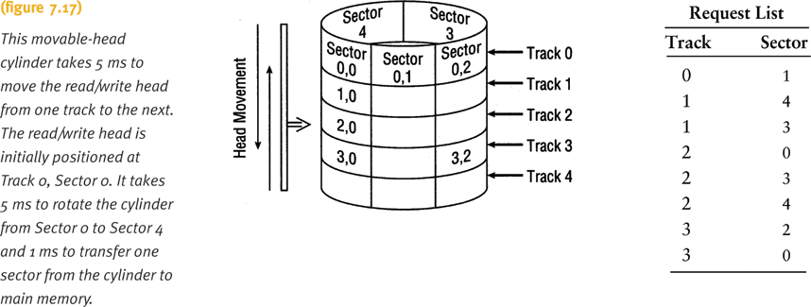
Search Strategies: Rotational Ordering (continued)

Slide 18
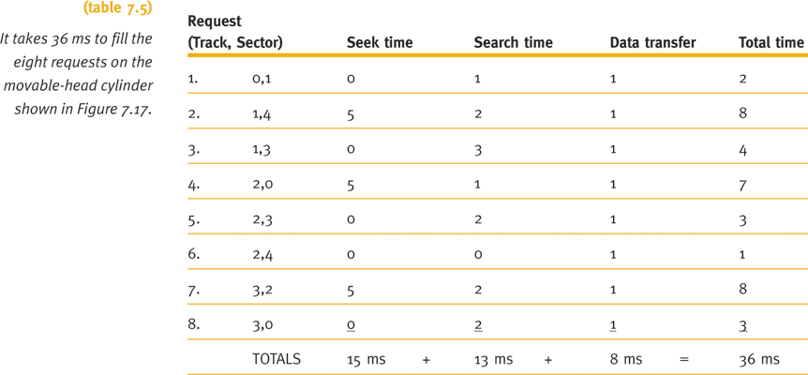
Search Strategies: Rotational Ordering (continued)

Slide 19
Unit-5 The File Manager
File management system
Software
File access responsibilities
Creating, deleting, modifying, controlling
File Manager’s efficiency directly affected by:
How the system’s files are organized
How files are stored
How each file’s records are structured
How user access to all files is protected

Slide 20
The File Manager
File Manager Provides
Library of program
Data to online users
Spooling operations
Interactive computing
These operations performed in collaboration with device manager

Slide 21
Responsibilities of the File Manager
Four tasks
File storage tracking
Policy implementation
Determine where and how files are stored
Efficiently use available storage space
Provide efficient file access
File allocation if user access cleared
Record file use
File deallocation
Return file to storage
Communicate file availability
For example-refer page no:250

Slide 22
Responsibilities of the File Manager (cont'd.)
File manager-Policy determines:
Where File storage location
How System and user access
Uses device-independent commands/device
Access to material
Two factors
Factor 1: flexibility of access to information
Share files
Provide distributed access
Allow users to browse public directories

Slide 23
Responsibilities of the File Manager (cont'd.)
Factor 2: subsequent protection
Prevent system malfunctions
Security checks
Account numbers and passwords
Computer system- File allocation
Activate secondary storage device, load file into memory, and update records
File manager- File deallocation
Update file tables, rewrite file (if revised), and notify waiting processes of file availability

Slide 24
Definitions
Field-:group of related bytes-identified by user-name, type,size
Record-:group of related fields
File:
Program files-contain instructions
Data files
Flat Files-no connection to other files
Database:-appears to the file manager to be a type of file but DB –more complex-group of related files-
Interconnected at various levels – users flexibility
Directories (folders)-special files-listing of filename-their attributes

Slide 25
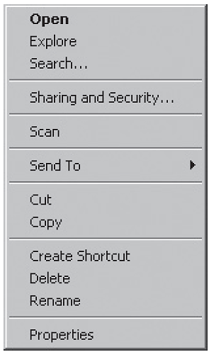
Interacting with the File Manager
Most common user commands
OPEN, DELETE, RENAME, COPY
Or Linux Command Line
cd, cp, rm, mkdir, rmdir, etc
(figure 8.2)
Typical menu of file options. © Cengage Learning 2014

Slide 26
Interacting with the File Manager
Device-independent
Physical location: knowledge not needed
Cylinder, surface, sector
Device medium: knowledge not needed
Tape, magnetic disk, optical disc, flash storage
Network knowledge: not needed

Slide 27
Interacting with the File Manager (cont'd.)
Logical commands
Broken into lower-level signals
Example: READ
Move read/write heads to record cylinder
Wait for rotational delay (sector containing record passes under read/write head)
Activate appropriate read/write head and read record
Transfer record to main memory
Send flag indicating free device for another request
System monitors for error conditions

Slide 28
Typical Volume Configuration
Volume
Secondary storage unit (removable, nonremovable)
Multi-file volume
Contains many files
Multi-volume files
Extremely large files spread across several volumes

Slide 29
Typical Volume Configuration (cont'd.)
(figure 8.3)
The volume descriptor, which is stored at the beginning of each volume, includes this vital information about the storage unit. © Cengage Learning 2014

Slide 30
Typical Volume Configuration (cont'd.)
Master file directory (MFD)
Stored immediately after volume descriptor
Lists
Names and characteristics of every file in volume
File names (program files, data files, system files)
Subdirectories
If supported by file manager
Remainder of volume
Used for file storage

Slide 31
Volume Configuration Evolution
OS supported- Single directory per volume
Directory created- file manager
Contains-file name,organized in order-spatial-chronological order
Simple,easy to implement
Disadvantages:long time search individual file
Space 256-disk full
Users couldn’t created more sub directory
Multiple user not safe file

Slide 32
Introducing Subdirectories
File manager-create MFD –file-sub directory
Sub directory-user open an account-access computer system
User directory treated as a file-entry in MFD
Sub directory-unique properties
Master File Directory linking to Sub-directories
Users allowed to create own sub-directories
Symbolic links allow alternate directory paths
Subdirectory-folders
Tree structure

Slide 33
Introducing Subdirectories (cont'd.)
File descriptor
Filename: each must be unique (within directory)
File type: organization and usage
System dependent - (file extensions in Windows)
File size: for convenience
File location
Identifies first physical block (or all blocks)
Date and time of creation
Owner
Protection information: access restrictions
Record size: fixed size, maximum size

Slide 34
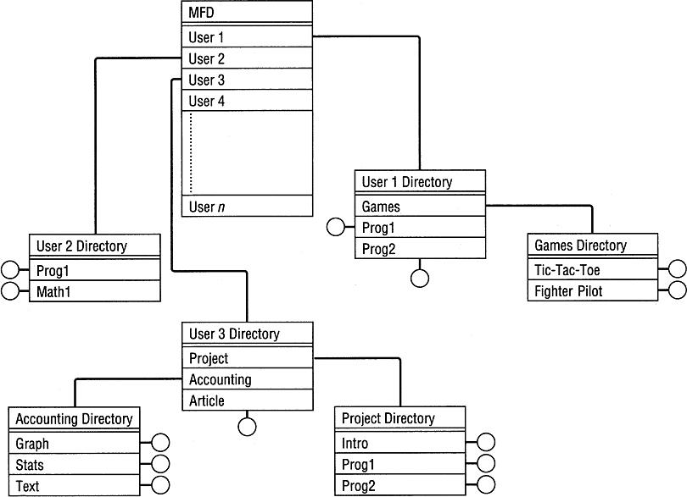
(figure 8.4)
File directory tree structure. The “root” is the MFD shown at the top, each node is a directory file, and each branch is a directory entry pointing to either another directory or to a real file. All program and data files subsequently added to the tree are the leaves, represented by circles. © Cengage Learning 2014

Slide 35
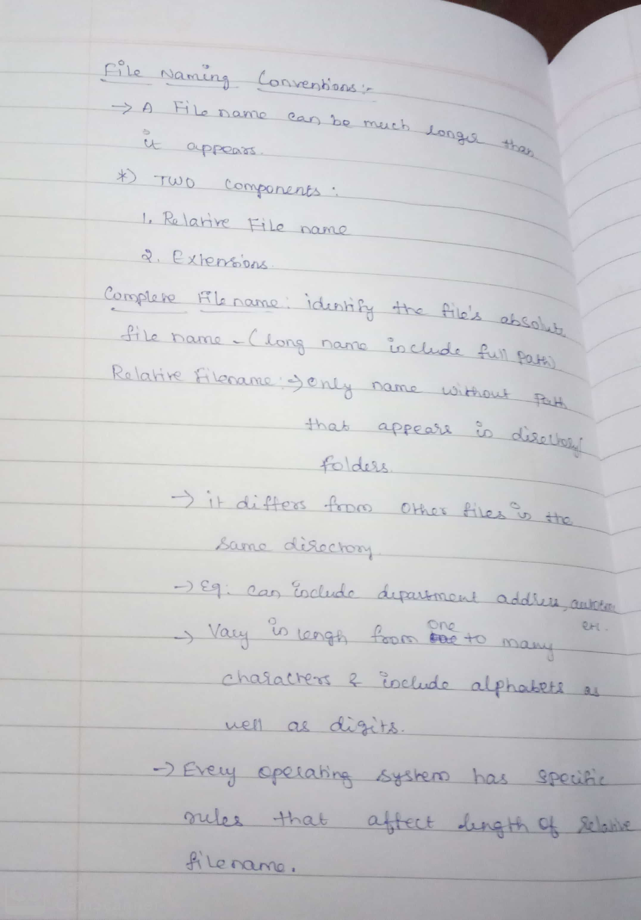
File Naming Conventions

Slide 36
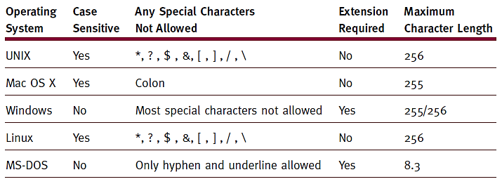
File Naming Conventions
(table 8.1)
File name parameters for several operating systems.
© Cengage Learning 2014

Slide 37
Thank You

